Slide 1
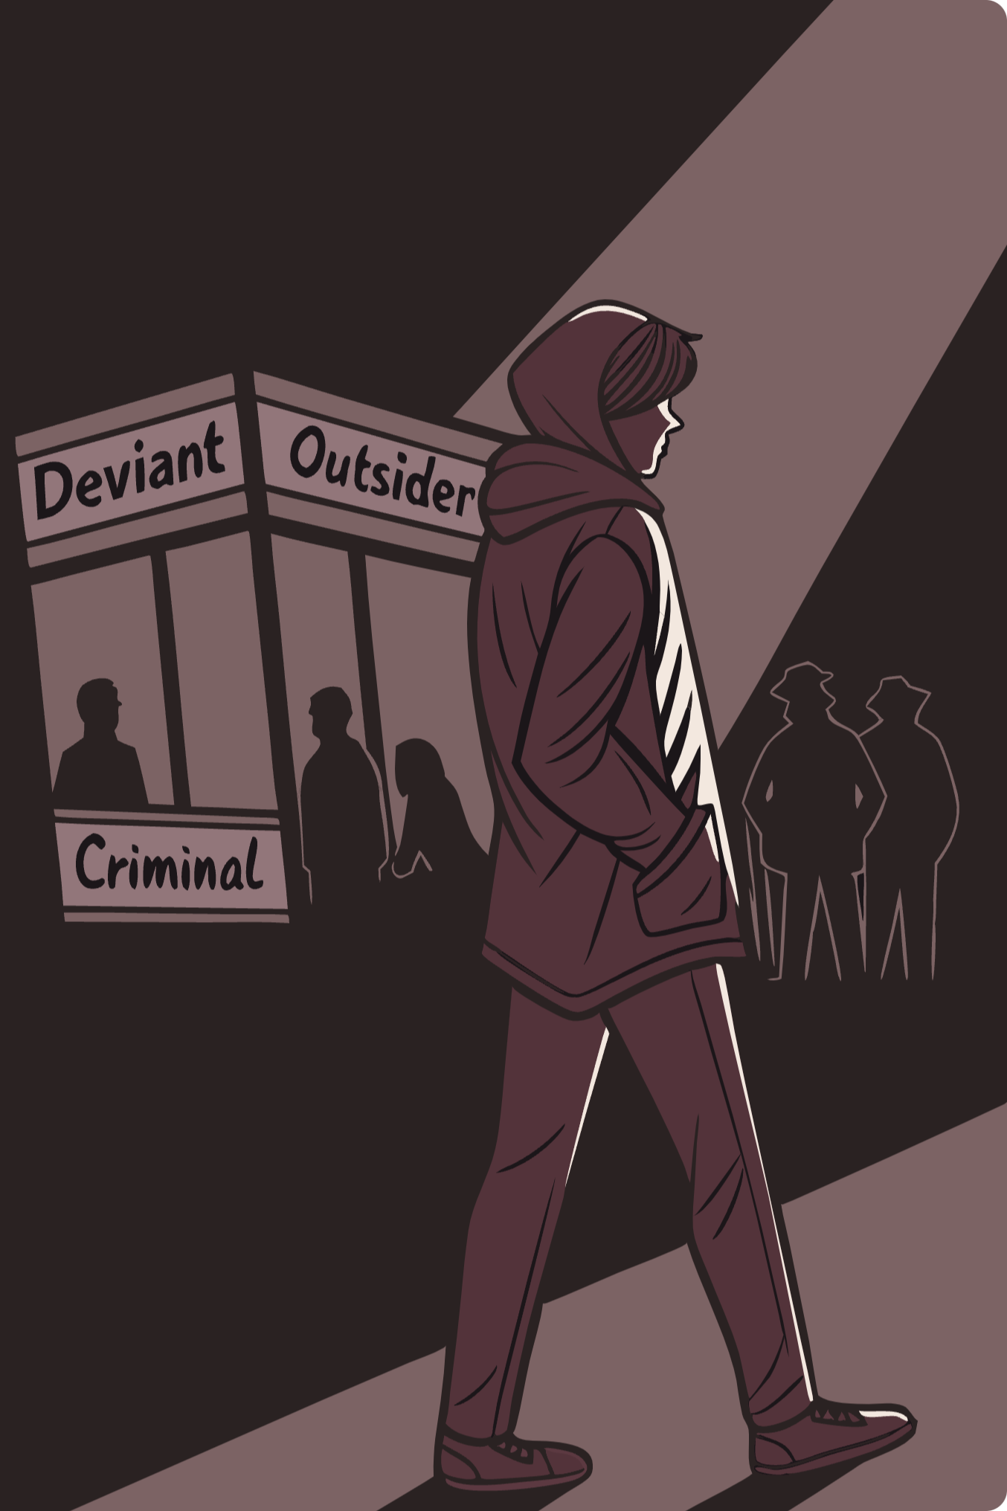

Labelling Theory: How Society Creates Deviance
Labelling theory examines how society's reaction to certain behaviors can influence and perpetuate those behaviors. When individuals are labeled as "deviant," they may internalize this label and continue the behavior, creating a self-fulfilling prophecy.

Slide 2


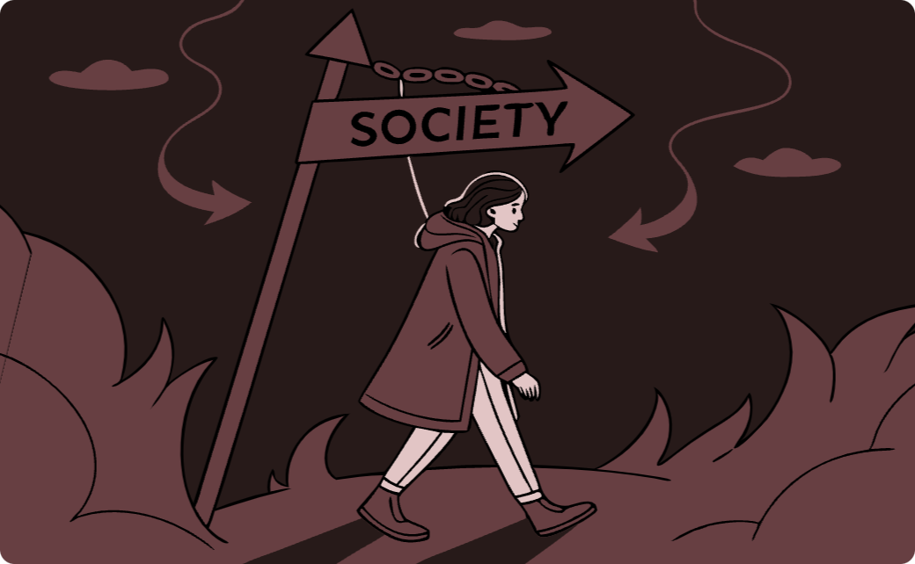
Origins of Labelling Theory
Labelling theory emerged in the 1960s as a core element of "new deviancy theory" - offering a radical alternative to traditional criminology by shifting focus from the causes of crime to the social processes that define and create deviance.
Historical Context
Theoretical Influences
Paradigm Shift
The theory aligned with the 1960s counterculture's "do your own thing" sensibilities, rejecting consensus in favor of cultural plurality and questioning assumptions about "bad" behavior.
Labelling theory drew from an eclectic mix of theoretical influences including Interactionism, Phenomenology, and Marxism to form a new approach to understanding deviance.
It represented a fundamental shift in criminology, moving away from studying "why people commit crimes" to examining how society defines and reacts to certain behaviors as deviant.

Slide 3

Howard Becker's Central Argument
"Social groups create deviance by making the rules whose infraction constitutes deviance, and by applying those rules to particular people and labeling them outsiders. From this point of view, deviance is not a quality of the act the person commits, but rather a consequence of the application by others of rules and sanctions to an 'offender'."
- Howard Becker (1963: 9)
No behavior is inherently deviant
Deviance exists only because social rules exist, and these rules vary across time and societies.
Deviance is created by social reaction
It's not the rule-breaking itself but the labelling of specific cases as deviant by a social audience that creates deviance.

Slide 4
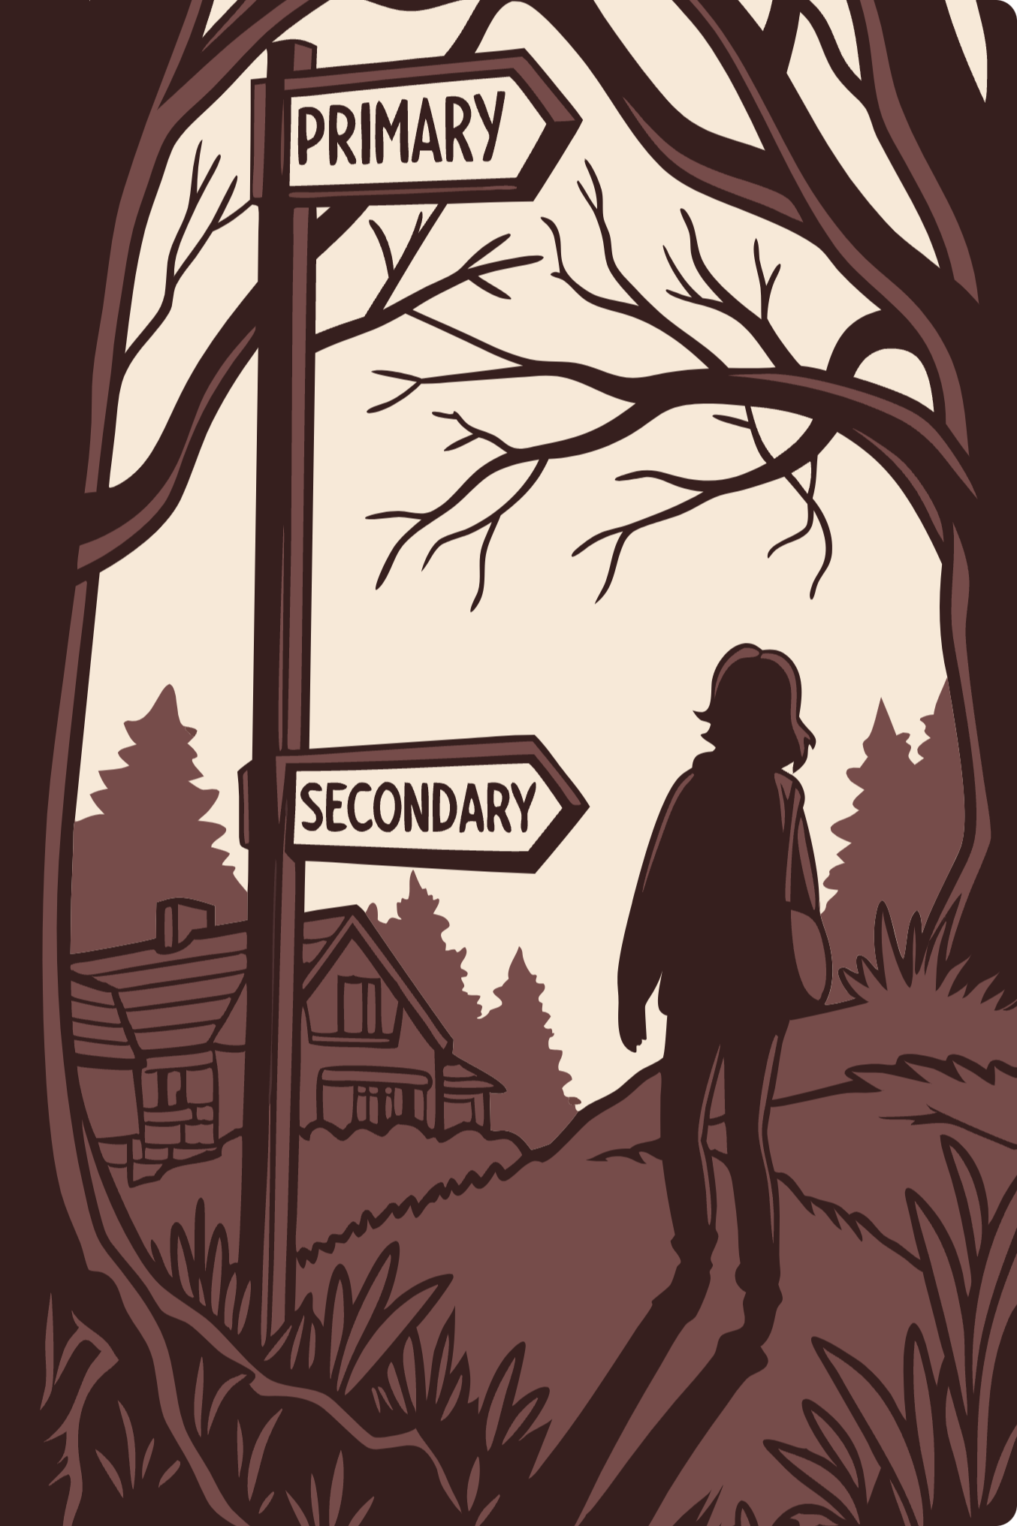



Primary vs. Secondary Deviation
Primary Deviation
Rule-breaking behavior that avoids being labeled as deviance. The person maintains a non-deviant self-image and avoids negative societal reaction.
Labelling Process
Social audience defines and labels specific cases of perceived rule-breaking as deviant. Power dynamics influence whose labels "stick."
Secondary Deviation
Rule-breaking that gets labeled deviant, affecting self-image and leading to further deviance - what Becker called a "deviant career."

Slide 5
Becker's Typology of Deviance
Obedient Behavior
Rule-breaking Behavior
Perceived as Deviant
Falsely Accused
Pure Deviant
Not Perceived as Deviant
Conforming
Secret Deviant
This typology generated debate about the constitutive model of deviance. Critics argued that:
The "falsely accused" are effectively in the same category as "pure deviants" since what matters is the construction of deviant status through social interaction
The concept of "secret deviant" is problematic - if someone avoids being labeled deviant, they are not deviant according to labelling theory
Becker later acknowledged that "potential deviant" would have been a more appropriate term than "secret deviant."

Slide 6










Deviancy Amplification
Leslie Wilkins introduced the concept of deviancy amplification - the ironic process where social control responses intended to reduce deviance can actually increase it.
Media Reaction
Initial Rule-Breaking
Exaggerated and sensationalized coverage
Minor infractions occur and gain attention
Heavy-Handed Response
Increased surveillance and punishment
Increased Rule-Breaking
Deviant Identity Formation
More frequent and serious deviance
Isolation from mainstream society

Slide 7

Moral Panics and Folk Devils
Stanley Cohen's influential study Folk Devils and Moral Panics (1972) examined how media representations and social control responses to mods and rockers in 1960s England created a deviancy amplification spiral.
Key Elements of a Moral Panic:
Intense media interest and coverage
Exaggeration of scale and harm
Creation of "folk devils" (demonized groups)
Connection to deeper moral issues
Hall et al. (1978) applied the concept to analyze how the British state created a moral panic around "muggings" in the 1970s, linking them to black youth to deflect attention from deeper social and economic problems.

Slide 8

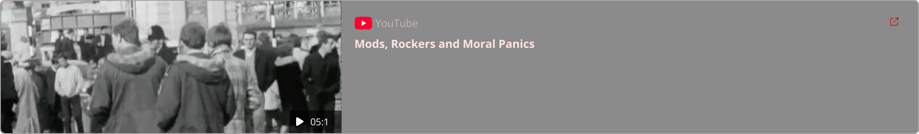
Moral Panics

Slide 9

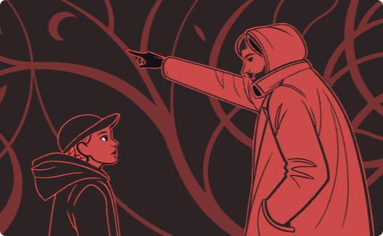

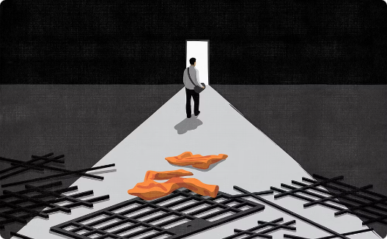
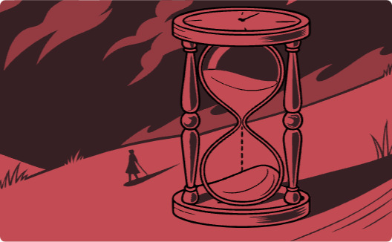

John Braithwaite: Reintegrative Shaming
"The crucial distinction is between shaming that is reintegrative and shaming that is disintegrative (stigmatization). Reintegrative shaming means that expressions of community disapproval, which may range from mild rebuke to degradation ceremonies, are followed by gestures of reacceptance into the community of law-abiding citizens. These gestures of reacceptance will vary from a simple smile expressing forgiveness and love to quite formal ceremonies to decertify the offender as deviant. Disintegrative shaming (stigmatization), in contrast, divides the community by creating a class of outcasts. (Braithwaite, 1989: 55)"
Key Principles of Reintegrative Shaming
Focus on the act, not the person
Shame as a social process
Reintegration rather than ostracization
Finite duration of shaming
The theory distinguishes between the act itself and the offender's character, emphasizing that disapproval is directed at harmful behavior, not the individual's inherent worth.
Reintegrative shaming involves social disapproval communicated by family, friends, and the community, aiming to induce remorse and a desire to make amends.
Reintegrative shaming is not intended to be a permanent state of disgrace. It is a finite process, culminating in forgiveness and reintegration, often marked by ceremonies to certify deviance and then to decertify it.
The goal is to bring the offender back into the community after they have acknowledged their wrongdoing and demonstrated a commitment to change, rather than casting them out as outcasts.
Importance of social bonds
Reintegrative shaming is most effective when the offender's social bonds (family, friends, community) are maintained throughout the process, ensuring they have a support system to return to.

Slide 10

John Braithwaite and Reintegrative Shaming

Slide 11

Critical Perspectives and Legacy
1
Focus on Low-Level Control Agents
Critics argued labelling theory ignored the role of those with significant economic and political power in defining behavior as deviant or criminal.
2
Stereotypical Images of Deviants
The theory was criticized for perpetuating images of deviants as marginalized, powerless and exotic ("nuts, sluts and perverts") while ignoring powerful rule-breakers like corporate fraudsters.
3
Passive View of Deviants
Gouldner (1968) criticized labelling theory for characterizing deviants as helpless victims rather than active challengers of dominant norms.
4
Lasting Impact
Despite criticisms, labelling theory had a major impact on criminology, challenging taken-for-granted understandings and influencing subsequent developments in radical criminology.

