Slide 1
Social Science Research Overview
Week 4

Slide 2
Introduction
Though we live in the social world, our perceptions and observations are necessarily limited
We all have unique points of view, meaning that we do not have an objective basis for understanding the world
Social research provides us with a systemic methods for investigating our social worlds

Slide 3
Introduction
Asking effective questions is essential to the work of social scientists
The more that you begin to “think like a social scientist,” the more such questions will come to mind
Our everyday experiences influence how and what we perceive

Slide 4
Avoiding Errors in Reasoning About the Social World
How can we avoid errors rooted in the particularities of our own backgrounds and improve our reasoning about the social world?
  First, let’s identify the different processes involved in learning about the social world and the types of errors that can result as we reason about the social world.

Slide 5
Avoiding Errors
Observing through our five senses (seeing, hearing, feeling, tasting, and/or smelling)
Generalizing from what we have observed to other times, places, or people
Reasoning about the connections between different things that we have observed
Reevaluating our understanding of the social world on the basis of these processes

Slide 6
Observing
One common mistake in learning about the social world is selective observation--choosing to look only at things that are in line with our preferences or beliefs
  For example, if we are convinced in advance that all heavy Internet users are antisocial, we can find many confirming instances
But what about seniors who serve as Internet pen pals for grade-school children?

Slide 7
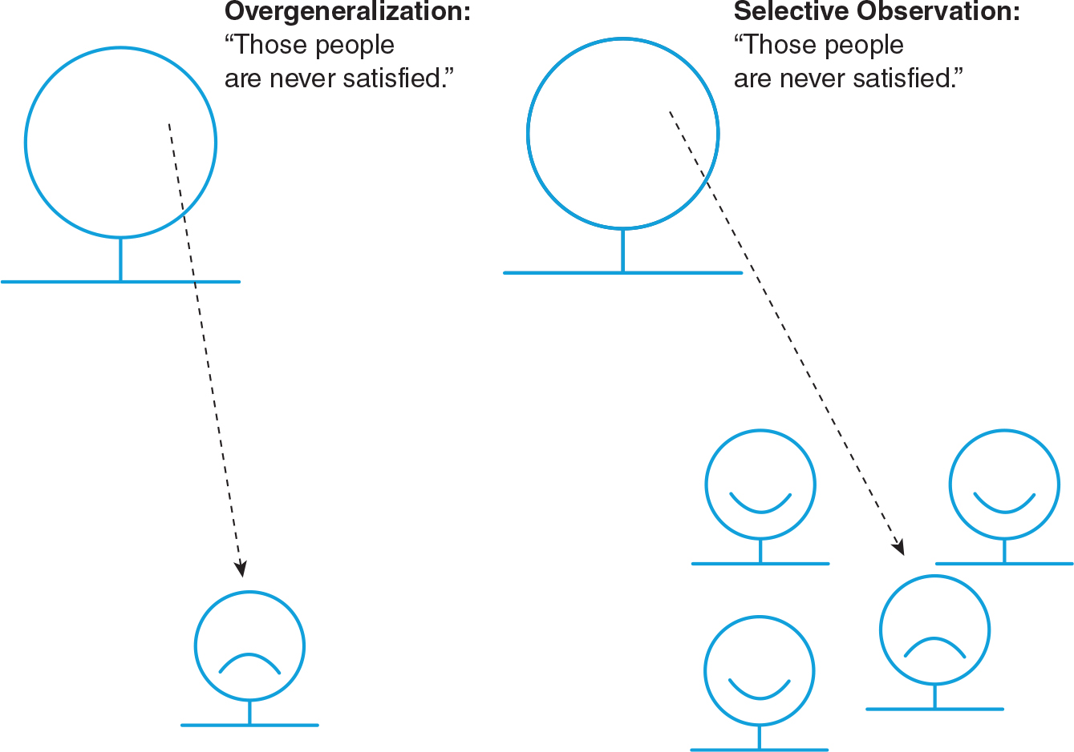
Observing
Our observations can also simply be inaccurate.
  If, after a quick glance around the computer lab, you think there are 14 students present, when there are actually 17, you have made an inaccurate observation.
Notes:
Exhibit 1.5 depicts the difference between selective observation and overgeneralization.

Slide 8
Generalizing
Overgeneralization occurs when we conclude that what we have observed or what we know to be true for some cases is true for all or most cases.
  The following comment is an example: “Unlike most people, I take the bus to work.”

Slide 9
Reasoning
When we prematurely jump to conclusions or argue on the basis of invalid assumptions, we are using illogical reasoning.
It is not always so easy to spot illogical reasoning.
Notes:
For example, about 63% of Americans age 18 or older now use the Internet. Would it be reasonable to propose that the 37% who don’t participate in the “information revolution” avoid it simply because they don’t want to participate?

Slide 10
Reevaluating
Resistance to change, the reluctance to reevaluate our ideas in light of new information, may occur for several reasons:
  Ego-based commitments: It is easy to make statements about the social world that conform to our own needs rather than to the observable facts.

Slide 11
Reevaluating
Excessive devotion to tradition: When we distort our observations or alter our reasoning so that we can maintain beliefs we hinder our ability to accept new findings and develop new knowledge.
Uncritical agreement with authority: If we do not have the courage to evaluate critically the ideas of those in positions of authority, we will have little basis for complaint if they exercise their authority over us in ways we don’t like.

Slide 12
Science and Social Science
The scientific approach to answering questions about the natural world and the social world is designed to reduce errors in everyday reasoning.
Science relies on logical and systematic methods to answer questions.
Scientific research develops a body of knowledge that is continually refined, as beliefs are evaluated through empirical evidence.

Slide 13
Science and Social Science
Science: A set of logical, systematic, documented methods for investigating nature and natural processes.
Social science relies on scientific methods to investigate individuals, societies, and social processes.
When we conduct social science research, we often engage in activities, like asking questions, which are similar to things we do in our everyday lives.
However, social scientists develop, refine, apply, and report their understanding of the social world systematically, or scientifically.

Slide 14
Social Scientists Face Three Specific Challenges
The objects of our research are people like us, so biases rooted in our personal experiences and relationships are more likely to influence our conclusions.
Those whom we study can evaluate us, even as we study them. As a result, subjects’ decisions to “tell us what they think we want to hear” or alternatively, to refuse to cooperate in our investigations can produce misleading evidence.
In physics or chemistry, research subjects (objects and substances) may be treated to extreme conditions and then discarded when they are no longer useful. However, social (and medical) scientists must concern themselves with the way their human subjects are treated in the course of research.

Slide 15
Science and Social Science
Pseudoscience claims are not always easy to identify, and many people believe them.
Pseudoscience claims are presented so that they appear scientific even though they lack supporting evidence and plausibility.

Slide 16
Motives for Social Research
Policy motivations. Research focused on policy guidance or program management, such as government decisions or planning.
Academic motivations. Questions about changing social relations have stimulated much academic social science.
Personal motivations. Social scientists may become interested in a topic because of personal experiences.
Notes:
How does one design policy focused research? View this video to listen to a researcher from the National Centre for Social Research explain how research is used in policy formation.

Slide 17
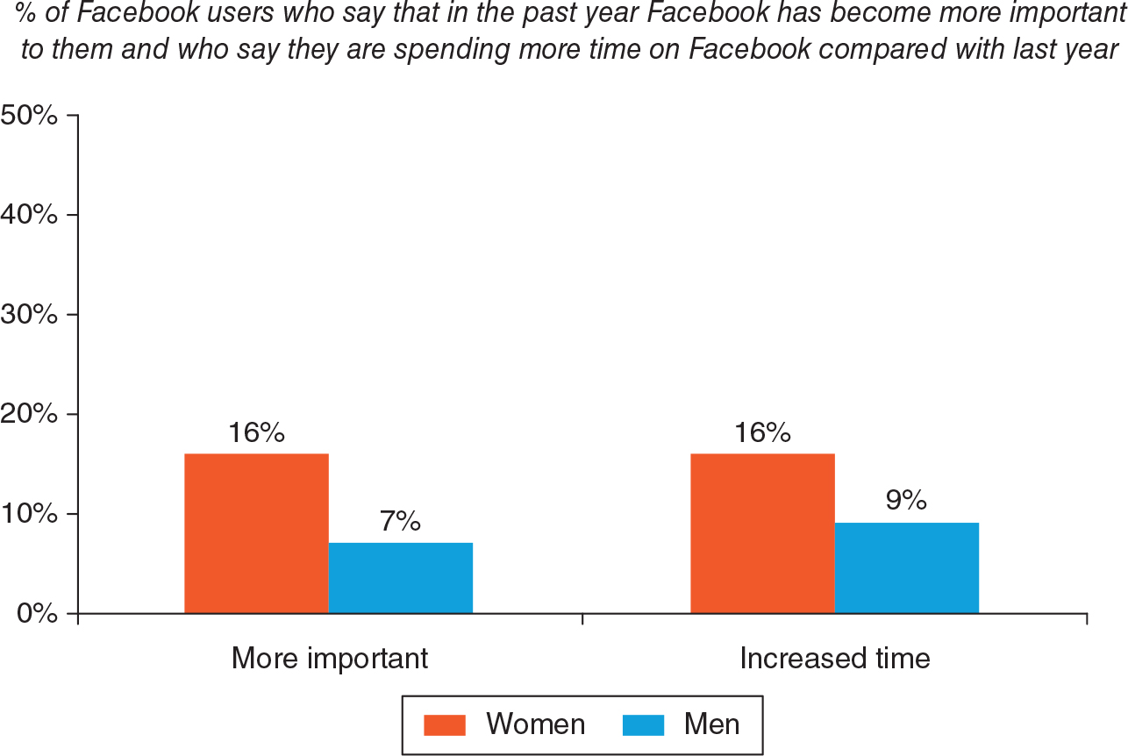
Notes:
Exhibit 1.7 displays the Internet home page for a preschool. Can you imagine some parents or their children, in later years, developing an interest in social effects of Internet use as a result of exposure to such sites?

Slide 18
Types of Social Research
Descriptive Research--defining and describing
  Example: What is the level of social ties in America?
Exploratory Research--seeks to find out how people get along in the setting under question, what meanings they give to their actions, and what issues concern them
  Example: Can Internet resources help elderly persons manage heart conditions?

Slide 19
Types of Social Research
Explanatory Research--seeks to identify causes and effects of social phenomena
  Example: What effect does Internet use have on social relations?
Evaluation Research--seeks to determine the effects of programs, policies, or other efforts to impact social patterns, whether by government agencies, private non-profits, or for-profit businesses
  Example: Does high-speed Internet access change community life?

Slide 20
Strengths and Limitations of Social Research
Using social research methods to develop answers to questions about the social world reduces the likelihood of making everyday errors in reasoning.
Research always has some limitations and our findings are always subject to differing interpretations.
But even in areas of research that are fraught with controversy, the quest for new and more sophisticated research has value.

Slide 21
Strengths and Limitations of Social Research
In addition to deciding on the type of research they will conduct, social researchers also must choose among several alternative orientations to research.
Choosing among these orientations involves answering three questions.

Slide 22
Strengths and Limitations of Social Research
Will the research use primarily quantitative or qualitative methods, or some mixture?
Is the goal to accumulate new knowledge (basic science) or to make a practical contribution (applied research), or both?
Should the research be guided by a positivist philosophy or by some type of interpretivist philosophy, or by principles reflecting multiple philosophies?

Slide 23
Quantitative and Qualitative Methods
Quantitative methods. Methods such as surveys and experiments that record variation in social life in terms of quantities.
Data that are either numbers or attributes that can be ordered in terms of magnitude.
Quantitative methods are most often used when the motives for research are explanation, description, or evaluation.

Slide 24

Quantitative and Qualitative Methods
Qualitative methods. Methods such as participant observation and focus groups that are designed to capture social life as participants experience it.
These methods rely on written or spoken words or observations that do not often have a direct numerical interpretation and typically involve exploratory research questions.

Slide 25
Positivist and Interpretivist Philosophies
Positivism. The positivist approach assumes that there is an objective reality, separate from perceptions of observers
Postpositivism. The postpositivism approach assumes that there is an external, objective reality, but is sensitive to the complexity of this reality and to the limitations of the scientists who study it
Notes:
Researchers with a positivist philosophy believe that there is an objective reality that exists apart from the perceptions of those who observe it, and that the goal of science is to better understand this reality.

Slide 26
Positivist Research Guidelines
Test ideas against empirical reality without becoming too invested in a particular outcome
Plan and carry out investigations systematically
Document all procedures and disclose them publicly
Clarify assumptions
Specify the meaning of all terms
Maintain a skeptical stance toward current knowledge
Replicate research and build social theory
Search for regularities or patterns

Slide 27
Interpretivism
Interpretivism is the belief that reality is socially constructed.
The goal of interpretive social scientists is to understand what meanings people give to reality.

Slide 28
Basic Science or Applied Research
The effort to figure out what the world is like and why it works as it does--academic motivations--is the goal of basic science.
Evaluation research and other social research motivated by practical concerns is termed applied research.

Slide 29

Conclusions
No matter your motivations, knowing about research methods has many benefits.
This knowledge will give you greater confidence in your own opinions, improve your ability to evaluate others’opinions, and encourage you to refine your questions, answers, and methods of inquiry about the social world.
Notes:
Whether you plan to conduct your own research projects, read others’research reports, or just think about and act in the social world, knowing about research methods has many benefits.

