Slide 1


Rational Choice and Routine Activities Theories
Week 5

Slide 2

Neoclassical Theories
Similar to Classical Theory—views people as rational
Considers environmental, psychological, and other mitigating circumstances that influence decision to commit crime.
Focuses on policies rather than crime causation

Slide 3
Rational Choice Theory (RCT) – Cornish and Clarke (1986)
Criminals make a conscious, rational choice to commit crime
Cost-benefit analysis
Behavior result of personal choices made after weighing costs and benefits
Crime will decrease when opportunities, limited, benefits reduced, costs increased
Notes:
Developed in the late 1970s and early 1980s – includes many of the principles of classical criminology
It is based on the belief that criminals make a conscious, rational, and at least partially informed choice to commit crime
Two main varieties of choice theory: routine activities theory and situational choice theory

Slide 4
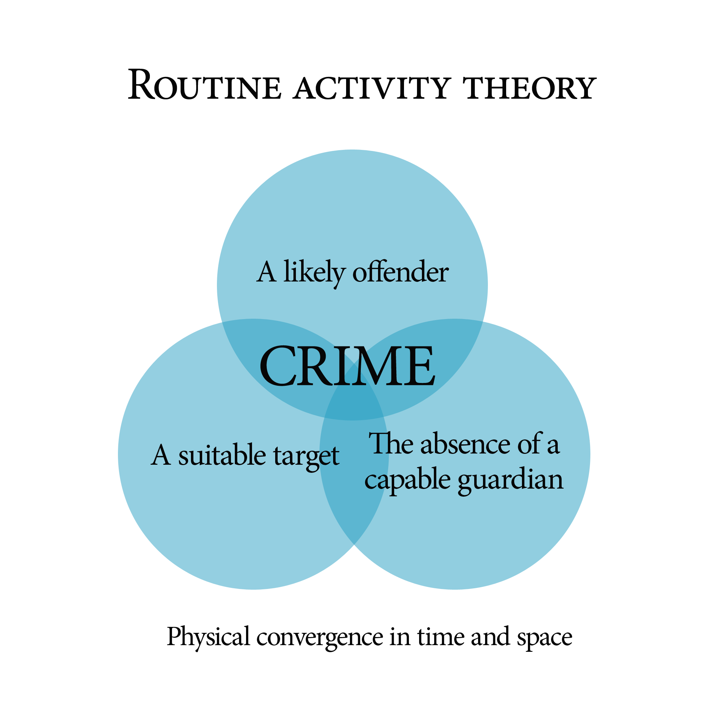
Routine Activities Theory
Routine Activities Theory
Lawrence Cohen and Marcus Felson
  Lifestyle and changes in society contribute to volume, type of crime
Elements needed for crime:
  Motivated offender
  Suitable target
  Absence of capable guardians
continued on next slide

Slide 5
Routine Activities Theory
Lifestyles that contribute to criminal opportunities likely to result in crime because increase risk of potential victimization

Slide 6
Situational Choice Theory
Ronald V. Clarke and Derek Cornish
Soft determinism
  Crime is a function of choices and decisions made within a context of situational constraints and opportunities
  Crime requires motivation and opportunity
Reduce crime by changing the environment
Notes:
Situational choice theory was developed by Ronald V. Clarke and Derek Cornish and is an extension of the rational choice perspective
An example of soft determinism, seeing crime as a matter of both motivation and opportunity
Focuses on the choice-structuring properties of a potentially criminal situation, the opportunities, costs, and benefits attached to particular types of crime
Suggests the use of situational strategies to prevent crime and lower the likelihood of criminal victimization

Slide 7
Situational Crime Control Objectives
Increase the effort involved in crime
01
Increase the risks associated with crime
02
Reduce the rewards of crime
03
Reduce the provocations for crime
04
Remove the excuses that facilitate crime
05
Notes:
Situational crime prevention includes five main objectives, each with five techniques that may be used to meet these objectives

Slide 8
Situational Crime-Control Policy
Situational crime prevention shifts the focus away from the offender and onto the context in which crime occurs
Begins with opportunity structure of crime – reduce opportunities to reduce crime
Focus on context of crime as alternative to traditional offender-based crime prevention policies
Notes:
Situational crime prevention shifts the focus of crime prevention away from the offender and onto the context in which crime occurs
Instead of focusing on why people commit crime, it looks primarily at why crime occurs in specific settings
It emphasizes the concept of opportunity – reduce opportunities for crime in specific situations to prevent crime
Situational crime control works by removing or reducing criminal opportunity

Slide 9
Critique of Rational Choice Theory
Overemphasis on individual choice, relative disregard for the role of social factors in crime causation
Assumes everyone is equally capable of making rational decisions
Displacement may occur as a result of situational crime prevention strategies
Notes:
There is an overemphasis on individual choice and a relative disregard for the role of social factors in crime causation (poverty, poor home environment, inadequate socialization, etc.)
Rational choice theory does not adequately consider the impact of emotional states on cognitive ability or the role of psychopharmacological agents (e.g., alcohol) in decision making
Rational choice theory assumes that everyone is equally capable of making rational decisions
The issue of displacement – situational crime prevention strategies may cause criminals to find new targets of opportunities in other areas

Slide 10
A Critique of Classical Theories
Represents more a philosophy of justice than a theory of crime causation
Lacks explanatory power over criminal motivation – does not really explain how choices for/against crime are made
Little empirical scientific basis for claims of Classical School
Notes:
Classical and neoclassical thought represents more a philosophy of justice than a theory of crime causation
B. Proponents of the neoclassical school take credit for the recent decline in crime rates
They claim that following the implementation of get-tough-on-crime policies, official rates of crime have decreased substantially
This decline may due in part to demographic changes in the U.S. population or to the changing nature of crime over time
C. Critics claim that classical and neoclassical thought does not really explain criminal motivation
It suggests that crime is the result of free will and individual choice but does not explain how a choice for or against criminal activity is made
There is little scientific basis for the claims made by the Classical School

