Slide 1

MEASURING CRIME

Slide 2
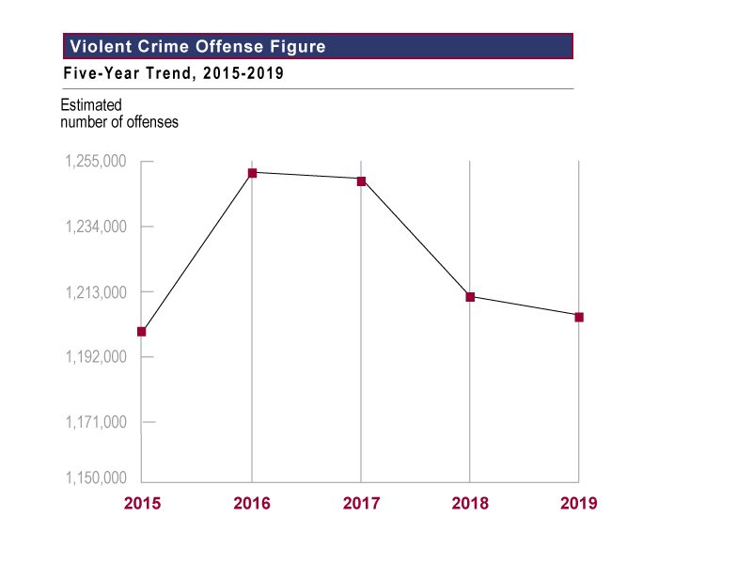
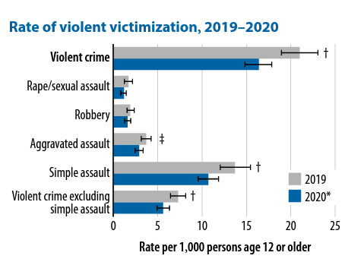
CRIME DATA in the United States
FBI: Violent Crime in the U.S.
BJS: National Crime Victimization

Slide 3
Introduction
Undetected, or unreported, crimes are referred to as the dark figure of crime.
Measuring crime is necessary for various reasons.
  Describe or gauge, criminal activity.
  Risk assessment of different social groups.
  Explanation.
  Evaluate and justify programs and policies.

Slide 4
Sources of Official Crime Data in the U.S.
National Incident-Based Reporting System (NIBRS
Collected by FBI
01
Self-Report Surveys of Criminality and Victimization
03
National Crime Victimization Survey (NCVS)
Conducted by the U.S. Census Bureau for the Bureau of Justice Statistics (BJS)
02

Slide 5
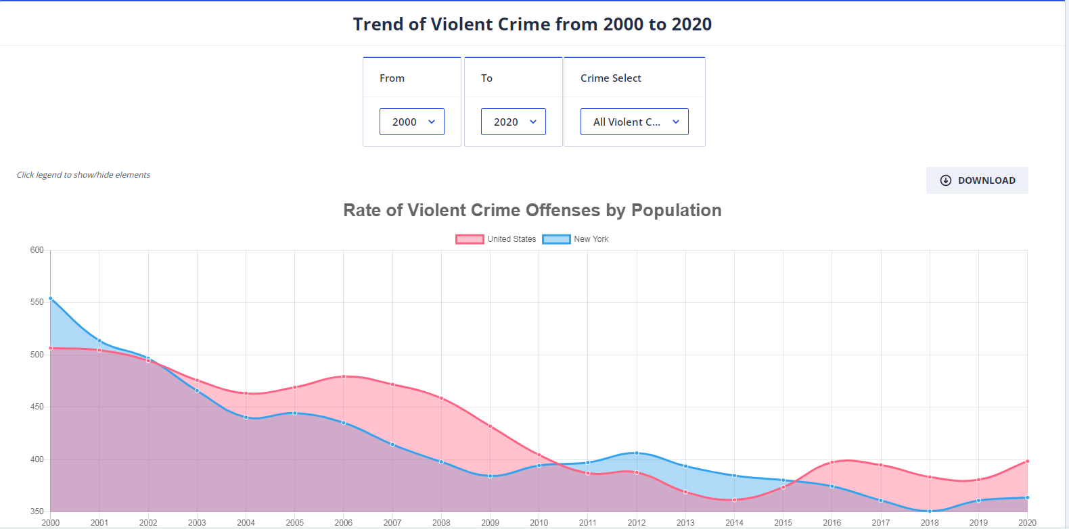
Crime Data From Law Enforcement Agencies (13 of 13)
Data Collection
Supplementary data collection program of the UCR.
  Information obtained assists agencies in developing policies to enhance officer safety.
The UCR Program distinguishes between: Line-of-duty, felonious, and accidental deaths.
Notes:
Satisfies Learning Objective 2.2 Distinguish key features and some of the major limitations associated with the National Crime Victimization Survey.
The UCR Program distinguishes between line-of-duty, felonious, and accidental deaths:
Line-of-duty death: This type of death occurs when the officer is on or off duty and acting in an official capacity while reacting to a situation that would ordinarily fall within the scope of his or her official duties as a law enforcement officer.
Felonious death: This type of death occurs when an officer is killed because of or while performing his or her official duties and as a direct result of a criminal act by a subject.
Accidental death: This type of death occurs when an officer dies as a result of an accident he or she is involved in while performing his or her duties.

Slide 6
Crime Data From Law Enforcement Agencies (1 of 13)
Law enforcement agencies gather a number of crime statistics.
Five techniques.
  National Incident-Based Reporting System (NIBRS
  The Uniform Crime Reports (retired)
  The Supplementary Homicide Reports,
  The National Incident-Based Reporting System,
  Hate Crime Statistics, and
  The Law Enforcement Officers.

Slide 7
Crime Data From Law Enforcement Agencies (2 of 13)
Uniform Crime Reports (UCR): Historical Overview
  Between 1830 and 1930, the collection of crime statistics involved various agencies.
  In 1927, efforts were made to collect crime statistics in an uniform manner.
  In 1960, Part I crimes were termed the Crime Index.

Slide 8
Crime Data From Law Enforcement Agencies (4 of 13)
Uniform Crime Reports (UCR): The UCR Program
Generate a consistent set of crime statistics that can be used in law enforcement.
Classifying and scoring crimes are important functions of agencies participating in the UCR Program.
  Classifying: Determining the appropriate crime category.
  The hierarchy rule.
Notes:
Satisfies Learning Objective 2.1 Identify and distinguish the various crime data from law enforcement agencies.
Generate a consistent set of crime statistics that can be used in law enforcement: The primary objective of the Uniform Crime Reports (UCR) is to generate a consistent (or reliable) set of crime statistics that can be used in law enforcement administration, operation, and management. Over the years, however, the UCR has become one of the country’s foremost indicators of crime. The UCR has provided information on fluctuations in the level of crime for criminologists, sociologists, legislators, municipal planners, and the media—information that has subsequently been used for both research and planning purposes.
Classifying and scoring crimes are the two most important functions of agencies participating in the UCR Program: The FBI emphasizes that classifying and scoring crimes are the two most important functions of agencies participating in the Uniform Crime Reporting Program.
Determining the appropriate crime category: Classifying is defined as determining the appropriate crime category in which to report an offense in the UCR.
An annual report published by the FBI: An annual report published by the Federal Bureau of Investigation in the U.S. Department of Justice. It is meant to estimate most of the major street crimes in the United States.
FBI emphasizes that classifying and scoring crimes are the two most important functions of agencies: The FBI emphasizes that classifying and scoring crimes are the two most important functions of agencies participating in the Uniform Crime Reporting Program.

Slide 9
Crime Data From Law Enforcement Agencies (5 of 13)
Uniform Crime Reports (UCR): Limitations of the UCR
Even with criticisms, the UCR continued to be a major source of information.
UCR is a summary-based system.
  Obtain total counts of crimes on a city/country level using UCR data.
Types of crime measures:
  Supplementary Homicide Reports.
  National Incident-Based Reporting System.
Notes:
Satisfies Learning Objective 2.2 Distinguish key features and some of the major limitations associated with the National Crime Victimization Survey.
Even with criticisms, the UCR continues to be a major source of information: As early as 1931, there were criticisms concerning the UCR, and some of these still apply to the current UCR. Even with these criticisms, the UCR continues to be a major source of information pertaining to crime in the United States.
UCR is a summary-based system: It is essential to note that the UCR is a “summary-based system.” These data are a summary, or total count, of crimes based on the reporting agencies. The best-known summary UCR measures are numbers of Part I and Part II offenses.
Obtain total counts of crimes on a city/country level using UCR data: Using UCR data, one can obtain total counts of crimes on a city or county level and move upward to a state or regional level. One cannot obtain information on individual crimes, offenders, or victims.

Slide 10
Crime Data From Law Enforcement Agencies (6 of 13)
Supplementary Homicide Reports
Provides detailed information on the incident.
Another national data collection system: CDC.
NVSS consistently demonstrates a higher number of homicides than the SHR.
The SHR is regarded the precursor of the NIBRS.
Notes:
Satisfies Learning Objective 2.2 Distinguish key features and some of the major limitations associated with the National Crime Victimization Survey
Provides detailed information on the incident: Part of the UCR Program. These data provide more detailed information on the incident.
Another national data collection system: CDC: In addition to the SHR, another national data collection system administered in the United States to collect detailed information on homicides is from the Centers for Disease Control and Prevention (CDC). They developed the National Vital Statistics System (NVSS).
The SHR is regarded the precursor of the NIBRS: The SHR may also be regarded the precursor of the National Incident Reporting System (NIBRS), as it supplied extra incident data.

Slide 11
Crime Data From Law Enforcement Agencies (7 of 13)
The National Incident-Based Reporting System (NIBRS): The NIBRS Program
Enhanced version of the UCR program.
The National Crime Statistics Exchange (NCS-X).
There are two goals of the NIBRS data collection program:
  Enhance the quantity, quality, and timeliness of crime statistical data.
  Improve the methodology.
Notes:
Satisfies Learning Objective 2.2 Distinguish key features and some of the major limitations associated with the National Crime Victimization Survey.
The NIBRS Program, enhanced version of the UCR program: An enhanced version of the UCR Program that collects more detailed information on incidents.
The National Crime Statistics Exchange (NCS-X): To further enhance participation, the UCR Program is working with the Bureau of Justice Statistics on what has been referred to as the National Crime Statistics Exchange (NCS-X). The NCS-X is a “collaborative undertaking, supported by the Federal Bureau of Investigation and other Department of Justice agencies” to generate nationally representative, incident-based data on those crimes reported to law enforcement agencies.
There are two goals of the NIBRS data collection program:
Enhance the quantity, quality, and timeliness of crime statistical data: To enhance the quantity, quality, and timeliness of crime statistical data collected by law enforcement entities;
Improve the methodology: To improve the methodology used for compiling, analyzing, auditing, and publishing the collected crime data.

Slide 12
Crime Data From Law Enforcement Agencies (8 of 13)
The National Incident-Based Reporting System (NIBRS): Data Collection
NIBRS expands the types of offenses.
NIBRS includes a greater degree of detail in reporting.
The UCR Program uses the hierarchy rule with some exceptions.
Notes:
Satisfies Learning Objective 2.2 Distinguish key features and some of the major limitations associated with the National Crime Victimization Survey
NIBRS expands the types of offenses: While the UCR Program collects counts on the number of criminal incidents involving eight offenses, and NIBRS expands the types of offenses reported.
NIBRS includes a greater degree of detail in reporting: Since NIBRS uses an incident-based reporting system, it includes a greater degree of detail in reporting.
The unit of analysis for the UCR is the reporting agency.

Slide 13
Crime Data From Law Enforcement Agencies (9 of 13)
The National Incident-Based Reporting System (NIBRS): Limitations of NIBRS
Unreported and unrecorded crimes are not included in NIBRS.
Inflexible specifications and problems with reporting procedures.
The NIBRS record structure is more complex.
Notes:
Satisfies Learning Objective 2.2 Distinguish key features and some of the major limitations associated with the National Crime Victimization Survey
Unreported and unrecorded crimes are not included in NIBRS: As with the UCR Program, NIBRS data include only crimes reported to law enforcement; unreported and unrecorded crimes are not included in NIBRS.
Inflexible specifications and problems with reporting procedures: Since the NIBRS specifications were developed by a federal agency, participating local agencies may find it difficult to work with inflexible specifications and impose problems with reporting procedures. Various organizations may have different goals and incentives, while the FBI and other national agencies are interested in a national monitoring system and national-level research applications, local and state agencies may have different organizational interests.
The NIBRS record structure is more complex: While NIBRS data include more detailed information than the UCR Program, this is also a drawback, and the NIBRS record structure is more complex.

Slide 14

All about NIBRS

Slide 15
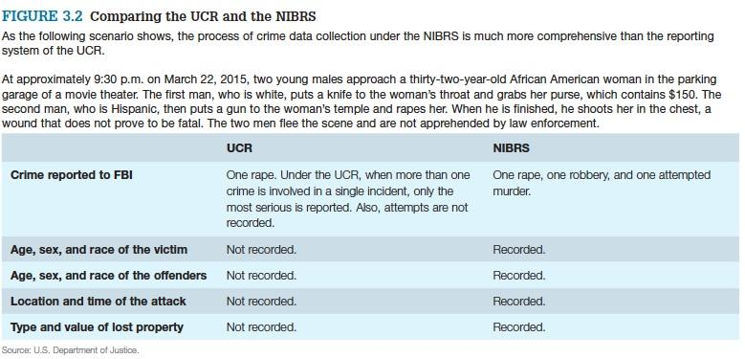
Comparing the UCR and NIBRS

Slide 16
Crime Data From Law Enforcement Agencies (10 of 13)
Hate Crime Data
The Hate Crime Statistics Act of 1990.
The Hate Crime Statistics collects information on traditional offenses.
  Murder and vandalism that have an additional factor of bias.
Notes:
Satisfies Learning Objective 2.2 Distinguish key features and some of the major limitations associated with the National Crime Victimization Survey
The Hate Crime Statistics Act of 1990: On April 23, 1990, the president signed into law the “Hate Crime Statistics Act of 1990.”
Collect information on traditional offenses: The best-known hate crime data source is the Hate Crime Statistics, which collect information on traditional offenses, such as murder and vandalism that have an additional factor of bias.

Slide 17
Crime Data From Law Enforcement Agencies (11 of 13)
Data Collection
Provides additional information on traditional UCR collection.
Hate crimes are not separate, distinct crimes, but rather traditional offenses.
Hate Crime Incident Report.
Notes:
Satisfies Learning Objective 2.2 Distinguish key features and some of the major limitations associated with the National Crime Victimization Survey.
Provides additional information on traditional UCR collection: The collection of hate crime data provides additional information on traditional UCR collection.
Hate crimes are not separate, distinct crimes, but rather traditional offenses: Hate crimes are not separate, distinct crimes, but rather traditional offenses motivated by the offender’s bias.
Hate Crime Incident Report: If a traditional offense has been motivated by the offender’s bias, the reporting agency is to complete the “Hate Crime Incident Report”.

Slide 18
Crime Data From Law Enforcement Agencies (12 of 13)
Law Enforcement Officers Killed and Assaulted Statistics
The FBI collects data in the United States each year.
This is important information that has been used for several reasons:
  Estimates of the risk involved in police work.
  Analyses of what influences assaults.
The UCR Program began gathering the data in 1972.
Notes:
Satisfies Learning Objective 2.2 Distinguish key features and some of the major limitations associated with the National Crime Victimization Survey.
The FBI collects data in the United States each year: The FBI also collects data on the number of law enforcement officers killed and assaulted in the United States each year.
This is important information that has been used for several reasons: This is important information that has been used for several reasons, including estimates of the risk involved in police work and analyses of what influences assaults against, and killings of, police officers.

Slide 19
Crime Data From Law Enforcement Agencies (13 of 13)
Data Collection
Supplementary data collection program of the UCR.
  Information obtained assists agencies in developing policies to enhance officer safety.
The UCR Program distinguishes between: Line-of-duty, felonious, and accidental deaths.
Notes:
Satisfies Learning Objective 2.2 Distinguish key features and some of the major limitations associated with the National Crime Victimization Survey.
The UCR Program distinguishes between line-of-duty, felonious, and accidental deaths:
Line-of-duty death: This type of death occurs when the officer is on or off duty and acting in an official capacity while reacting to a situation that would ordinarily fall within the scope of his or her official duties as a law enforcement officer.
Felonious death: This type of death occurs when an officer is killed because of or while performing his or her official duties and as a direct result of a criminal act by a subject.
Accidental death: This type of death occurs when an officer dies as a result of an accident he or she is involved in while performing his or her duties.

Slide 20
Crime Data From Victims of Crime: The National Crime Victimization Survey (1 of 4)
Primary measure of crime in the United States
  The purpose of the data is to provide additional insight into dark figure of crime.
NCVS are used by law enforcement agencies.
  Deterring and detecting crime enhances citizen cooperation with officials.
  Establishing special police strike forces.
  Developing street and park lighting programs.
Notes:
Satisfies Learning Objective 2.3 Distinguish the major differences between the Uniform Crime Reports and the National Crime Victimization Survey.
Primary measure of crime in the United States: National Crime Victimization Survey is a primary measure of crime in the United States. It is collected by the Department of Justice and the Census Bureau and is based on interviews with victims of crime.
Law enforcement agencies use the NCVS for:
Enhancing citizen cooperation with officials in deterring and detecting crime.
Establishing special police strike forces to combat those crimes that the NCVS reported as being most prevalent.
Developing street and park lighting programs in those areas with high reported crime rates.

Slide 21
Crime Data From Victims of Crime: The National Crime Victimization Survey (2 of 4)
The Law Enforcement Assistance Administration commissioned the Committee on Social Statistics of the NRC to evaluate the victim surveys.
The NCVS converted to a computer-assisted personal interviewing (CAPI) environment.
Notes:
Satisfies Learning Objective 2.3 Distinguish the major differences between the Uniform Crime Reports and the National Crime Victimization Survey.
The LEAA commissioned the Committee on Social Statistics of the NRC to evaluate the victim surveys: The Law Enforcement Assistance Administration commissioned the Committee on Social Statistics of the National Academy of Sciences–National Research Council (NRC) to evaluate the victim surveys.

Slide 22
Crime Data From Victims of Crime: The National Crime Victimization Survey (3 of 4)
Limitations of the NCVS
Prostitution, drug dealing, and gambling are not revealed in interviews.
NCVS surveys only households.
Validity of the NCVS is also an issue.
Two different procedures: Forward record checks and reverse record checks.
Notes:
Satisfies Learning Objective 2.3 Distinguish the major differences between the Uniform Crime Reports and the National Crime Victimization Survey.
Prostitution, drug dealing, and gambling are not revealed in interviews: Crimes such as prostitution, drug dealing, and gambling are not often revealed in interviews for obvious reasons.
NCVS surveys only households: NCVS surveys only households, crimes committed against commercial businesses (e.g., stores) are not included.
Validity of the NCVS is also an issue: The validity of the NCVS refers to whether it is appropriately measuring individuals who have been victims of crimes.
Two different procedures: Forward record checks and reverse record check: Two different procedures have been used to test the validity of the participants’ responses: forward record checks and reverse record checks.
A forward record check begins with victims’ reports, and these are subsequently checked against crimes known to police.
A reverse record check starts with police records and then traces these back to victims to determine whether these crimes were reported to NCVS interviewers.

Slide 23
Crime Data From Victims of Crime: The National Crime Victimization Survey (4 of 4)
Comparing the NCVS With the UCR
Each program was developed to serve different purposes.
  Both programs use different methods to collect crime data.
  Use different bases to calculate rates for certain crimes.
  Both programs implement different sampling procedures.
Notes:
Satisfies Learning Objective 2.3 Distinguish the major differences between the Uniform Crime Reports and the National Crime Victimization Survey.
Each program was developed to serve different purposes: While both programs collect information on overlapping types of crimes, these types of crimes are not necessarily identical.
Both programs use different methods to collect crime data: The UCR and the NCVS programs use different methods to collect crime data. Thus, for some crimes, they use different definitions.
Both programs implement different sampling procedures: Since the UCR and the NCVS implement different sampling procedures, there may be variations in estimates of crime.

Slide 24
Crime Data From Self-Report Surveys (1 of 4)
Four broad classes of questions are addressed by surveys.
Collected either through written questionnaires or through in-person interviews.
Also administered to measure drug and alcohol use.
Notes:
Satisfies Learning Objective 2.4 Identify different types of self-report surveys.
Four broad classes of questions are addressed by surveys:
The prevalence of attitudes, beliefs, and behaviors.
Changes in these attitudes, beliefs, and behaviors over time.
Differences between groups of people in their attitudes, beliefs, and behaviors.
Causal propositions about these attitudes, beliefs, and behaviors.

Slide 25
Crime Data From Self-Report Surveys (2 of 4)
Monitoring the Future
Collects information to measure substance and alcohol use patterns among youths.
Survey on the 12th-grade students contains about 1,400 variables.
Limitation: Does not survey those youth who drop out of high school.
Notes:
Satisfies Learning Objective 2.4 Identify different types of self-report surveys.
Collects information to measure substance and alcohol use patterns among youths: An annual self-report survey that collects information to measure substance and alcohol use patterns among youths.

Slide 26
Crime Data From Self-Report Surveys (3 of 4)
The National Survey on Drug Use and Health
Collects information on the use of illegal drugs by individuals in the United States
Goal of NSDUH is to provide estimates on:
  The level and patterns of alcohol, tobacco, and illegal substance use and abuse.
  Trends in the use of alcohol, tobacco, and other types of drugs.
  The consequences of substance use and abuse.
  Groups at high risk for substance use and abuse.
Notes:
Satisfies Learning Objective 2.4 Identify different types of self-report surveys.
Collects information annually on the use of illegal drugs by individuals: Since 1971, the NSDUH been used to collect information annually on the use of illegal drugs by individuals in the United States.

Slide 27
Crime Data From Self-Report Surveys (4 of 4)
National Youth Survey—Family Study
In 1977, NYS got implemented by University of Colorado.
NYS changed the name to NYS—Family Study, in 2000.
  Includes additional questions that cover the respondent’s family, family relationships, educational attainment, and careers.
Notes:
Satisfies Learning Objective 2.4 Identify different types of self-report surveys.
In 1977, NYS got implemented by University of Colorado: In 1977, researchers at the University of Colorado implemented the National Youth Survey (NYS).
NYS changed the name to NYS—Family Study, in 2000: In 2000, the name of the survey was changed to the National Youth Survey—Family Study.

