Slide 1

Social Disorganization Theory in Criminology
WEEK 10

Slide 2
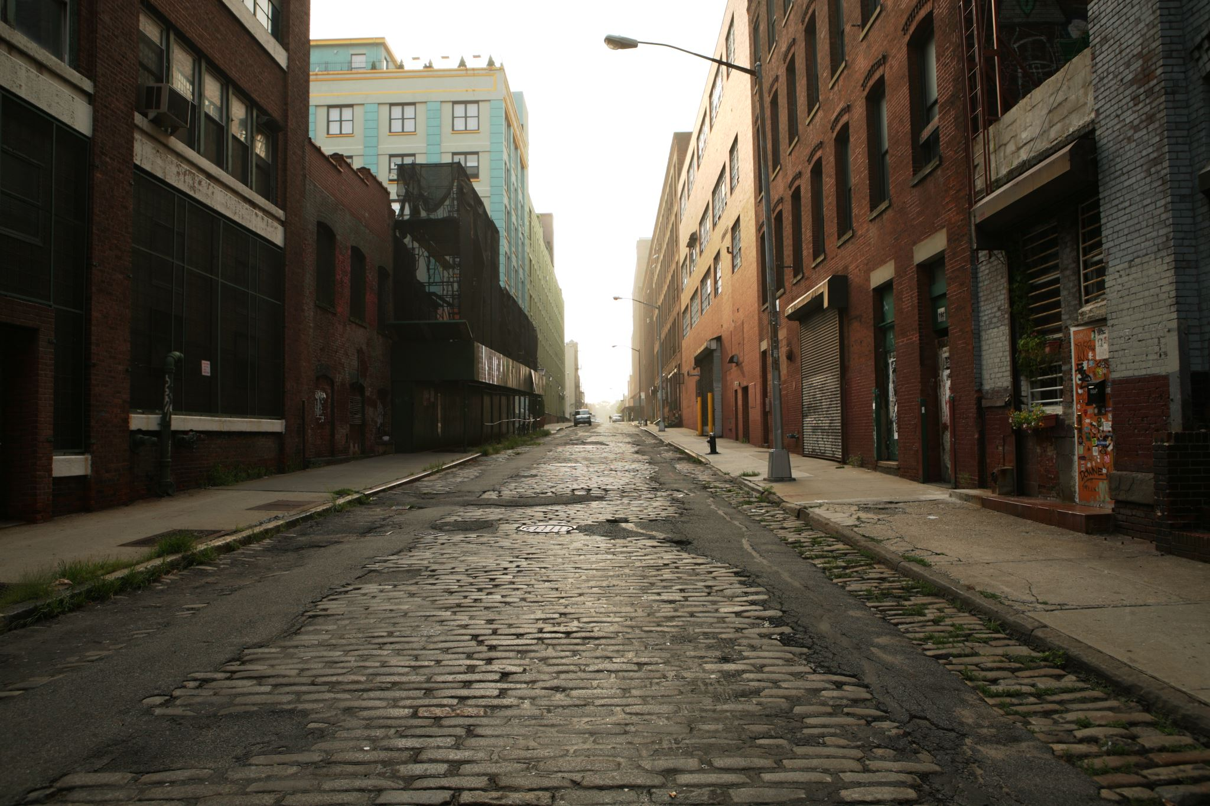
Introduction
Crime is not evenly distributed across urban areas.
This phenomenon has been consistent since the 1800s.
This week we will explore the intellectual history of criminological responses to this spatial inequality in crime.

Slide 3
Evolution of Urban Community Images in Criminology
Community images reflect both empirical reality and social constructs.
They influence criminological theories and crime-control policies.
Community images shape the development of criminological theories.
They also influence the formulation of crime-control policies.
These images carry significant consequences.

Slide 4
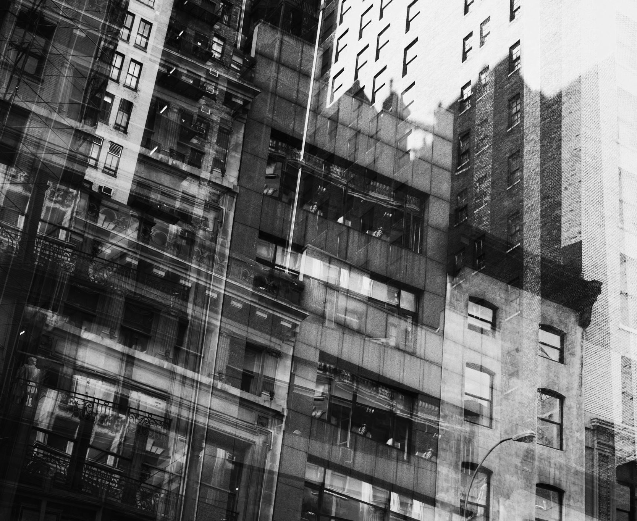
Sociohistorical Context
Three distinct sociohistorical eras in urban development:
  Growth of the city (1920s-1960s)
  Decline of the city (1960s-1990s)
  Resurgence of the city (2000s-present)
Each era presents unique challenges and conditions shaping criminological thought.

Slide 5

Social Disorganization Theory

Slide 6

Understanding the Spatial Distribution of Crime
Why do crime rates differ across neighborhoods within a city?
Is neighborhood crime due solely to the kinds of people who live there, or is there something about the neighborhood environment that fosters crime?

Slide 7

Chicago School
Social ecology of Park and Burgess
  Inspired by plant and animal ecology
    Based on competition for space
Studied Chicago, early-mid 20th century
  Rapid growth due to immigration, urbanization, and industrialization
  Interested in the moral effects of these changes

Slide 8
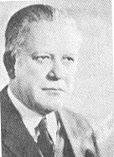
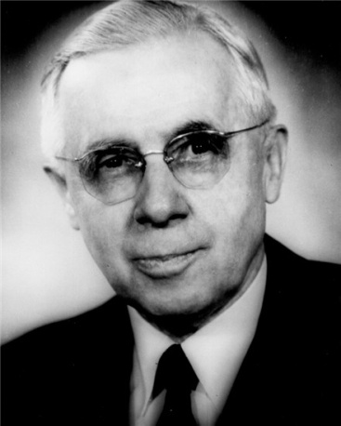
Chicago School: Ecological Models
Robert Park and Ernest Burgess (1886-1966)
Ecology
  Process of invasion & settlement of a territory
  Settlement patterns
Concentric Zones

Slide 9
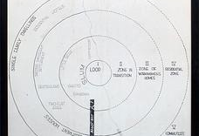
Chicago School: Ecological Models
Burgess’ diagram of concentric zones

Slide 10
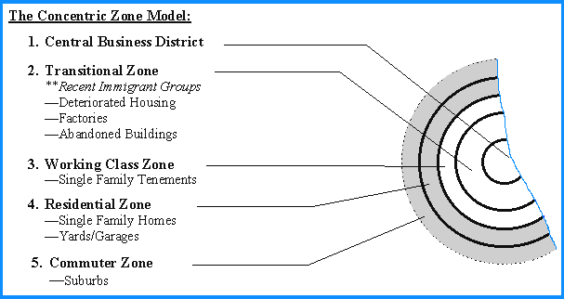
Ecology: Concentric Zones

Slide 11

Chicago School: Ecological Models
Zones
  Central Business District
    The Loop
  Zone II (zone in transition)
    High population turnover (4-7 years)
  Zone III
    Workingmen’s homes
  Zone IV
    Residential zone (single-family homes; apartments)

Slide 12
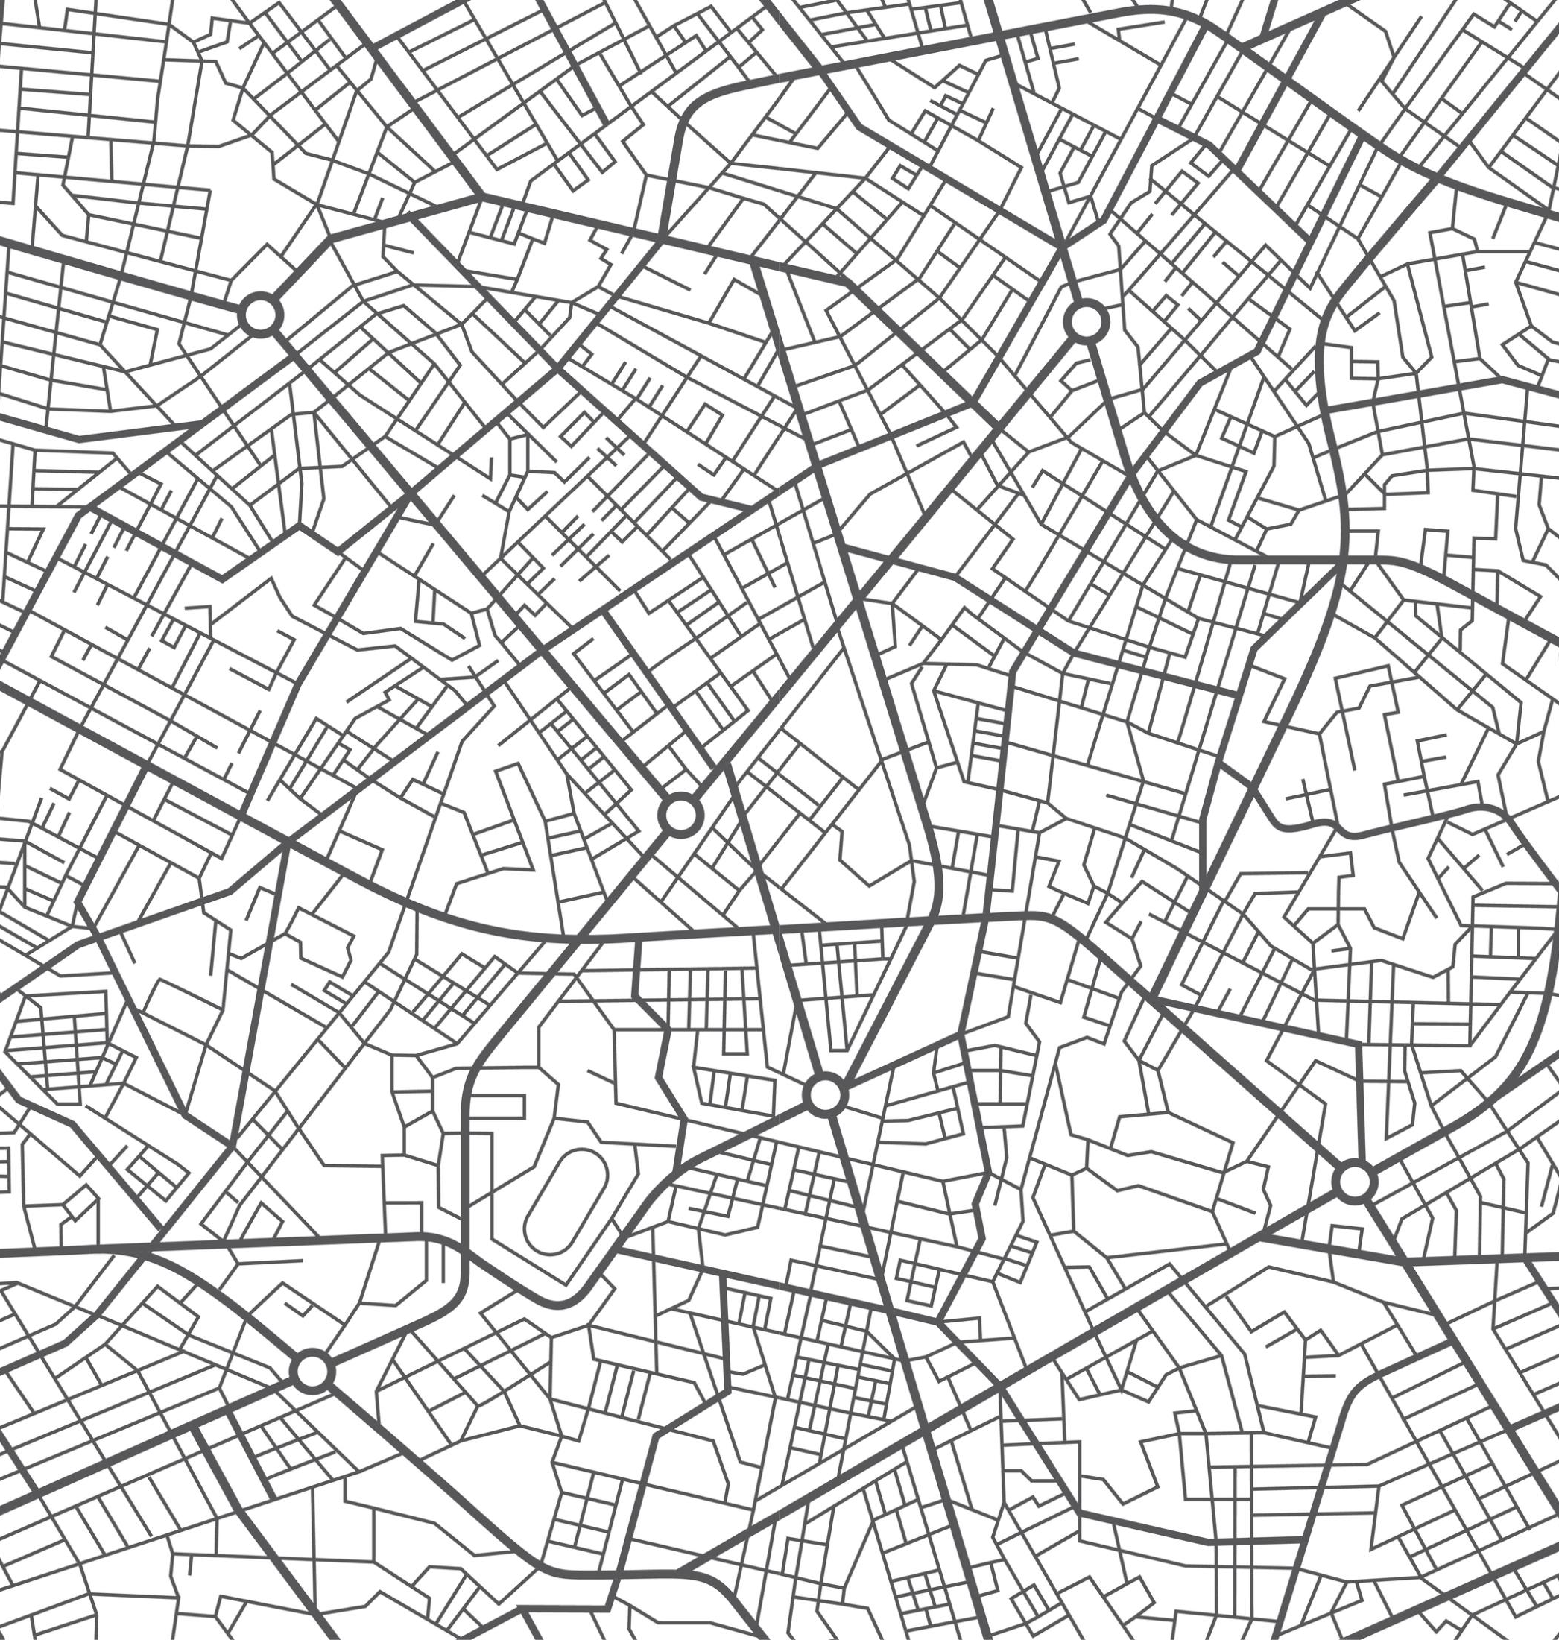
The Study of Crime in Chicago
Shaw and McKay
Mapped addresses of delinquents 1920-50
Findings
  Crime was highest in zone of transition (Zone 2), lowest in commuter zone
  High crime persisted in Zone 2 regardless of which ethnic group lived there
  Groups that left Zone 2 committed less crime, groups that entered committed more crime
  Same pattern for other social problems

Slide 13
Shaw and McKay’s Conclusions
Place matters!
Crime was NOT to due to inferior biology or ethnic pathology
The causes of crime were in the place

Slide 14
Why the Zone of Transition?
Poverty
Ethnic heterogeneity (foreign born)
Residential mobility (to other zones)
Disorder, incivilities
Competing ways of life – subcultures
Led to social disorganization, which led to crime

Slide 15
The Social Disorganization
Model
Poverty
Residential Mobility
Ethnic Heterogeneity
Social
Disorganization
Crime
Criminal
Subculture

Slide 16

What exactly is social disorganization?
Social disorganization:
  Sparse local networks, weak social ties
  Low organizational participation
  Lack of cohesion and trust among neighbors
Result:
  Inability to solve problems and pursue goals
  Parents less able to socialize and control youth
  Breakdown in surveillance

Slide 17
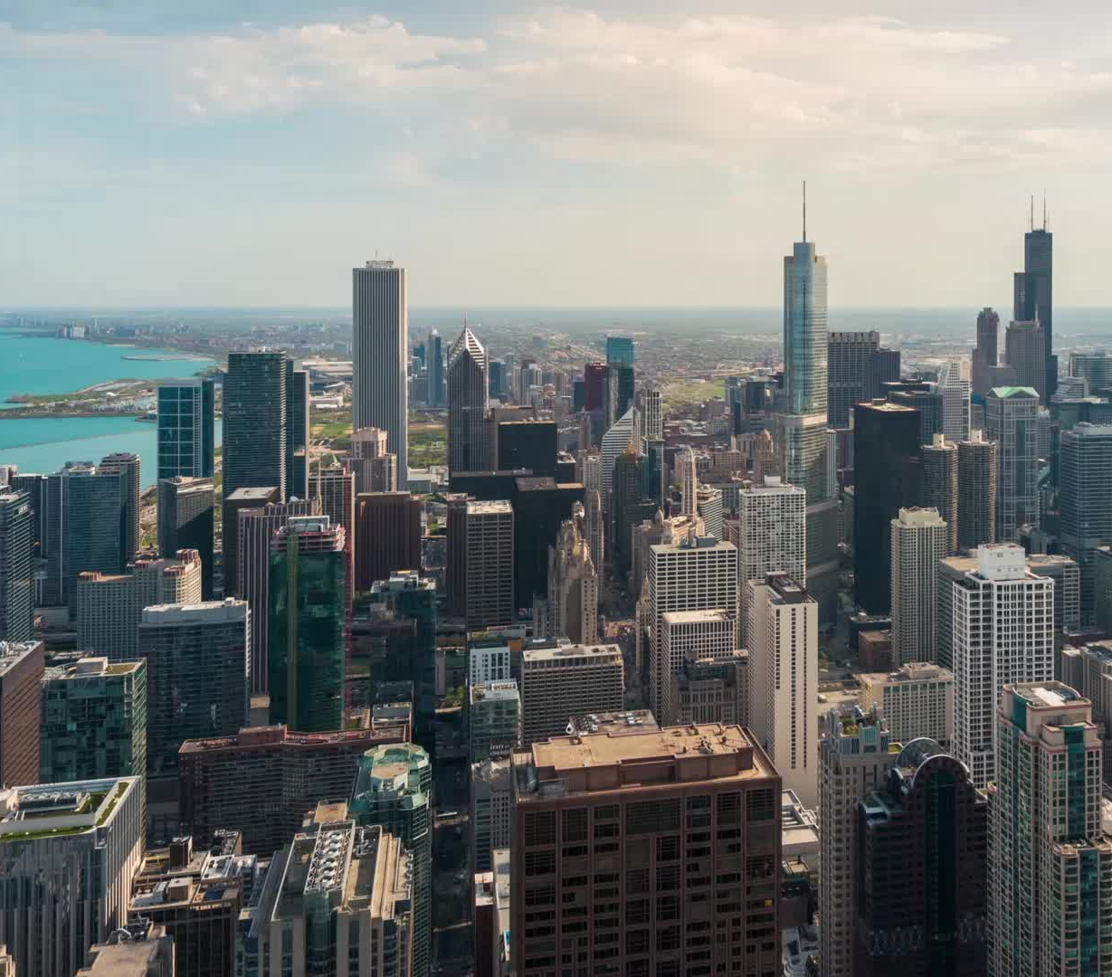
Chicago Area Project
Crime prevention and treatment
  Try to get residents to join together to improve their own neighborhoods, solve local problems, and create social organization
    Clean up disorder
    Recreation programs for youth
    Increase influence over politicians
Mixed results – difficult to create social organization

Slide 18

Collective Efficacy
Part II

Slide 19
What is Collective Efficacy Theory?
The theory was developed by Robert J. Sampson and John H. Laub
It focuses on the role of social cohesion and community in preventing crime.
It suggests that the collective efficacy of a community plays a crucial role in deterring criminal behavior.
Collective efficacy refers to the shared belief among members of a community that they can effectively intervene and control undesirable behavior, including crime, within their neighborhood.

Slide 20

Elements of Collective Efficacy
Social Cohesion: This aspect emphasizes the strength of social bonds and connections among community members. A cohesive community is more likely to look out for one another and cooperate in preventing crime.
Informal Social Control: Collective efficacy relies on the willingness of residents to engage in informal social control, such as monitoring the neighborhood and intervening when they witness suspicious or criminal activity.

Slide 21
Crime Deterrence Through Collective Efficacy
Increase in
Collective Efficacy
Decrease in
Criminal Behavior
When residents are connected and feel a sense of responsibility for their neighborhood's safety, potential offenders are less likely to engage in criminal behavior out of fear of being caught or confronted by their neighbors.

Slide 22
Factors Affecting Collective Efficacy
Positively
negatively
Trust among community members
Social capital, which includes the resources and social networks within a community.
  High social capital can enhance collective efficacy by facilitating communication and cooperation.
Poverty
Instability
History of criminality in the neighborhood

Slide 23
Implications for Crime Prevention
Building social cohesion and fostering a sense of collective responsibility within communities can be effective in reducing crime rates.
Examples
Community Engagement Events (block parties, town hall meetings, and neighborhood clean-up initiatives)
Youth Programs (afterschool activities, sports leagues, recreational activities)
Community Gardens
Conflict Resolution Workshops
Community-Based Restorative Justice Programs

Slide 24

Paterson Healing Collective
Let’s take a look at Paterson Healing Collective’s work: https://www.instagram.com/patersonhealingcollective/

Slide 25
Criticism of the Theory
While the theory of collective efficacy in criminology has garnered empirical support and has been influential in understanding community-level crime dynamics, it has also faced criticism and debate within the field.
Conceptual Ambiguity
Causality and Reverse Causation
Overemphasis on Informal Social Control
Limitations in Generalizability
Simplification of Complex Factors
Neglect of Individual-Level Factors

Slide 26

Questions?

Slide 27
In Class Activity

