Slide 1
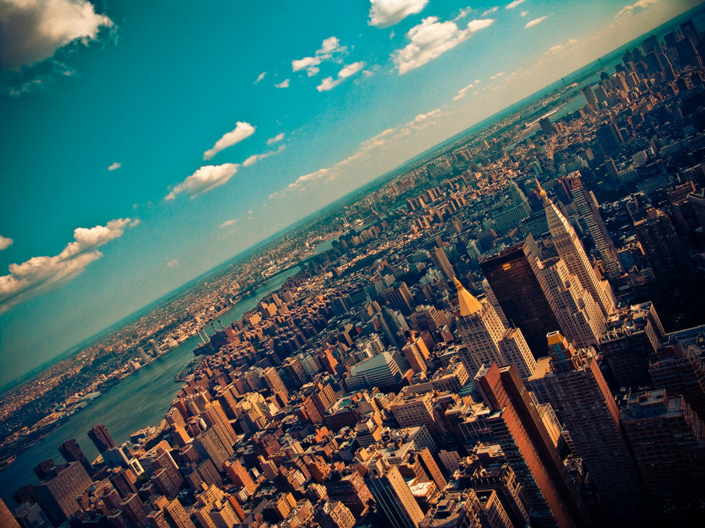

CRJ 204 1700:
Criminal Justice and the Urban Community
SPRING 2021
Tuesdays & Thursdays from 5:30 – 6:45 pm in Zoom
Michelle Ronda, Ph.D.
Associate Professor and Criminal Justice Program Coordinator
Dept. of Social Sciences, Human Services & Criminal Justice
BMCC/CUNY

Slide 2
This week’s agenda
Class session 21: T 4/20 | The War on Drugs and Public Policy READ: “Social Problems: Continuity and Change.” Chapter 7.5 Drug Policy and the War on Illegal Drugs, 307-315. Open Textbook Library, University of Minnesota Libraries Publishing, 2016, open.umn.edu/opentextbooks/textbooks/141. CC BY-NC-SA
Class session 22: Th 4/22 | History of neglect of neighborhoods by the City Film in class: Vázquez Irizarry, Vivian, and Gretchen Hildebran. “Decade of Fire.” PBS, Public Broadcasting Service, 2018, www.pbs.org/independentlens/films/decade-of-fire/. Red Nut Films, LLC. Reminder: Neighborhood Assignments 3a & 3b are due on Tu 4/27

Slide 3
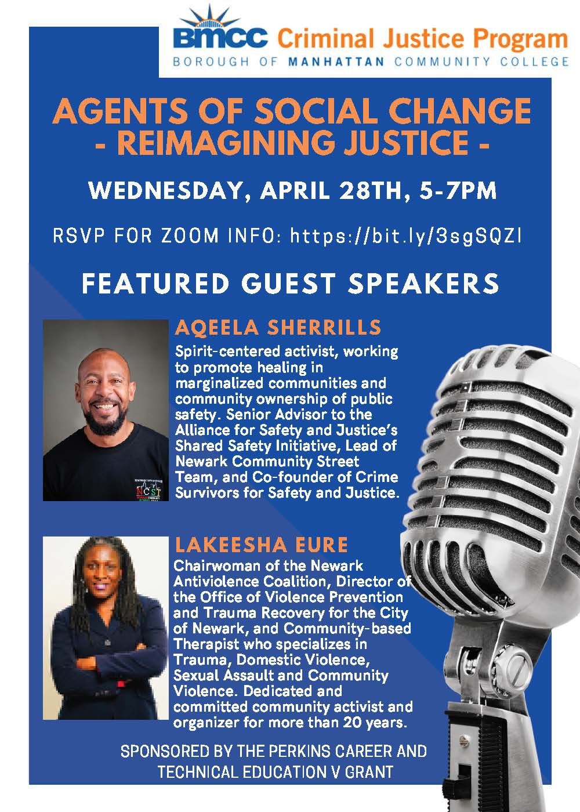

Slide 4
“War on Drugs” defined, from Wikipedia:
The war on drugs is a global campaign, led by the U.S. federal government, of drug prohibition, military aid, and military intervention, with the aim of reducing the illegal drug trade in the United States.
The initiative includes a set of drug policies that are intended to discourage the production, distribution, and consumption of psychoactive drugs that the participating governments and the UN have made illegal.
The term was popularized by the media shortly after a press conference given on June 18, 1971, by President Richard Nixon—the day after publication of a special message from President Nixon to the Congress on Drug Abuse Prevention and Control—during which he declared drug abuse "public enemy number one".
Can we win?

Slide 5
20th Century War on Drugs (Wikipedia)
QUOTE: The Nixon campaign in 1968, and the Nixon White House after that, had two enemies: the antiwar left and black people. You understand what I'm saying? We knew we couldn't make it illegal to be either against the war or black, but by getting the public to associate the hippies with marijuana and blacks with heroin, and then criminalizing both heavily, we could disrupt those communities. We could arrest their leaders, raid their homes, break up their meetings, and vilify them night after night on the evening news. Did we know we were lying about the drugs? Of course, we did.
  — John Ehrlichman, to Dan Baum for Harper's Magazine in 1994, about President Richard Nixon's war on drugs, declared in 1971.

Slide 6
20th Century War on Drugs (Wikipedia)
On October 27, 1970, Congress passed the Comprehensive Drug Abuse Prevention and Control Act of 1970, which, among other things, categorized controlled substances based on their medicinal use and potential for addiction. (from Wikipedia, “War on Drugs”)
CONTROLLED SUBSTANCES ACT
The Controlled Substances Act (CSA) is the statute establishing federal U.S. drug policy under which the manufacture, importation, possession, use, and distribution of certain substances is regulated. It was passed by the 91st United States Congress as Title II of the Comprehensive Drug Abuse Prevention and Control Act of 1970 and signed into law by President Richard Nixon.
The legislation created five schedules (classifications), with varying qualifications for a substance to be included in each.

Slide 7
Drug Policy and the War on Illegal Drugs
Learning objectives
Explain whether DARE program is effective (spoiler: it’s NOT)
Outline goals and examples of a harm reduction approach to rug use
List problems arising from current war on drugs

Slide 8
Strategies to deal with drugs
Treatment: often in group setting, but also individual treatment from psychologist, psychiatrist, or drug counselor; detox units; most famous is Alcoholics Anonymous (and all the Anonymous organizations); may involve medication; most have high failure rate (but ultimate success over time)
Prevention: drug education and drug testing; D.A.R.E. is popular but not very effective
Harm reduction: minimize harm caused by drugs; e.g.: provide clean, sterile needles; drug courts; testing drugs for purity/contamination (drugs as a public health problem)
Criminalization: make use illegal and then punish people for it (drugs as a legal or criminal justice problem)

Slide 9
War on Drugs: questions
Philosophical question: should government outlaw behaviors that may be harmful even if people (legal adults) want to engage in them?
Do laws against drugs do more harm than good?
Harms of prohibition of alcohol:
  Rise of organized crime
  Violence of murder of organized crime
  Harm of bystanders to organized crime
  Harm of police officers
  Rampant corruption
  Expenditure of time, money, and energy

Slide 10
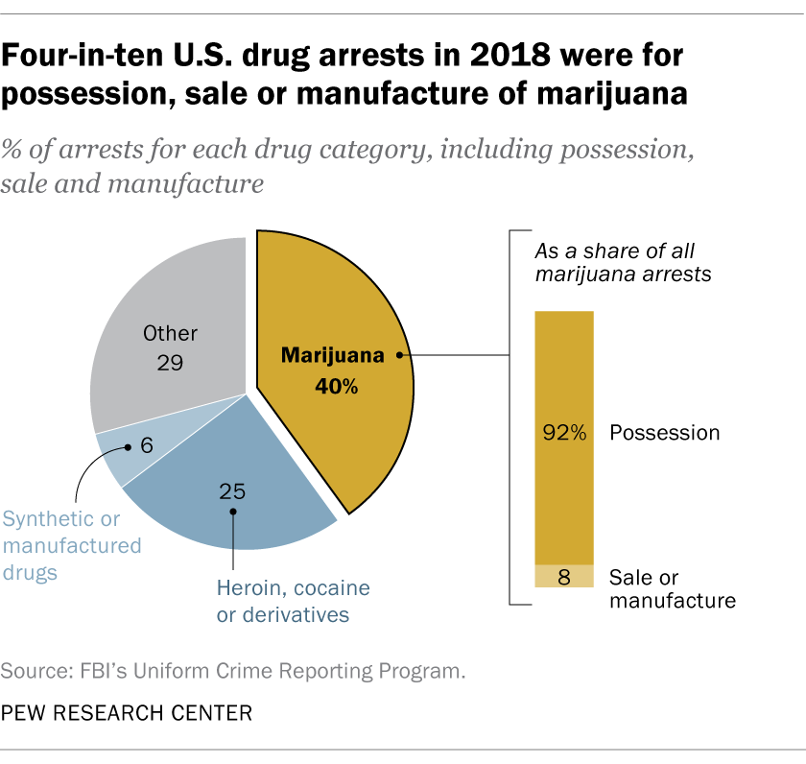

Slide 11
Attendance and question for Tu 4/20/21
https://forms.gle/ZEpfMjv9fqefb7MT6

Slide 12
Marijuana decriminalization and legalization
2021: New York became the 15th state to legalize recreational marijuana
The Netherlands decriminalized drugs in 1976 (some penalties remain for “hard” drugs and large quantities)
Use of marijuana decreased after decriminalization; use is still lower than US.
In 2001, Portugal decriminalized all drug possession.

Slide 13
This week’s agenda
Class session 22: Th 4/22 | History of neglect of neighborhoods by the City Film in class: Vázquez Irizarry, Vivian, and Gretchen Hildebran. “Decade of Fire.” PBS, Public Broadcasting Service, 2018, www.pbs.org/independentlens/films/decade-of-fire/. Red Nut Films, LLC. Reminder: Neighborhood Assignments 3a & 3b are due on Tu 4/27

