Slide 1
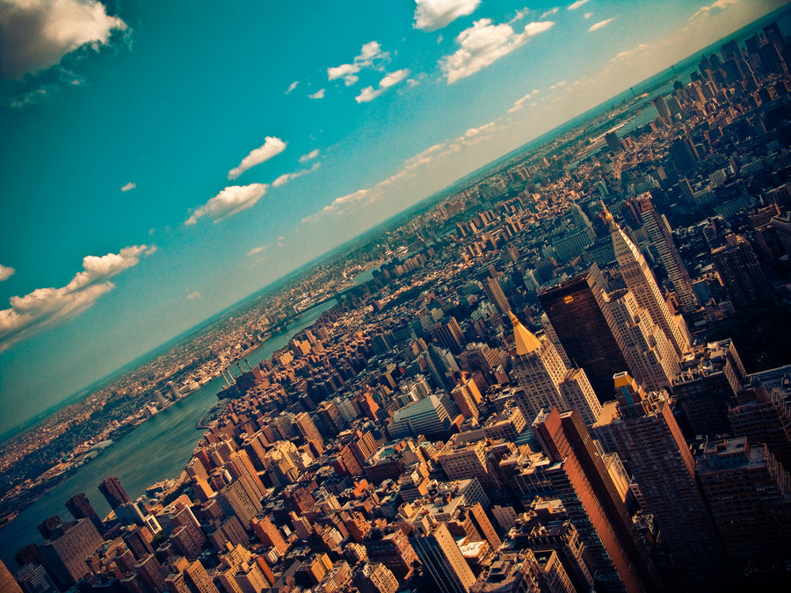

CRJ 204 1700:
Criminal Justice and the Urban Community
SPRING 2021
Tuesdays & Thursdays from 5:30 – 6:45 pm in Zoom
Michelle Ronda, Ph.D.
Associate Professor and Criminal Justice Program Coordinator
Dept. of Social Sciences, Human Services & Criminal Justice
BMCC/CUNY

Slide 2
Agenda
Neighborhood Assignment 2 due tonight @ 11:59 pm
Complete Majora Carter: Economic diversity in low-status communities
Policing in urban neighborhoods: Cops see it differently
  READ: Glass, I. (2015, February 13). Cops see it differently, Part Two. [Online recording]. This American Life. Chicago, IL: WBEZ Chicago.
Looking ahead

Slide 3
Looking ahead
Class session 19: T 4/13 | Neighborhood research Workshop 1 in class: Neighborhood assignment 3a
Class session 20: Th 4/15 | Neighborhood research Workshop 2 in class: Neighborhood assignment 3b

Slide 4
Neighborhood Assignment 2
Due @ 11:59 pm tonight
Be sure to look at the SafeAssign Similarity Report!
  https://www.youtube.com/watch?v=ww4uAXbaGsE&t=153s
Be sure to cite your sources

Slide 5
Attendance https://forms.gle/ws3iLLgXngfomxvD8

Slide 6
Economic diversity in low-status communities: Majora Carter (continued)
Reclaiming neighborhood control of land use: Get buy-in from residents
Promote environmental equality: You don’t have to move out of your neighborhood to live in a better one
American urbanization do-over: Spofford Juvenile Detention Center; wanted to focus on keeping local residents, but was awarded by the City to outsiders
We don’t always win: https://youtu.be/tDdfuFS76GQ
But there are options available, like land trusts: https://www.youtube.com/watch?v=6SGq35Ty88c
  Offers neighborhoods more control

Slide 7
Police violence
Police killed 1,127 people in 2020 in the US
Black people were 28% of those killed despite being only 13% of the population.
“State racism” index: five key indicators of systemic racism — racial segregation, incarceration rate gaps, educational attainment gaps, the economic disparity index, and employment disparity gaps
For every ten-point increase in the state racism index there’s a corresponding 24 percent increase in the ratio of unarmed black people killed by police compared to white people killed in same conditions.

Slide 8
Cops see it differently, part 2
When Eric Garner said over and over, “I can't breathe,” Robyn sees a man who's dying. Her friend (a police officer) does not.
The officer tells Robyn “people say that all the time when they're being arrested. They can't breathe. You're hurting them. It happens all the time.”
The officer totally understood why the police on the scene did not pay any attention to it.

Slide 9
Cops see it differently, part 2
Miami Gardens, FLA; most black community; about 110, 000 people; became separate city in 2003
Alex Saleh owns Quickstop and joined the new Zero-Tolerance Zone Trespassing Program; police begin coming into the store to remove customers
Earl Sampson is hired to do odd jobs; eventually he is stopped 258 times; arrested for trespassing 60 times, but he works in the store. Earl usually pleaded guilty; could not afford the alternative.
Their zero-tolerance program was a version of broken windows policing; officers had to prove they were catching the small stuff; you needed to bring in the numbers; violent crime didn’t go down, though burglaries and car thefts did. Youth also targeted.

Slide 10
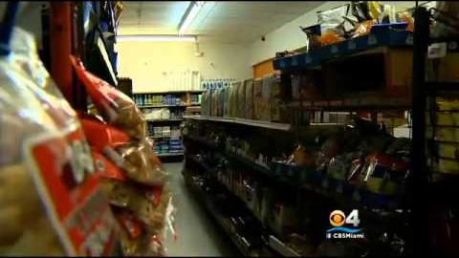

Slide 11
Suspicious persons
Alice Brennan: So, what I'm going to do now is I'm going to sort for age, right? So, we've got ages one, two, we've got seven-year-olds. This is a particularly alarming one. Five years old this kid is, and it says, the listed subject was fitting the description of the suspect in the area of a burglary.
…OK, so here's another one. This kid was seven years old, stopped for being a suspicious person. Officer says in the remarks, "I was dispatched to the above location. Several subjects, possibly selling narcotics. This subject was observed in front of this location. And pat searched was conducted after consent. No wants nor warrants."
Miki Meek: So, they say they ran a seven-year-old's name.
Alice Brennan: Yeah, they ran the name. And what do you know? No wants or warrants were found. It says here in the physical characteristics that this seven-year-old had a slight beard.

Slide 12
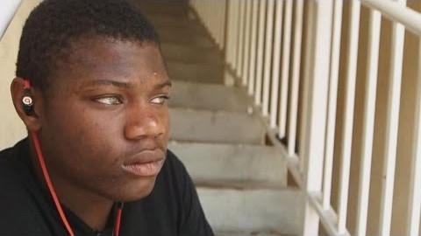

Slide 13
Cops see it differently
In 5 years, police in Miami (2.5 million people) made 3700 stops
In 5 years, police in Miami Gardens (107,000 people) made 99,000 stops
What else was problematic about the data?
Changes

Slide 14
Cops see it differently
Act 2:
FBI Director James Comey: Unconscious racial bias
It is implicit because it is not conscious. It is something we are socialized to.
Gang units do not perform as well as other police. More likely to shoot unarmed black “targets.”
Test yourself: https://implicit.harvard.edu/implicit/takeatest.html

Slide 15
Cops see it differently
Big city police chiefs don’t like to talk about race or say it doesn’t matter when they do.
Training Las Vegas Metro PD and implicit bias training (among other things)
A police force confronting racial bias and showing positive results. From 2007-2011, police shot 100+ people and 8 of the 11 unjustified shootings were of black men.
The training and change of culture brought unjust police shootings to zero.
Distinguishing between racism and bias

Slide 16
Looking ahead
Class session 19: T 4/13 | Neighborhood research Workshop 1 in class: Neighborhood assignment 3a
Class session 20: Th 4/15 | Neighborhood research Workshop 2 in class: Neighborhood assignment 3b

