Slide 1
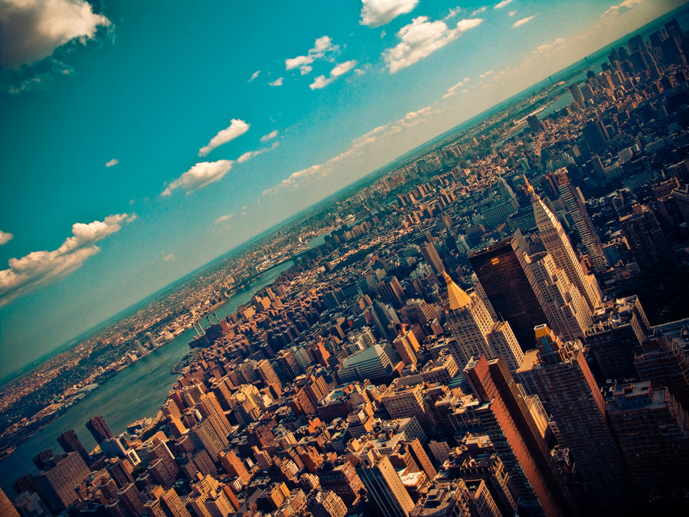

CRJ 204 1700:
Criminal Justice and the Urban Community
SPRING 2021
Tuesdays & Thursdays from 5:30 – 6:45 pm in Zoom
Michelle Ronda, Ph.D.
Associate Professor and Criminal Justice Program Coordinator
Dept. of Social Sciences, Human Services & Criminal Justice
BMCC/CUNY

Slide 2
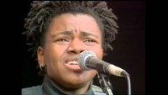
Notes:
https://www.youtube.com/watch?v=x8IToLUJStg

Slide 3
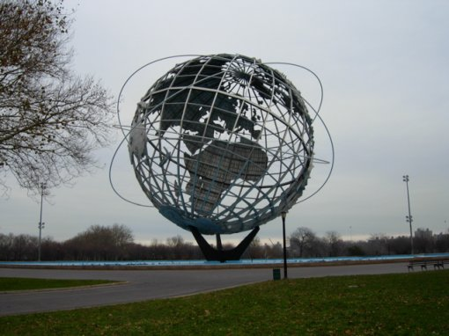
AGENDA: Tuesday, February 16, 2021
Complete discussion of The uses of sidewalks – safety.
Reminder: NEIGHBORHOOD ASSIGNMENT 1
Understanding disparities: Poverty in the city
  READ: Austensen, M., Been, V., O’Regan, K. M., Rosoff, S., & Yager, J. (2016). 2016 focus: Poverty in New York City. New York, NY: New York University Furman Center.
Looking ahead

Slide 4
Looking ahead
Class session 6: Th 2/18 | Understanding disparities: How a War on Poverty became a War on the Poor READ: Piven, Frances Fox. “Our Endless War on the Poor.” Progressive.org, The Progressive, 30 Mar. 2020, progressive.org/magazine/our-endless-war-on-poor-fox-piven/. REMINDER: Neighborhood Assignment 1 is due T 2/23

Slide 5
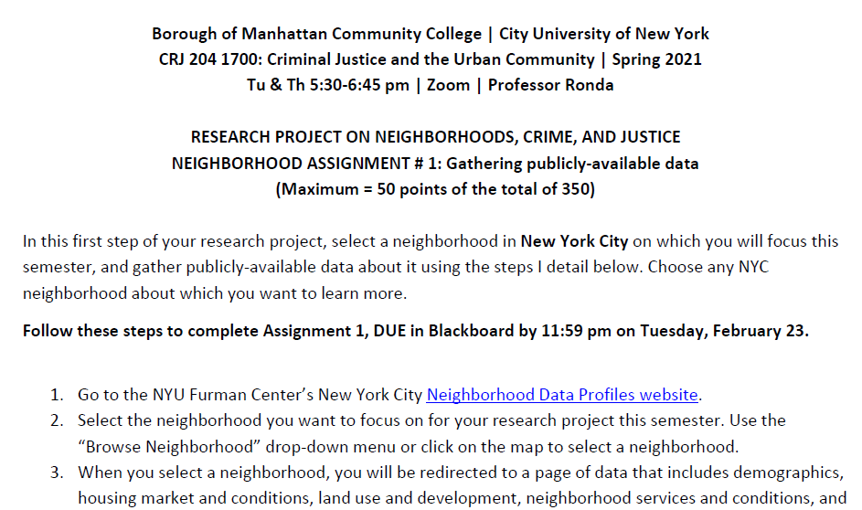
Neighborhood assignment 1

Slide 6
Where were we?
How do cities promote or undermine community?
Jacobs, J. (1961). Death and Life of Great American Cities. Chapter 2: The uses of sidewalks – safety.
Jacobs: How do sidewalks operate in the City?
City planners, politicians (like Robert Moses), developers, and corporations promoted ideas that compromised cities and their neighborhoods
She and others were fighting against suburbanization, which was anti-urban

Slide 7
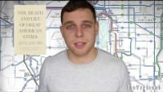

Slide 8
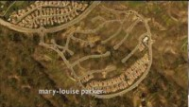
Suburbanization

Slide 9
How do cities promote or undermine community?
  Jane Jacobs:
  Streets and sidewalks are vital; they keep the city safe; if people fear streets, they don’t use them, and those streets become less safe
  Successful city streets:
  Clearly mark public versus private space
  Have “eyes upon the street”
  Have many users
We need enough reasons to visit streets to bring people to streets to make them safe; police are necessary but do not keep streets safe; mixed-use is essential.

Slide 10
But social policy also shapes neighborhoods, and resources matter:
DEFINITIONS
Absolute poverty: lack of means necessary to meet basic needs such as food, clothing and shelter.
Relative poverty: considers individual social and economic status compared to the rest of society.
Poverty threshold or line: The 2017 poverty threshold published by the U.S. Census Bureau says an under-65 individual with no kids falls under the poverty level at $12,752 in annual income.
OTHER CONTEXT
US: highest wealth inequality in the world. Wealth (what you own minus debts; not income) insulates against poverty and permits more class mobility.
There is racial disparity in wealth, just like in poverty.
Notes:
I asked you to read about Poverty in NYC from the report by the Furman Center. The section you read never defines what it means by poverty. So let’s consider definitions. Poverty is measured in the United States by comparing a household’s income to a minimum amount of income needed to cover basic needs. People whose income falls under the threshold are considered poor. The U.S. Census Bureau is the government agency in charge of measuring poverty.
The Census Bureau determines poverty status by using an official poverty measure (OPM) that compares pre-tax cash income against a threshold that is set at three times the cost of a minimum food diet in 1963 and adjusted for family size.
In 2016, the most recent year for which data are available, the OPM national poverty rate was 12.7 percent. There were 40.6 million people in poverty.
Also useful to distinguish between absolute and relative poverty; why would relative poverty matter?

Slide 11
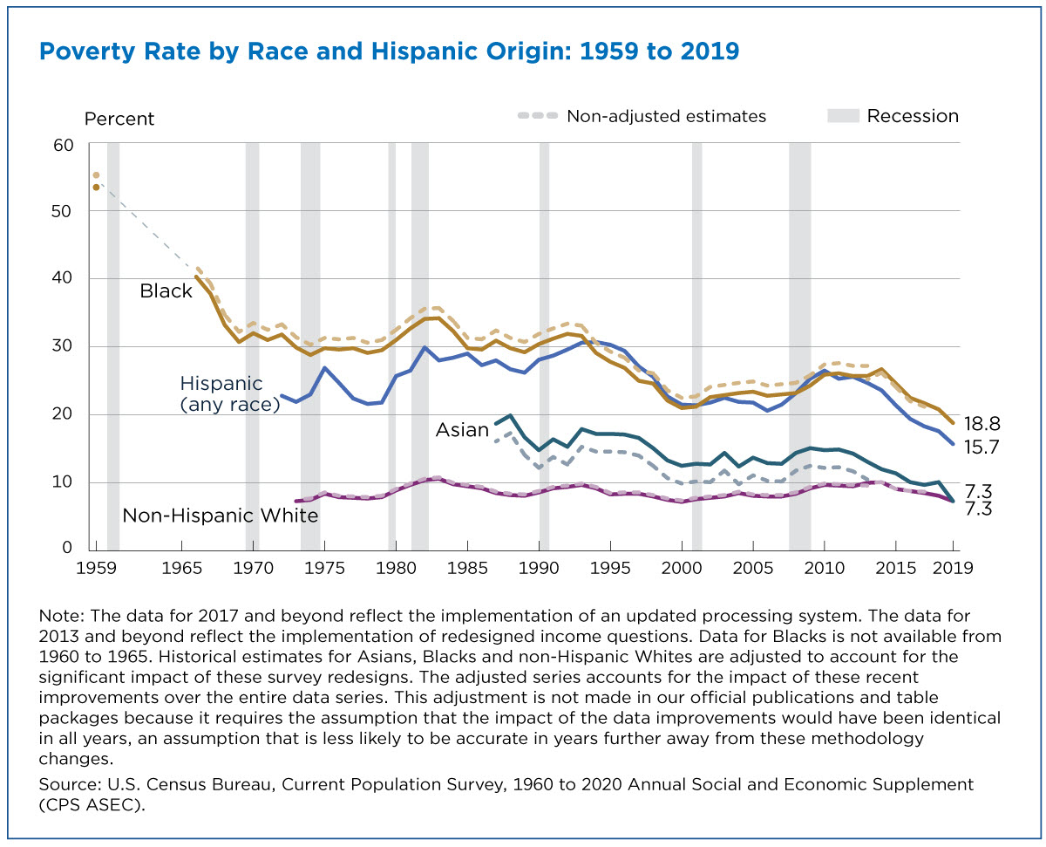
Ethnic and racial disparities in poverty rates

Slide 12
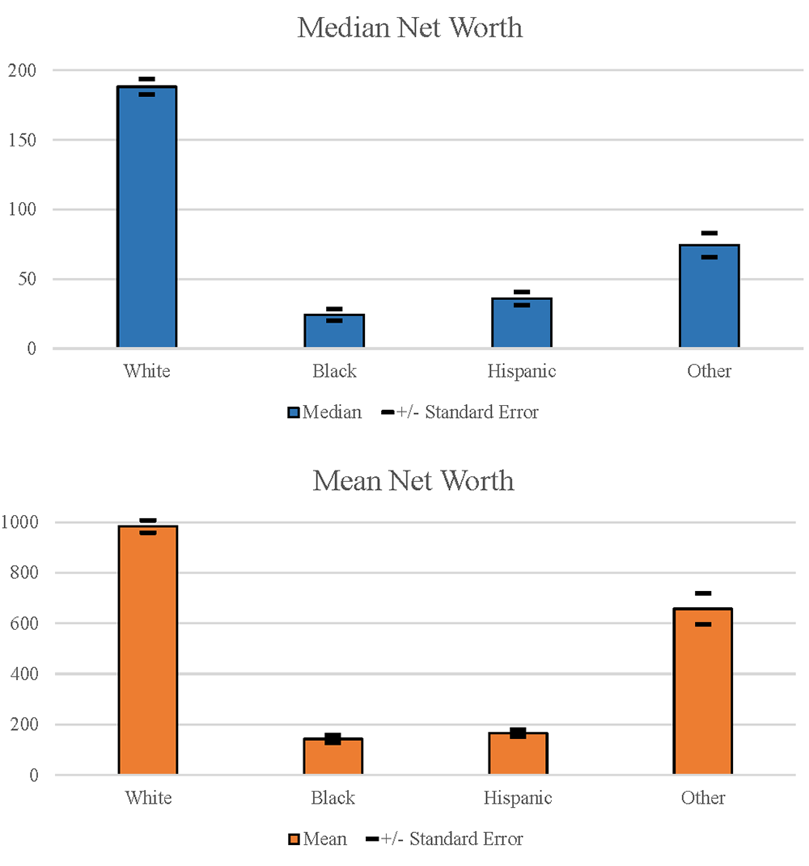
Racial and ethnic disparities in wealth (wealth = net worth, or assets - debts)
Source: Federal Reserve Board, 2019 Survey of Consumer Finances.
Notes: Figures displays median (top panel) and mean (bottom panel) wealth by race and ethnicity, expressed in thousands of 2019 dollars.

Slide 13
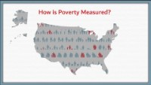
The official poverty measure may underestimate (or overestimate) people living in poverty.

Slide 14
Looking ahead
Class session 6: Th 2/18 | Understanding disparities: How a War on Poverty became a War on the Poor READ: Piven, Frances Fox. “Our Endless War on the Poor.” Progressive.org, The Progressive, 30 Mar. 2020, progressive.org/magazine/our-endless-war-on-poor-fox-piven/. REMINDER: Neighborhood Assignment 1 is due T 2/23

