Slide 1
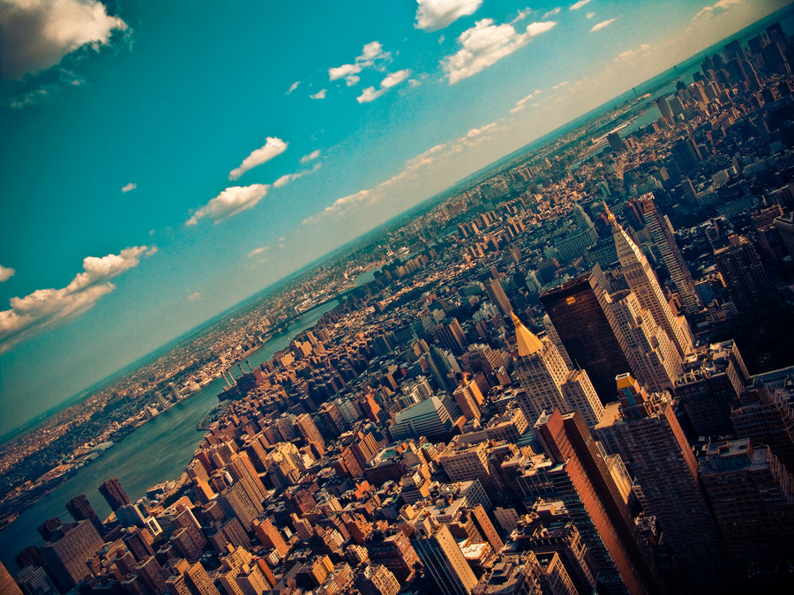

CRJ 204 1700:
Criminal Justice and the Urban Community
SPRING 2021
Tuesdays & Thursdays from 5:30 – 6:45 pm in Zoom
Michelle Ronda, Ph.D.
Associate Professor and Criminal Justice Program Coordinator
Dept. of Social Sciences, Human Services & Criminal Justice
BMCC/CUNY

Slide 2
Agenda
Midterm graded – feedback
Neighborhood Assignment 2 due tonight @ 11:59 pm
Majora Carter: Economic diversity in low-status communities
Looking ahead

Slide 3
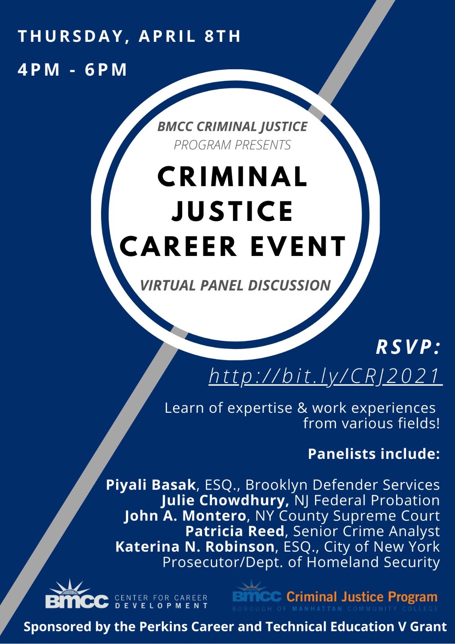

Slide 4
Looking ahead
Class session 18: Th 4/8 | Policing in urban neighborhoods: Cops see it differently READ: Glass, I. (2015, February 13). Cops see it differently, Part Two. [Online recording]. This American Life. Chicago, IL: WBEZ Chicago. https://www.thisamericanlife.org/548/cops-see-it-differently-part-two
Class session 19: T 4/13 | Neighborhood research Workshop 1 in class: Neighborhood assignment 3a
Class session 20: Th 4/15 | Neighborhood research Workshop 2 in class: Neighborhood assignment 3b

Slide 5
Midterm graded
What questions do you have?
What feedback do you have?

Slide 6
Neighborhood Assignment 2
Due @ 11:59 pm tonight
Be sure to look at the SafeAssign Similarity Report!
  https://www.youtube.com/watch?v=ww4uAXbaGsE&t=153s
Be sure to cite your sources

Slide 7
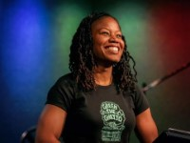
Majora Carter: Greening the ghetto

Slide 8
Attendance https://forms.gle/wh5wNLJ4ViUeP6EYA

Slide 9
Economic diversity in low-status communities: Majora Carter
When we concentrate poverty, we exacerbate inequality (p. 60)
Affordable housing and social services are concentrated in low-status communities that already suffer from widespread unemployment and associated health, education, and criminal justice related problems (p. 60)
Low-status communities: …”the places where the schools are worse, the air is dirtier, the parks and trees are fewer and less well-maintained, and the health statistics are not good… places where inequality is assumed…” (p. 61)

Slide 10
Economic diversity in low-status communities: Majora Carter (continued)
Brain drain: “…when successful individuals leave, they take with them their income-generating potential, the capacity for local reinvestment, and their day-to-day example of what success can look like” (p. 61).
Self-gentrification: making communities more vibrant and diverse; build on strengths of existing residents
Develop amenities to serve as talent retention: benefit existing residents while attracting new residents

Slide 11
Economic diversity in low-status communities: Majora Carter
Reclaiming neighborhood control of land use: Get buy-in from residents
Promote environmental equality: You don’t have to move out of your neighborhood to live in a better one
American urbanization do-over: Spofford Juvenile Detention Center; wanted to focus on keeping local residents, but was awarded by the City to outsiders
We don’t always win: https://youtu.be/tDdfuFS76GQ
Land trusts: https://www.youtube.com/watch?v=6SGq35Ty88c
  Offers neighborhoods more control

Slide 12
Looking ahead
Class session 18: Th 4/8 | Policing in urban neighborhoods: Cops see it differently READ: Glass, I. (2015, February 13). Cops see it differently, Part Two. [Online recording]. This American Life. Chicago, IL: WBEZ Chicago. https://www.thisamericanlife.org/548/cops-see-it-differently-part-two
Class session 19: T 4/13 | Neighborhood research Workshop 1 in class: Neighborhood assignment 3a
Class session 20: Th 4/15 | Neighborhood research Workshop 2 in class: Neighborhood assignment 3b

