Slide 1
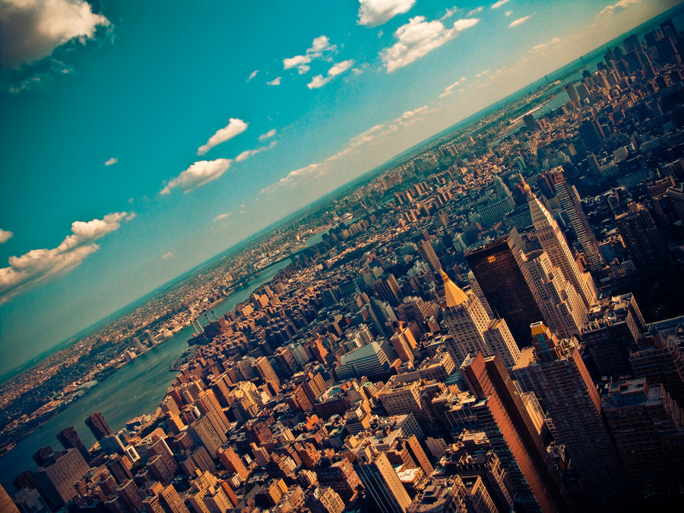

CRJ 204 1700:
Criminal Justice and the Urban Community
SPRING 2021
Tuesdays & Thursdays from 5:30 – 6:45 pm in Zoom
Michelle Ronda, Ph.D.
Associate Professor and Criminal Justice Program Coordinator
Dept. of Social Sciences, Human Services & Criminal Justice
BMCC/CUNY

Slide 2
Agenda
Class session 23: Tu 4/27 | The War on Drugs | Crack and the South Bronx Film in class continued READ: Contreras, R. (2012). Stickup Kids. Ch. 1, The Rise of South Bronx and Crack. Los Angeles, CA: University of California Press. (p. 35-55) NEIGHBORHOOD ASSIGNMENTS 3a & 3b due in Blackboard by 11:59 pm

Slide 3
Looking ahead
Class session 24: Th 4/29 | Alternatives to the criminal justice system as a solution to social problems READ: Austria, R. & Peterson, J. (2017). Credible Messenger Mentoring for Justice-Involved Youth. The Pinkerton Papers.

Slide 4
Internships/Job
NYPD Summer Internship
DART

Slide 5
Decade of Fire (http://decadeoffire.com/get-involved/)
In the 1970s, fires raged throughout the South Bronx.
Abandoned by landlords and city officials, nearly a half million people were displaced. Black and Puerto Rican residents were blamed for the devastation, even as they battled daily to save their neighborhoods.
Now, Bronx-born filmmaker Vivian Vázquez Irizarry is pursuing the truth: uncovering policies of racism and neglect that still shape our cities and offering hope to communities on the brink today.
https://www.pbs.org/video/decade-of-fire-uoty1d/

Slide 6
Attendance and question

Slide 7
The rise of the South Bronx and crack
Contreras, Stickup Kids, Ch. 1, The Rise of South Bronx and Crack. p. 35-55 (from Contreras, R. (2013). The stickup kids: Race, drugs, violence, and the American dream. Berkeley, CA: University of California Press.)
Context: Stickup Kids – Research about the lives of young men who begin selling crack, and even turn to robbery of other drug dealers in the South Bronx.
“…these Dominican men did not create the South Bronx, [but] it set the stage for their lives” (Contreras, 2013, p. 36).
Notes:
Having considered how policy has shaped mass incarceration, especially in relation to the War on Drugs, we now turn to a local view of what happened.

Slide 8
From the “Wonder Borough” to the
“Bronx is Burning”
19th Century (the 1800s): The Bronx attracts wealthy Manhattan residents who wanted to escape City slums
By the 1900s: Crotona, Claremont, Van Cortland, Pelham Bay parks; Grand Boulevard and Concourse; Yankee Stadium; Bronx Zoo; Botanical gardens; Concourse Plaza Hotel; the Bronx was a symbol of accomplishment; when you had “made it,” you moved to the Bronx
After World War II (1939 to 1945) many things changed for the Bronx… what happened?

Slide 9
“The Bronx slides downhill”
Late 1940s-1950s
White flight and two great migrations
Robert Moses (and urban renewal)
Deindustrialization (decline in manufacturing economy) and prioritizing white-collar business interests
1960s: Loss of manufacturing jobs (how many?), the language barriers, the need for education and training were not considered in the public’s explanation of crime and poverty in the Bronx (focused instead on the so-called “culture of poverty”).
1970s: The Bronx is burning.
1980s: The zero-tolerance approach was applied in policy, and it helped to create a drug epidemic. The conservative rhetoric was based on racist rhetoric and fear mongering. “Reason, science, and dialogue were lost to irrationality… (p. 54).

Slide 10
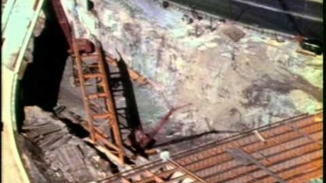

Slide 11
Resilience in the Bronx
The birthplace of hip-hop, electric boogie, and break dancing. South Bronx neighborhoods also started to organize to demand better housing and opportunities.
South Bronx community organizing (agitate about winnable issue, then tackle more challenging issues)
The built environment, implemented through policy, impacts urban life (environmental justice)

Slide 12
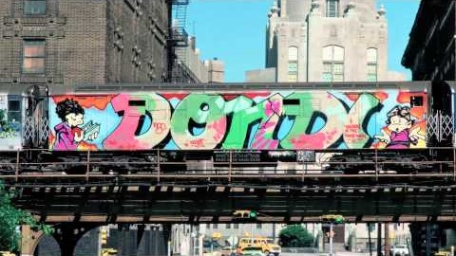

Slide 13
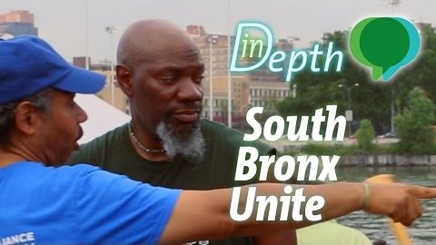

Slide 14
Looking ahead
Class session 24: Th 4/29 | Alternatives to the criminal justice system as a solution to social problems READ: Austria, R. & Peterson, J. (2017). Credible Messenger Mentoring for Justice-Involved Youth. The Pinkerton Papers.

