Slide 1
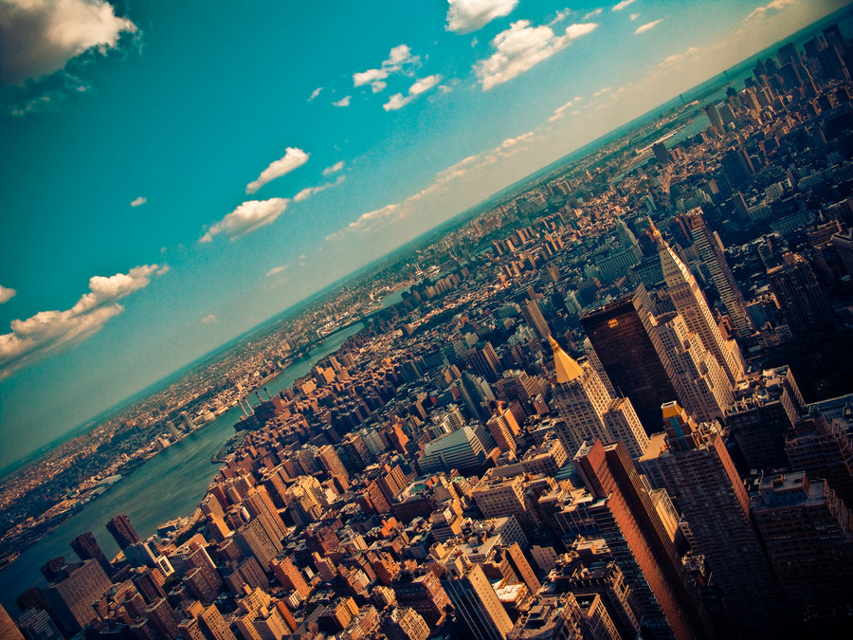

CRJ 204 1700:
Criminal Justice and the Urban Community
SPRING 2021
Tuesdays & Thursdays from 5:30 – 6:45 pm in Zoom
Michelle Ronda, Ph.D.
Associate Professor and Criminal Justice Program Coordinator
Dept. of Social Sciences, Human Services & Criminal Justice
BMCC/CUNY

Slide 2
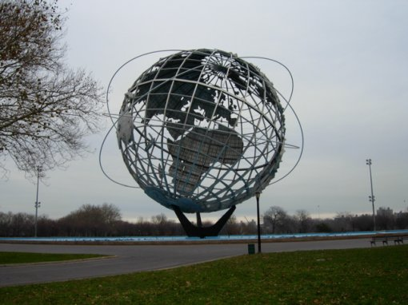
AGENDA: Tuesday, March 16, 2021
Gentrification and Neighborhood Effects
READ: Freeman, Lance. There Goes the Hood: Views of Gentrification from the Ground Up, Temple University Press, 2005. ProQuest Ebook Central.
Looking ahead

Slide 3
Looking ahead
Class session 14: Th 3/18 | Midterm exam review in Zoom class
Class session 15: T 3/23 | Midterm exam review in Zoom class, Part 2 The midterm exam for CRJ 204 0501 will be released on Tuesday, March 23 at 9 pm. Midterm exam is DUE on Thursday, March 25 by 9 pm.
Class session 16: Th 3/25 | Urban inequality - Do Broken Windows lead to more crime? READ: Sampson, R. J., & Raudenbush, S. W. (2001). Disorder in urban neighborhoods: Does it lead to crime (pp. 1-6). US Department of Justice, Office of Justice Programs, National Institute of Justice. Reminder 1: Neighborhood Assignment 2 is due on Tu 4/6 Reminder 2: Midterm exam is due at 9 pm tonight

Slide 4
What is gentrification?
It is difficult to find one, agreed-upon definition of gentrification. Here are a few:
“the transformation of neighborhoods from low value to high value”
“neighborhoods that start off predominantly occupied by households of relatively low socioeconomic status, and then experience an inflow of higher socioeconomic status households.”
“a range of neighborhood changes, including rising incomes, changing racial composition, shifting commercial activity, and displacement of original residents”
For your final paper, use the one from NYC Health: “One measure that is used in NYC is to determine if a low-income neighborhood (those with the lowest 40% of average household income in 1990) saw higher than median rent growth over the past 20 years.”

Slide 5
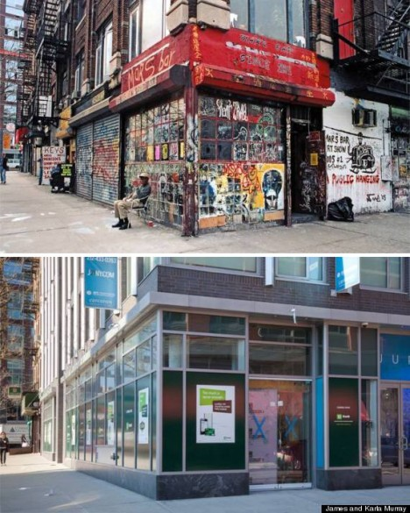
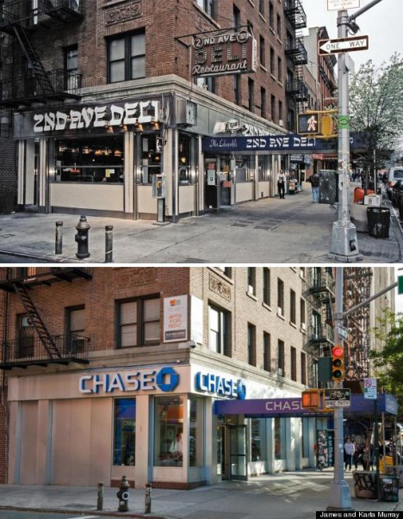
Before
After

Slide 6
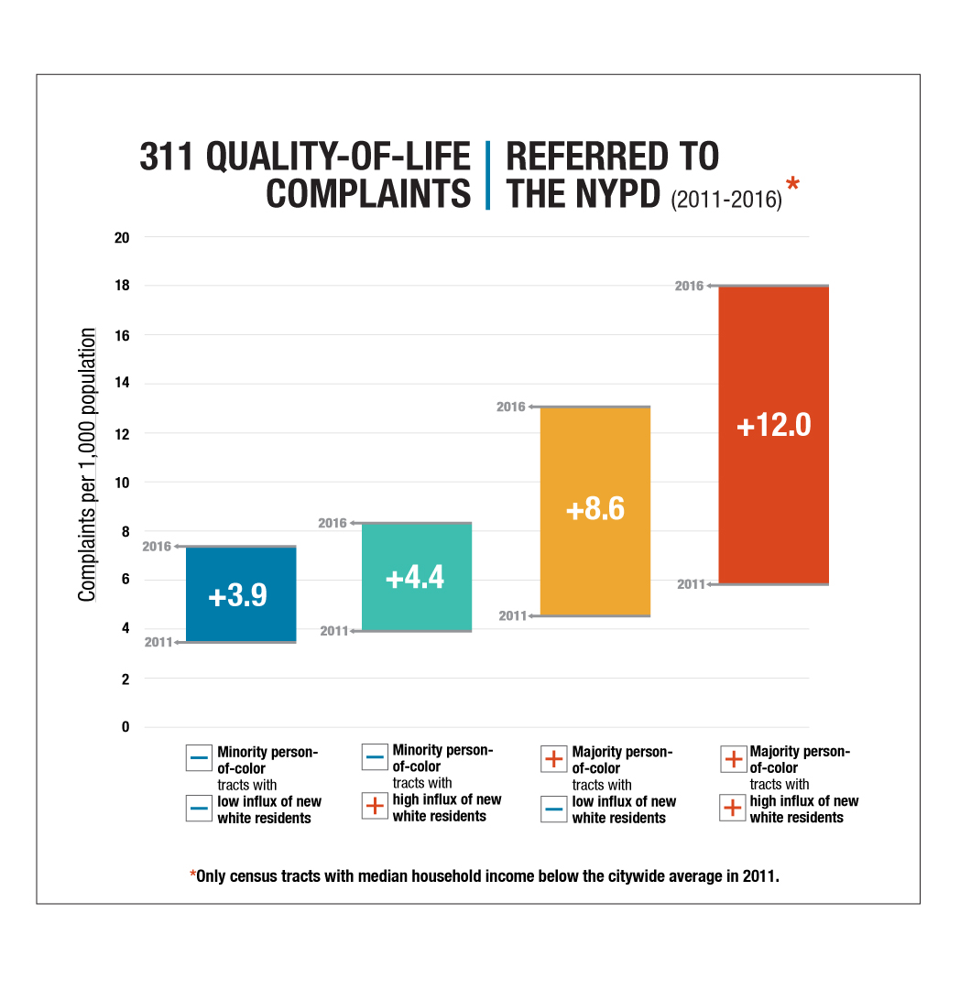
Gentrification and criminalization
Notes:
The highest quality-of-life complaint rates occurred in lower-income communities of color with the largest influxes of white residents.
FINDING 2:
311 complaints for quality-of-life issues were significantly more likely to end in a summons or arrest in lower-income communities of color that experienced the largest influxes of white residents.

Slide 7
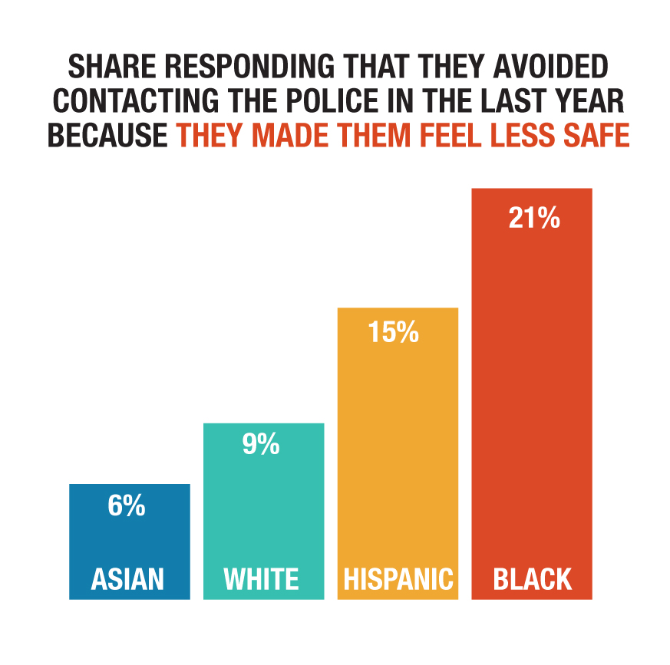
Detachment from law enforcement

Slide 8
Breakout: What does gentrification bring?
https://forms.gle/qMWjAoRLo7dqWbS3A

Slide 9
Lance Freeman: Neighborhood Effects in a Changing ‘Hood
Harlem and Clinton Hill: both experienced gentrification
Disinvestment: Financial institutions not making loans, landlords not maintaining buildings, stores closing
Considering personal interactions between “gentry” and older residents
William Julius Wilson – the flight of the Black middle-class was destabilizing to ghetto neighborhoods, so they could not withstand economic deprivation
Everyone agrees: “concentrated poverty leads to deleterious consequences;” in other words, neighborhoods matter
Policy approach: deconcentrate poverty
That means either we move lower-income people to higher-income areas, or vice versa (this is gentrification)

Slide 10
Neighborhood effects
Peer effects
Behavioral norms (socialization) and collective efficacy: neighborhood can set norms for behavior, protect its turf from threats, and secure resources for the neighborhood
  In poorer communities, we see less collective efficacy because “disadvantage breeds cynicism and instability and undermines cohesion”
Social ties
Institutional resources

Slide 11
Neighborhood effects
Social ties
  Social capital: Ties that provide support and help us cope with everyday life (ties that help us get by)
  Bridging ties: Ties that help us get ahead (doesn’t need to be intimate to matter)
Institutional resources
  Institutions that provide services and amenities to a neighborhood

Slide 12
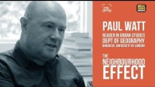
Is this really the solution?

Slide 13
Class divisions matter
There may be benefits to adding middle-class residents to a neighborhood, but there are also costs
Costs: clashes over neighborhood norms, increased police harassment
Role model thesis is not so realistic and is paternalistic
Collective efficacy may or not be strengthened in gentrification (more likely if the goal is outside the neighborhood)
Weak social ties may be more beneficial
Most likely that gentrification will bring improvements to institutional resources that benefit everyone

Slide 14
Looking ahead
Class session 14: Th 3/18 | Midterm exam review in Zoom class
Class session 15: T 3/23 | Midterm exam review in Zoom class, Part 2 The midterm exam for CRJ 204 0501 will be released on Tuesday, March 23 at 9 pm. Midterm exam is DUE on Thursday, March 25 by 9 pm.
Class session 16: Th 3/25 | Urban inequality - Do Broken Windows lead to more crime? READ: Sampson, R. J., & Raudenbush, S. W. (2001). Disorder in urban neighborhoods: Does it lead to crime (pp. 1-6). US Department of Justice, Office of Justice Programs, National Institute of Justice. Reminder 1: Neighborhood Assignment 2 is due on Tu 4/6 Reminder 2: Midterm exam is due at 9 pm tonight

