Slide 1


CRJ 204 1700:
Criminal Justice and the Urban Community
SPRING 2021
Tuesdays & Thursdays from 5:30 – 6:45 pm in Zoom
Michelle Ronda, Ph.D.
Associate Professor and Criminal Justice Program Coordinator
Dept. of Social Sciences, Human Services & Criminal Justice
BMCC/CUNY

Slide 2
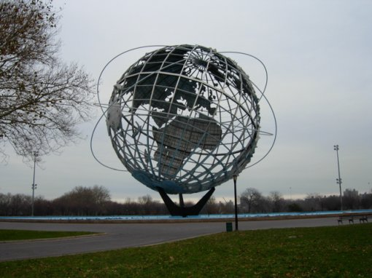
AGENDA: Thursday, March 4, 2021
Understanding disparities: Gender in neighborhoods
Special guest: Richie Reseda, Success Stories
Materials for today:
Feminist on CellBlock Y: https://youtu.be/JYxTzsabkH8
Rios, V. (2011). Preface and Chapter 1. Punished: Policing the lives of Black and Latino boys (pp. vii to 23). New York, NY: NYU Press.
Looking ahead

Slide 3
Looking ahead
Class session 11: Tu 3/9 | “Dangerous” neighborhoods and White Flight READ: Lurie, Stephen. “There's No Such Thing as a Dangerous Neighborhood.” Bloomberg CityLab, Bloomberg, 25 Feb. 2019. "White flight." Wikipedia, The Free Encyclopedia. Wikipedia, The Free Encyclopedia, 28 Jan. 2021. Web. 1 Feb. 2021.
Class session 12: Th 3/11 | Neighborhood research assignment 1 & 2 review in class Review returned neighborhood assignment 1 and distribute neighborhood assignment 2: Researching Community District needs and community health indicators

Slide 4
Guest: Richie Reseda
Abolitionist-feminist organizer, hip hop artist, and producer
Success Stories: https://www.successstoriesprogram.org/
Success Stories was cofounded by two incarcerated young men, Charles Berry and Richie "Reseda" Edmond-Vargas at the California Training Facility prison in 2014. It was completely developed and ran by incarcerated people there and still is to this day.
Initiate Justice: https://www.initiatejustice.org/
Our mission is to end mass incarceration by activating the political power of the people it directly impacts. We organize our members, inside and outside of prisons, to advocate for their freedom and change criminal justice policy in California.

Slide 5
Patriarchy & toxic masculinity
“Patriarchy is political-social system that insists that males are inherently dominating, superior to everything and everyone deemed weak, especially females, and endowed with the right to dominate and rule over the weak and to maintain that dominance through various forms of psychological terrorism and violence.”
In other words, patriarchy is a social and political system that gives men privileges, which result from a socialization process that teaches people heterosexual men are superior to women and all non-heterosexual men. Sexism is a consequence and symptom of a society that practices patriarchy.
Toxic masculinity: Violence, objectifying women, money

Slide 6
Where were we?
Disproportionality and disparity: Gender
MILLER:
Neighborhoods are a major feature of social life for youth in disadvantaged communities
African American young women are more likely to be victimized by people they know (in neighborhoods of extreme disadvantage; it is the disadvantage, not the individual people); these neighborhoods are socially isolated and don’t develop collective efficacy
Public spaces are male-dominated
Three facets of violence against women:
  Exposure to public incidents of physical violence against women
  Widespread sexual harassment in neighborhoods
  Sexual assault and coercion

Slide 7
Responses to violence, harassment and assault
Women are blamed for their victimization
Norms that view intimate partner violence as a private problem
Sexual comments by peers and harassment by adult men: double bind
More than half of the girls in the study reported some form of sexual victimization; boys gain status rewards for this behavior
Girls develop strategies for risk avoidance

Slide 8
Rios: Punished (Preface and Chapter 1)
Systematic research is one way to know about the social world.
Punished is the result of systematic research into the lives of a group of young men.
  Rios tells us he is doing critical criminology: The study of crime in relation to power.

Slide 9
Rios: Punished, Preface and Chapter 1
Rios also says that he is doing urban ethnography (study of the people/culture): A method of doing social research. Examining culture in everyday life.
Rios is both an insider and an outsider to the context he is investigating.

Slide 10
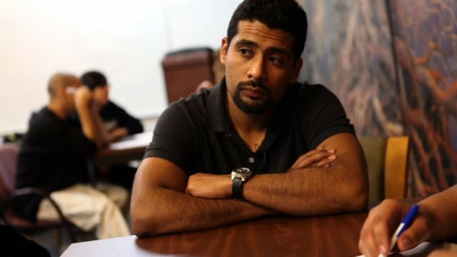

Slide 11
Attendance and questions (for exam)
https://forms.gle/4h5db1LTt8bg2HiYA

Slide 12
Rios: Punished; Preface
What do Victor and Pelon, his former fellow gang member, conclude about their group of “homies” as they review the names on the refrigerator they had tagged when they were younger men? (p. viii)
Why did Rios join the gang when he was 14? (p. ix)
What did police tell Rios after his friend Smiley was shot and killed by a rival gang member? (p. xi)
After Smiley’s death, what led to Rios feeling inspired to change his life? (pp. xi-xii)
What does he mean by “criminalization”? (p. xiv)
What is the “youth control complex,” according to Rios? (p. xiv)
How do crime and violence function in the lives of these young men, according to Rios? (p. xv)

Slide 13
Rios: Punished; Chapter 1
Who did Rios focus on in this research study, and why did he choose this group on which to focus?
How many youth did he study, how did he study them, and for how long?
What research questions does Rios want to answer with this study?
How many of the young men in his study had previously been arrested?
How many young men in his study had a parent in jail or prison?
What are his definitions of “working class,” “working poor,” and living in “extreme poverty”?

Slide 14
Looking ahead
Class session 11: Tu 3/9 | “Dangerous” neighborhoods and White Flight READ: Lurie, Stephen. “There's No Such Thing as a Dangerous Neighborhood.” Bloomberg CityLab, Bloomberg, 25 Feb. 2019. "White flight." Wikipedia, The Free Encyclopedia. Wikipedia, The Free Encyclopedia, 28 Jan. 2021. Web. 1 Feb. 2021.
Class session 12: Th 3/11 | Neighborhood research assignment 1 & 2 review in class Review returned neighborhood assignment 1 and distribute neighborhood assignment 2: Researching Community District needs and community health indicators

