Slide 1
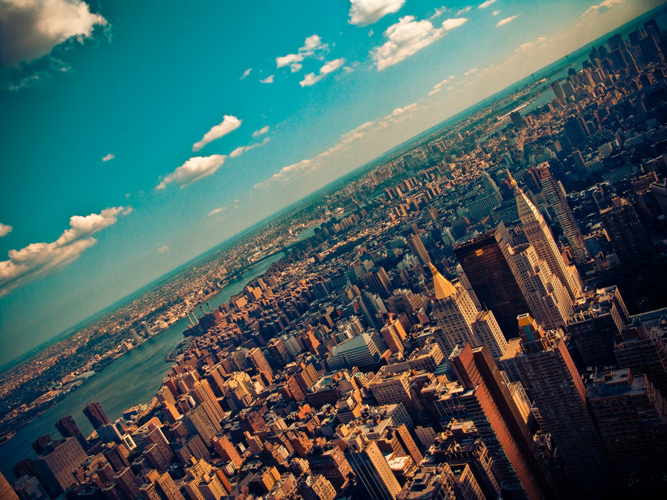

CRJ 204 1700:
Criminal Justice and the Urban Community
SPRING 2021
Tuesdays & Thursdays from 5:30 – 6:45 pm in Zoom
Michelle Ronda, Ph.D.
Associate Professor and Criminal Justice Program Coordinator
Dept. of Social Sciences, Human Services & Criminal Justice
BMCC/CUNY

Slide 2
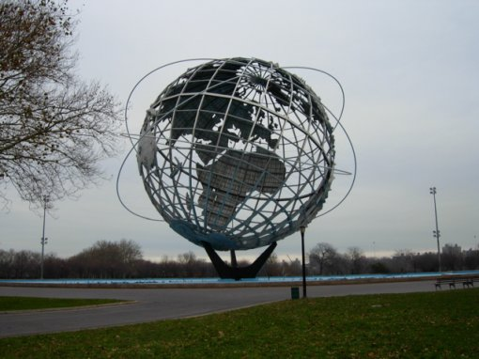
AGENDA: Tuesday, February 23, 2021
Complete discussion of How a War on Poverty became a War on the Poor
  READ: Hinton, Elizabeth, LeShae Henderson, and Cindy Reed. "An unjust burden: The disparate treatment of black Americans in the criminal justice system." Vera Institute of Justice. May (2018).
Understanding disparities: Gender in neighborhoods
  READ: Miller, J. (2008). Chapter 2: Gender ‘n the ‘Hood: Neighborhood violence against women and girls. Getting Played: African American girls, urban inequality, and gendered violence (pp. 32-66). New York, NY: NYU Press.
Looking ahead

Slide 3
Looking ahead
Class session 9: Tu 3/2 | Understanding disparities: Gender in neighborhoods READ: Miller, J. (2008). Chapter 2: Gender ‘n the ‘Hood: Neighborhood violence against women and girls. Getting Played: African American girls, urban inequality, and gendered violence (pp. 32-66). New York, NY: NYU Press.
Class session 10: Th 3/4 | Understanding disparities: Gender in neighborhoods Guest: Richie Reseda https://www.successstoriesprogram.org/ourroots Watch BEFORE class: https://www.successstoriesprogram.org/thefeministoncellblocky

Slide 4
Implicit bias against Black/African Americans
Police
  Greater use of force, more likely to be pulled over and searched, stopped as pedestrians and arrested
Prosecutors
  More likely to be prosecuted, held in pretrial detention, charged with higher crimes/harsher sentences for same crime, and plea bargaining more harsh
Judges
  Pretrial detention, higher bail, harsher sentences, sentenced to death, colorism in sentencing
Juries
  Mock jurors show more implicit bias

Slide 5
Key Takeaway
Racial disparities in the criminal justice system are no accident, but rather are rooted in a history of oppression and discriminatory decision making that have deliberately targeted black people and helped create an inaccurate picture of crime that deceptively links them with criminality.

Slide 6

Don’t lose heart!
Protests (and la lucha) continue
Social change takes time
There are dozens of organizations working on change
Get involved with change!
https://drugpolicy.org/
https://famm.org/
https://www.changethenypd.org/
https://maketheroadny.org/

Slide 7
Attendance here: https://forms.gle/jVYoxyisPsBwEU9KA

Slide 8
Difference, disproportion, or disparity?
A disparity is not measured directly, but rather as a difference between two groups, often only after other factors that might contribute to that difference have been statistically controlled for.
Neighborhood disparities are also reflected in the criminal justice system: consider rankings;
Now we will look at neighborhood disparities by gender

Slide 9
Definitions that are useful for our conversation
(An intro to sociology review)
Sex
Gender
  Cis-gender
  Transgender
Sexuality
Sex, gender, and sexuality do not always align
Gendered behavior: ways in which an individual acts in accordance with their identified male or female gender.
Notes:
But let’s review. You may have taken sociology a while back. Who wants to assist in defining here?
So gender is a social construction meaning expectations can change over time and place. Any that have changed? How so?
Sex: the biological traits that society associates with being male or female
Gender: the cultural meanings attached to being masculine and feminine
Cis-gender describes people whose biological body they were born into matches their personal gender identity.
This gender experience is distinct from being transgender, which is where one’s biological sex does not align with their gender identity.
Sexuality describes sexual identity, attraction, and experiences which may or may not align with sex and gender. This includes but is not limited to heterosexuality, homosexuality (gay or lesbian), bisexuality, queer and so on.
Sex and gender do not always align.

Slide 10
Sexualization
(from the American Psychological Association Task Force on the Sexualization of Girls)
Sexualization occurs when
a person’s value comes only from his or her sexual appeal or behavior, to the exclusion of other characteristics;
a person is held to a standard that equates physical attractiveness (narrowly defined) with being sexy;
a person is sexually objectified—that is, made into a thing for others’ sexual use, rather than seen as a person with the capacity for independent action and decision making; and/or
sexuality is inappropriately imposed upon a person
Notes:
And one more definition for a word that came up repeatedly in the reading but wasn’t exactly defined. When how and why would sexualization be a problem?

Slide 11
Neighborhood Studies of Crime & Inequality: Miller’s Getting Played
Miller: There is research looking at crime and inequality; not much about how neighborhood violence is gendered
Urban African American girls’ risks for non-fatal violence is nearly equal that of African American boys
    (Lauritsen, 2003)
Women’s risks for gender violence are higher in distressed, racially segregated (mostly urban) neighborhoods
    (Benson et al., 2003)
Notes:
So let’s turn to Miller…
She did research in St Louis. She was interested in young people’s experiences of violence because she thought people were not paying attention to the different experiences that young men and young women might have. Also was concerned that for black girls, the risks for violence are similar to those for boys in distressed communities. Those are:
No high school diploma: Percent of the population 25 years and older without a high school diploma or equivalent
Housing vacancy rate: Percent of habitable housing that is unoccupied, excluding properties that are for seasonal, recreational, or occasional use
Adults not working: Percent of the prime-age population (ages 25-64) not currently in work
Poverty rate: Percent of the population living under the poverty line
Median income ratio: A geography’s median income expressed as a percentage of its state’s median income
Change in employment: Percent change in the number of jobs from 2011 to 2015
Change in business establishments: Percent change in the number of business establishments from 2011 to 2015
Sex: the biological traits that society associates with being male or female
Gender: the cultural meanings attached to being masculine and feminine

Slide 12
Research Methodology:
How Miller did her research
Qualitative (meaning not numbers, but conversations), in-depth interviews
35 young women, 40 young men
African American youth, residing in “distressed” urban neighborhoods in St. Louis
Purposive sampling: Chose youth “at risk” or involved in delinquency
Young people were found through local community agency & alternative public high schools
Notes:
Here’s what she did

Slide 13
“Distressed” neighborhoods or communities
No high school diploma: Percent of the population 25 years and older without a high school diploma or equivalent
Housing vacancy rate: Percent of habitable housing that is unoccupied, excluding properties that are for seasonal, recreational, or occasional use
Adults not working: Percent of the prime-age population (ages 25-64) not currently in work
Poverty rate: Percent of the population living under the poverty line
Median income ratio: A geography’s median income expressed as a percentage of its state’s median income
Change in employment: Percent change in the number of jobs
Change in business establishments: Percent change in the number of business establishments

Slide 14
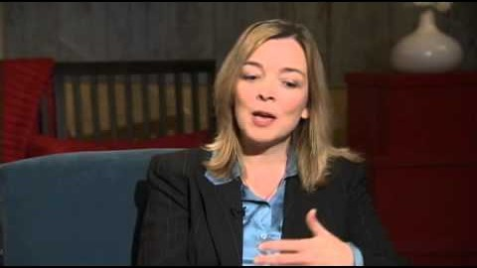
Miller: Getting Played: African American girls, urban inequality, and gendered violence

Slide 15
Neighborhood characteristics in the research
 | Respondents’ Neighborhoods | St. Louis City | St. Louis County
Percent African American | 82.6% | 51.2% | 18.9%
Median Family Income | $24,806 | $32,585 | $61,680
Percent Poverty | 33.8% | 24.6% | 6.9%
Percent Unemployment | 18.0% | 11.3% | 4.6%
Percent Female-Headed Families with Children | 43.1% | 28.8% | 10.7%
Source: US Census, 2000
Notes:
Note that she argues that cultural adaptations emerge in response to structural conditions. She is asking you to use your sociological imagination. African American young women are more likely to be victimized by people they know (this is in neighborhoods of extreme disadvantage; it is the disadvantage, not the individual people); these neighborhoods are socially isolated and don’t develop collective efficacy

Slide 16
Discussion
Do you feel that your neighborhood is safer for men or women? How so?
Miller says that in the neighborhood where she did her research “public community space is male space, especially at night.” Have you seen evidence of this in your neighborhood?
Youth in the St. Louis neighborhoods in the research say there is a neighborhood norm that requires people to mind their own business. Does that happen in NYC neighborhoods too? What’s at the root of that norm?

Slide 17
Looking ahead
Class session 9: Tu 3/2 | Understanding disparities: Gender in neighborhoods READ: Miller, J. (2008). Chapter 2: Gender ‘n the ‘Hood: Neighborhood violence against women and girls. Getting Played: African American girls, urban inequality, and gendered violence (pp. 32-66). New York, NY: NYU Press.
Class session 10: Th 3/4 | Understanding disparities: Gender in neighborhoods Guest: Richie Reseda https://www.successstoriesprogram.org/ourroots Watch BEFORE class: https://www.successstoriesprogram.org/thefeministoncellblocky

