Slide 1
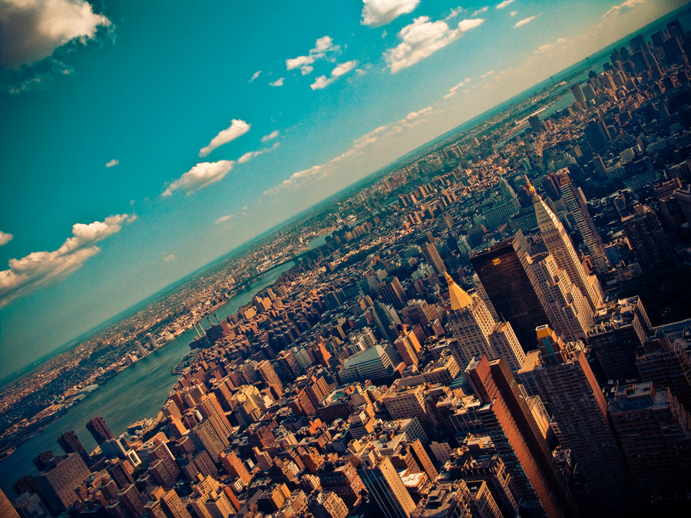

CRJ 204 1700:
Criminal Justice and the Urban Community
SPRING 2021
Tuesdays & Thursdays from 5:30 – 6:45 pm in Zoom
Michelle Ronda, Ph.D.
Associate Professor and Criminal Justice Program Coordinator
Dept. of Social Sciences, Human Services & Criminal Justice
BMCC/CUNY

Slide 2
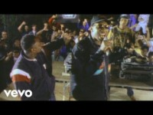
Notes:
https://youtu.be/78gslUjRV9k

Slide 3
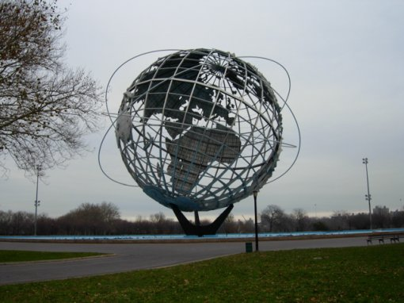
AGENDA: Tuesday February 9, 2021
Complete discussion of the Promise of the Sociological Imagination
How do we know what we know? Using systematic research to understand crime and justice in urban communities
READ: Schwalbe, M. (2009). Finding out how the social world works. In J. Ferguson (ed.), Mapping the Social Landscape (6th ed.) (pp. 32-42). New York, NY: McGraw-Hill, Inc.
Looking ahead

Slide 4
Things to do by Tuesday, February 9
Join Remind (25 points)
Upload your E-Learning orientation certificate to Blackboard (25 points)

Slide 5
Looking ahead: Thursday, February 11
How do cities promote or undermine community?
READ: Jacobs, J. (1961). Death and Life of Great American Cities. Chapter 2: The uses of sidewalks – safety. In Gates and Stout (Eds.), The City Reader. Pp. 106-111.
DISTRIBUTE NEIGHBORHOOD ASSIGNMENT 1

Slide 6
Where were we? Sociological Imagination
The sociological imagination: a skill and a perspective that permits us to understand our own biography by understanding history and the social structure (or social forces that impact our lives)
A reminder that our individual choices are constrained
It also offers a way to seek solutions to the public issues we face and often experience as private troubles
PRIVATE troubles: within the character of the individual
PUBLIC issues: involves a crisis in institutional arrangements
Let’s consider anxiety/depression
Notes:
What is the sociological imagination, and what does it enable us to do if we have one?
The first fruit of this imagination is the idea that the individual can understand his own experience and gauge his own fate only by locating himself within his period, that he can know his own chances in life only by becoming aware of those of all individuals in his circumstances. By living we contribute however minutely to the shaping of society and to the course of its history even as we are made by society and its historical push and shove. The sociological imagination enables us to grasp history and biography and the relations between the two within society. That is its task and its promise.
Perhaps the most fruitful distinction with which the sociological imagination works is between “the personal troubles of milieu” and “the public issues of social structure.” This distinction is an essential tool of the sociological imagination and a feature of all classic work in social science.
What distinction does Mills make between personal troubles and public issues? How might they be related?
Perhaps the most useful distinction with which the sociological imagination works is between the “personal troubles of milieu” and the “public issues of social structure.” Troubles occur within the character of the individual and the range of his immediate relations with others; the resolution of troubles lie within the individual as a biographical entity; a trouble is a private matter; values cherished by the individual are felt to be threatened.
Issues have to do with matters that transcend these local environments of the individual. An issue is a public matter; some value cherished by publics is felt to be threatened. An issue often involves a
crisis in institutional arrangements and often too it involves what Marxists call contradictions or antagonisms.
Consider unemployment: if 1 in 100,000 is unemployed this is a personal trouble. In a nation of 50 million employees, 15 million are unemployed, that is an issue.
Both the correct statement of the problem and the range of possible solutions require us to consider the economic and political institutions of the society, and not merely the personal situation and character of a scatter of individuals. Consider war; consider marriage; consider the metropolis. What we experience in various and specific milieu (social surroundings or environment) is often caused by structural changes.

Slide 7
How do we know what we know?
Introduction to social research methods.
The sociological perspective is theoretical, and we can apply it to how we gather and analyze data.
“The best way to learn about research is through hands-on experience gained by conducting a study.” Schwalbe
Reading begins with example of confusion between rates (percentages) and actual numbers of people living below the poverty line

Slide 8
Poverty by the numbers, 2016
Title: Poverty Rate by Race/Ethnicity (Numbers)
Timeframe: 2016
Location | White | Black | Hispanic | Other | Total
United States | 17,494,800 | 8,719,100 | 11,251,700 | 3,611,900 | 41,077,500
California | 1,438,100 | 496,800 | 2,836,400 | 708,900 | 5,480,200
Louisiana | 384,800 | 444,300 | 57,400 | 42,000 | 928,500
Mississippi | 185,100 | 387,900 | N/A | N/A | 626,800
New Jersey | 311,800 | 188,700 | 261,700 | 81,200 | 843,300
New York | 875,600 | 461,200 | 668,200 | 332,300 | 2,337,300
Pennsylvania | 811,600 | 250,300 | 268,700 | 97,700 | 1,428,300
Texas | 897,900 | 698,200 | 2,068,500 | 161,900 | 3,826,500
From the Keiser Family Foundation (www.kff.org)
Notes:
The U.S. Census Bureau's poverty threshold for a family with two adults and one child was $20,160 in 2016.
This is the official measurement of poverty used by the Federal Government, and the measure used for most poverty-based data presented on State Health Facts.
The Department of Health and Human Services (HHS) produces simplified - but very similar - versions of these poverty thresholds called "poverty guidelines" that are used to assess eligibility for income-based programs such as Medicaid.
For more information on measures of poverty, please see the detailed description provided by HHS:

Slide 9
Poverty by percentage, 2016
Title: Poverty Rate by Race/Ethnicity (Percentage)
Timeframe: 2016
Location | White | Black | Hispanic | Other | Total
United States | 9% | 22% | 20% | 13% | 13%
California | 10% | 23% | 19% | 10% | 14%
Louisiana | 14% | 30% | 24% | 24% | 20%
Mississippi | 11% | 36% | 44% | N/A | 21%
New Jersey | 6% | 17% | 17% | 8% | 10%
New York | 8% | 17% | 19% | 15% | 12%
Pennsylvania | 8% | 18% | 31% | 13% | 11%
Texas | 8% | 21% | 20% | 9% | 14%

Slide 10
Finding out how the social world works
Schwalbe says that these are some of ways we can know things.
What are the problems with these ways of knowing?
Logical deduction
Straight from others
Personal experience or observation
Systematic research
Mystical revelation
Instinctively
Which one does he recommend to find out about the social world?
Notes:
Logical deduction: if premise is wrong, we’re wrong
Straight from others: others may be wrong
Personal experience or observation: we can misjudge and overgeneralize
Systematic research: closer to reliable and valid
Mystical revelation: unique and personal
Instinctively: could be wrong

Slide 11
Questions we can ask: Defining
Empirical questions:
Aesthetic questions:
Moral questions:
Interpretation:

Slide 12
What kind of question is this, following Schwalbe’s definitions?
Empirical, aesthetic, moral, or interpretive?
What percentage of college students get 7 hours of sleep a day?
What is the average percentage of people who play video games as a stress-reliever?
Are Protestants more likely to get into heaven?
How many dog owners live in Brooklyn?
Should people who are not virgins be permitted to marry in religious institutions?
Should people be arrested for selling marijuana?
What are the factors that contribute to school shootings?
Is curly hair more attractive than straight hair?
Notes:
Discuss with your neighbors

Slide 13
Thinking about valid and reliable knowledge
Breakout rooms
Please have one person enter group responses on this form:
  https://forms.gle/uddsVxJ4SJ58YV5d6
  If you took notes last time, let someone else take notes this time

Slide 14
Things to do by Tuesday, February 9
Join Remind (25 points)
Upload your E-Learning orientation certificate to Blackboard (25 points)

Slide 15
Looking ahead: Thursday, February 11
How do cities promote or undermine community?
READ: Jacobs, J. (1961). Death and Life of Great American Cities. Chapter 2: The uses of sidewalks – safety. In Gates and Stout (Eds.), The City Reader. Pp. 106-111.
DISTRIBUTE NEIGHBORHOOD ASSIGNMENT 1

