Slide 1


Business Management
BUS 200 Spring 2022
Business Organizations and Management
Session 8

Slide 2
Session 8
Review of Last Session
BP – Framing the Case: Chapter 1 –Introduction
Career or Academic Strategic Plan
Session 9 Outlook

Slide 3
Questions – Follow Up
Any Questions from Last Class?

Slide 4
BP Deepwater Horizon
What are the Organization Structure issues evident in this case?
What are the Human Resource issues?
What are the safety issues?
How did these issues impact the disaster?
Deepwater Horizon - 10 Years Later

Slide 5
BP Deepwater Horizon Case Analysis
Progress Report #1 Due 04/06/22
Did you answer these questions in this order with separate sub-titles:
Introduction What is Chapter 1 going to cover?
The History of BP What was the history of its organization and leadership?
            What was the history of its organizational structure?
The Disaster What are the facts/figures – cause and impact?
Summary What did Chapter 1 cover?
Write in the 3rd person – 12pt font
Double space – 1” margins on all sides

Slide 6
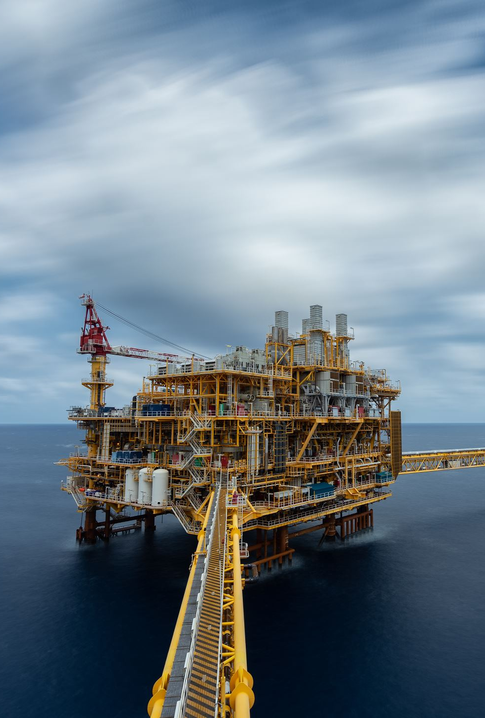
BP Deepwater Horizon
Describe the organization and the setting of the case.
Place
People
Impact: lives lost – lives injured – economic - environmental
What was the organizational history of BP?
  Public Utility
  Private Company
  Centralized
  Decentralized
What was its current organizational structure prior to the disaster?
  Flat
  Many subcontractors

Slide 7
Progress Report #1
PROGRESS REPORT I - 05 points
Due 04/06/22 PRIOR to Start of Class
Key Issues:
Briefly describe the case study and the leading issues in this case using the information presented in the case description.
Deliverable:
A three-page (APA style) report that includes: A brief summary of the case and the key issues.
Grading Rubric:
3 points – case summary and key issues identified, well defined, and accurate 2 points – well written in APA format

Slide 8
HOW TO ORGANIZE YOUR FINAL PAPER
(see sample on BB)
TITLE PAGE (name of paper - your name – date - course & section)
Abstract (the last item you add to your paper)
Table of Contents
Introduction (Overview of the case and the KEY ISSUES Progress Report 1)
Diagnosis (PR 2 Identify the problems – use four frames and 5 principles)
Process Problems (PR 3 – what were the key issues? 2-3 related to the frames and/or principles)
Redesign/Recommendations (what do you recommend in order to avoid a similar situation from occurring)

Slide 9
Strategic Planning – WHY?
What is Strategic Planning - https://www.youtube.com/watch?v=mLJ34L5UW4E
Question: What does this video do to inform you as to how to create a career strategic plan. In small break out groups discuss your answers and be prepared to report back to the class

Slide 10
Strategic Planning Models
SWOT
SOAR
Force Field Analysis
AI

Slide 11
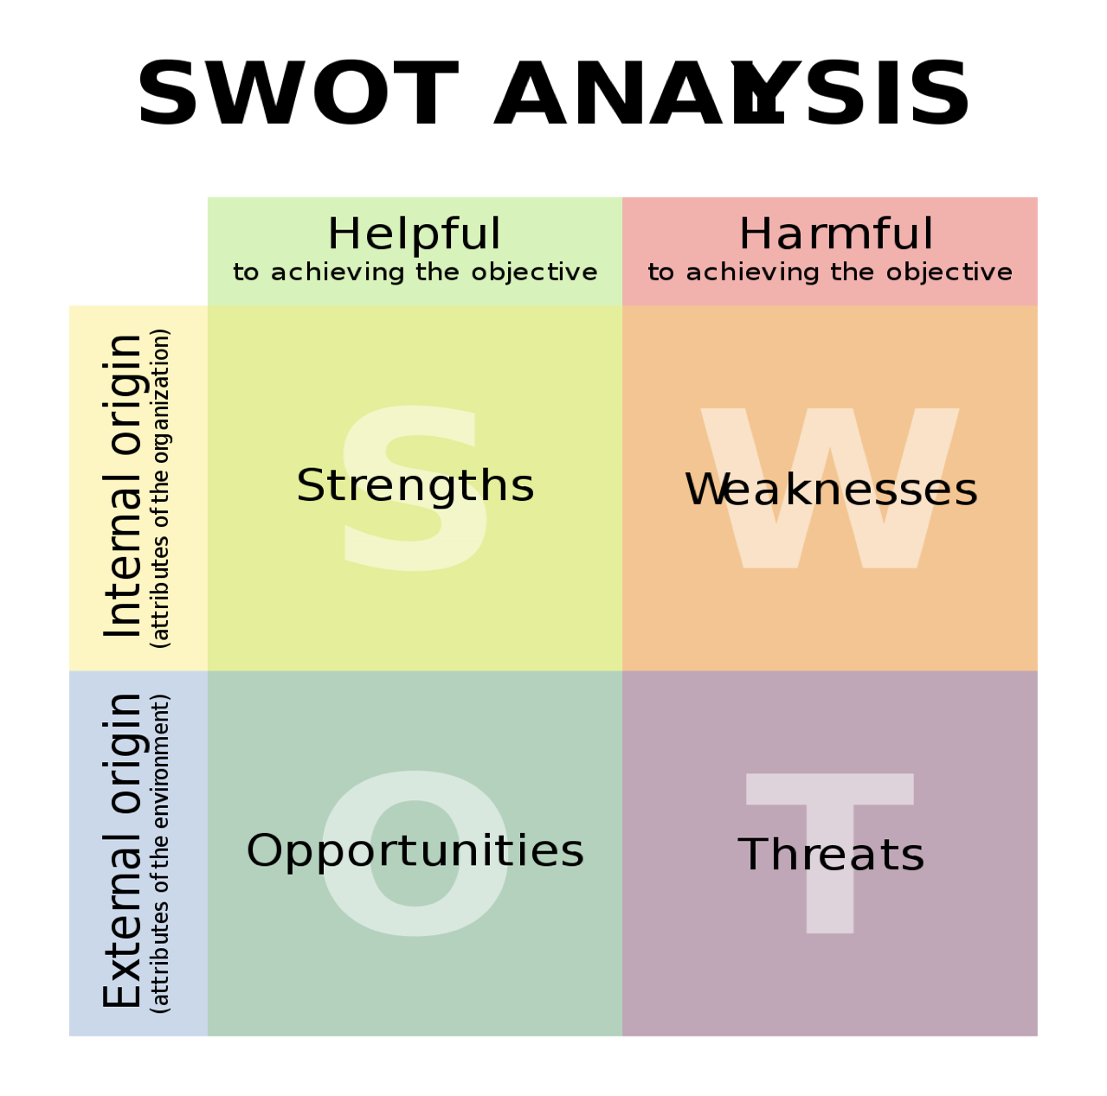

Slide 12
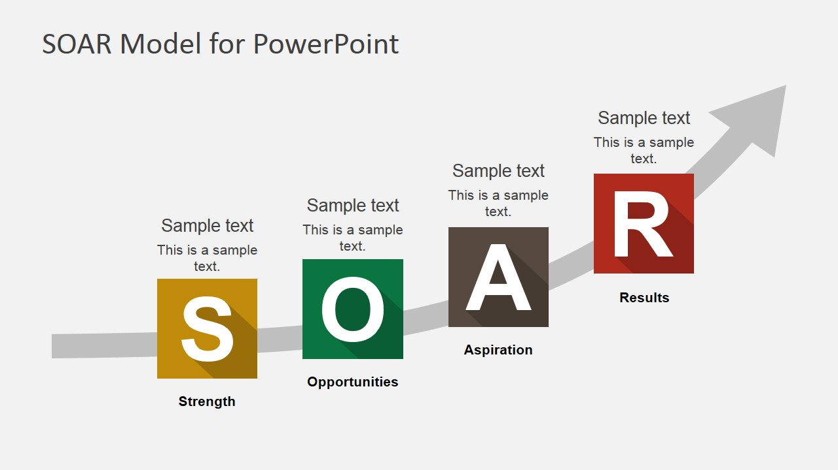

Slide 13
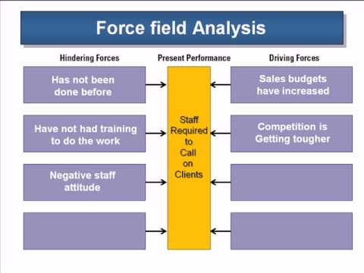

Slide 14
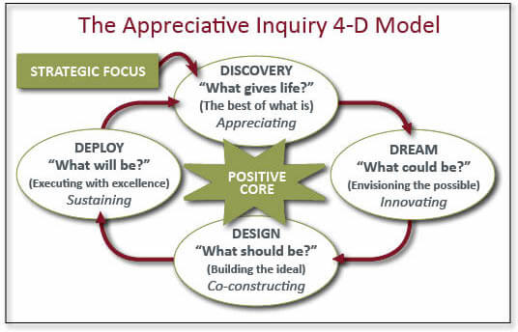

Slide 15
Strategic Planning Process
Past Performance
Collect Input Internal and External
Confirm Vision
Confirm Mission
Identify Future Direction
Test Future Direction – 5 Year Focus
Establish Strategic Goals
Establish Tactical Goals
Strategic Planning Theory
In
Practice

Slide 16

Mid-Term Paper – Career Strategic Plan
Prepare a Written Analysis
What is your career Vision and Mission?
What strategic planning model did you use?
What is your Strategic Plan?
What is your plan for achieving your career plan? Your road map – tactical plan.
The analysis is to be no more than 5 typed pages (not including attachments) – 1” margins, 12pt font, double- spaced, and in APA format - Include as an attachment your current resume.

Slide 17

Mid-Term – Simulated Interview Video
Prepare a Video Presentation
In a video no longer than 2 minutes (simulating an interview) answer two questions –
one from the list below and one of your own choosing:
o “Tell me a little about yourself”
o “What is your story?”
o “Why do you want this job?”
o “What do you consider to be your three strengthens and three weaknesses?”
You will be presenting your video in-class for feedback and reinforcement.

Slide 18
Session 9
04/06/22
Mid-Term Presentations Read Bolman and Deal pages 179 -294

