Slide 1


Business Management
BUS 200 Spring 2022
Business Organizations and Management
Session 12

Slide 2
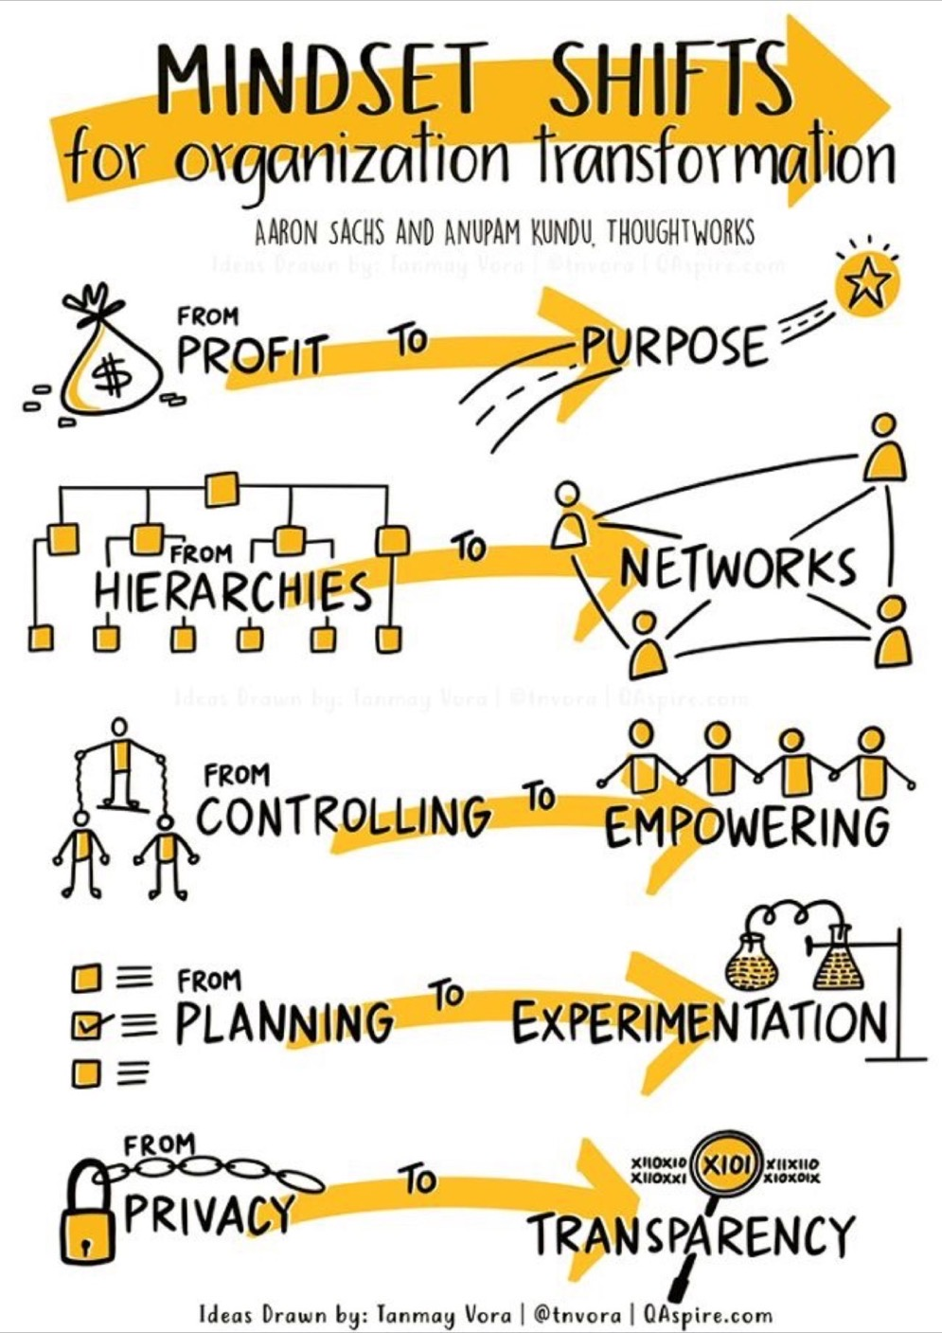

Slide 3
Session 12
Agenda
Questions/Follow Up
Session 13 – Final Exam Presentations
Symbolic Frame – Leadership
Career/Academic Strategic Plans

Slide 4
Questions – Follow Up
Any Questions?
Last Class 05/11
Final Papers and PPT Presentations 05/18

Slide 5
Strategic Planning ModStarels
SWOT
SOAR
Force Field Analysis
AI
In Practice

Slide 6
Strategic Planning Process
Past Performance
Collect Input Internal and External
Confirm Vision
Confirm Mission
Identify Future Direction
Test Future Direction – 5 Year Focus
Establish Strategic Goals
Establish Tactical Goals
Strategic Planning
Theory
In
Practice

Slide 7

FOUR ORGANIZATIONAL FRAMES
STRUCTURE Roles, Goals, Policies, Alignment
PEOPLE Needs, Skills, Relationships
POLITICAL Power, Conflict, Competition, Politics
SYMBOLIC Culture, Rituals, Heroes, Stories

Slide 8
The Symbolic FRAME
How Symbols, Myths, Vision, Values, Heroes, Heroines, Stories, Fairy Tales, Rituals, and Ceremony
Shape an Organization’s Culture

Slide 9
How do these Symbols Define the Organization?
Give examples.
Mission Statement
Founders
Stories – Myths
Trademarks
Packaging
Spokespersons

Slide 10
THE YMCA
The Young Men's Christian Association
  To put Christian principles into practice through programs that build healthy spirit, mind and body for all.

Slide 11

Business Symbol/Trademark/Log/Spokesperson
Identify a business Symbol/Trademark/Logo NEEDING TO CHANGE AND WHY?

Slide 12
Discussion Question #4
In your own words define the symbolic frame and cite an example.

Slide 13
Anne Barreta
1. Describe the situation and the key players (their roles and relationship to each other)
2. Identify why this case study is related to the Symbolic Frame and defend your position.
3. How you would have addressed the conflict if you were the CEO of the organization?

Slide 14
Progress Report 3 - Chapter 3
The FOCUS
The Central Issue(s) and The Link to:
The Theory of
Organizational Frames
Structure – Human Resources – Political – Symbolic
Leadership Principles
Values – Vision – Challenge – Empower - Heart

Slide 15
Chapter 3
The OUTLINE
INTRODUCTION – What is the chapter going to address?
What is the Central Issue(s) Identified?
How is (are) this (these) Issue(s) linked to the two theories of organizations and leadership?
SUMMARIZE – What did you present in this chapter?

Slide 16
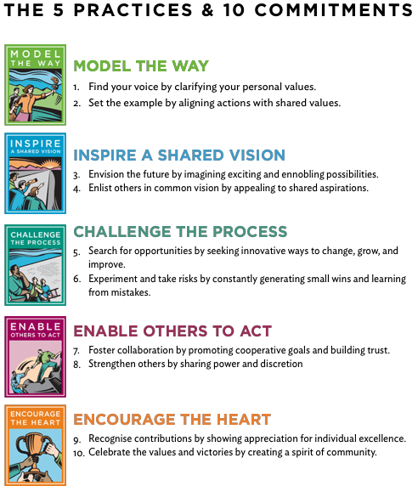
Describe an experience you have had with a leader (boss) who displayed one of these leadership principles.
How did their behavior impact you?
What kind of leader do you what to be?

Slide 17
FOUR ORGANIZATIONAL FRAMES
STRUCTURAL Roles, Goals, Policies, Alignment
PEOPLE Needs, Skills, Relationships
POLITICAL Power, Conflict, Competition, Politics
SYMBOLIC Culture, Rituals, Heroes, Stories

Slide 18
Chapter 4
Conclusions/Recommendations
THE FOCUS
Restate your research topic.
Restate the thesis.
Summarize the main points.
State the significance or results - recommendations
Conclude your thoughts.
https://youtu.be/NvbzZSY6_nM

Slide 19
Chapter 4
Conclusions/Recommendations
THE OUTLINE
INTRODUCTION – What is the chapter going to address?
What was the topic, what was your thesis (assumption), what did you find as the central issue(s), what theory did you apply in analyzing these issue, what are your recommendations?
SUMMARIZE – What did you present in this chapter?

Slide 20

FINAL PAPER
Cover page with your name ID# BUS 200 – section and date
Executive summary (abstract)
Table of contents
The body of the report (Progress reports 1-2-3)
Redesign (Recommendations)
Bibliography
Grading Rubric:
1.0 points – APA style fully employed
1.5 points – clearly summarized the case study and the problems presented
5 points – made a direct connection to the four frames and the problems presented in the case study
2.5 points – presented a redesign (recommendations) for improvement related to the four frames

Slide 21
FINAL PPT PRESENTATION
Deliverable
In a video no longer than 10 minutes and no more than 8- 12 slides present your project (you may use PowerPoint) and include:
  The Case Study summary – presentation of the key issues
  Your analysis of the key issues based on the four frames
  Your redesign (recommendations)
Grading Rubric
2.5 Points: 10 minutes – 8 slides – clear and succinct
2.5 Points: clear verbal presentation of research process and findings

Slide 22

Effective PowerPoint Presentations
Titles 30 – 40
Body 20-24
Minimal Color
5- Points/Slide
1 slide per 1.5 – 2.0 minutes
No Reading
No Animation
https://screencast-o-matic.com/

Slide 23
YOU NEED TO KNOW
ALL GRADES will be SUBMITTED to CUNY FIRST on 05/21/22
ANYONE AT < C can receive an INCOMPLETE GRADE (you need to email me to request this option by 05/20)
INCOMPLETE Grades need to be resolved my END OF THE SUMMER BREAK (Start of the FALL 22 Semester)
An A grade = > 93 points as of 05/20 11:59 pm

Slide 24
Sessions 13
05/18
Final Research Paper and PPT Presentation

