Slide 1


Museums and Costa Rica
Gatekeepers & Canon Makers
Ella Doyle BMCC, CUNY • BSAA 2022
This work is licensed under the Creative Commons Attribution-NonCommercial 4.0 International License. https://creativecommons.org/licenses/by-nc/4.0/
Notes:
=

Slide 2

How many artifacts were just returned to Costa Rica by the Brooklyn Museum?
Who was responsible for removing, selling and then “donating” them?

Slide 3
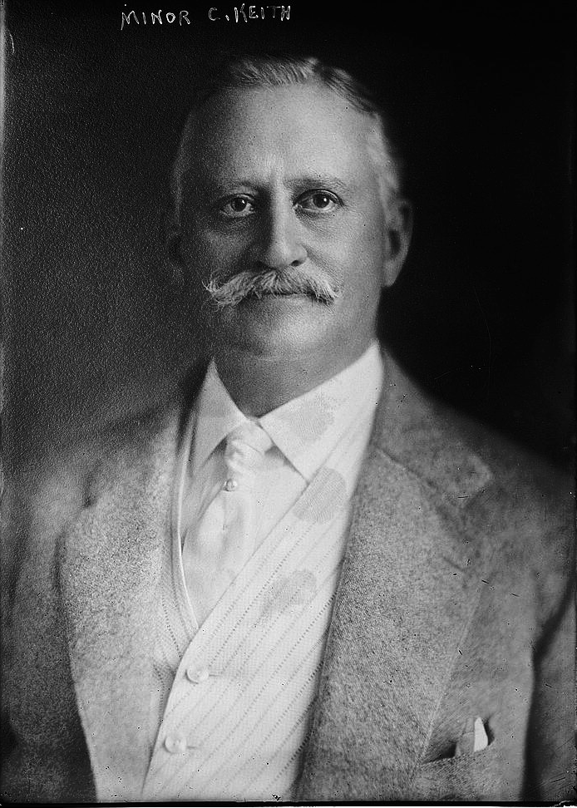
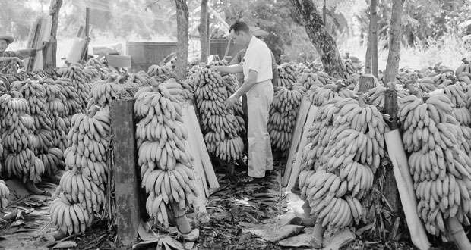
1,300 Costa Rican artifacts have returned to the National Museum of Costa Rica
Minor Cooper Keith was a railroad tycoon and a banana plantation owner. He was able to dominate the banana trade in Central America and Columbia. He also pursued the gold mines located in C.R.
By exploiting the local inhabitants and using their labor, he was able to move artifacts out of the country. By the time of his passing, over 16,000 artifacts had been exported to the United States.
Minor Cooper Keith (1848-1929)
"Minor Cooper Keith" by Library of Congress is in the Public Domain

Slide 4
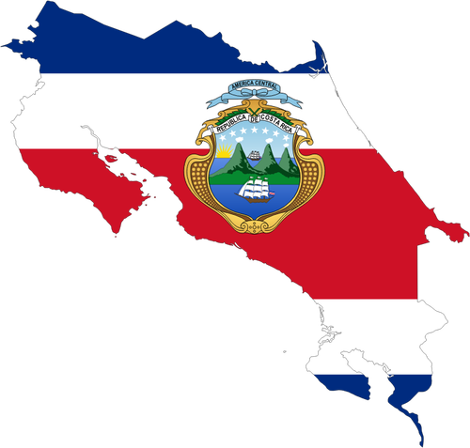
The results
Accessibility
There is currently (December 2022) very limited access to Costa Rican art and artifacts in Costa Rica.
Museum websites are not extensive and are not regularly updated. (This takes funding!)
Consequently, the best (and sometimes only) way to see this art is to travel, which is also largely inaccessible.
From our computers, what do we have access to?
We have “virtual travel” access to some of the most famous museums online via the internet:
  Smithsonian, Louvre, The Met, Nationally Gallery (England)

Slide 5
Something to consider…
Museums hold power,
directly and indirectly.
Let’s consider who controls what goes into a museum.
Board members, donors (both of artifacts/money) and curators are all players in deciding what the public sees and how we see it.

Slide 6
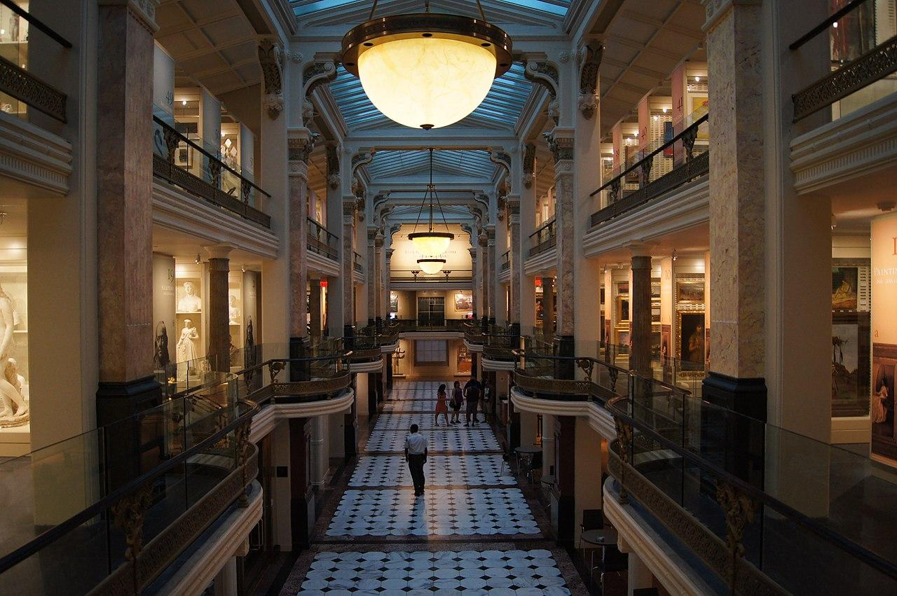

Smithsonian Museum- Washington DC, USA
Smithsonian Museum Donors
Board Members:
Dennis Keller- Chair
Michele J Hooper- Vice
Jorge G. Puente- Vice
Fredericka Stevenson- Vice
20 Million
10 Million
Lilly Endowment, INC
Robert Frederick Smith
Bill & Melinda Gates Foundation
The Oprah Winfrey Charitable Foundation
Amount of visitors per year:
3.15 Million
David M. Rubenstein
Source: Smithsonian Institute
"Smithsonian Museum" by Sebastian Wallroth is licensed under CC BY 3.0

Slide 7
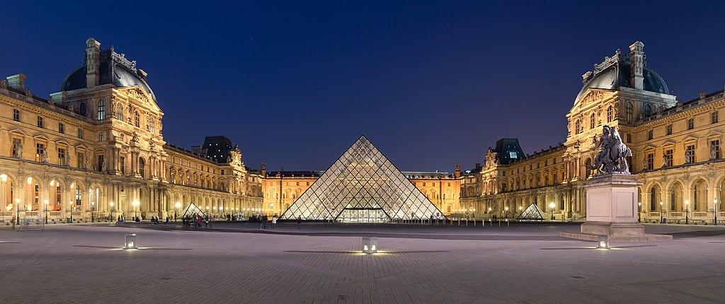
Louvre Museum - Paris, France
Laurence des Cars- Chairman, President director Musee du Louvre
Lionel Sauvage- former President of Capital Group Europe
Laurence Parisot- President of Citibank France
Bruno Crémel: General Partner at Partech
Kim Pham: Managing director of the Musee du Louvre
Marie Lacambre: Financial, Legal and resources director of the Musee du Louvre
Louvre Donors (American Friends of Louvre)
Board Members
*note: these are donors to American Friends of the Louvre. Regular donors are not available to public on the French website.
Christopher Babcock
Victoria Bjorklund
Elizabeth and Stanislas Debreu
Virginia Barbato
Ildiko & Gilbert Butler
Emilia Pirro-Mandel and Mark Mandel
Visitors per year: 9 Million
Source: American Friends of the Louvre,
"Louvre Museum" by Benh Lieu Song is licensed under CC BY 3.0

Slide 8
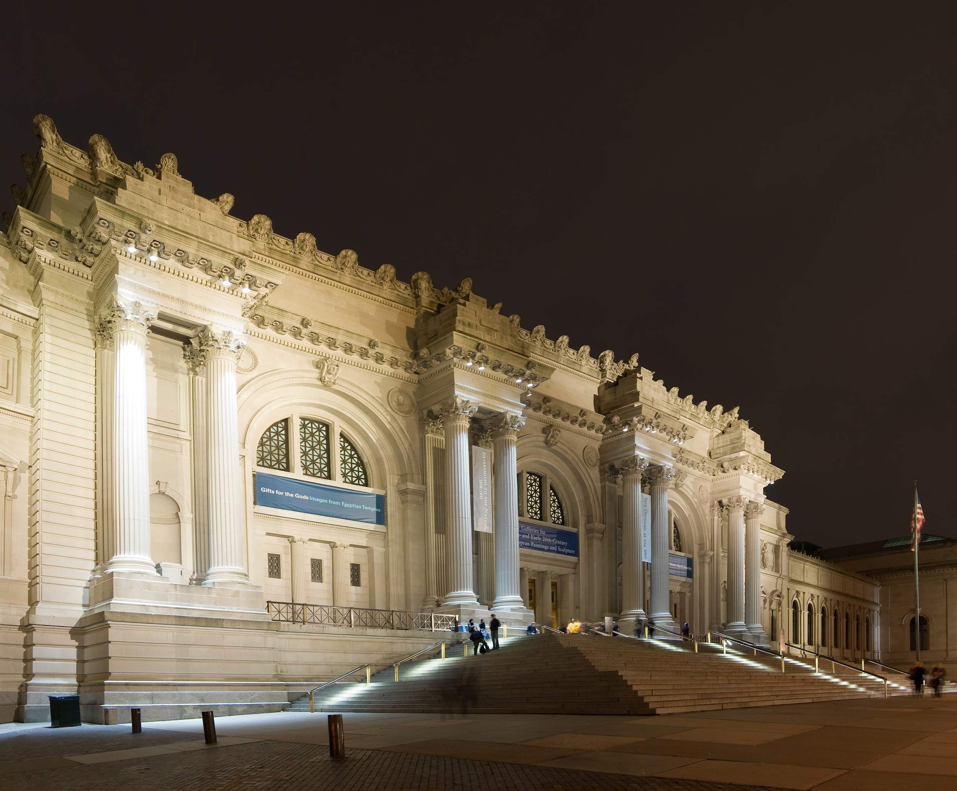



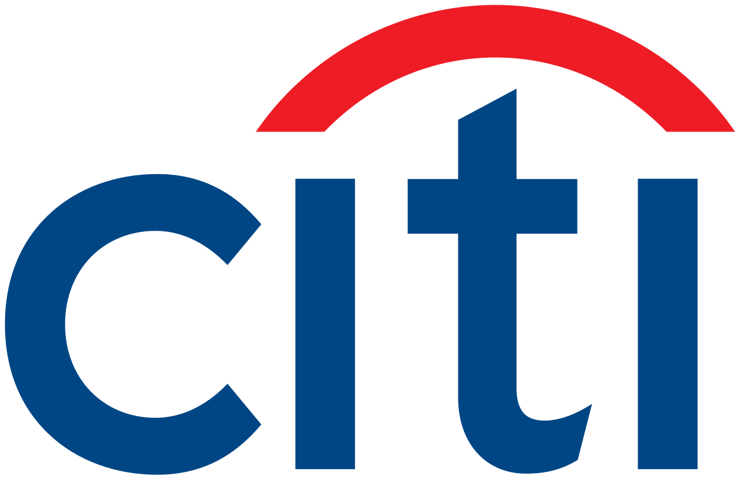
The Metropolitan Museum of Art- New York, USA
The MET Donors
Board members (trustee):
Candace K. Beinecke- Co-Chair
Hamilton E. James- Co-Chair
Richard L. Chilton Jr.- Vice Chair
Morgan Stanley
Visitors per year:
1.9 Million (as of 2021)
"Metropolitan Museum of Art" by Fcb981 is licensed under CC BY 3.0
Source: The Met, Board of Trustees

Slide 9


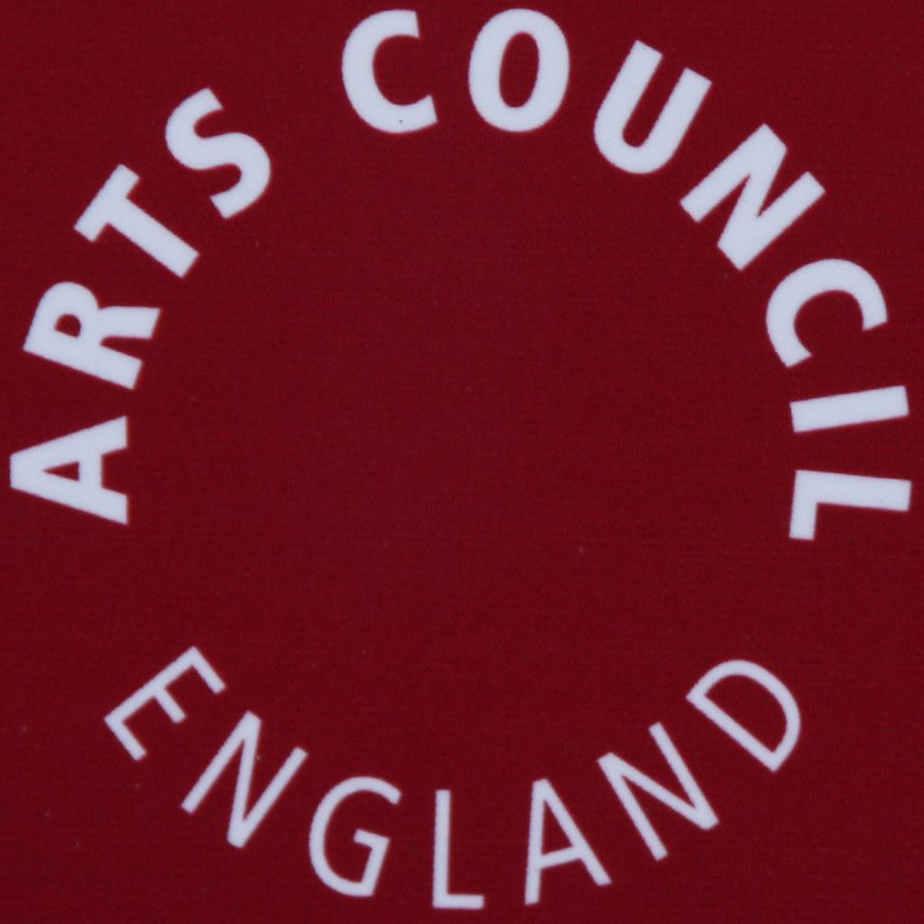
National Gallery- London, England
Board members (trustee):
John Booth- Chairman
Diana Berry
Catherine Goodman LVO
Katrin Henkel
Sir John Kingman KCB FRS
National Gallery Donors
Howard and Roberta Ahmanson
Visitors per year:
2.1 Million
The Aldama Foundation
Source: The National Gallery, Board of Trustees, Annual report
"National Gallery" by Maurice is licensed under CC BY 2.0

Slide 10
Things to consider…
We were able to easily get information on donors, board members and museum attendance on the internet for four of the biggest museums worldwide.
Access to donor information and exhibit information is limited when looking at Costa Rican museums.
Who really holds the power and say when it comes to what gets displayed or not displayed?

Slide 11
Where should art remain? In its home or in major museums worldwide that have searchable websites and welcome millions of visitors a year?
What are the pros and cons of returning art to where it is pillaged from?
Is it productive for museums to have more than European Art?
Discussion Activity
Split up into 2 groups:
Pros and Cons
Discuss the following questions:

