Slide 1
Thuc Thao Vy Tran
ASN 114 - Artifact Archive

Slide 2
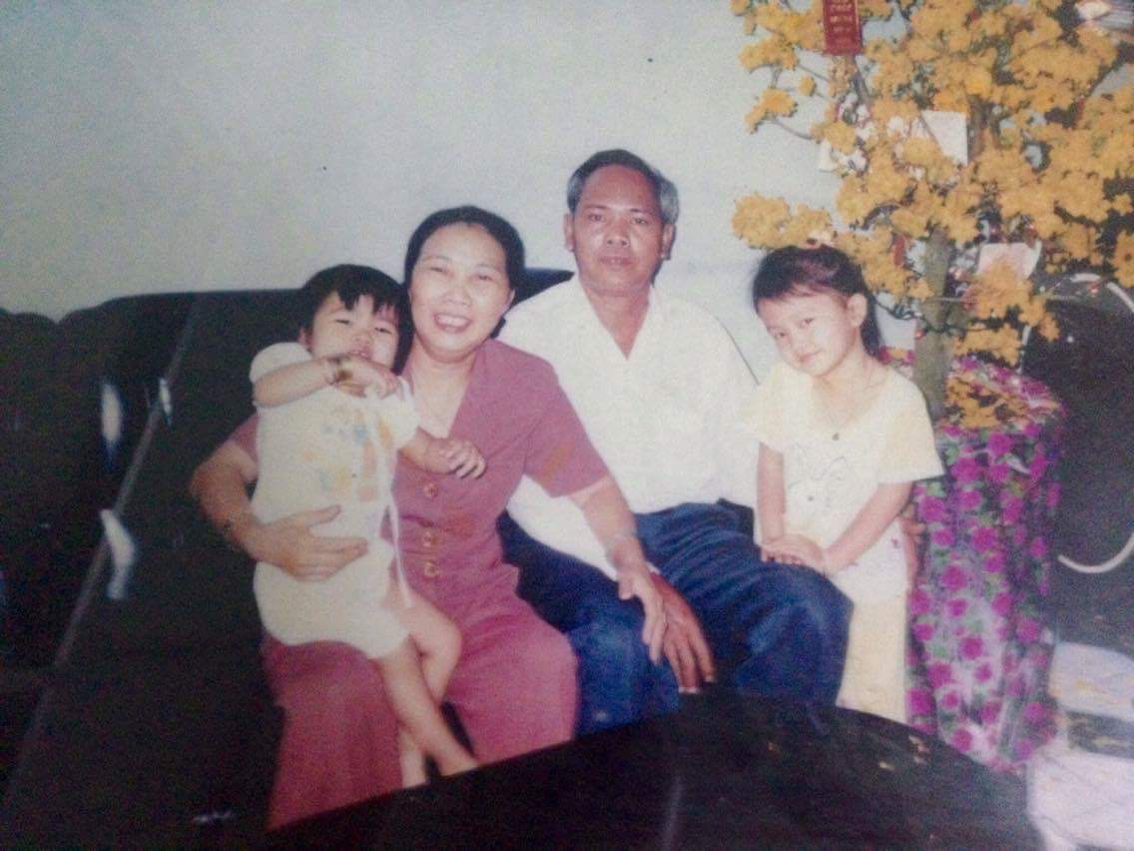
I have had the opportunity to interview my friend. She is also a migrant and she is also Asian and she lives with her family, she has also been to the US for 6 years. Her name is May and this is a symbolic picture of her grandparents, her grandparents who sponsored her family to go to America. Her grandparents are arguably the first to know what immigration and migration are!
And the reason they emigrated to the United States at that time was because they realized they could not grow in Vietnam and because at that time there were a lot of thoughts that America was a "heaven" and so in At that time many Asians were thinking about emigrating to the US, but it is extremely difficult to be legal in the US. For she says: "I am a yellow person, of course all countries live in the same environment, the discrimination is inevitable", it may have been easier for the United States to allow Asians to immigrate to the United States, but the perception about skin color and ethnicity remains.
Immigration and color have never been gone, it's just that life is changing gradually. Things are getting better, so things are getting easier with the immigration and migration of Asians.

Slide 3
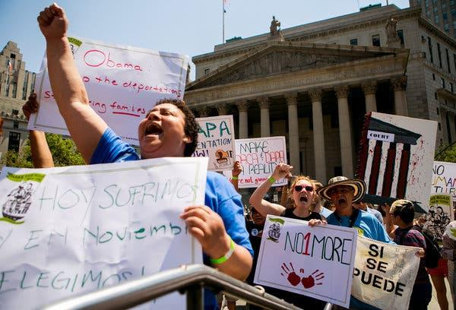
On June 24, 2016 by Liz Robbins, they held hand-painted signs of protest. “We’re all immigrants,” one sign said in Chinese. “We want to see comprehensive immigration reform” another said in Korean. Not so pithy, but present. Asian immigrants and their advocates say they are used to being a minority within a minority at rallies such as these, and Friday’s gathering, organized by the immigration rights group Make the Road New York was no different. The small band from the MinKwon Center for Community Action, a predominately Korean advocacy group that also serves the Chinese community in Flushing, Queens, was but a fraction of the 100 protesters.
In New York City, more than 220,000 immigrants would have been eligible for temporary protection from deportation under the president’s executive actions, which included a protection for parents with children who are American citizens or permanent residents. According to the Mayor’s Office of Immigrant Affairs, about 11 percent of those eligible were born in Korea or China.

Slide 4
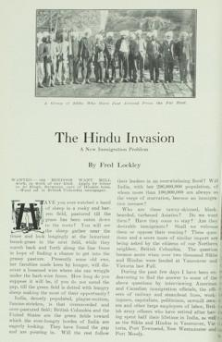
An article by the famous Oregon journalist Fred Lockley from the May 1907 issue of Pacific Monthly about the threat of "Invasion of the Hindus" in the US and Canada.
In this article there are some quotes about the Mayor's appeal against the British colonial government. Lockley also includes quotes from Sergeant Singh, a Sikh and Ram Chand, a Brahmin, before concluding with a discussion of India's triple curse: caste, tribulation. hunger and disease. Includes eight unique photos of East Indian workers, captioned as follows: " The Chinese team, Japan and East India at the Mill in New Westminster "," The Hindus in the Detention Center, awaiting the discontent question of their admission into British Columbia "," Sikhs and Christians Hindus are employed in the factory "," Two Sikhs wear a dress. "
https://www.saada.org/sites/all/themes/saada/bookreader.php?title=RnJlZCBMb2NrbGV5LCAmcXVvdDtUaGUgSGluZHUgSW52YXNpb246IEEgTmV3IEltbWlncmF0aW9uIFByb2JsZW0mcXVvdDsgKDE5MDcp&folder=MjAxMi0wMA==&object=aXRlbS1sb2NrbGV5LWludmFzaW9uLQ==&pages=MTI=#page/1/mode/1up

Slide 5
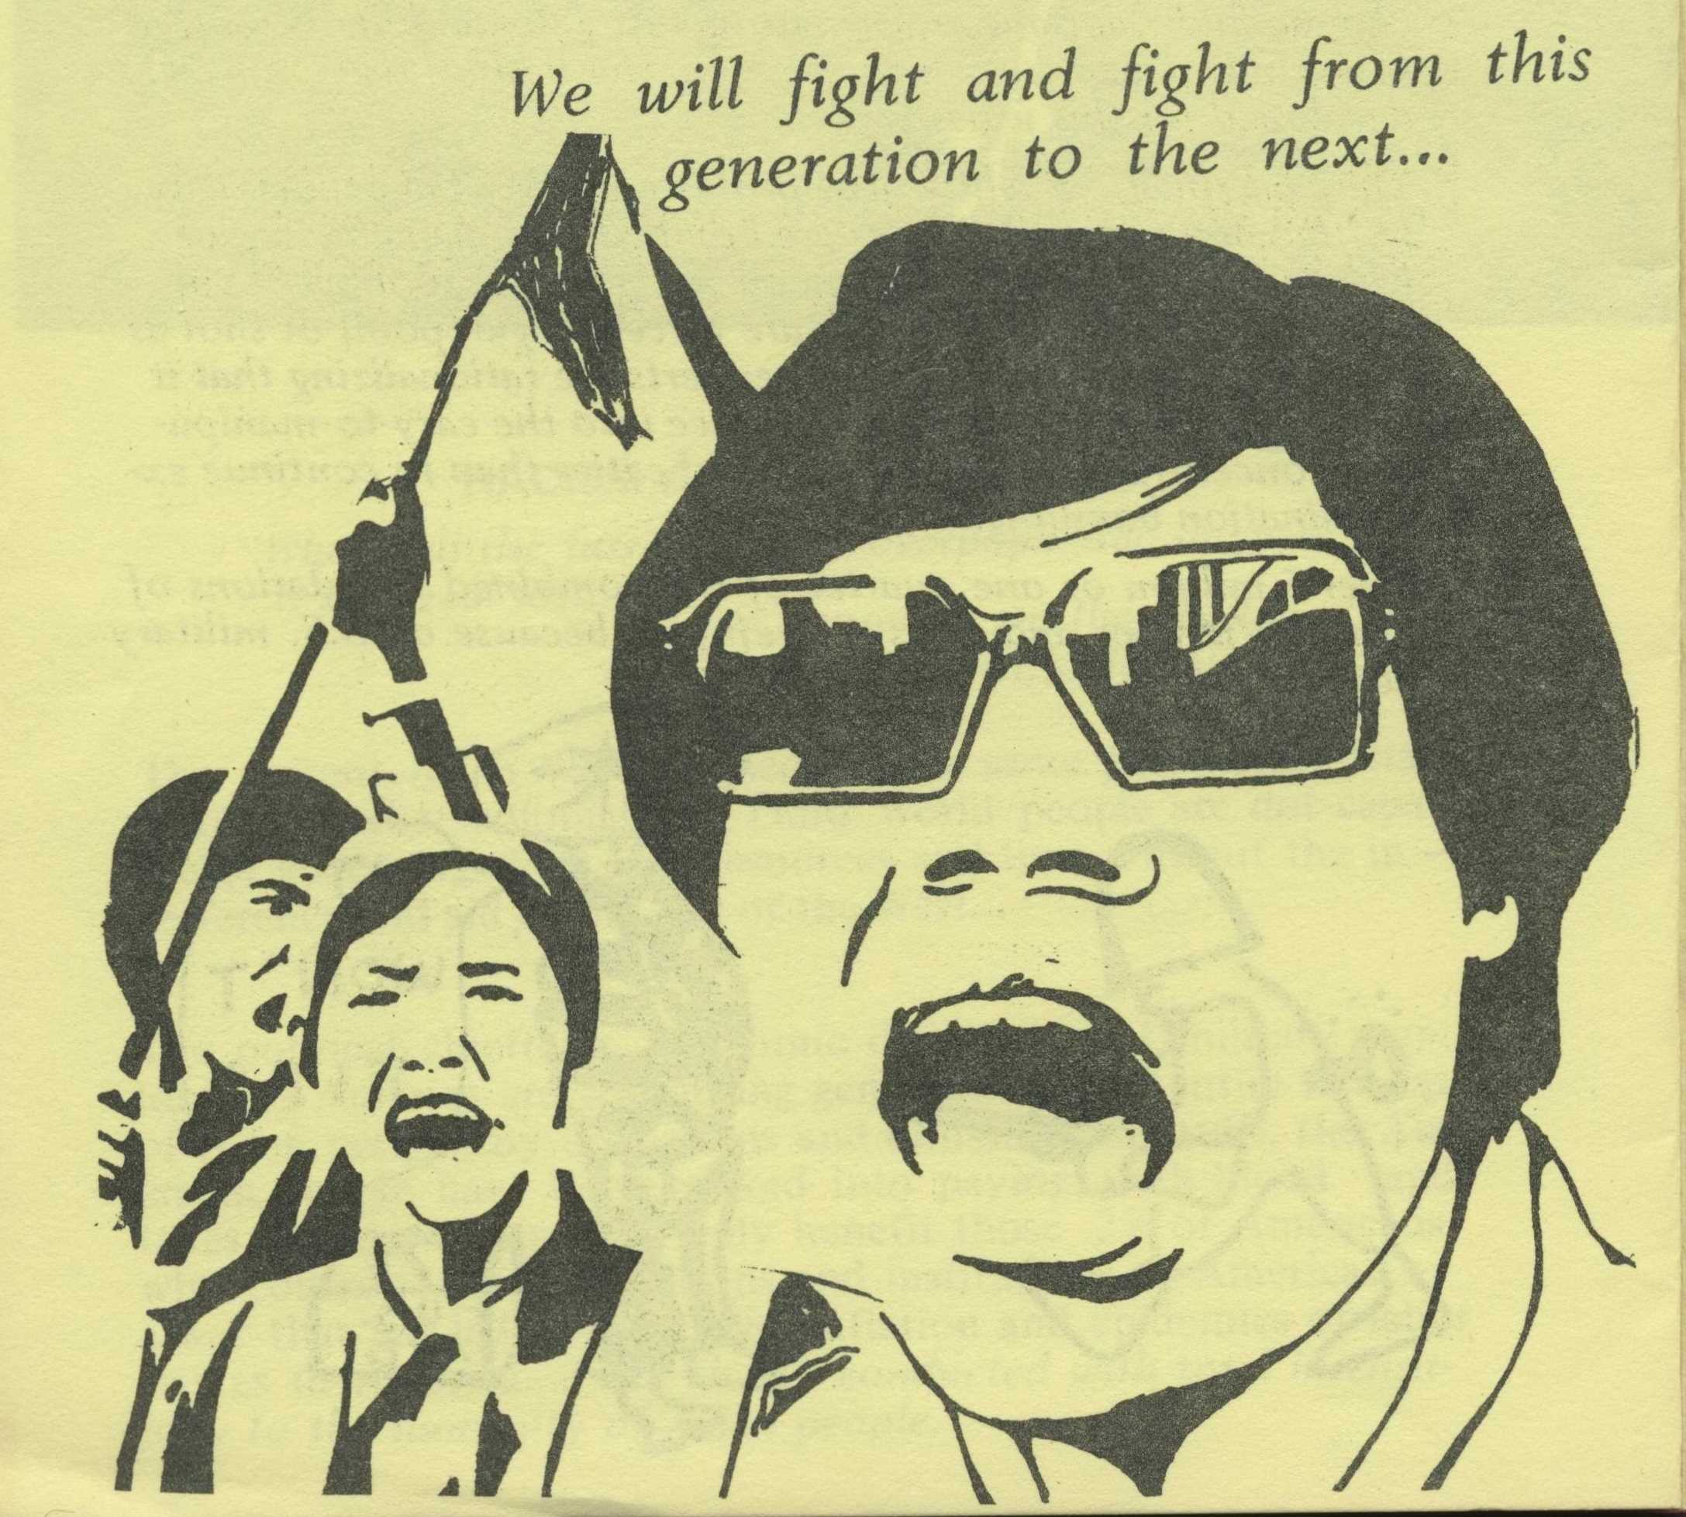
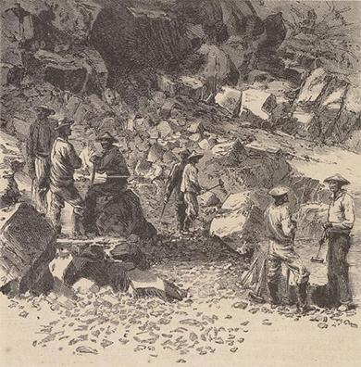
The initial arrival of Chinese immigrants to the United States began slowly in the 1820s, with only 650 Chinese immigrants living in the United States at the end of 1849. But when the gold rush swept through the land China immigrants were attracted by this notion of rapid fortune. By 1852, more than 25,000 Chinese immigrants had arrived in the United States, and by 1880 more than 300,000 Chinese were living in the United States, mostly in California.
In 1790, banned by law from US citizenship, Chinese immigrants faced severe discrimination and violence from American settlers in the West. Despite difficulties such as the special taxes that Chinese miners pay to join the Gold Rush and their subsequent forced relocation to Chinese counties, these immigrants continue to travel to the United States in search of a better life for the family they left behind.
Racism and discrimination became law. The new California constitution of 1879 denied naturalized Chinese citizens the right to vote or hold state employment. Additionally, in 1882, the US Congress passed the Chinese Exclusion Act, which was the first significant law restricting immigration into the United States. It restricted immigration from China for ten years. The ban was later extended on multiple occasions until its repeal in 1943.

Slide 6
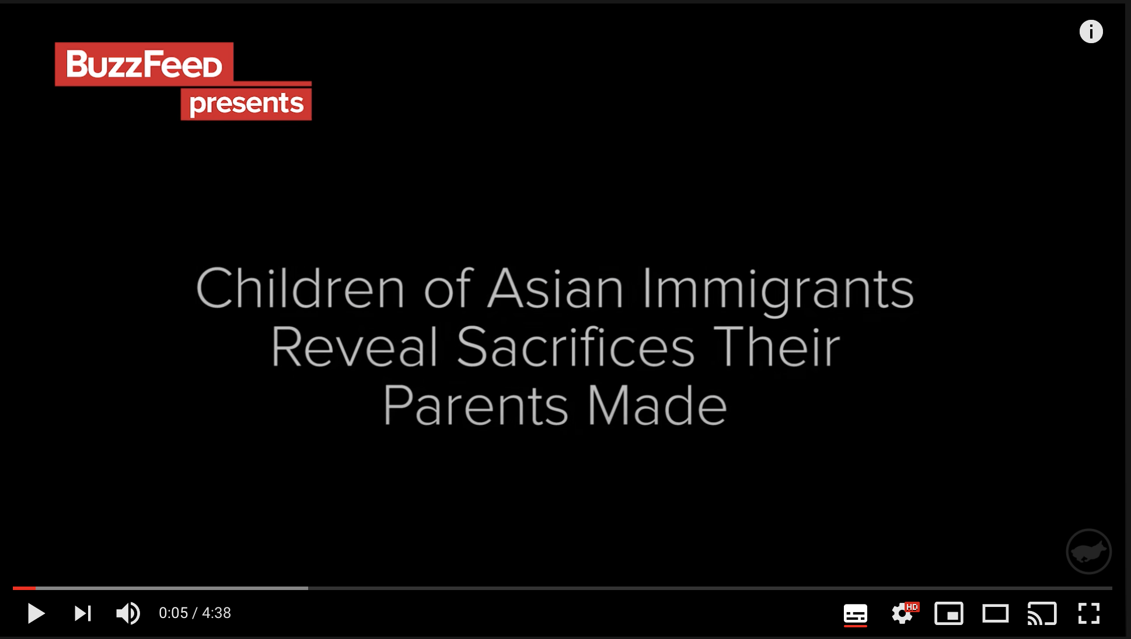
https://www.youtube.com/watch?v=k1lDX0lzhd4

