Slide 1

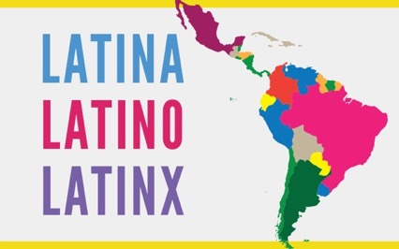
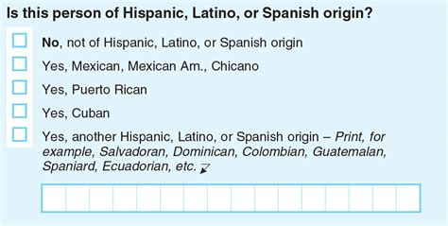
LATINX

Slide 2
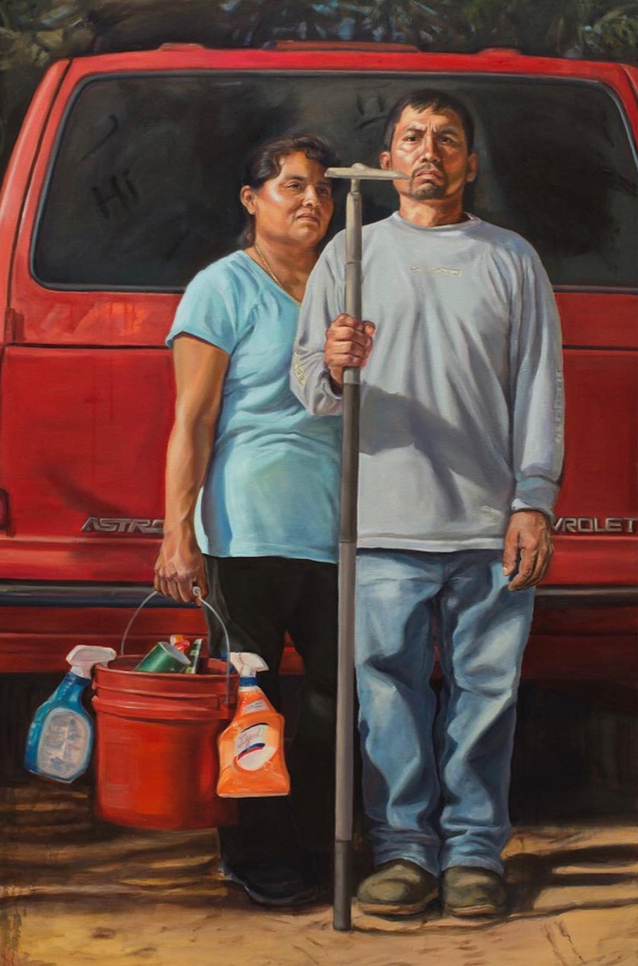
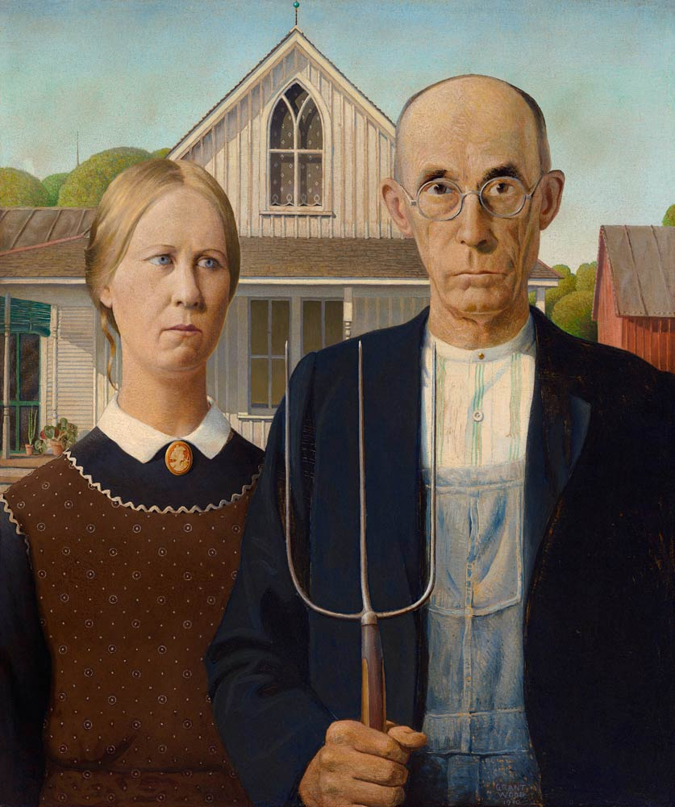
Criselda Vasquez, The New American Gothic, 2017

Slide 3
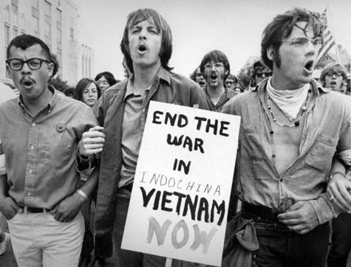
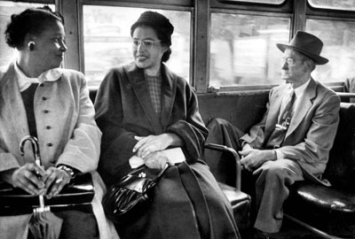
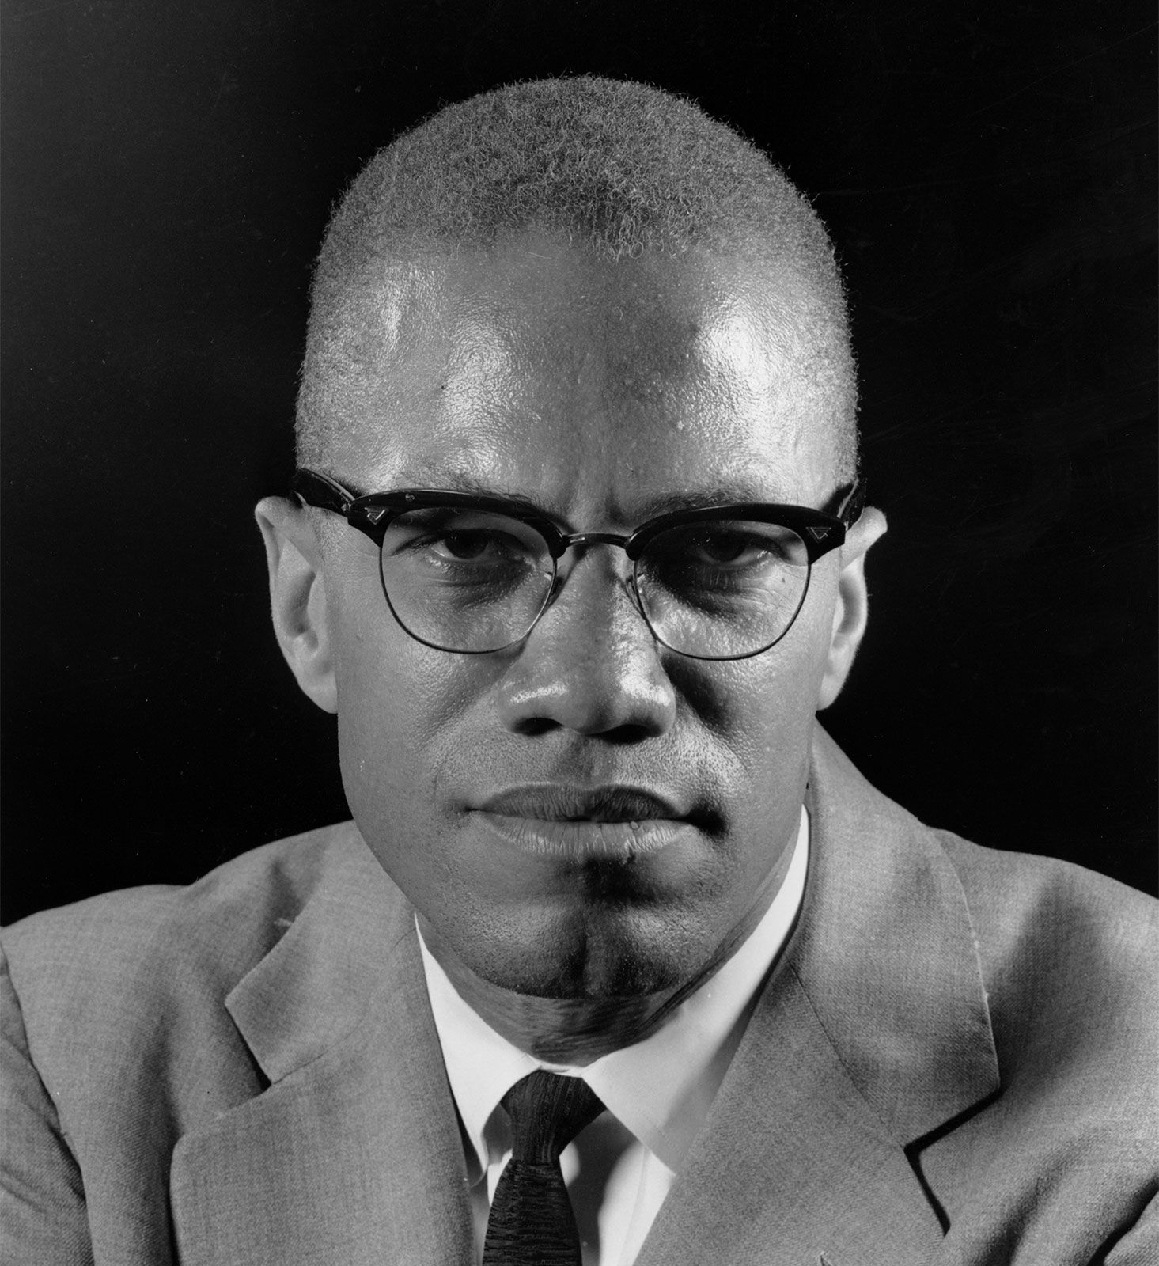
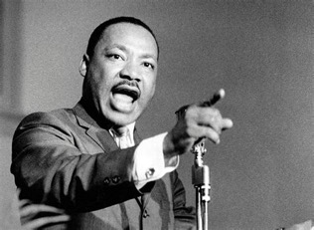
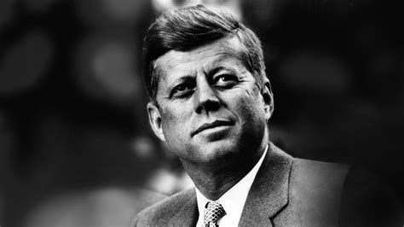
Vietnam War Protest
Civil Rights Movement
Assassination of John F. Kennedy, Malcolm X, and Martin Luther King

Slide 4
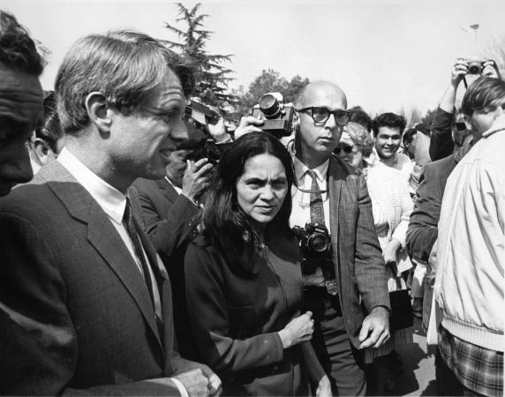
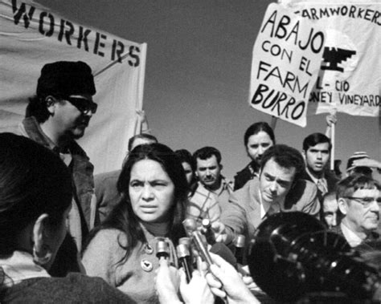
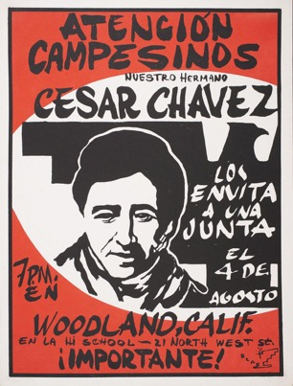
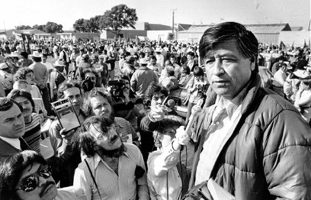
Dolores Huerta and Cesar Chavez
-United Farm Workers of America, founded in 1962
-California Agricultural Labor Relations Act of 1975

Slide 5
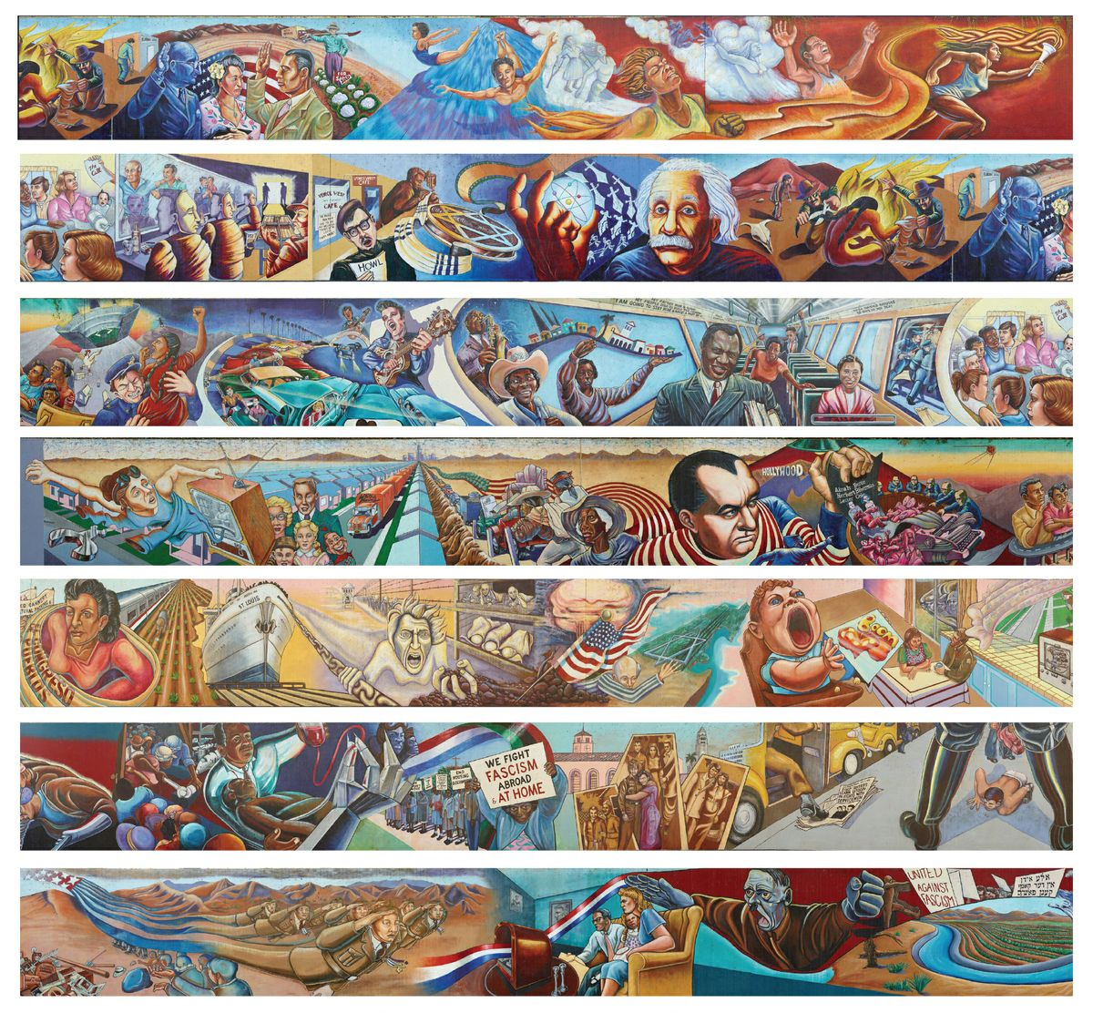
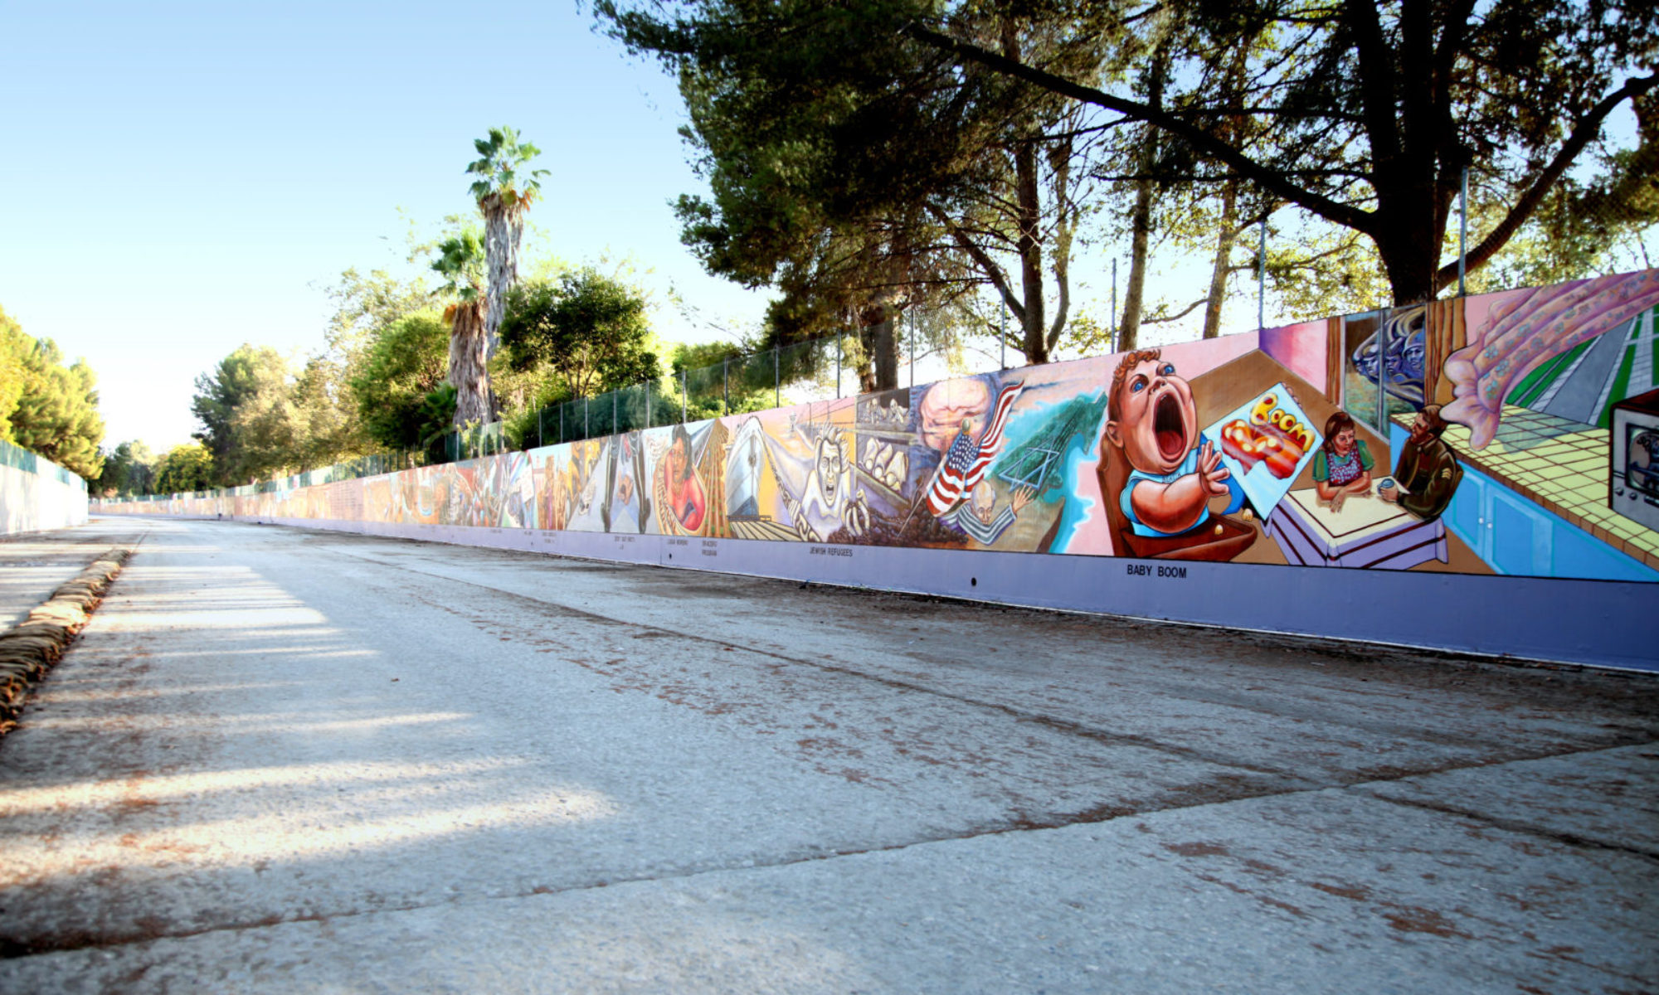
Judy Baca, in collaboration with SPARC (Social and Public Art Resource Center), The Great Wall of Los Angeles, 1976-1983

Slide 6
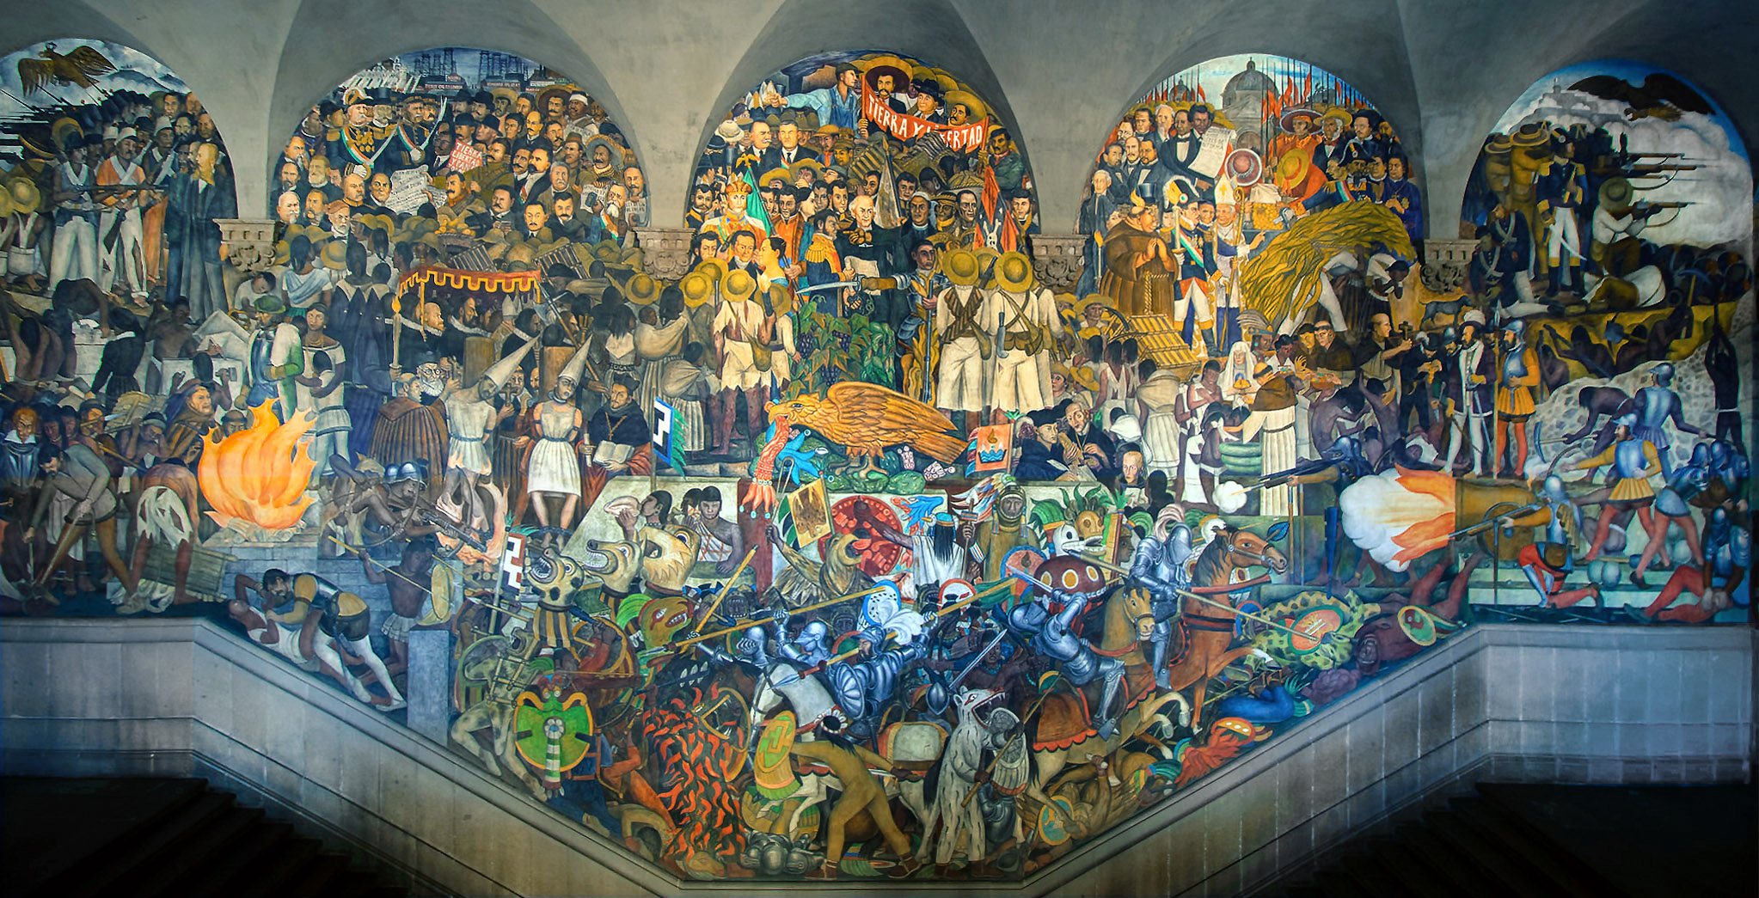
Compare and contrast these murals. How do they depict Mexican ancestry? How do they (re)define muralism?

Slide 7
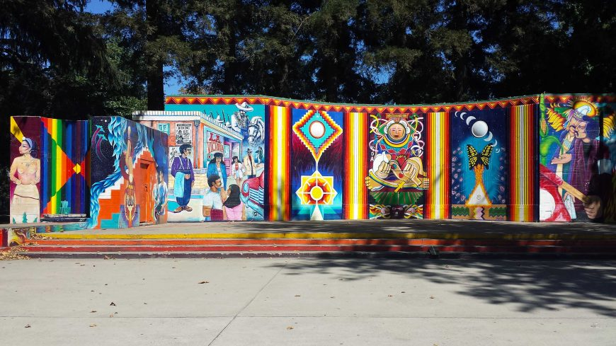
Royal Chicano Air Force, Southside Park Mural, 1977, Sacramento, CA

Slide 8
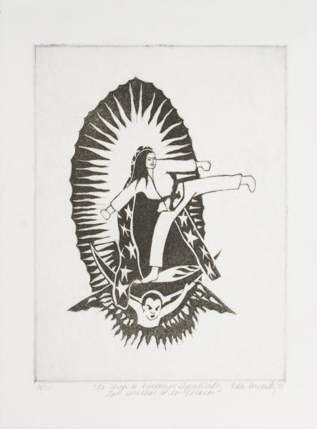
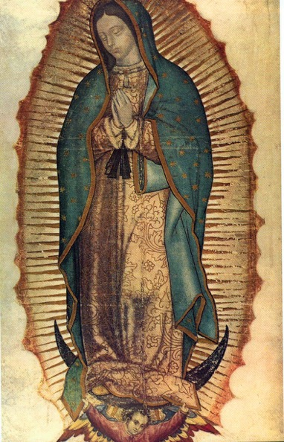
Hernández, La Virgen de Guadalupe Defendiendo los Derechos de los Xicanos, 1975

Slide 9
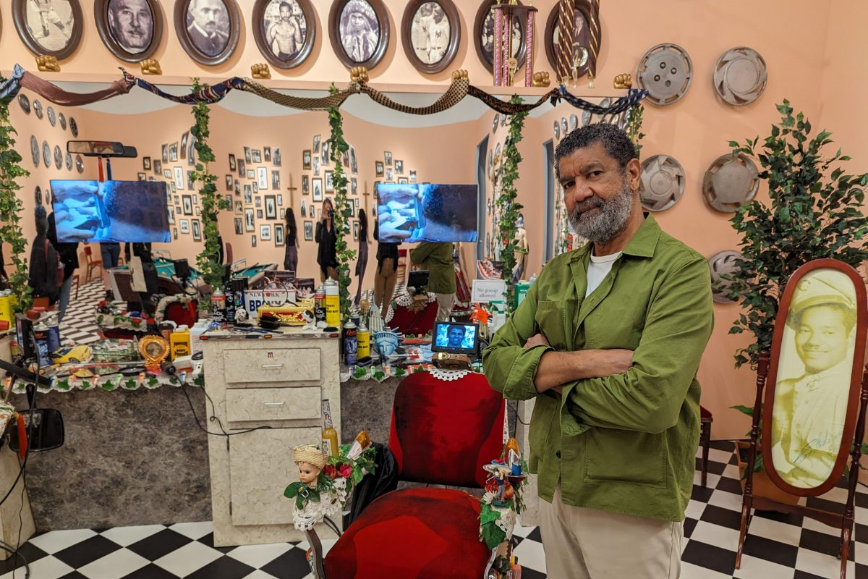
https://art21.org/watch/art-in-the-twenty-first-century/s1/pepon-osorio-in-place-segment/

Slide 10
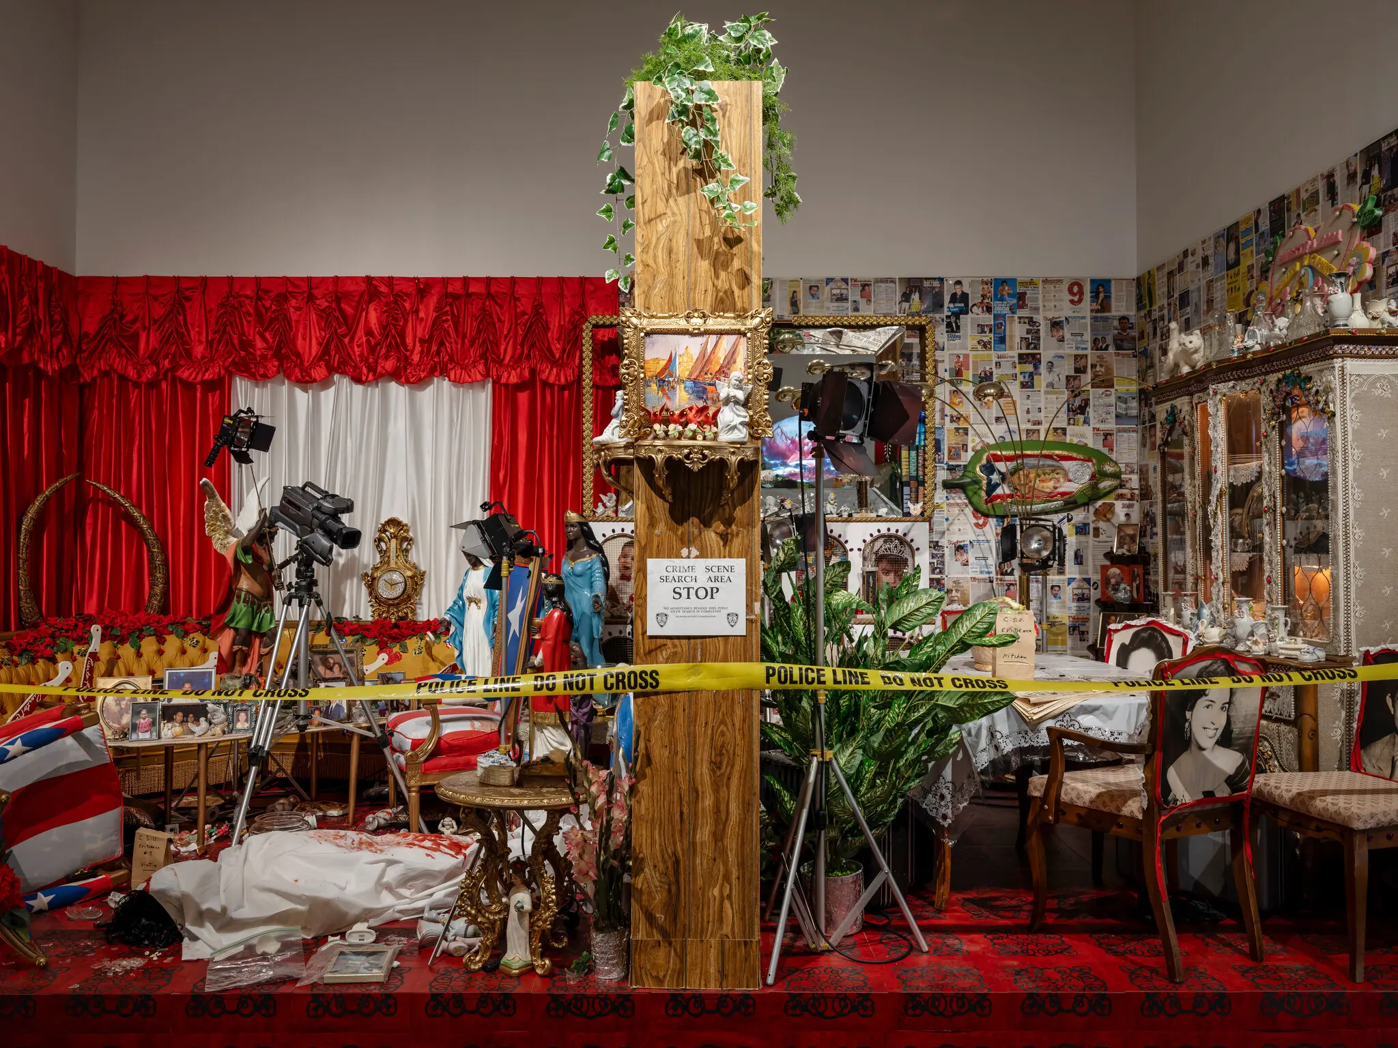
Pepón Osorio, Scene of the Crime, 1993

Slide 11
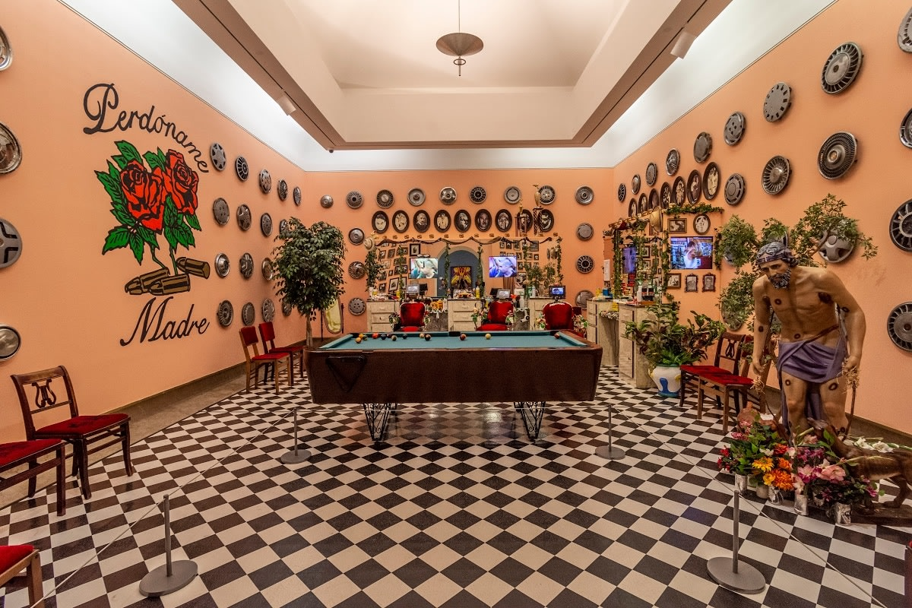
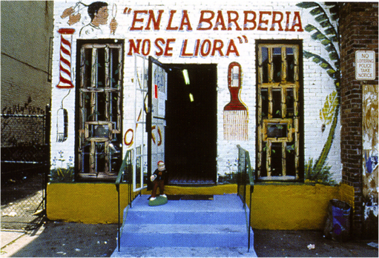
Pepón Osorio, En la barberia no se llora…, 1994

Slide 12
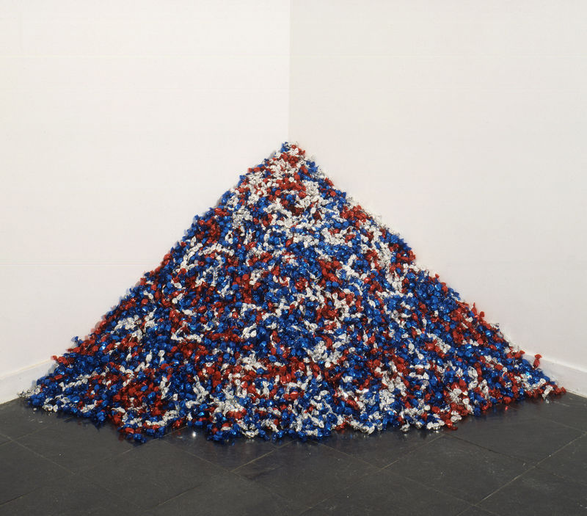
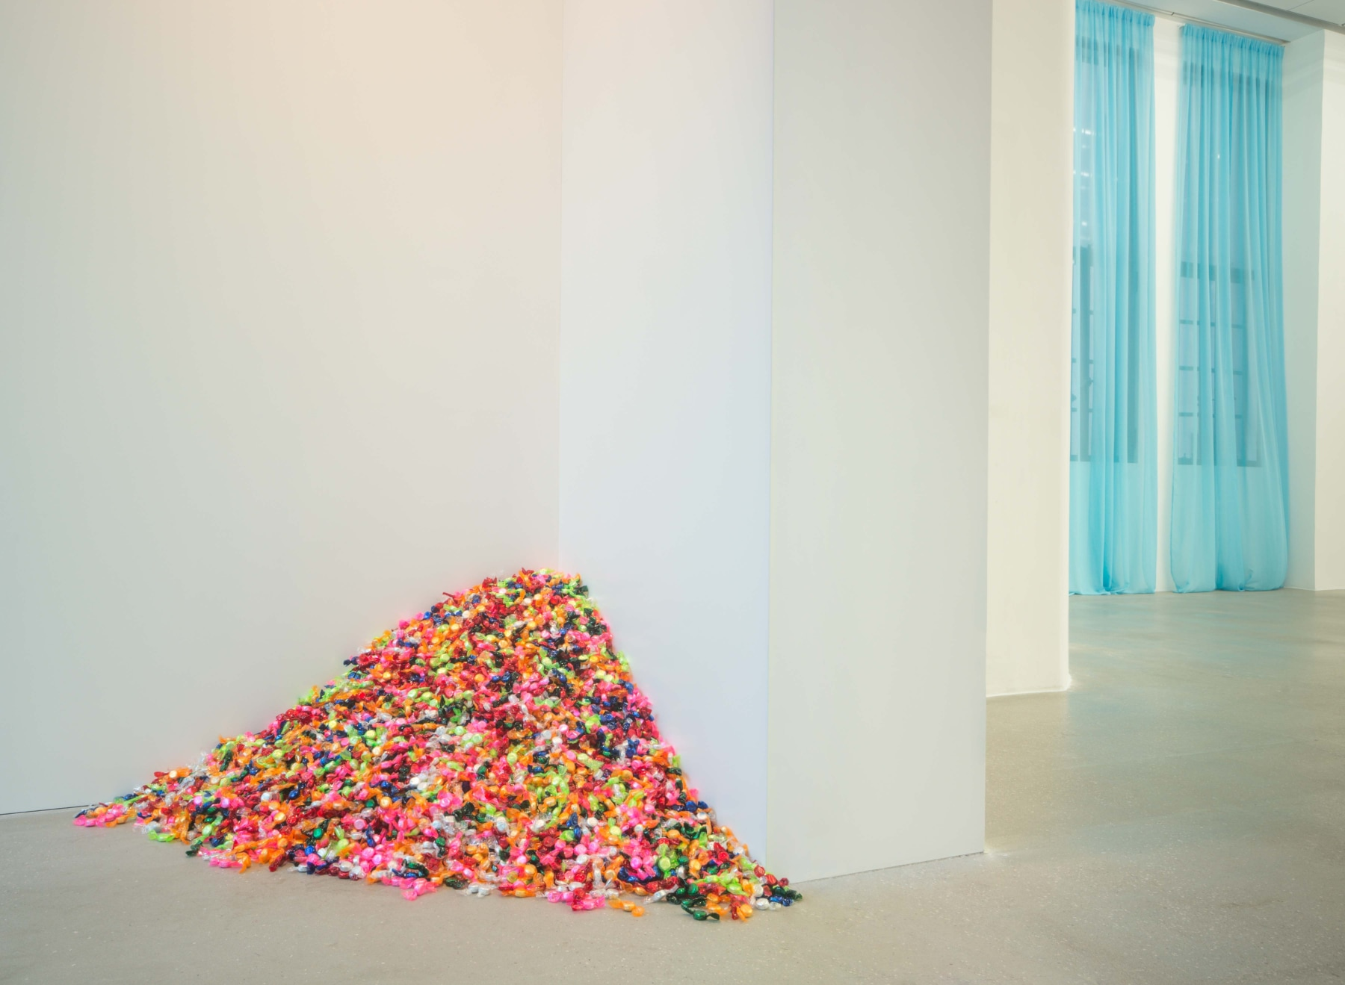
Gonzalez Torres, Untitled (USA Today), 1990
Gonzalez-Torres, Untitled (Portrait of Ross in L.A.), 1991
(AIDS Epidemic)

Slide 13
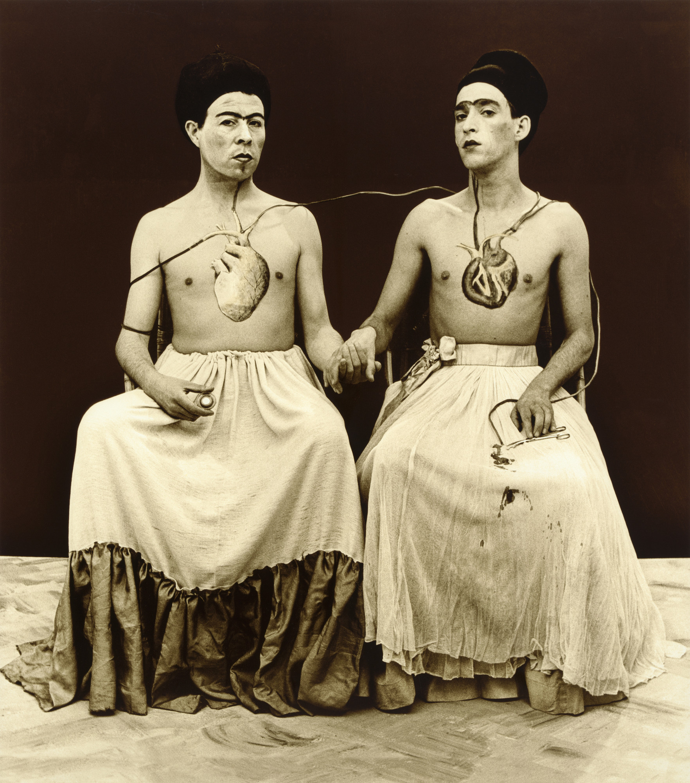
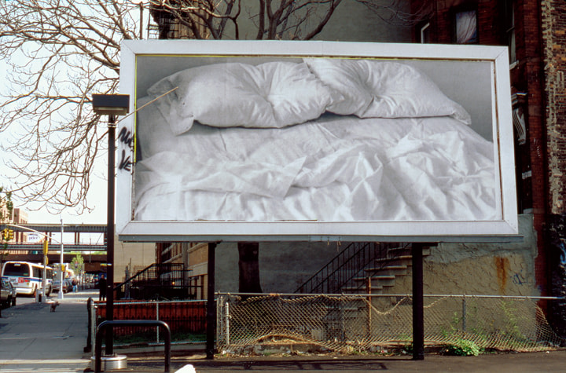
Gonzalez Torres, Untitled, 1991, Third Avenue and East 137th Street, Bronx, New York
Las Yeguas del Apocalipsis, Las Dos Fridas, 1989

Slide 14
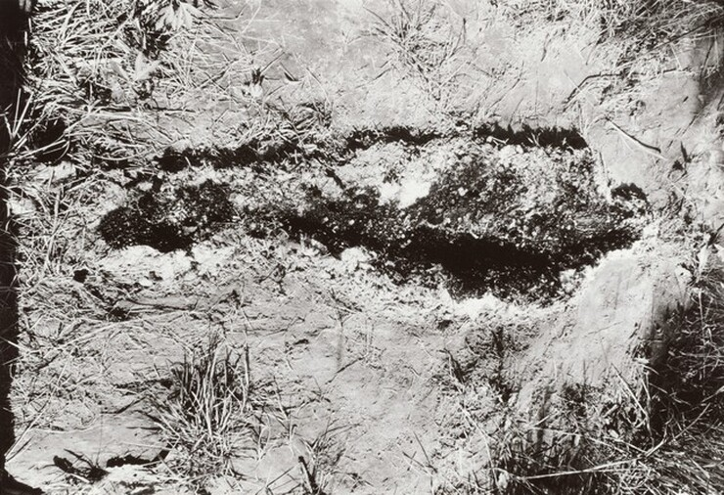
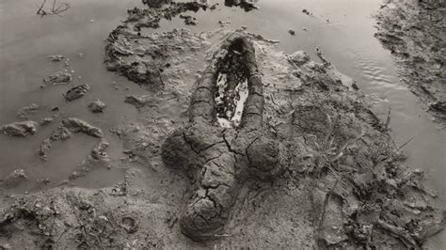
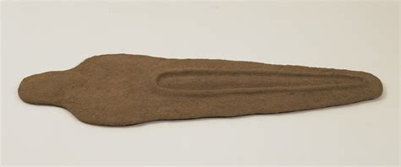
Ana Mendieta, Untitled, 1979, gelatin silver print

Slide 15
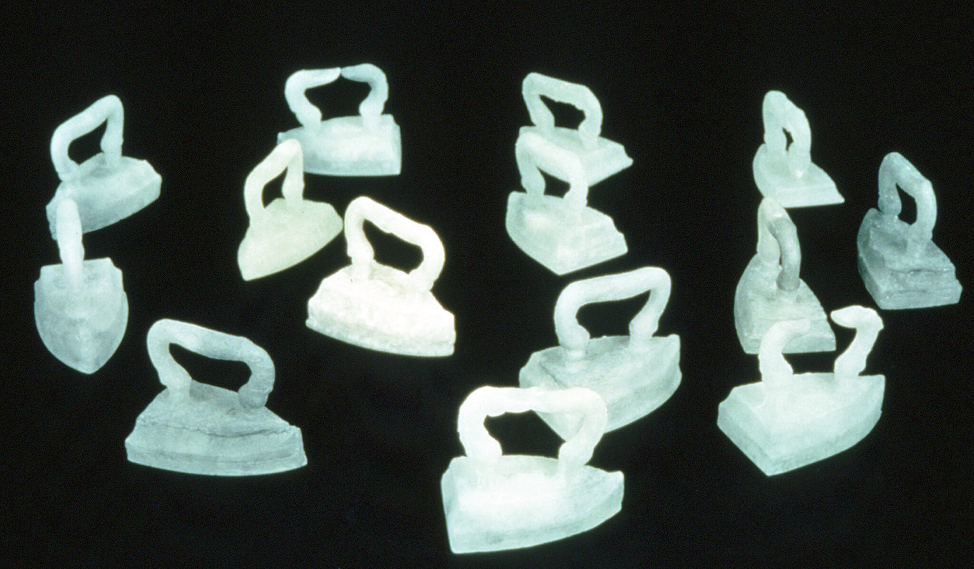
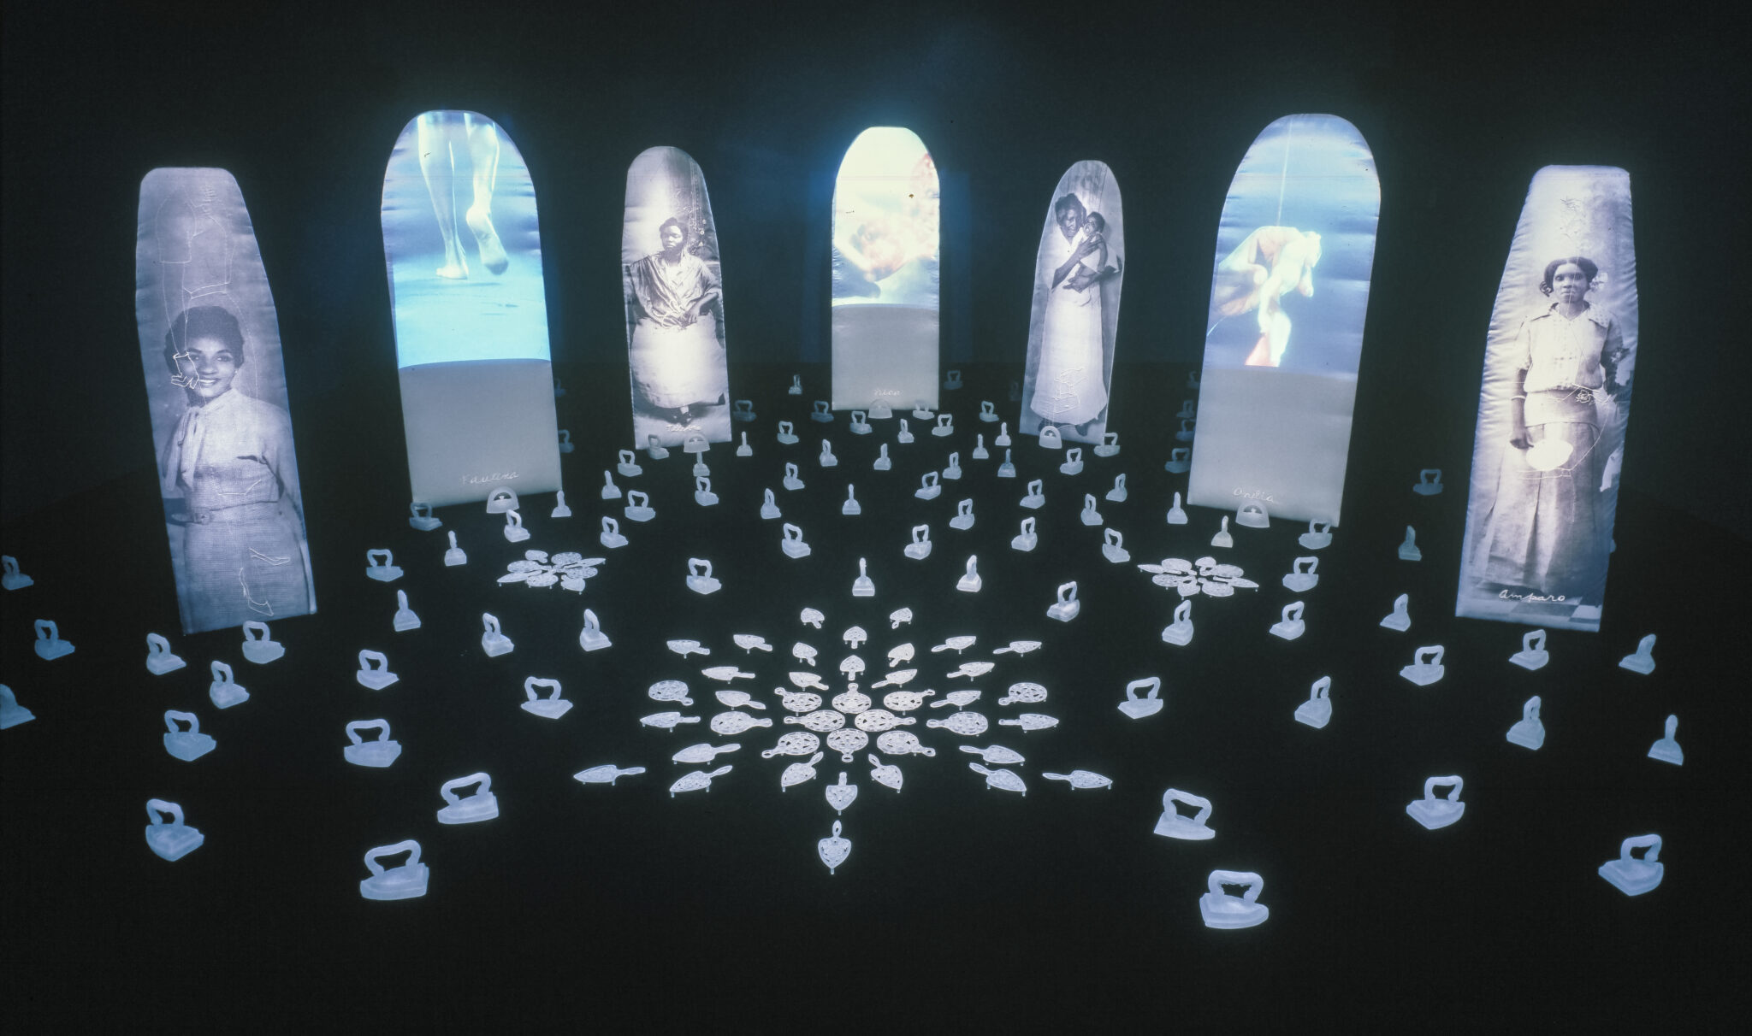
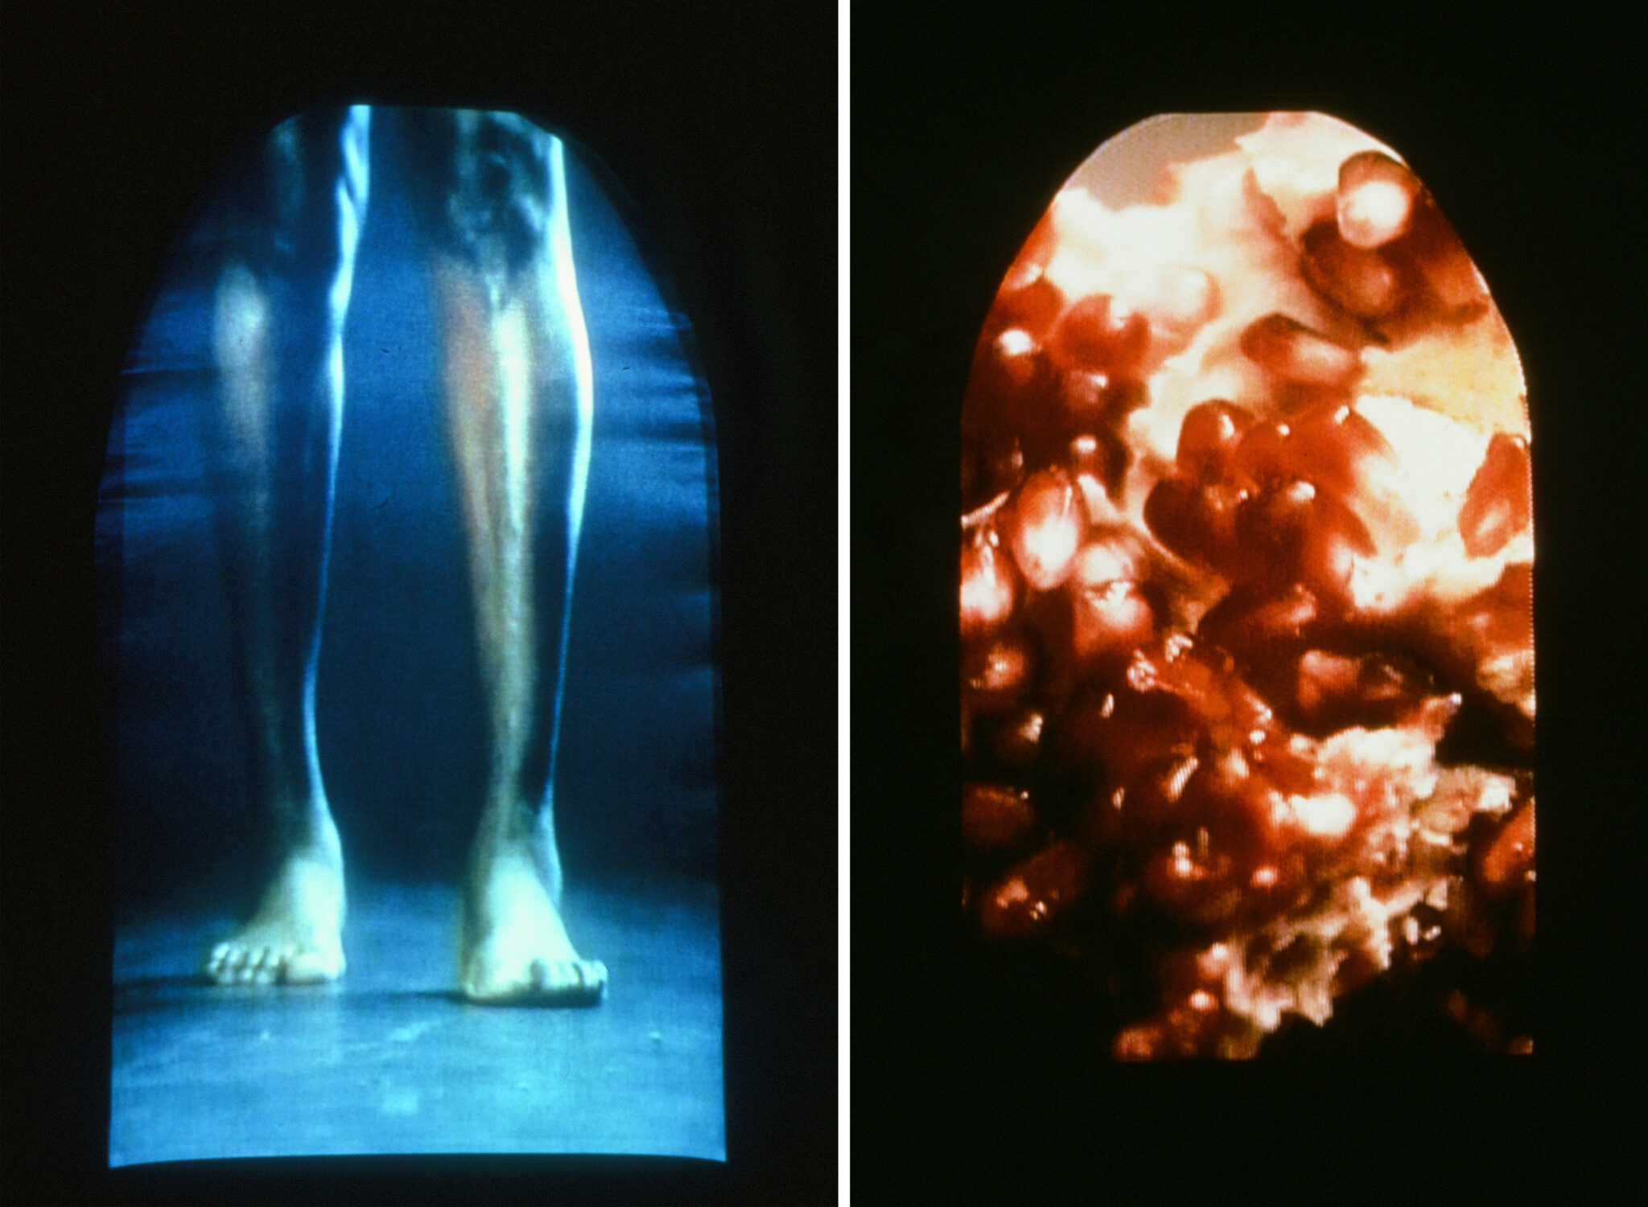
María Magdalena Campos-Pons, Spoken Softly with Mama, 1998

Slide 16
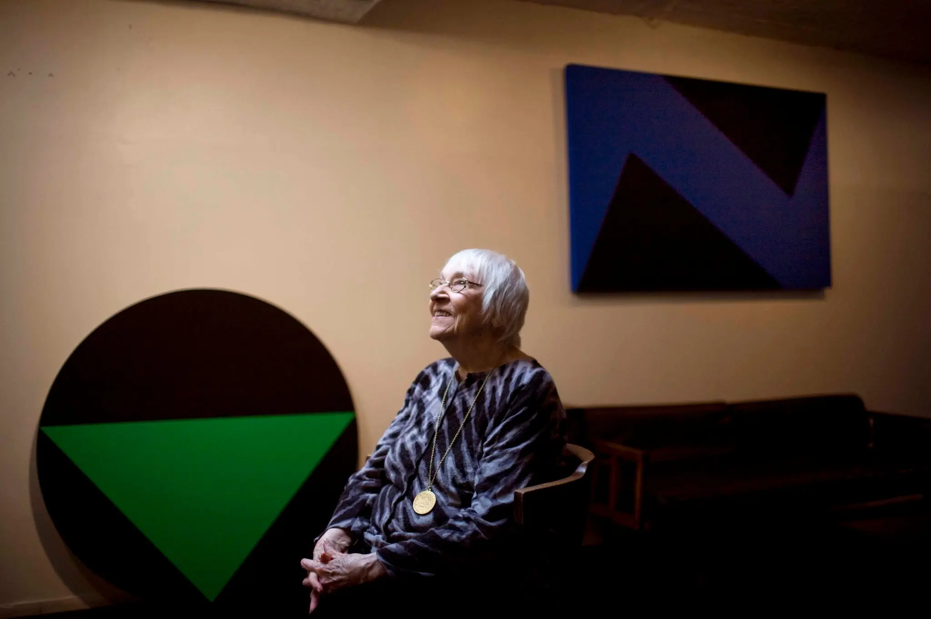

Slide 17
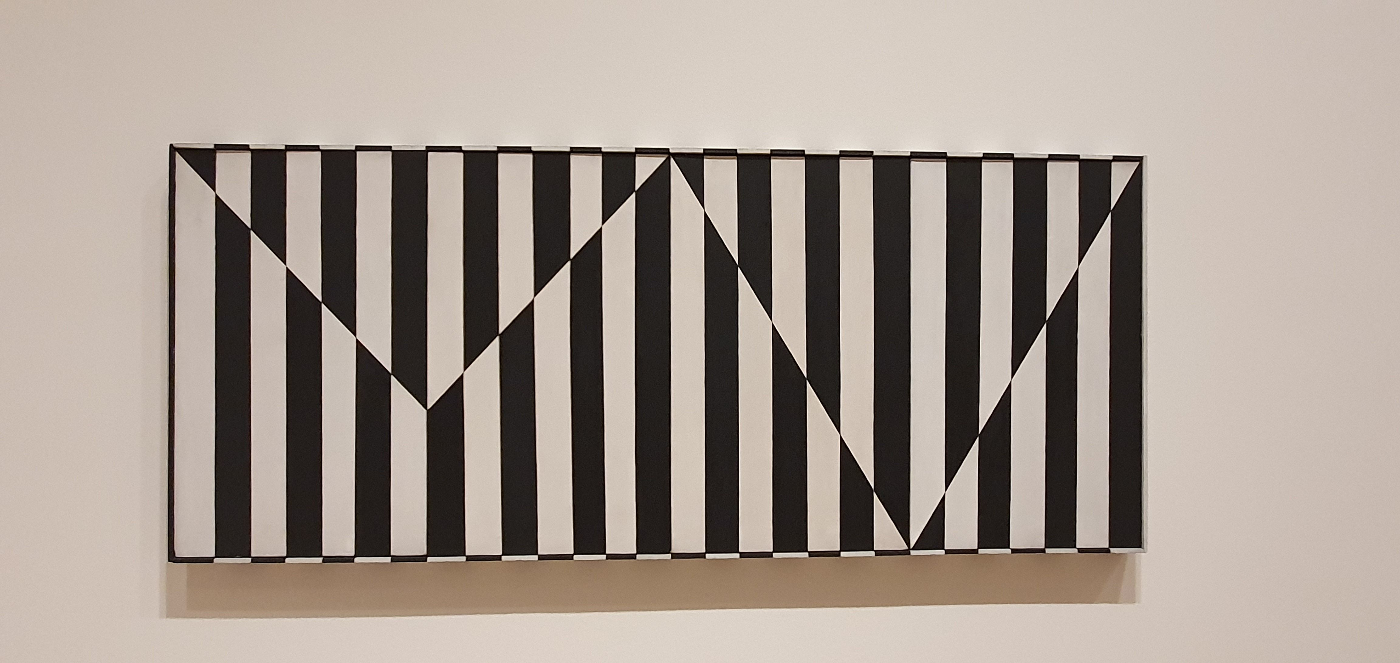
Carmen Herrera, Untitled, 1952

Slide 18
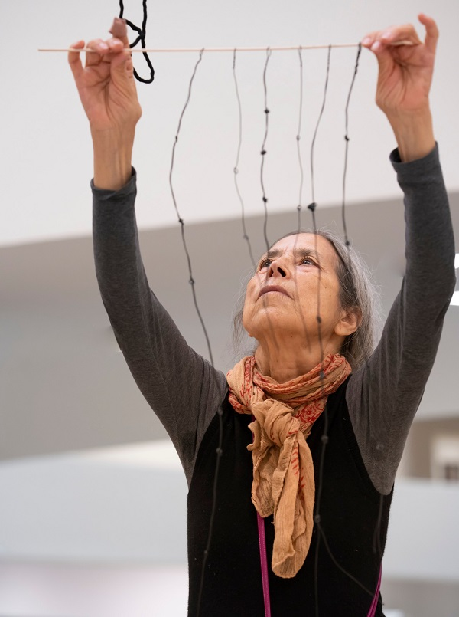
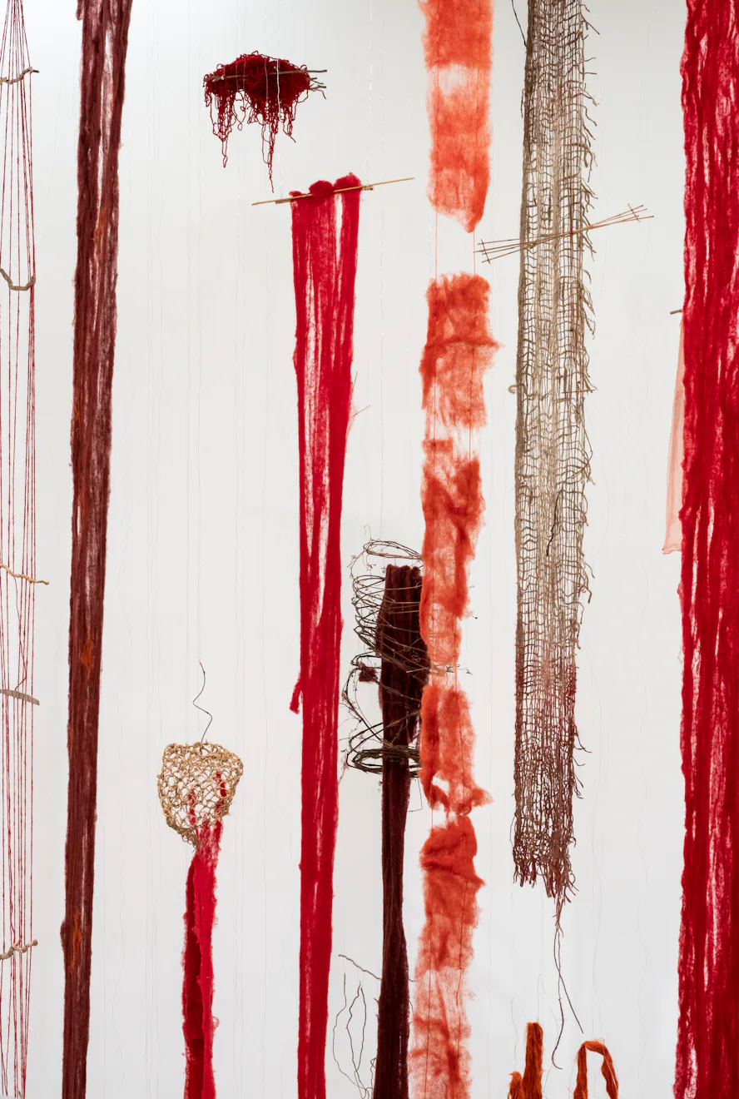

Slide 19
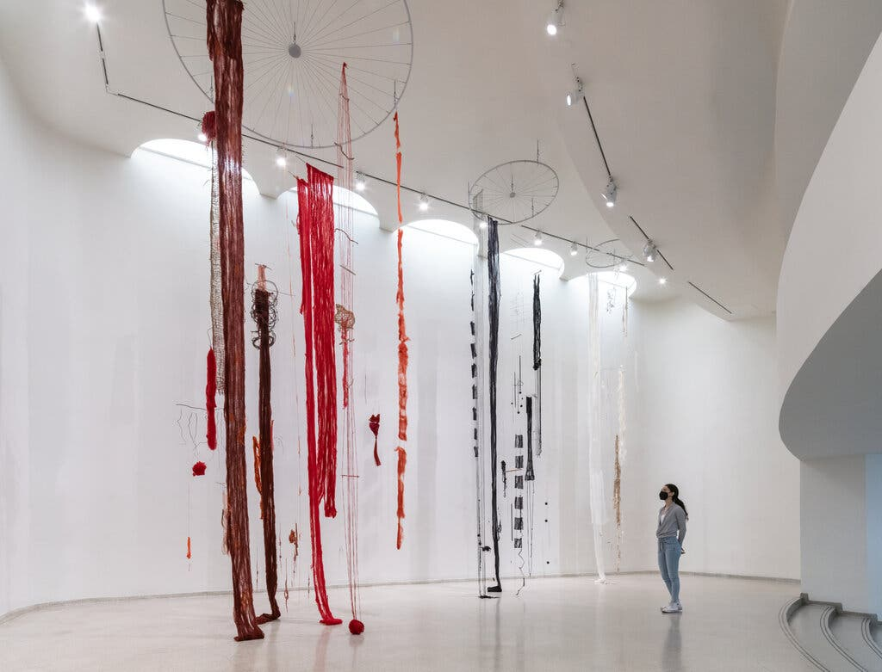
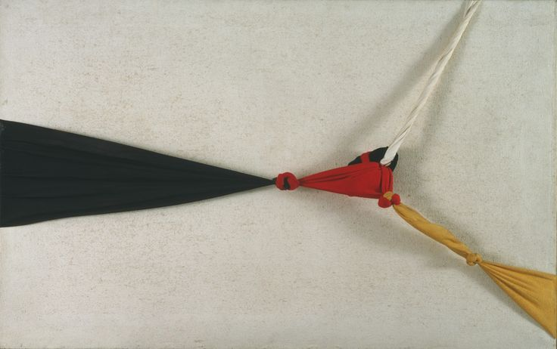
Cecilia Vicuña, Quipu del Exterminio/Extermination Quipu, 2022
Jorge Eilson, White Quipus, 1964

Slide 20
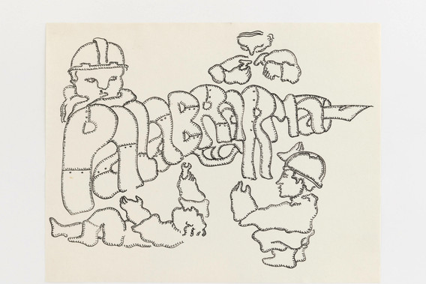
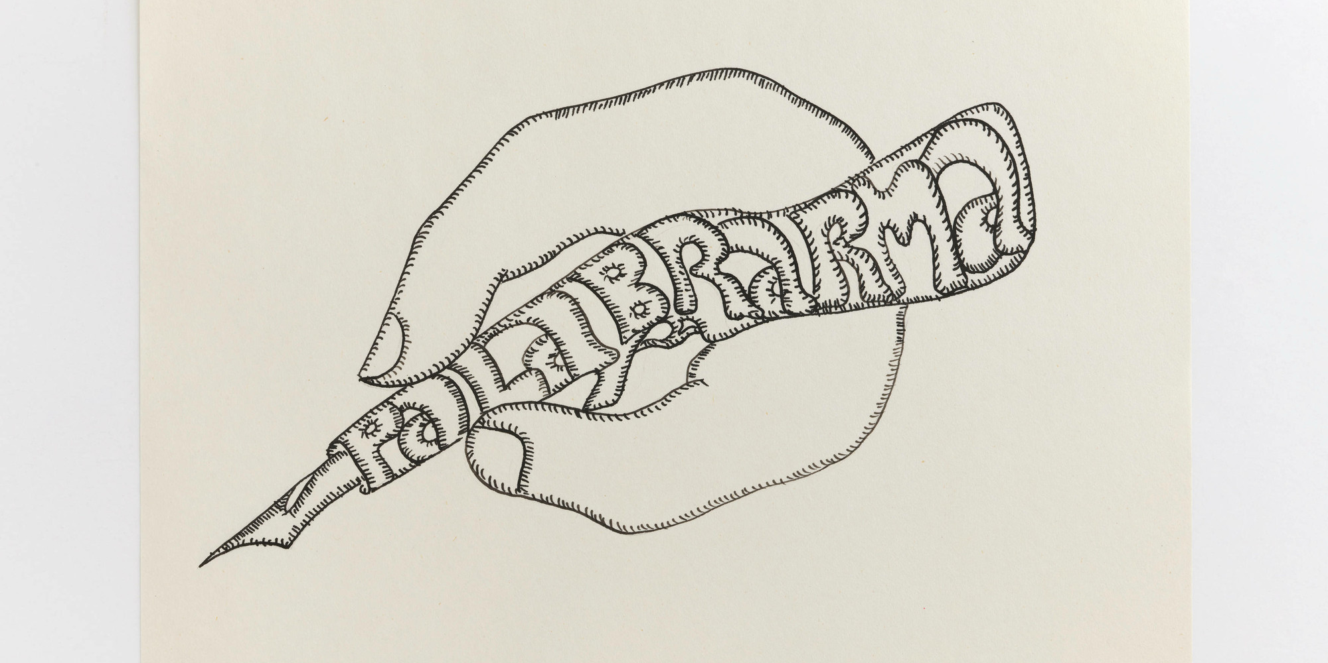
Cecilia Vicuña, “Palabrarma” from the series AMAzone Palabrarmas, 1978

