Slide 1
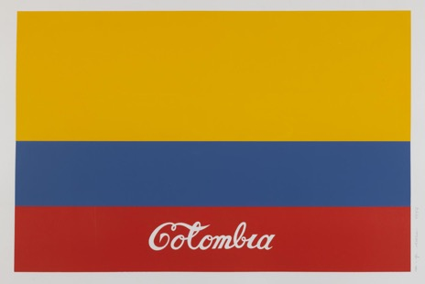

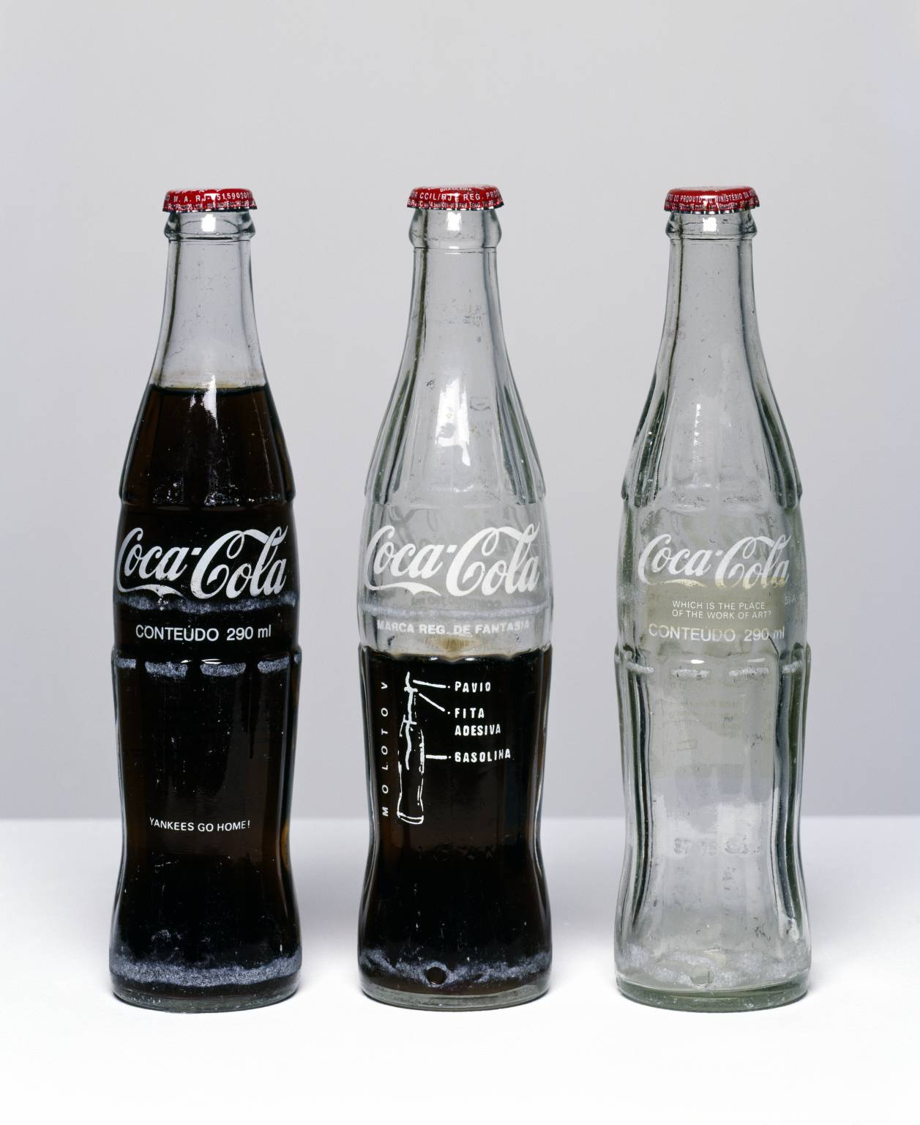
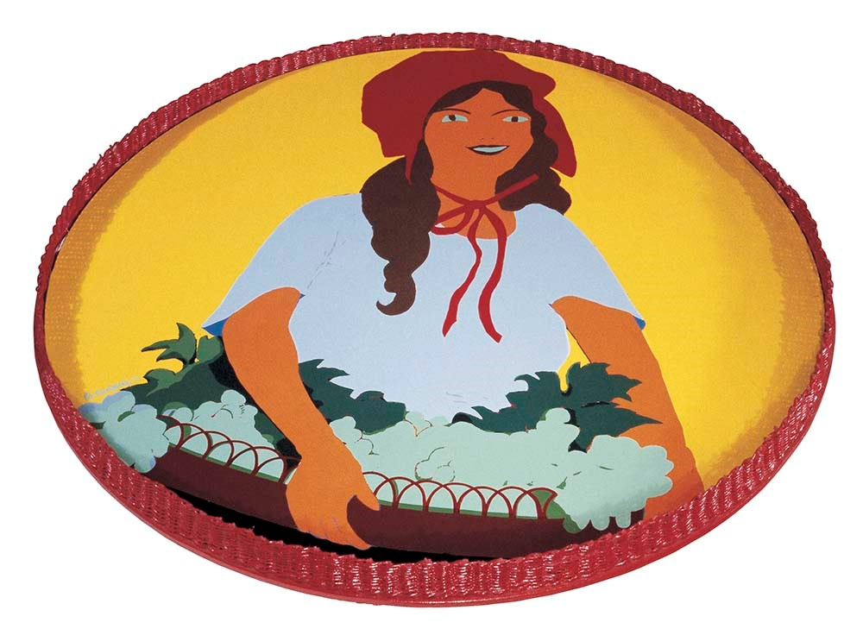
POP ART

Slide 2
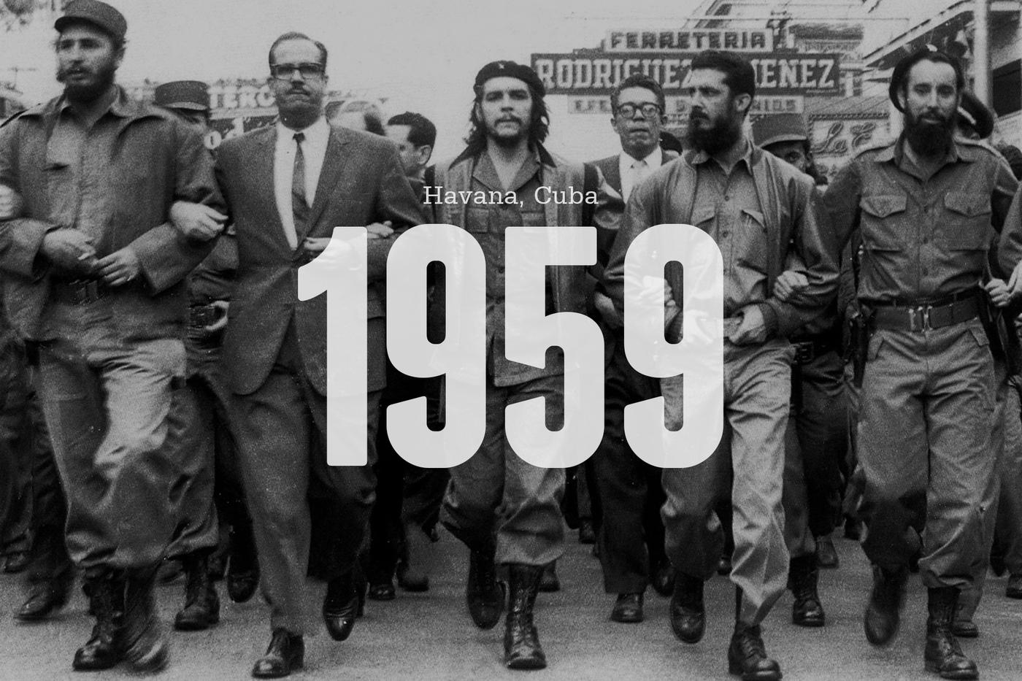
REVOLUTION
Cuban Revolution of 1959
Ernesto “Che” Guevara and Fidel Castro

Slide 3
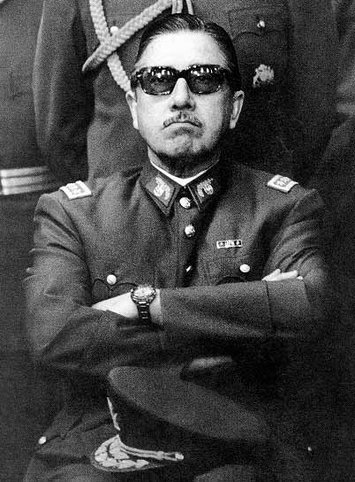
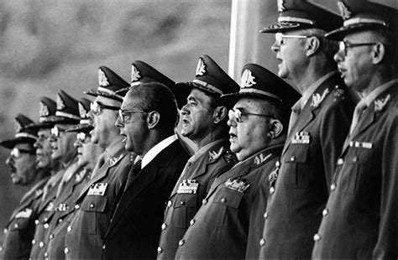
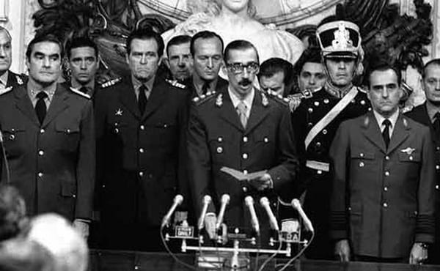
DICTATORSHIP
Brazil: Military dictatorship from 1964 to 1985
Chile: Dictatorship of Augusto Pinochet from 1973-1990
Argentina: Military dictatorship from 1976 to 1983

Slide 4
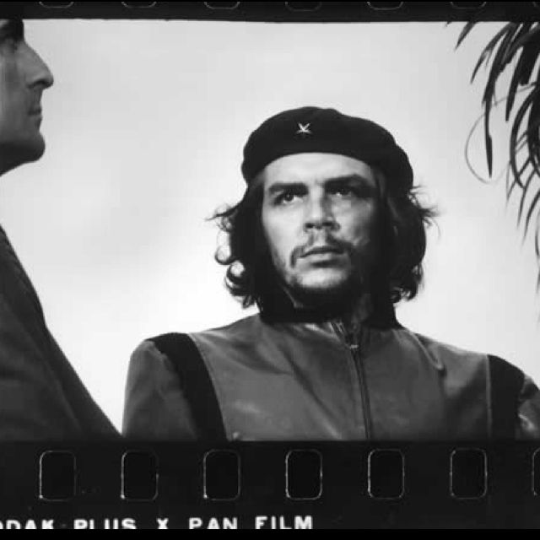
Alberto Korda, Heroic Guerrillero, 1960

Slide 5
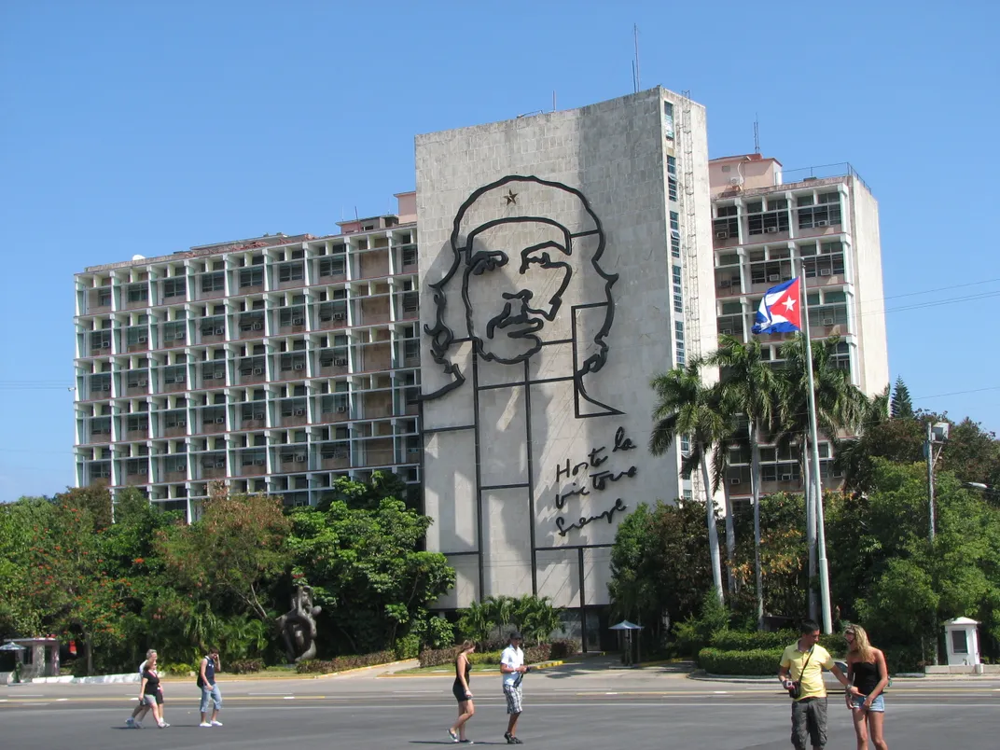
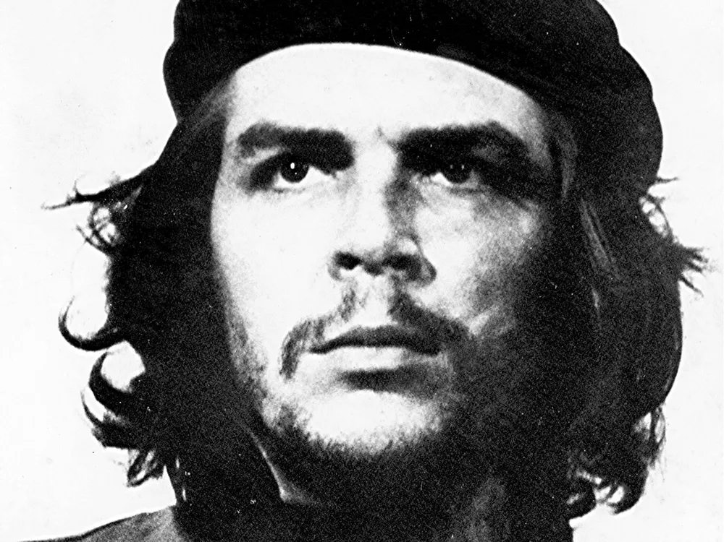

Slide 6
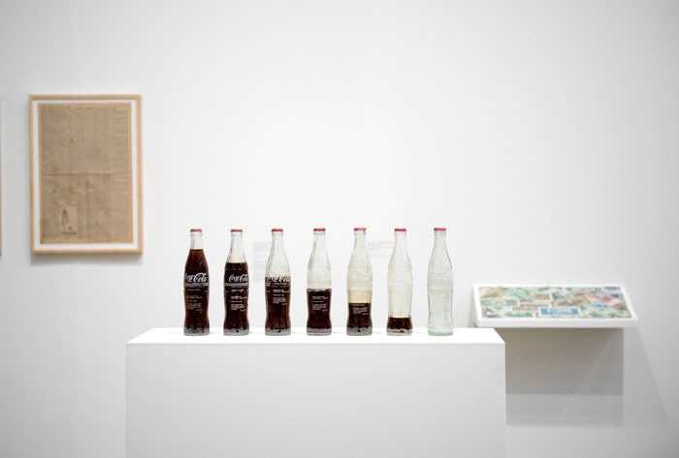
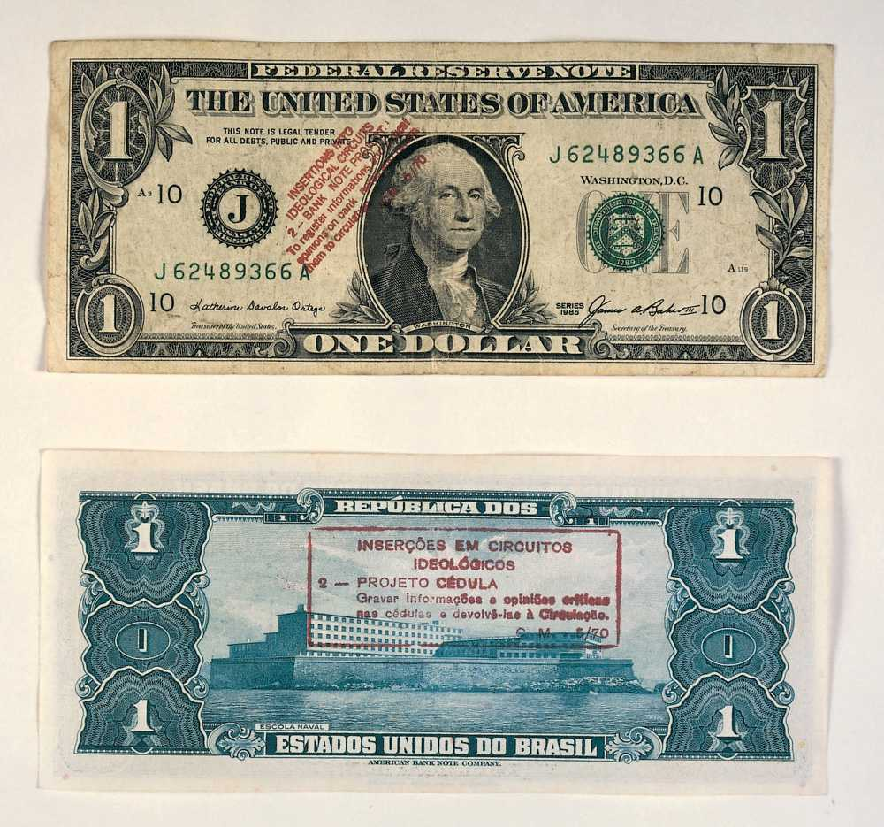
Cildo Meireles, Insertions into Ideological Circuits, 1970

Slide 7
“The Insertions into Ideological Circuits arose out of the need to create a system for the circulation and exchange of information that did not depend on any kind of centralized control. This would be a form of language, a system essentially opposed to the media of press, radio and television – typical examples of media that actually reach an enormous audience, but in the circulation systems of which there is always a degree of control and channeling of the information inserted ... The way I conceived it, the Insertions would only exist to the extent that they ceased to be the work of just one person. The work only exists to the extent that other people participate in it. What also arises is the need for anonymity. By extension, the question of anonymity involves the question of ownership. When the object of art becomes a practice, it becomes something over which you can have no control or ownership. ’"
(Quoted in Cameron, pp.110-12.)

Slide 8
Meireles, Insertions into Ideological Circuits: Coca-Cola Project, 1970, Brazil

Slide 9
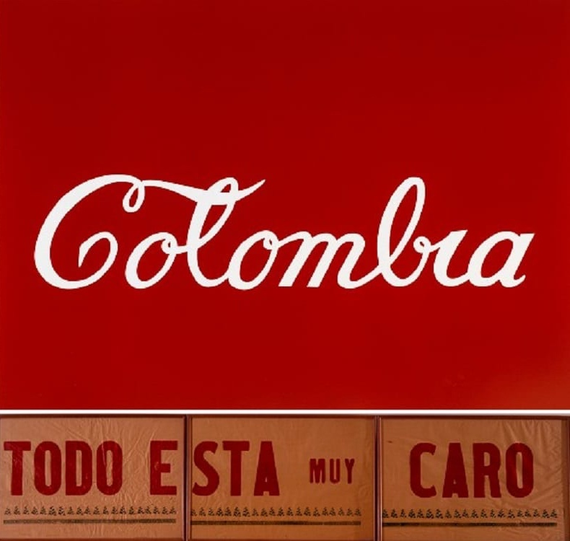
Caro, Colombia, 1977, Colombia

Slide 10


Hernández, Sun Mad, 1982

Slide 11
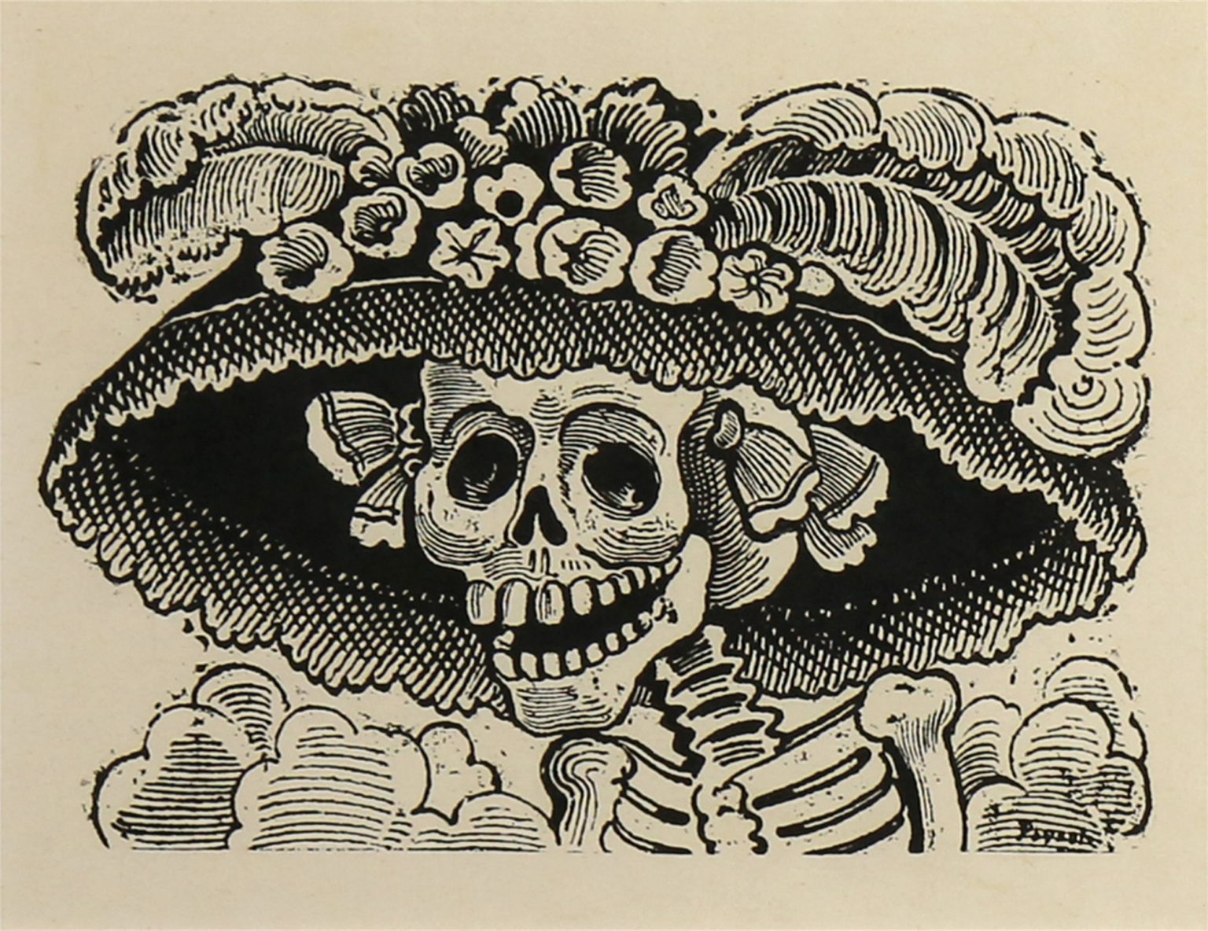
Posada, Calavera Catrina, c. 1910-1912

Slide 12
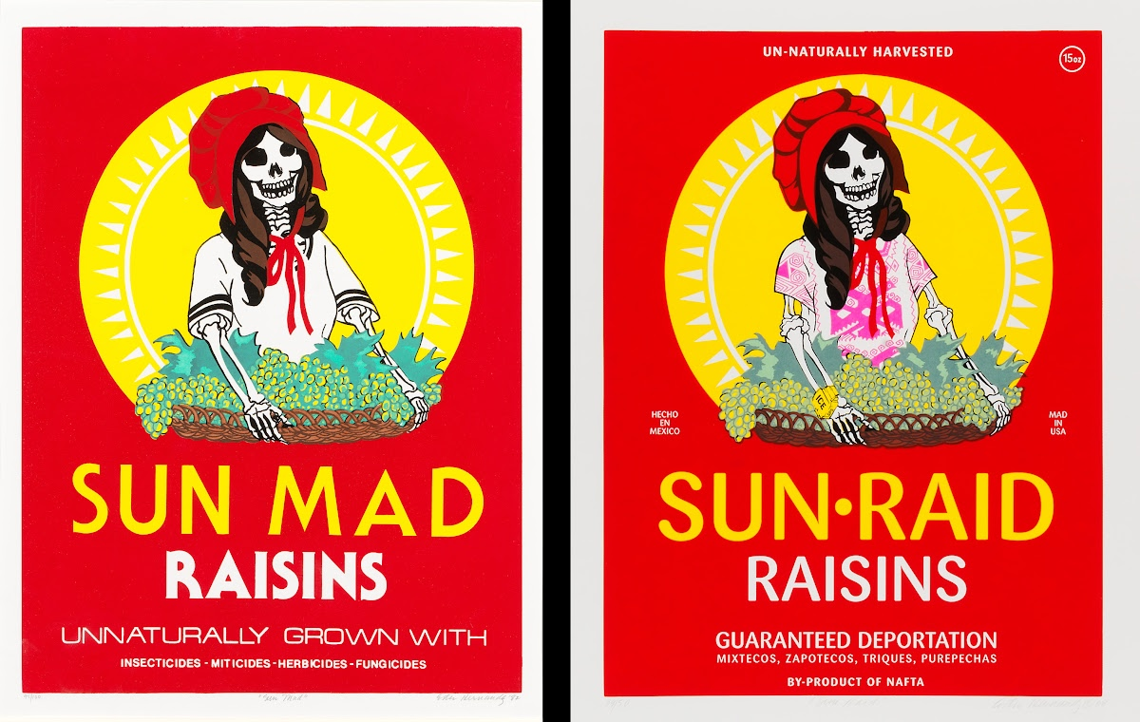
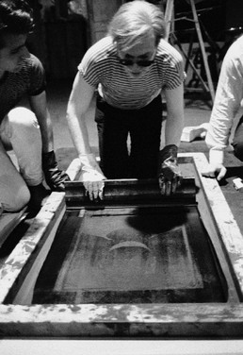
screenprint:
a printing technique where a mesh is used to transfer ink onto paper

Slide 13
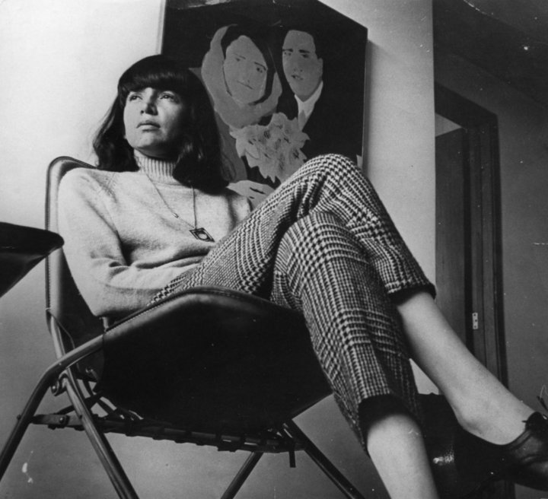
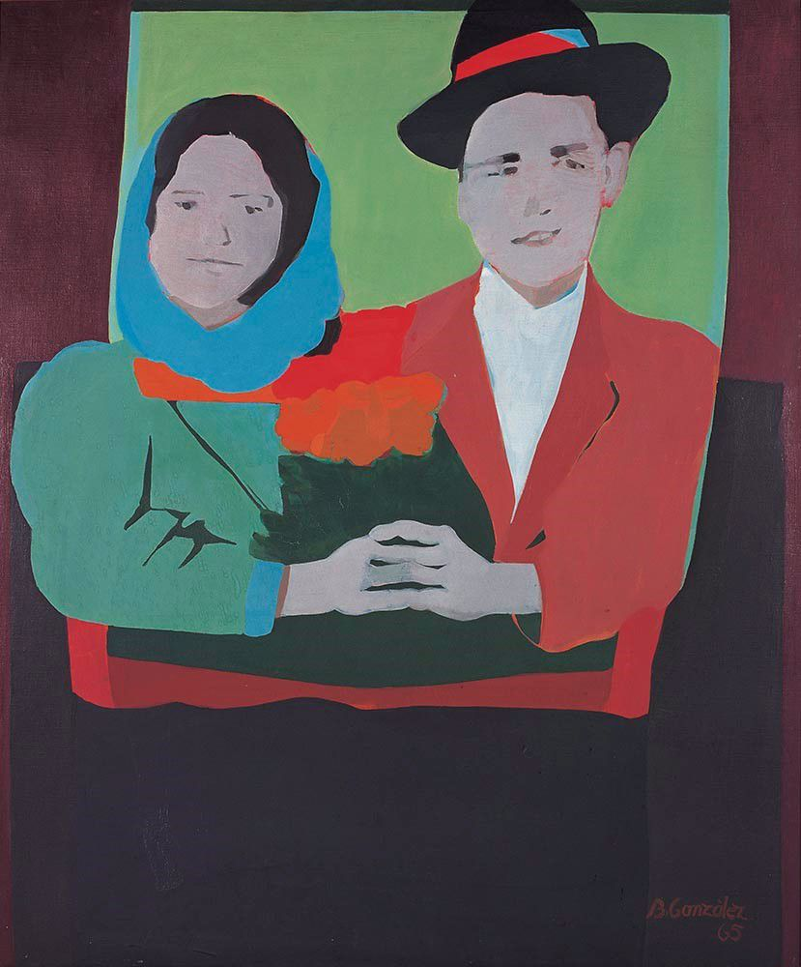
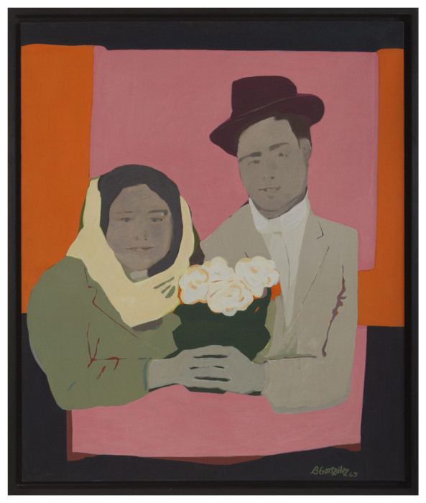
Beatriz González, The Suicides of Sisga, 1965, Colombia

Slide 14
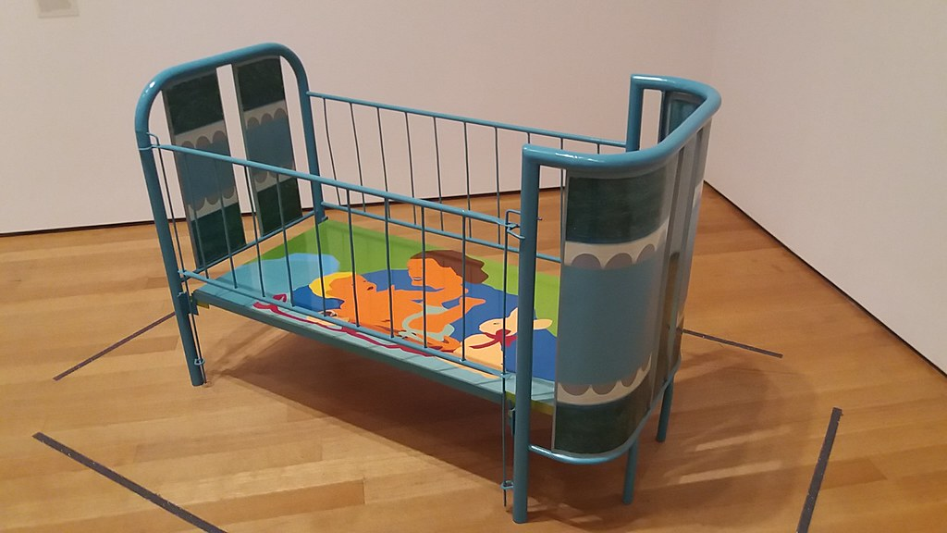
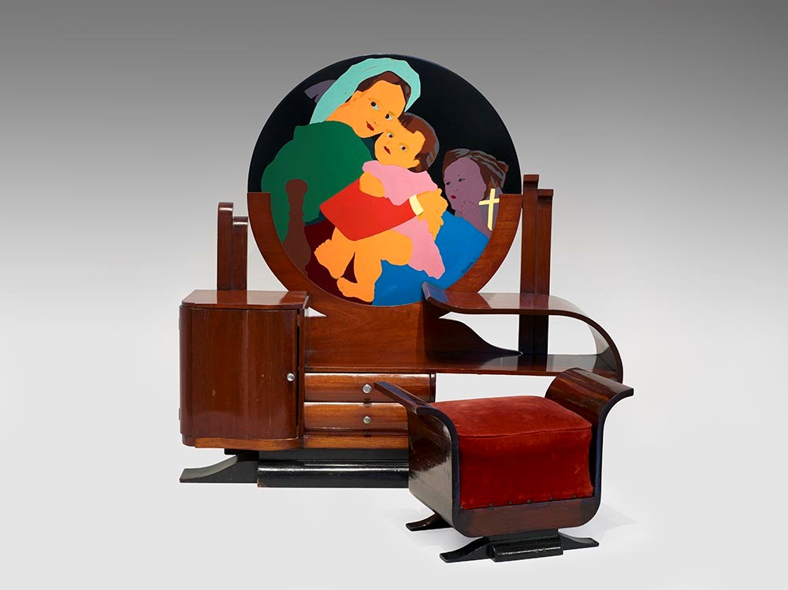
Beatriz González, Lullaby, 1970, Colombia
Beatriz González, Full of Grace, 1971, Colombia

Slide 15
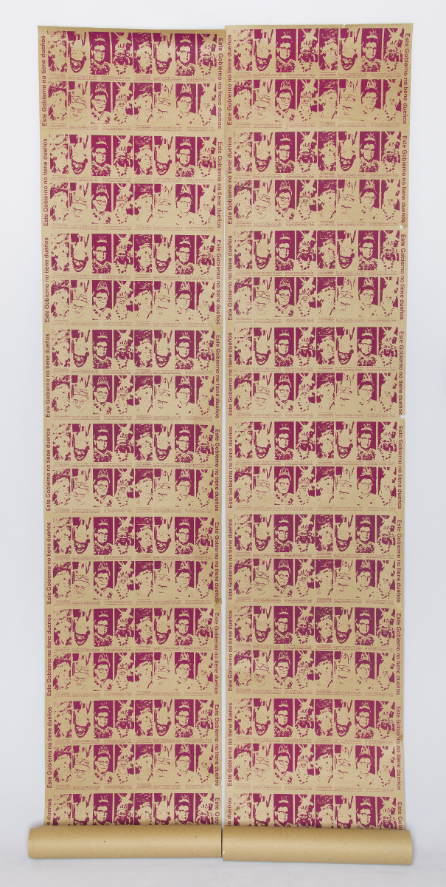
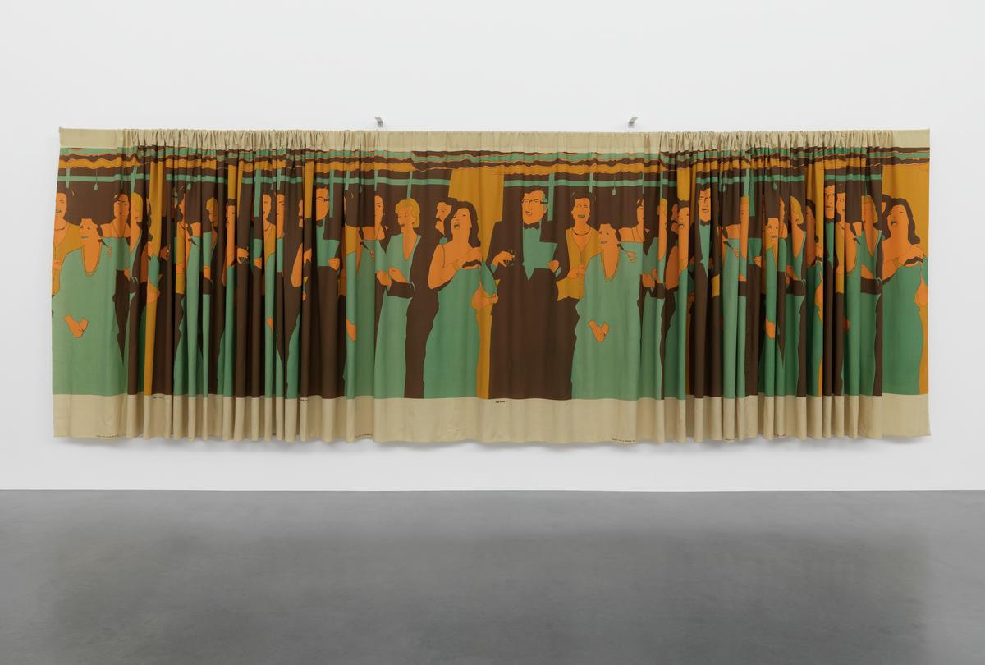
Beatriz González, Interior Decoration (curtain), 1981, Colombia
Beatriz González, Plumario Colombiano (wallpaper), 1983, Colombia

Slide 16
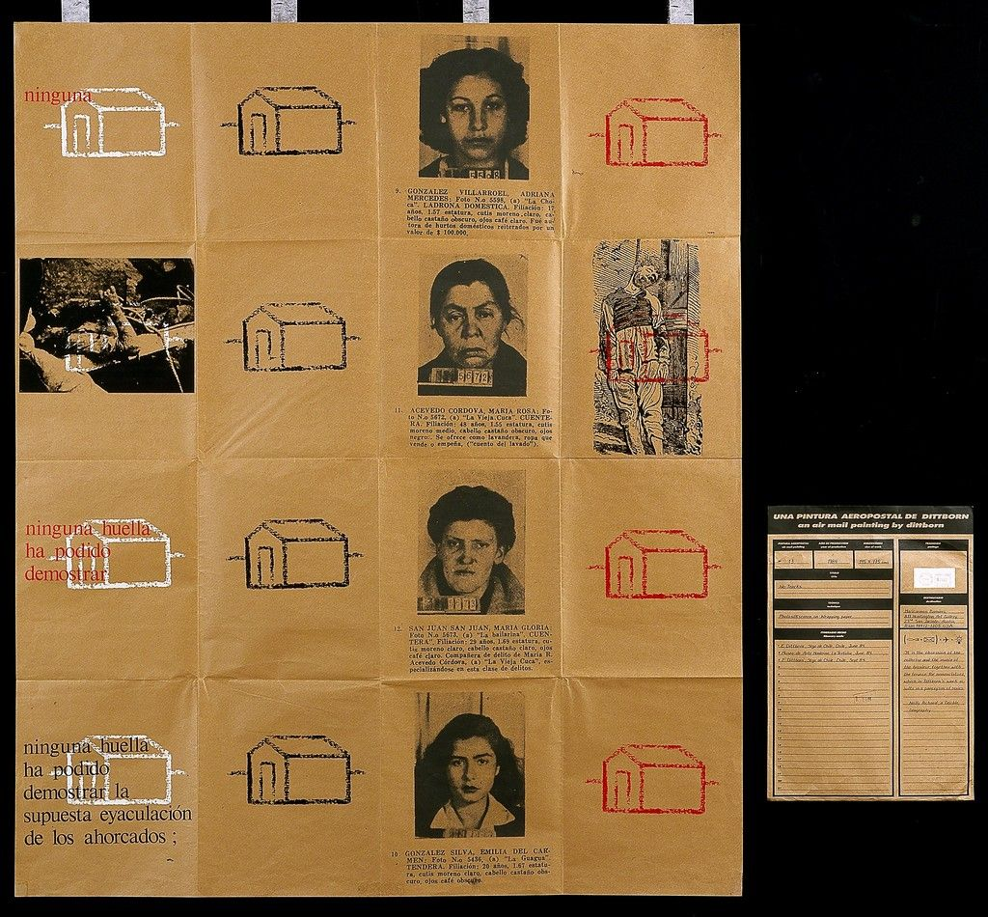
Dittborn, No Tracks (Airmail Paintings), 1986

Slide 17
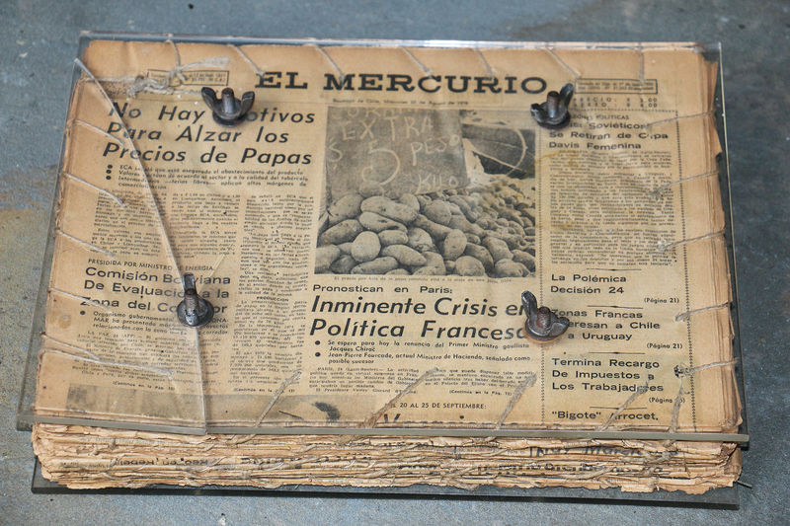
Catalina Parra,
Diario de vida (Diary of life) , 1977

Slide 18
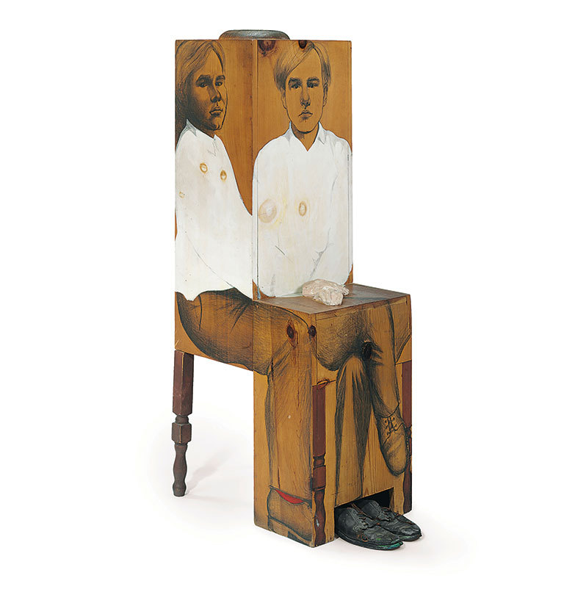
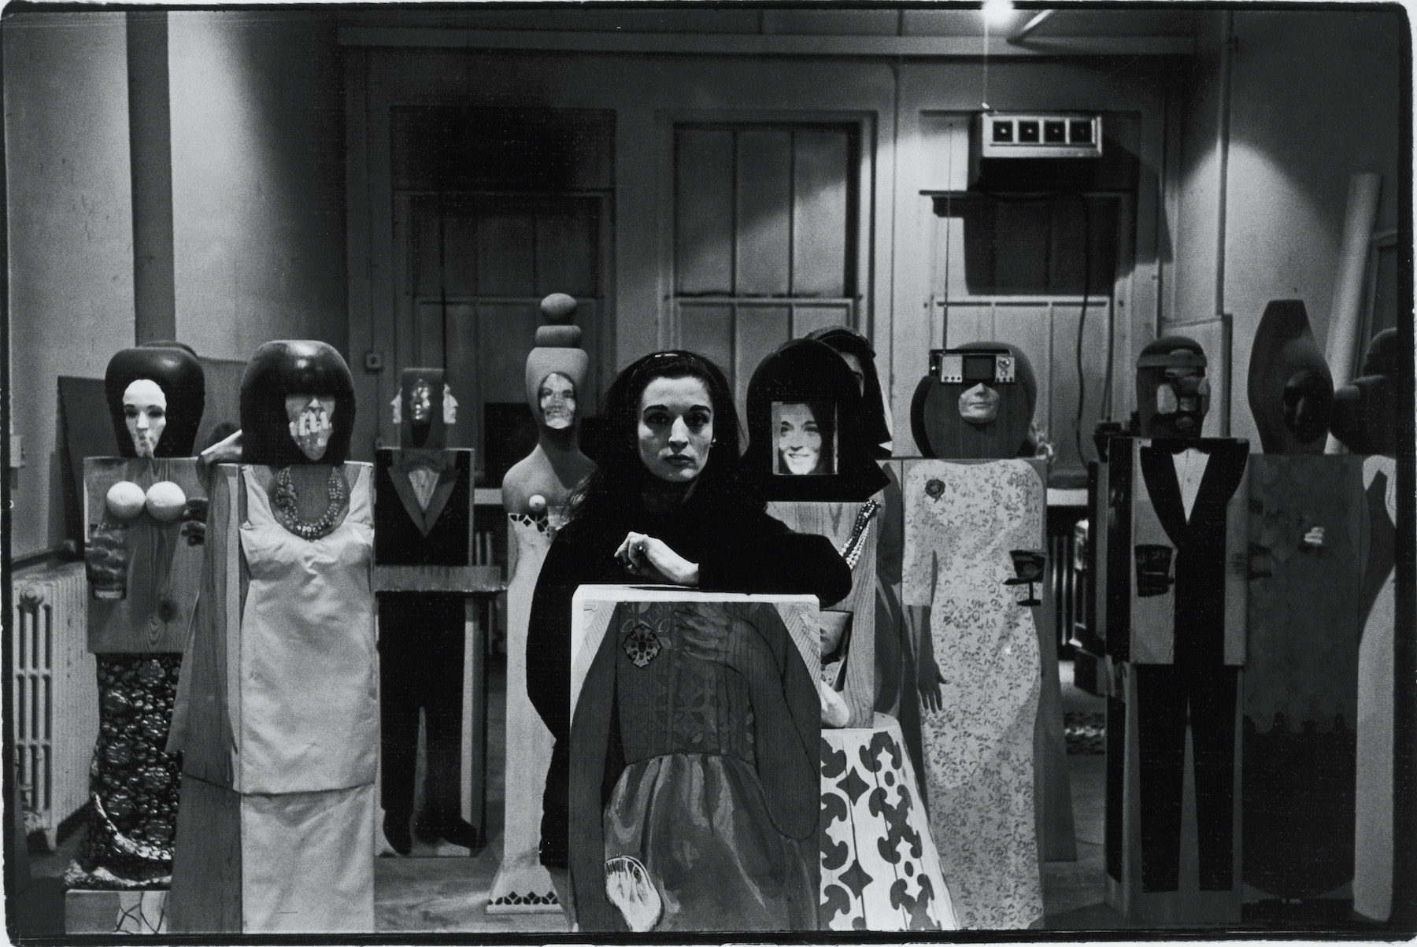

Slide 19
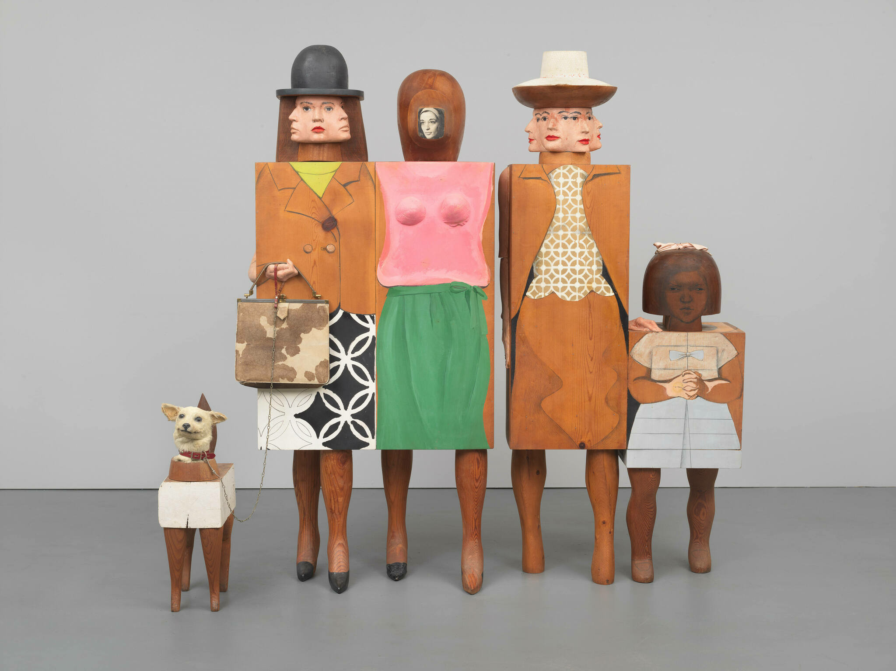
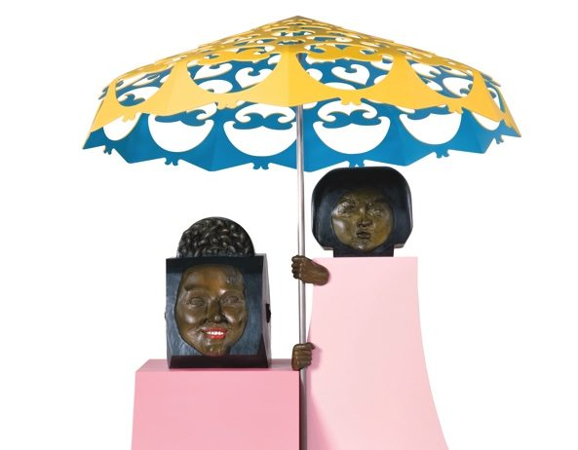
Marisol, My Mom and I, 1968
Marisol, Women and Dog, 1964

Slide 20
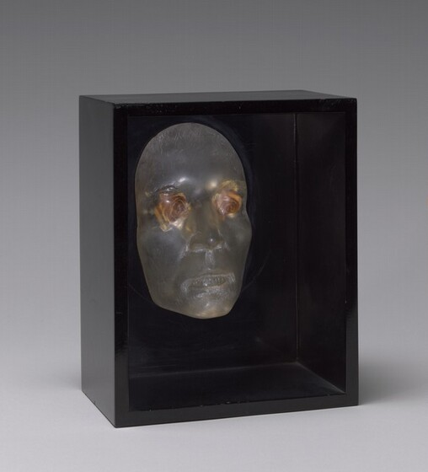
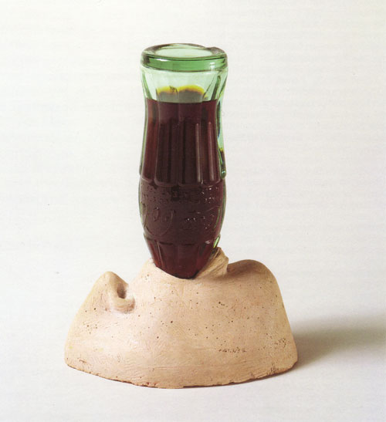
Marisol, Love, 1962

