Slide 1

GEOMETRIC ABSTRACTION

Slide 2
Reflects the idea of “inversion” by which hierarchies are inverted in terms of how Latin America relates to Europe and the U.S.
Torres-García, South America’s Inverted Map, 1936

Slide 3
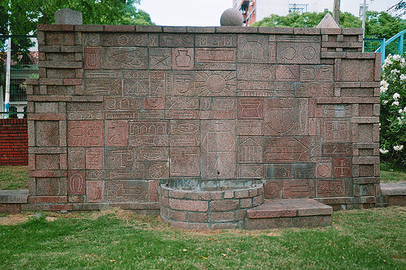
Torres-García, Cosmic Monument, 1938, Montevideo
(Universal Constructivism: inspired by the grid of Mondrian and Amerindian symbols)

Slide 4
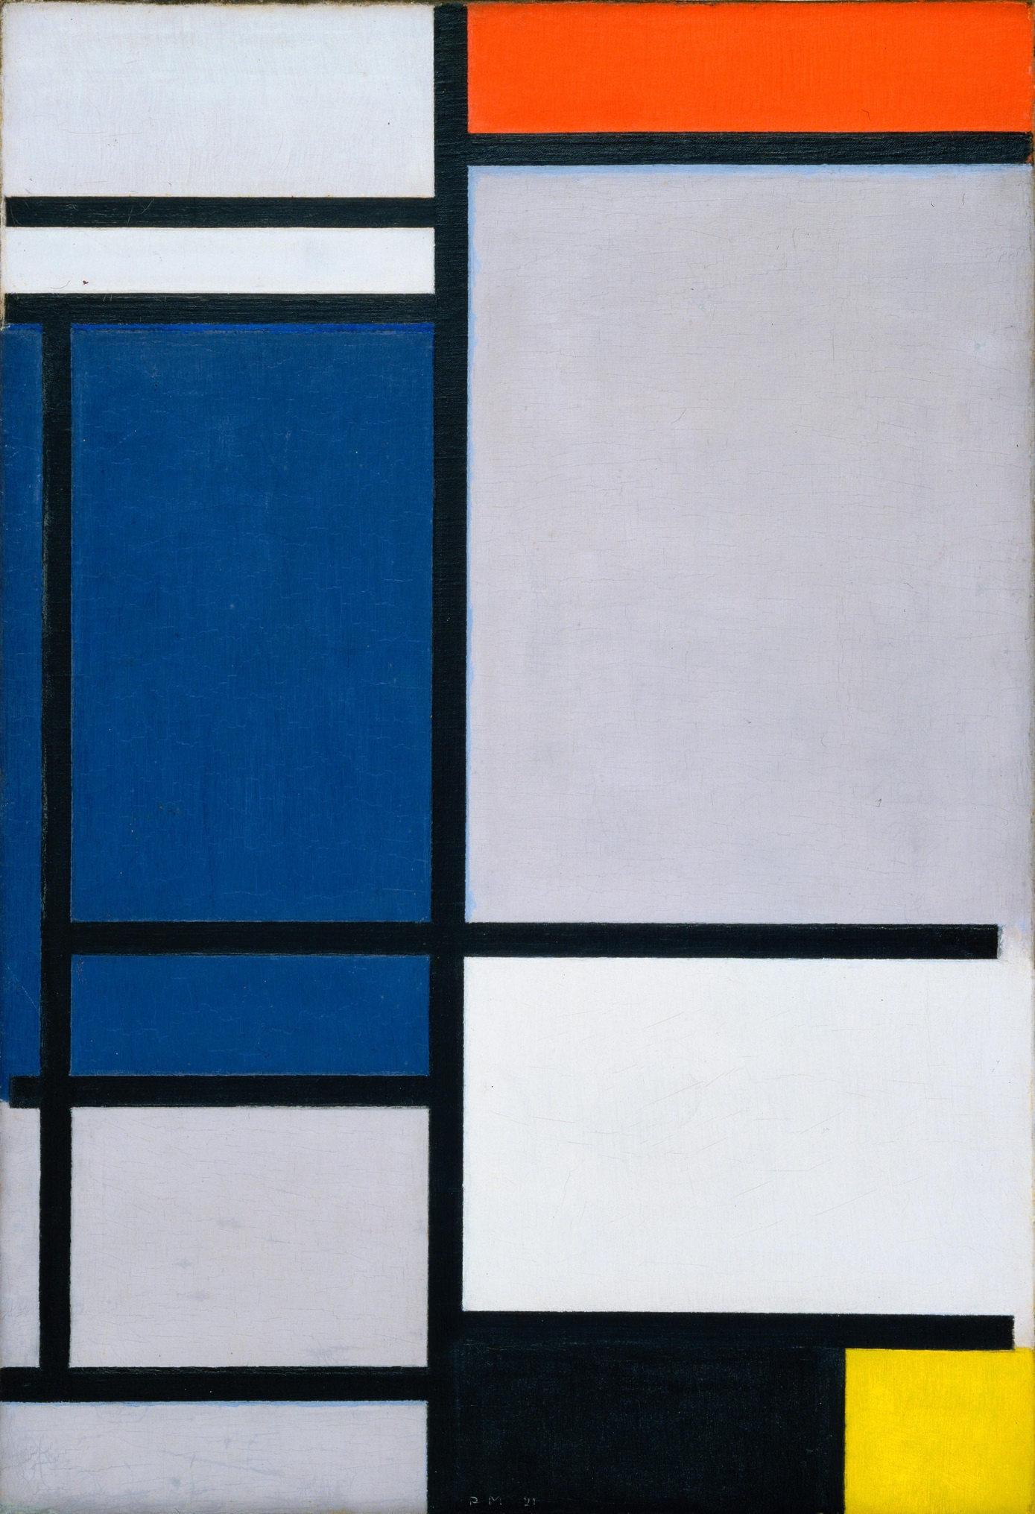
Influenced by Mondrian

Slide 5
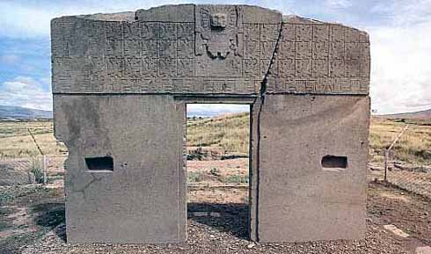
Gate of the Sun, Tiwanaku, Bolivia

Slide 6
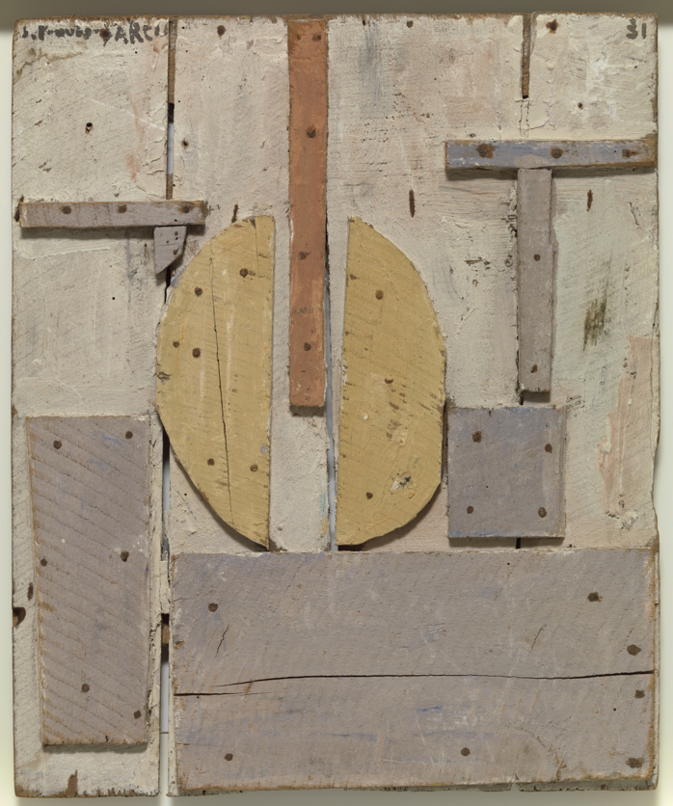
Torres-García, Pachamama, 1944
Torres-García, Construction with Curved Forms, 1931

Slide 7
Torres-García, Pachamama, 1944
(“Pachamama” is a reference to protector of mountain and colonial painting of the Virgin of Potosí)

Slide 8
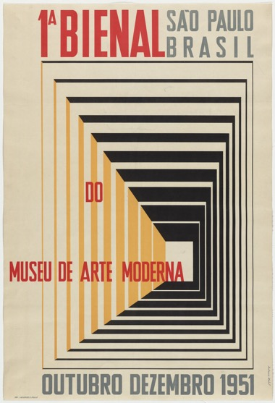
Sao Paulo Biennale, 1951

Slide 9
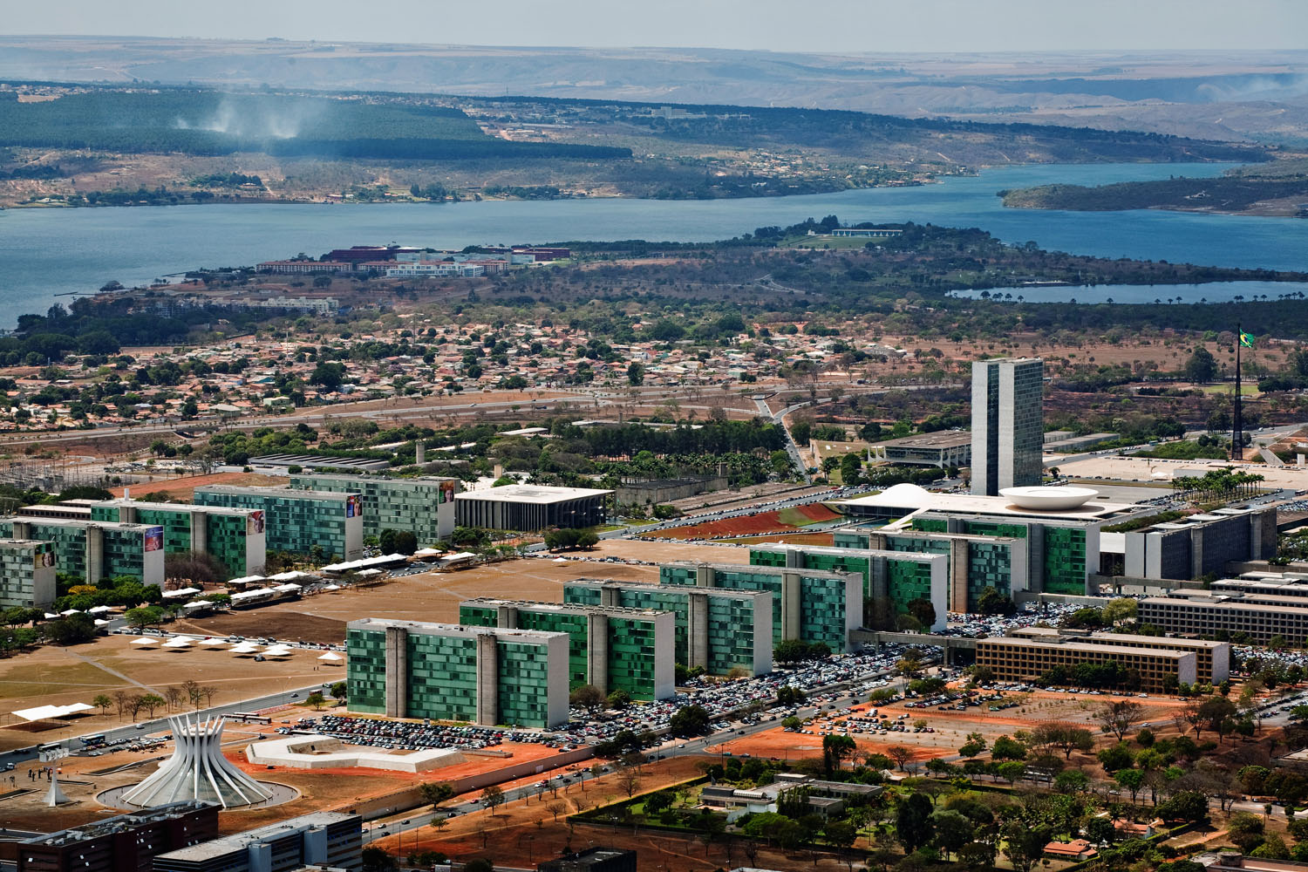
Brasilia: new capital city, built in 1956, reflects idea of “order and progress”

Slide 10
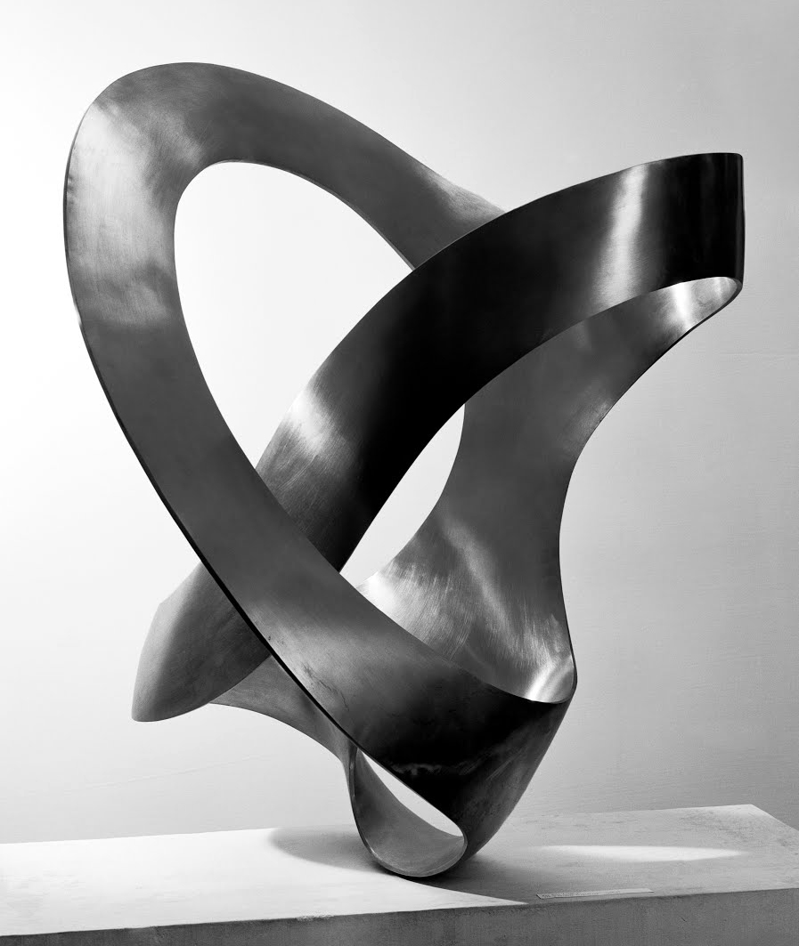
Max Bill, Tripartite Unity, 1948–1949, stainless steel

Slide 11
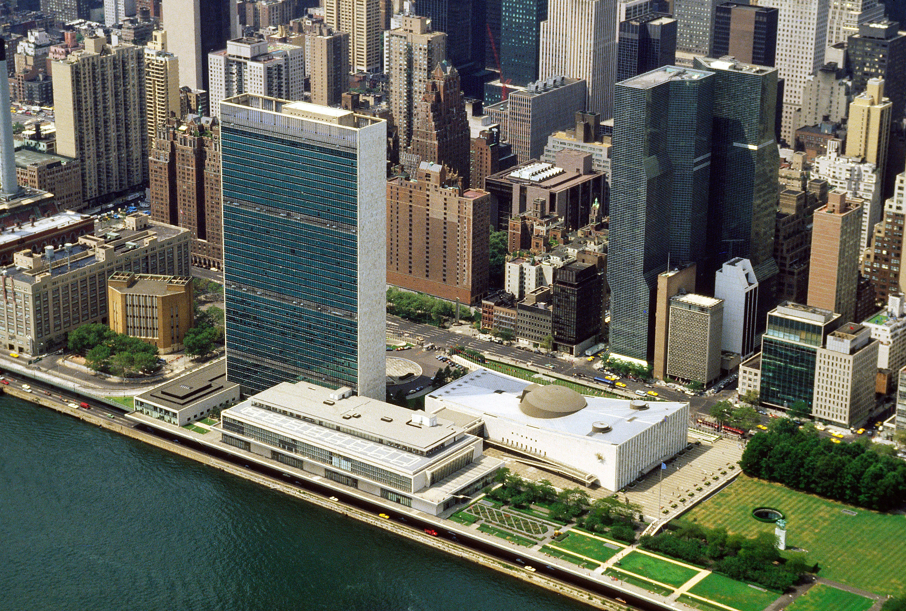
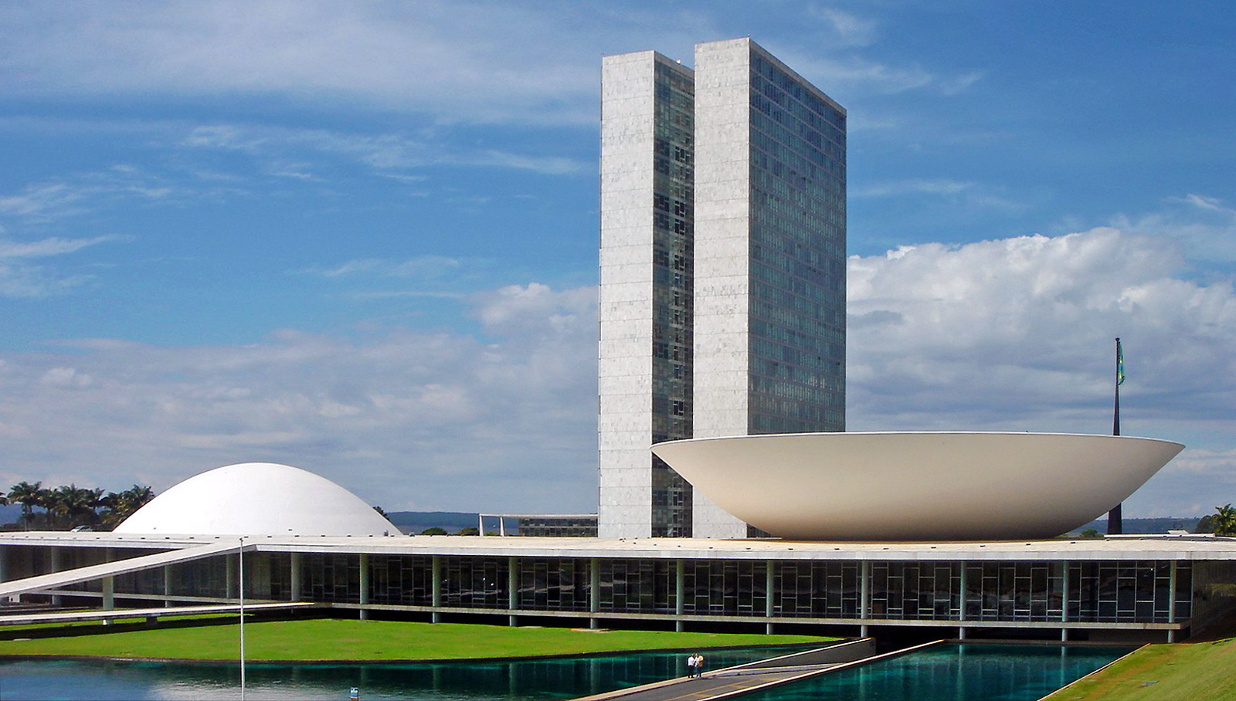
Oscar Niemeyer, National Congress, Brasília, Brazil

Slide 12
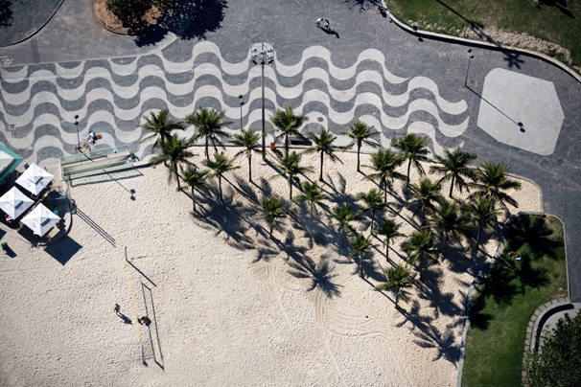
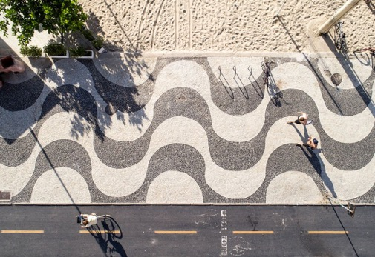
Burle Marx, Walkway Rio de Janeiro, Brazil

Slide 13
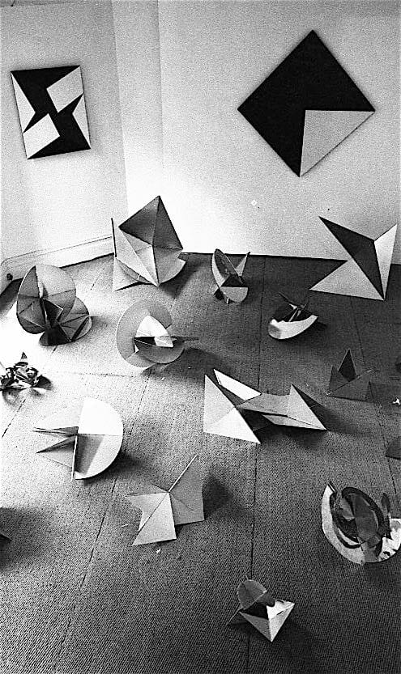
“The Bicho has his own and well-defined cluster of movements which react to the promptings of the spectator. He is not made of isolated static forms which can be manipulated at random, as in a game: no, his parts are functionally related to each other, as if he were a living organism; and the movements of these parts are interlinked.”
-Lygia Clark

Slide 14
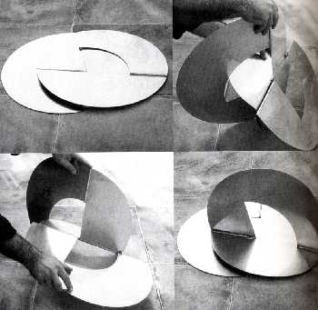
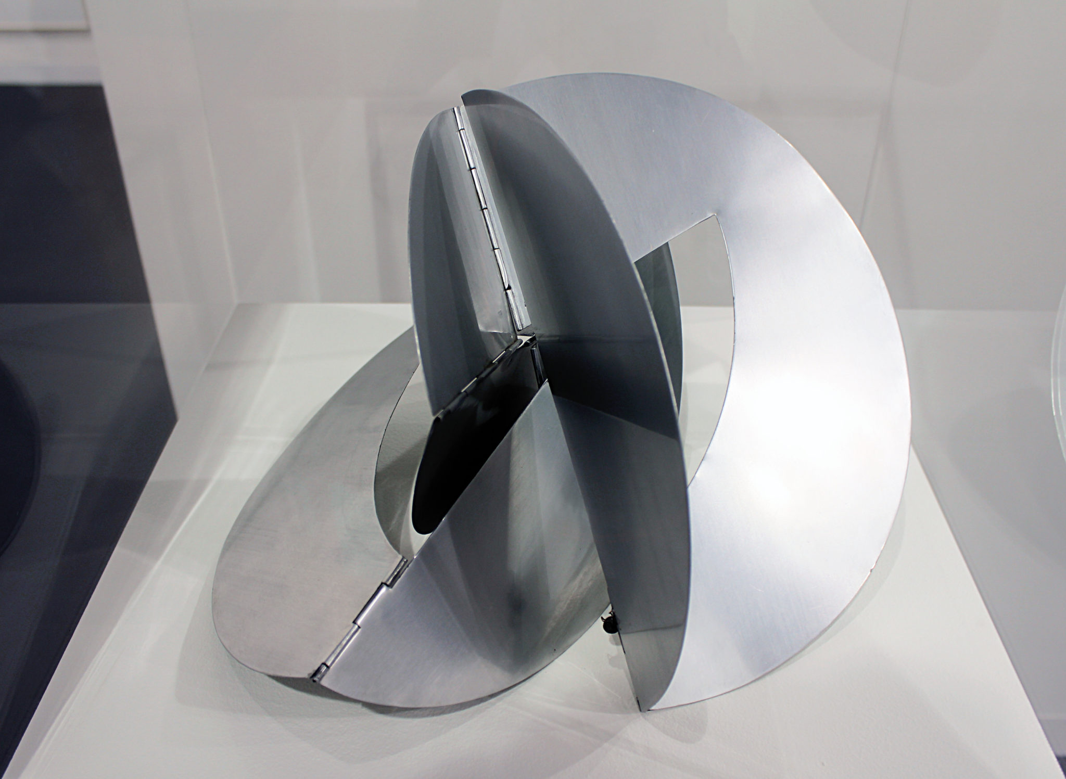
Clark, Bicho (Critter), 1962, aluminum*
How does Clark challenge traditional sculpture?

Slide 15
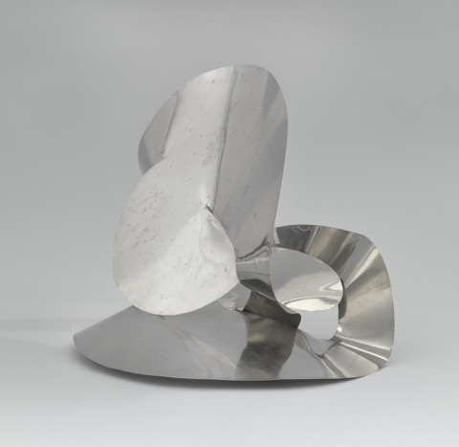
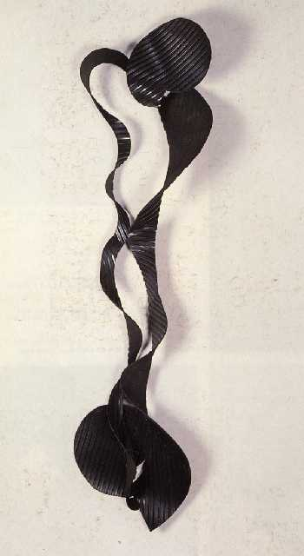
Clark, The Inside is the Outside, 1963
Clark, Rubber Grub, 1964, rubber

Slide 16
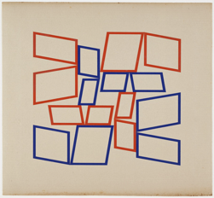
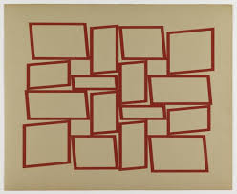
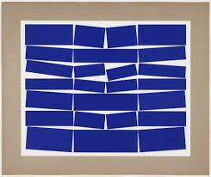
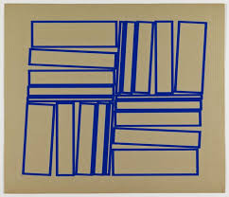
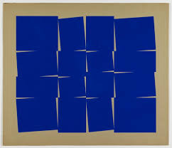
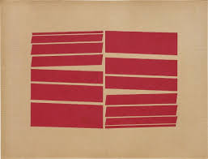
Oiticica, Metaesquema Series, 1958, gouache on cardboard

Slide 17
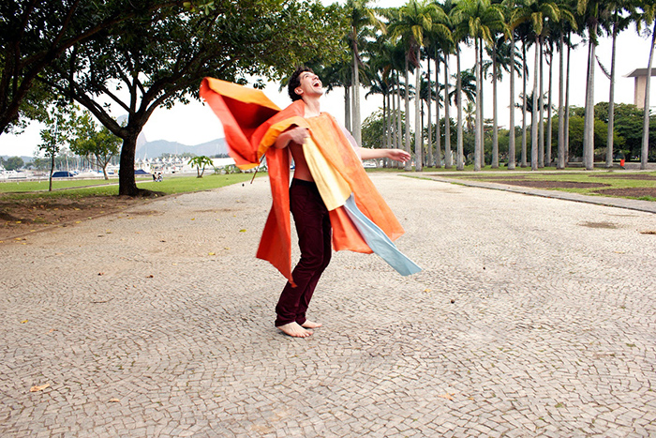

Slide 18
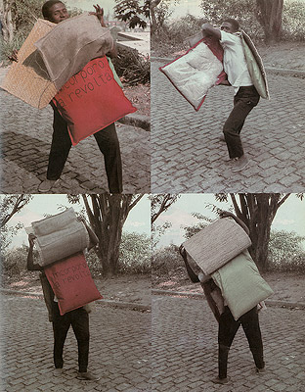
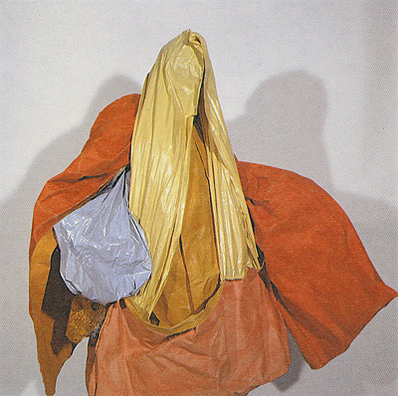
Oiticica, Parangole, 1967
-Work is activated by the wearer while Afro-Brazilian music contributes to the performance

Slide 19
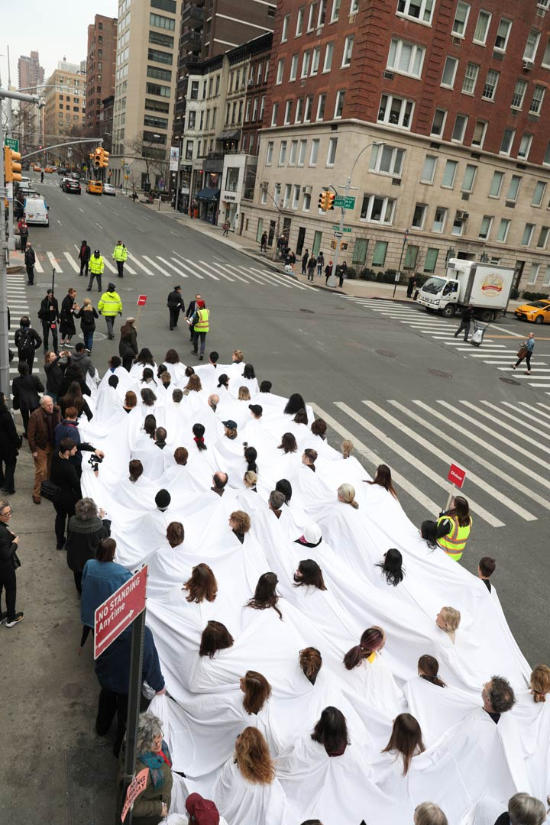
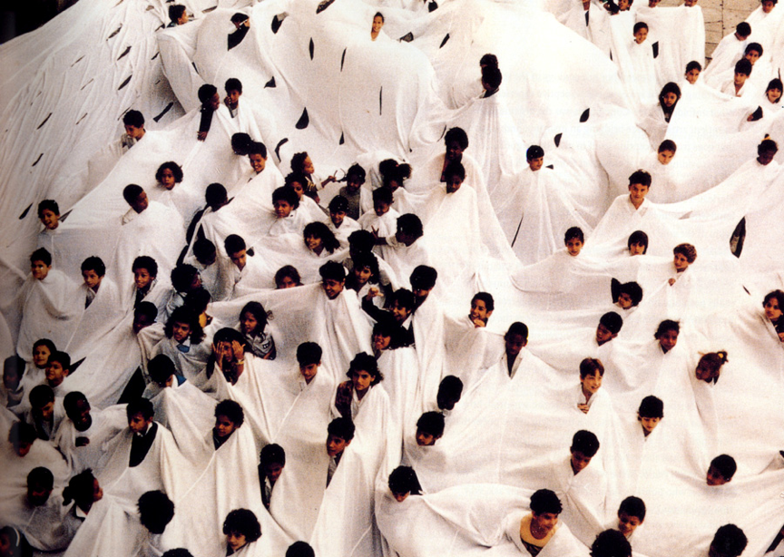
Lygia Pape, O Divisor, 1968

Slide 20
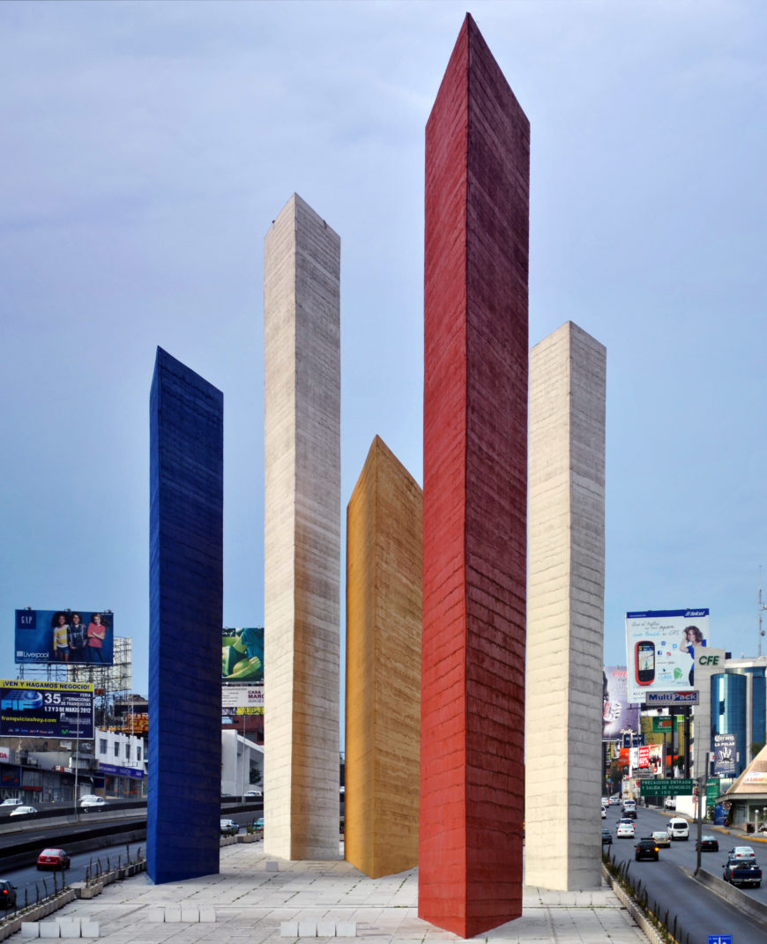
Luis Barragán, Jesús Reyes Ferreira, and Mathias Goeritz, The Towers of Satellite City, 1957–58, Mexico City

Slide 21
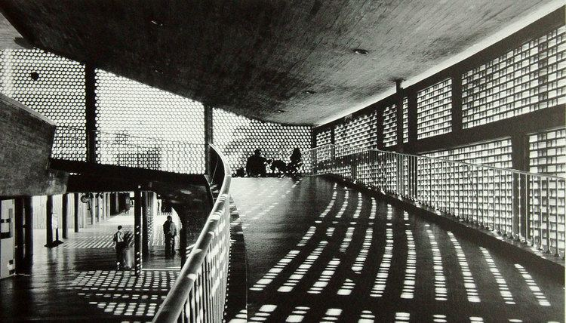
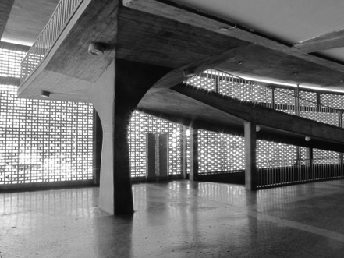
Villanueva, Central University of Venezuela, 1950s

Slide 22
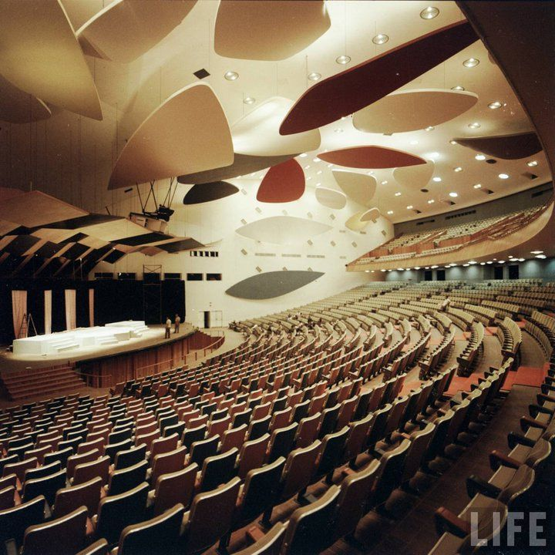
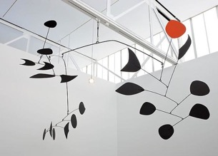
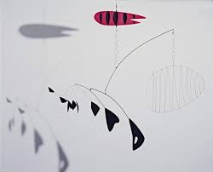
Calder, Aula Magna Auditorium, Central University of Venezuela, 1952

Slide 23
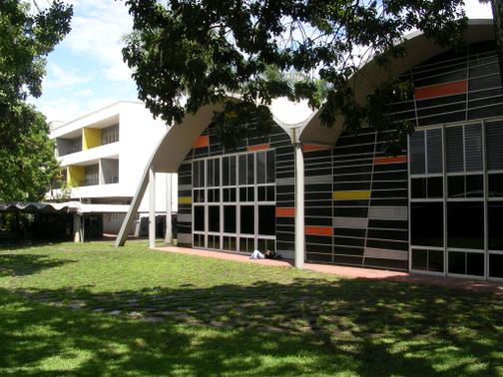
Otero, Engineering School, Central University of Venezuela, 1956

Slide 24
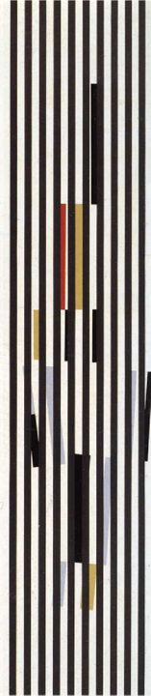
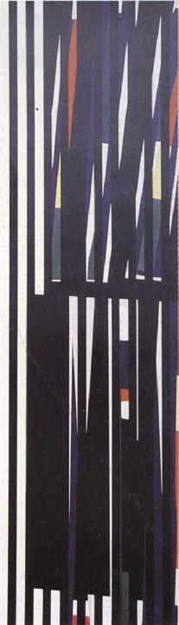
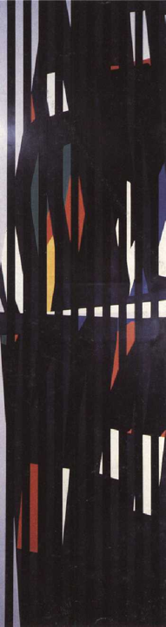
Otero, Colourhythm Series (Nos. 28, 39 and 40), 1957-1959, ducotone on wood

Slide 25
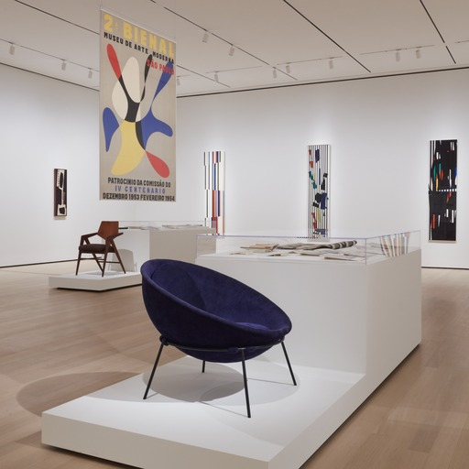
Influenced by Mondrian

Slide 26
What type of geometric abstraction is evoked in the Colourythm Series?

Slide 27
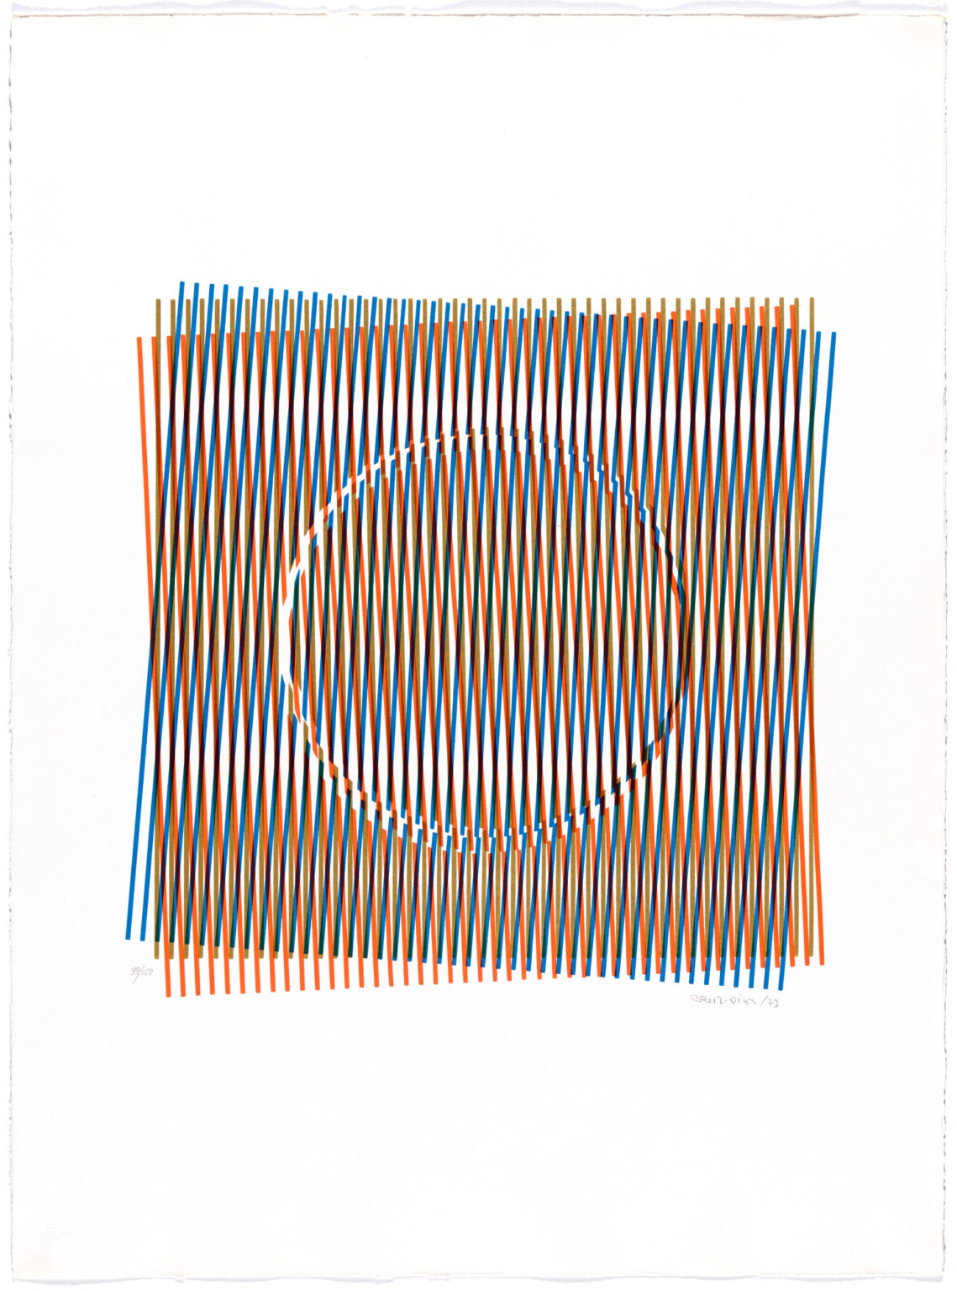
Cruz-Diez, Chromo-Interference (Cromo Interferencia), 1973

Slide 28
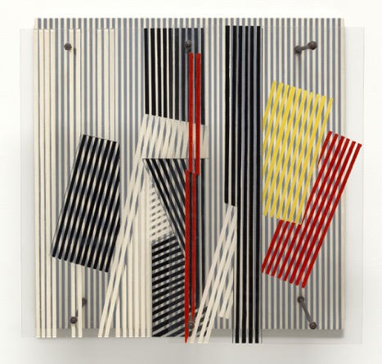
Soto, Double Transparency, 1956, plexiglass, wood and enamel

Slide 29
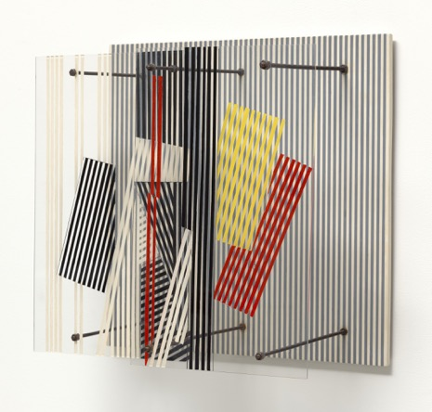
-Optical Vibration: the space between the foreground and background has depth and thus creates an optical illusion based on shadows, overlapping shapes, colors, and lines.

Slide 30
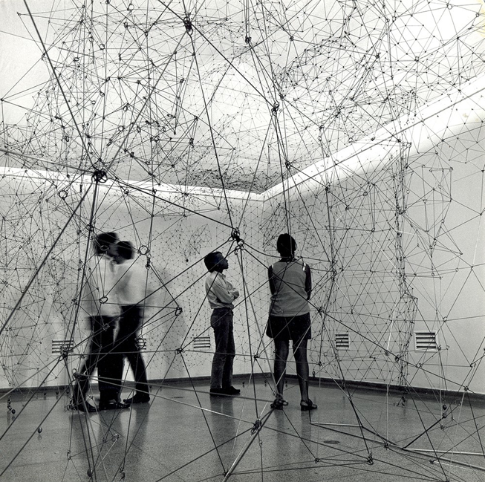
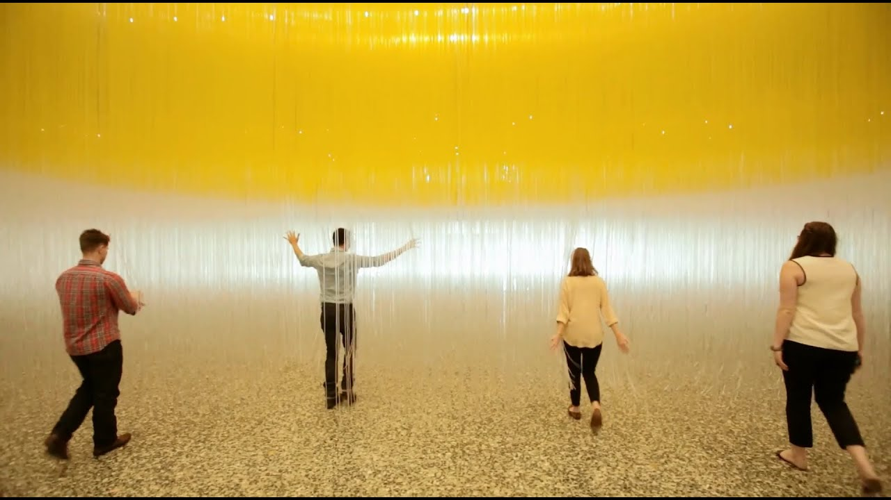
Gego, Reticularea, 1969
Soto, Penetrable, 2004

Slide 31
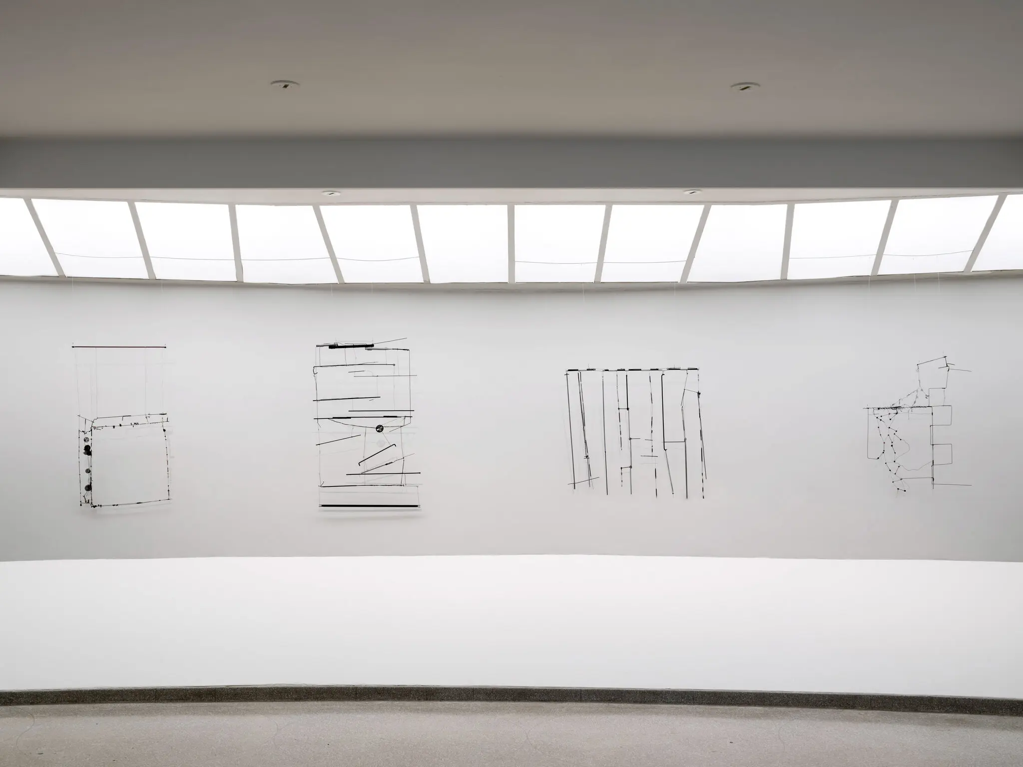
“Dibujos sin papel” -Gego

Slide 32
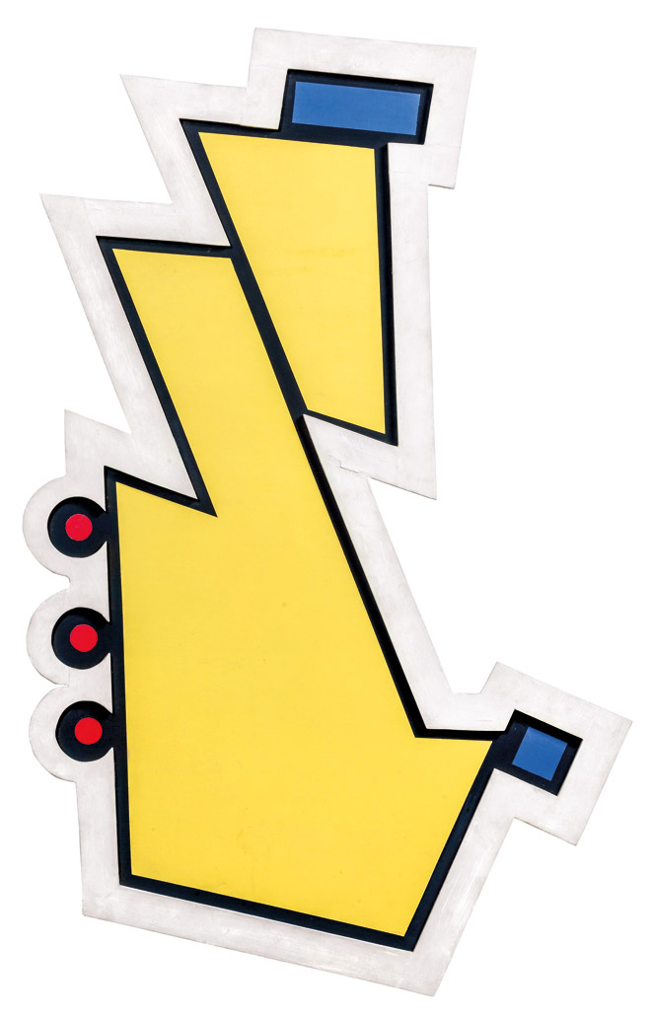
Rothfuss, Tres círculos rojos (Three Red Circles), 1948, filler and enamel on wood
(Madi Group, Argentina)

