Slide 1
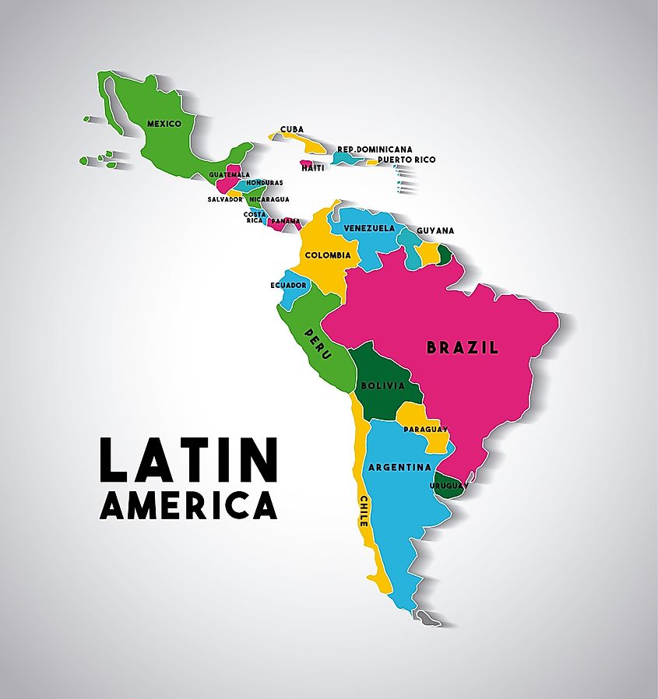

Introduction
What are the origins of the term “Latin America”?

Slide 2
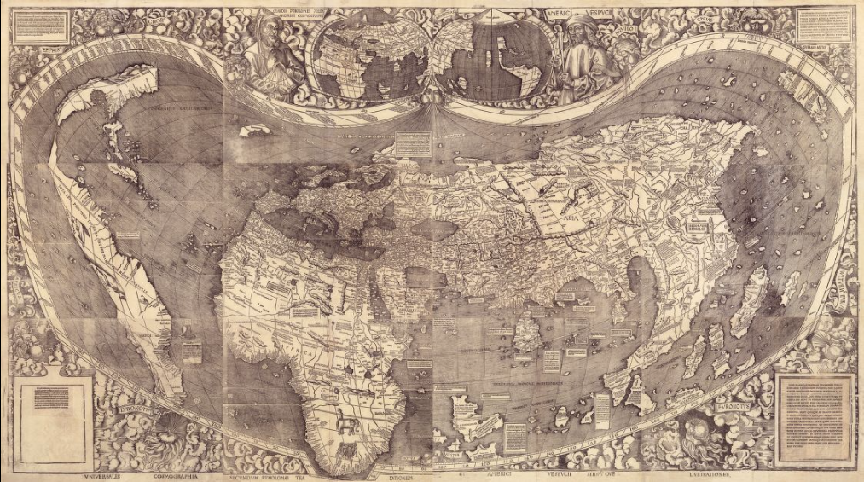
America: named after Amerigo Vespucci, Italian explorer and cartographer
*Waldseemüller Map, 1507

Slide 3
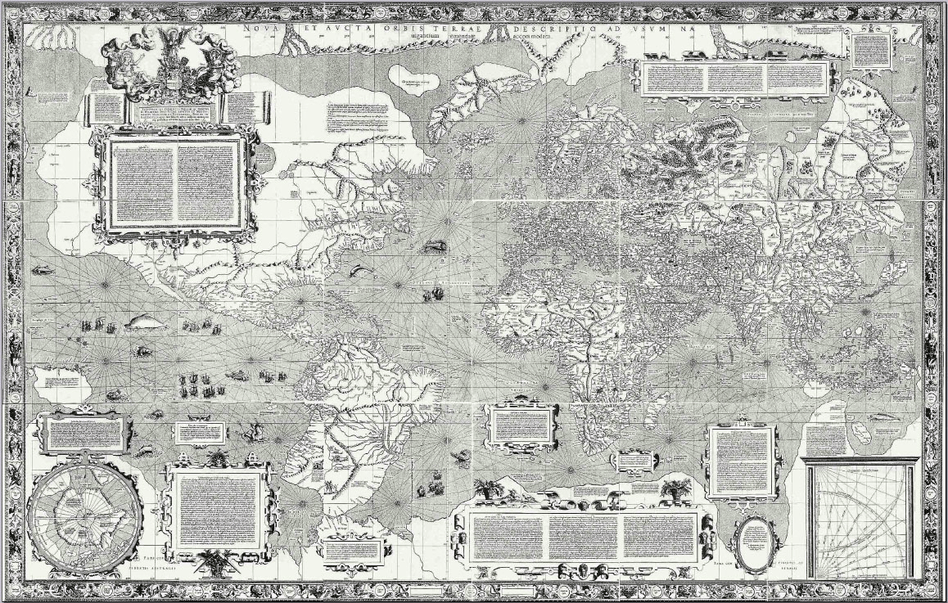
*Mercator Map, 1569

Slide 4
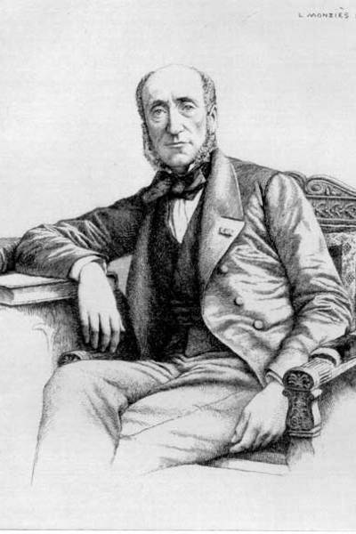
Latin America: term used by Michel Chevalier to distinguish between the (Anglo-Saxon) English-speaking U.S. and the (Latin) Spanish-speaking countries.

Slide 5
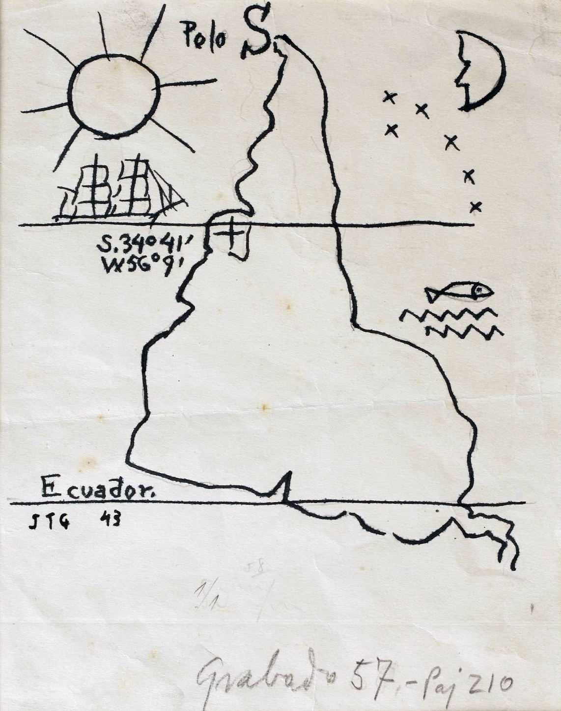
Torres-Garcia, Inverted Map, 1943

Slide 6
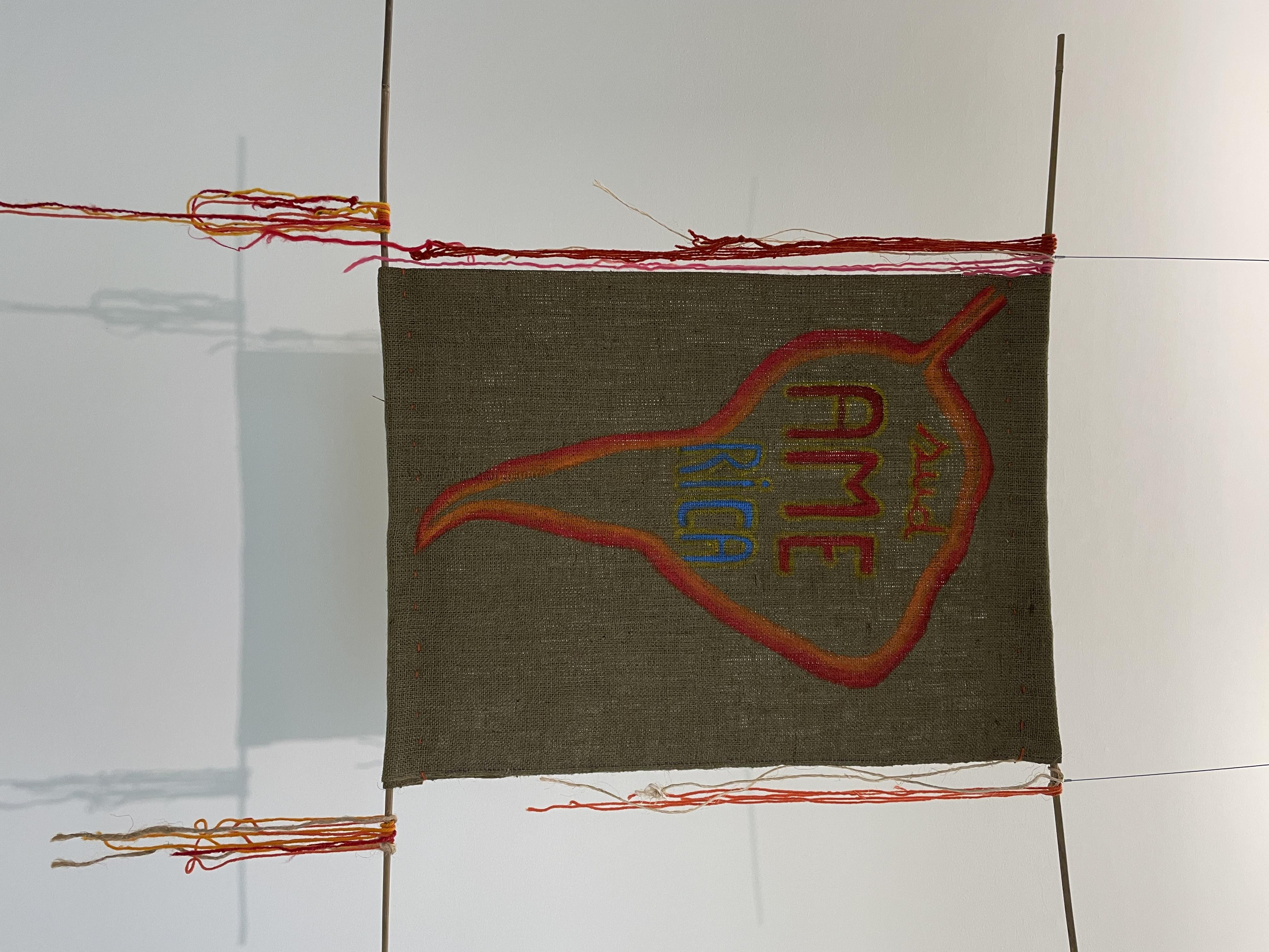
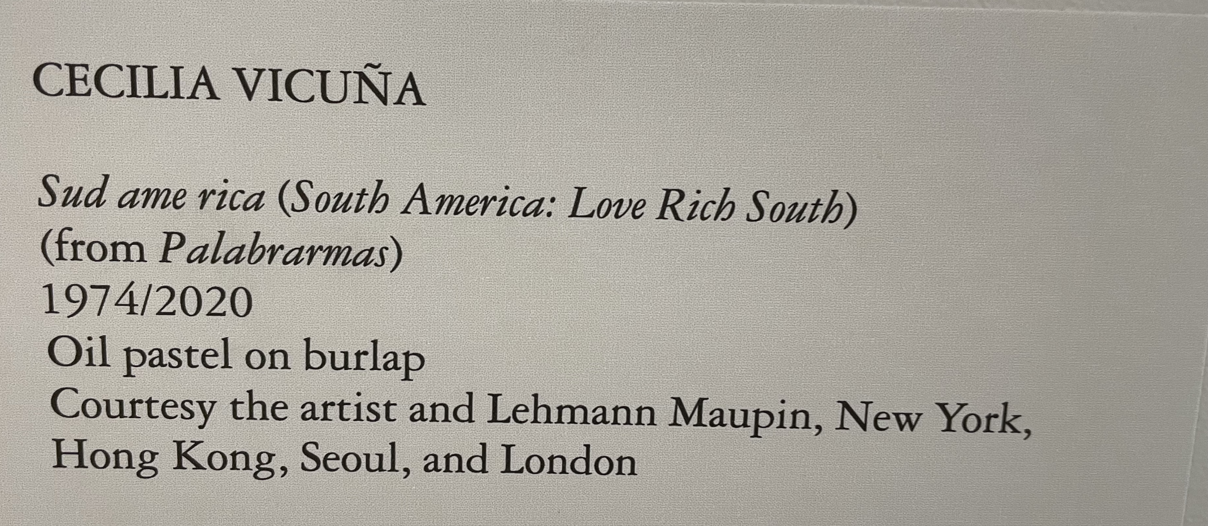

Slide 7
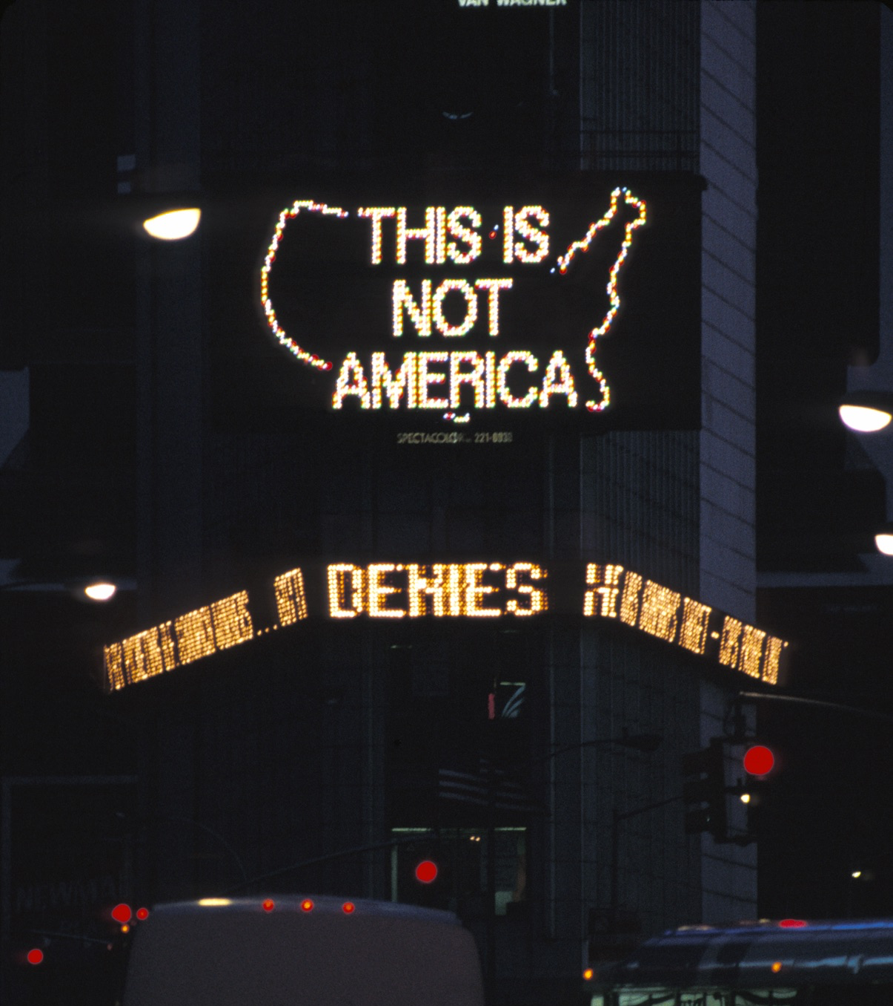
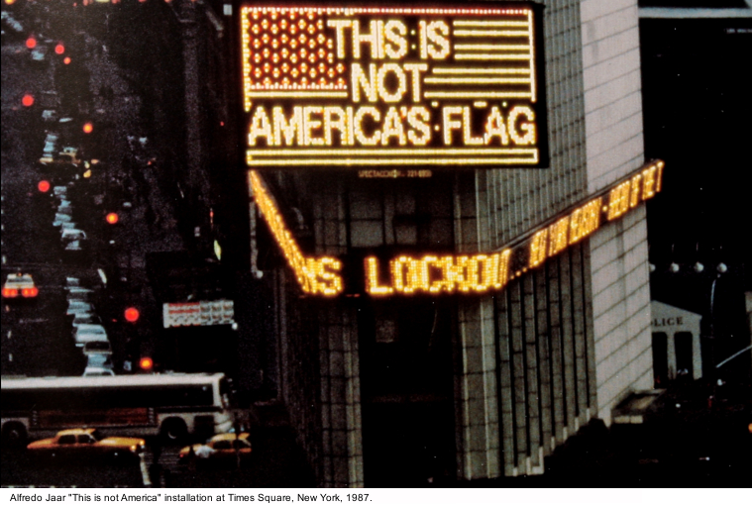
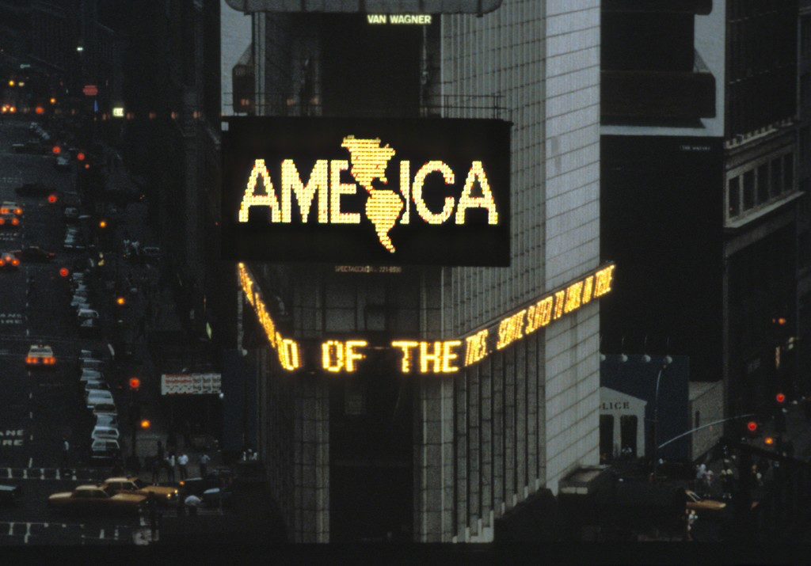
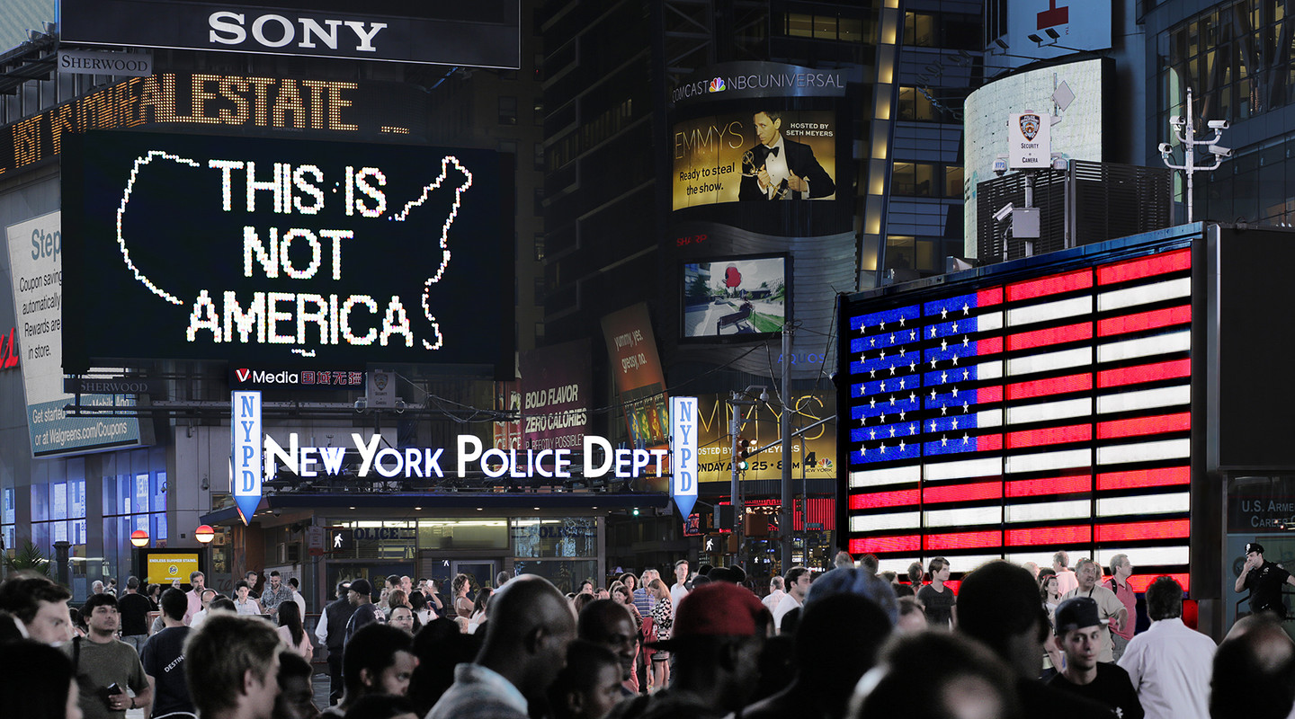
Alfredo Jaar, A Logo for America, 1987 (2014), New York City

Slide 8
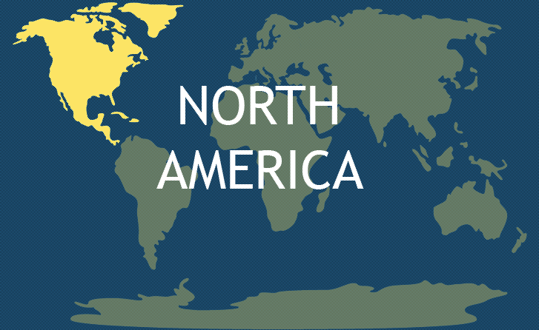
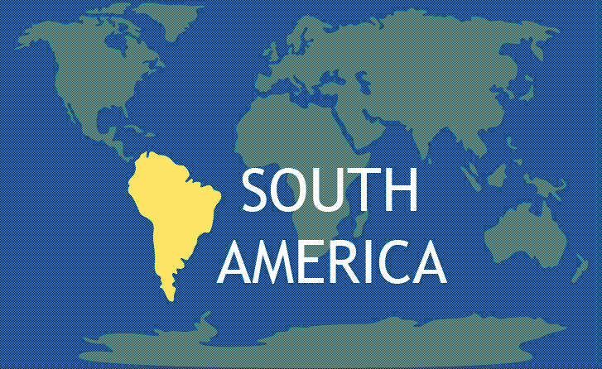

Slide 9
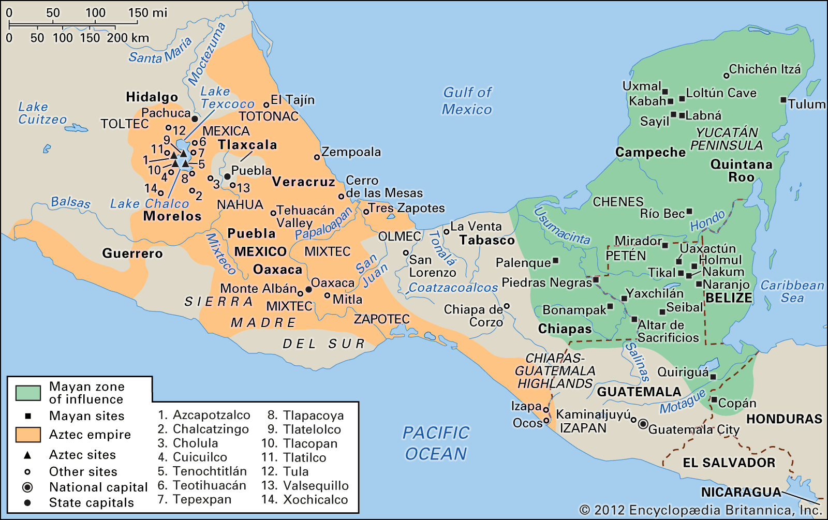
Mesoamerica: a cultural region that extends from southern Mexico to northern Central America, includes a shared cultural past.
Central America: countries to the south of Mexico and north of Colombia
Caribbean: group of culturally, linguistically, and historically diverse islands

Slide 10
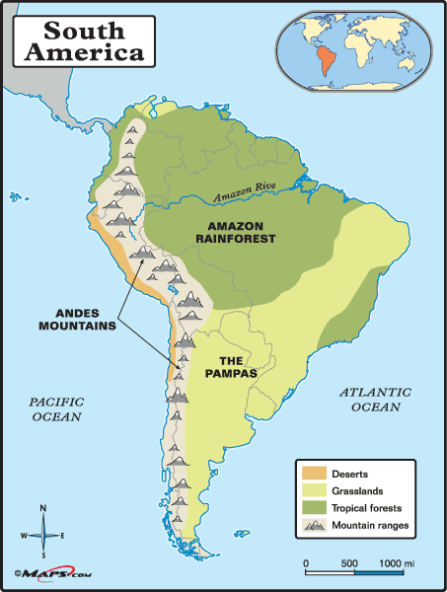
Andes Mountains
Amazon Rainforest
The Pampas
Pacific Coast
Atlantic Coast

Slide 11
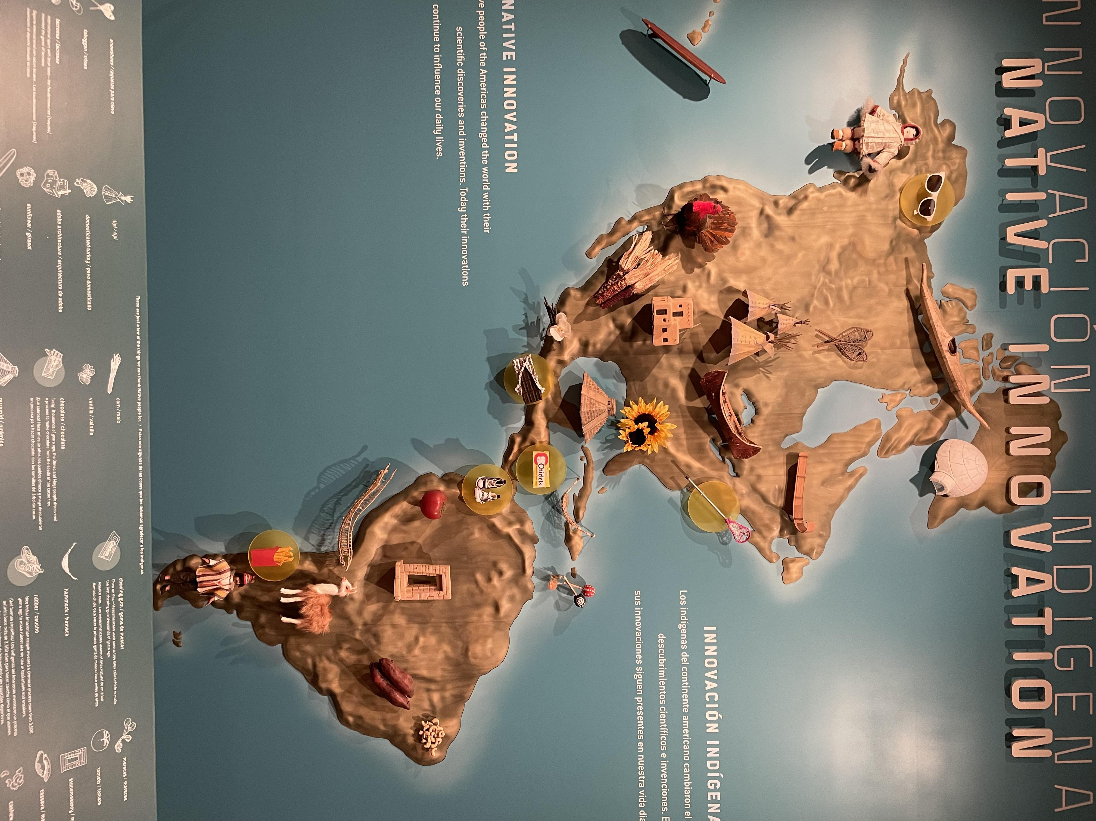

Slide 12
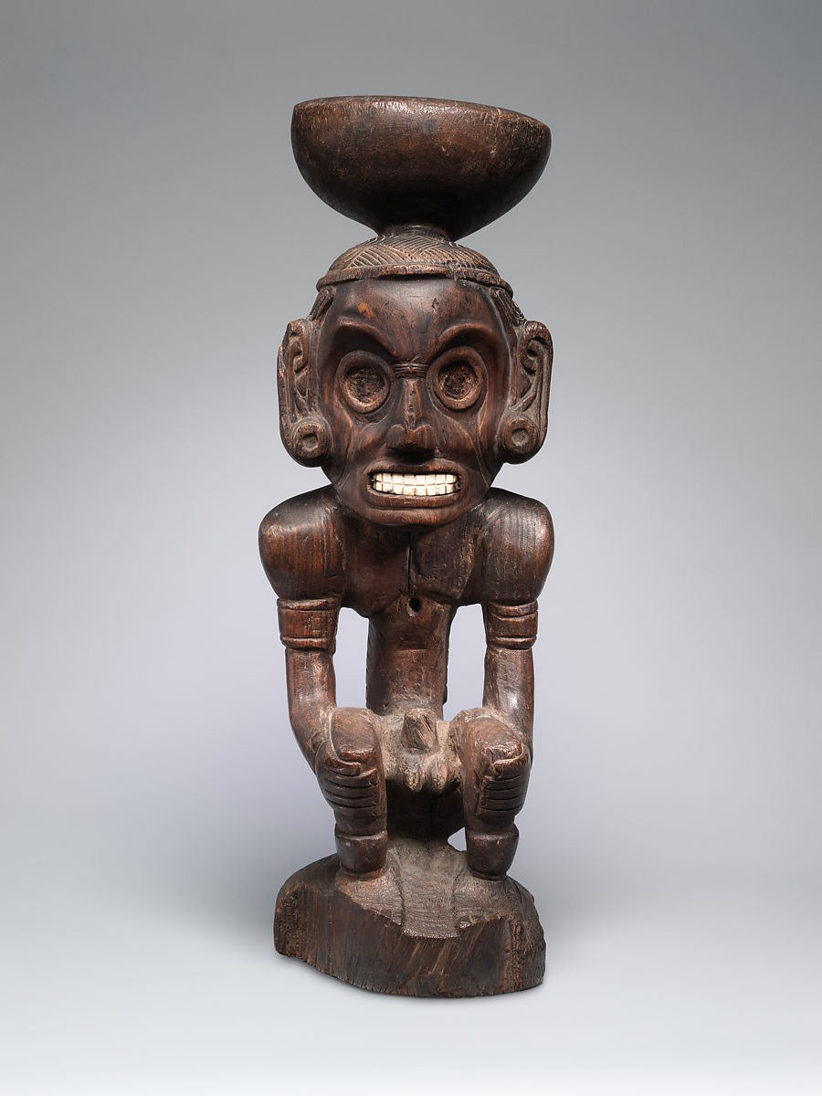
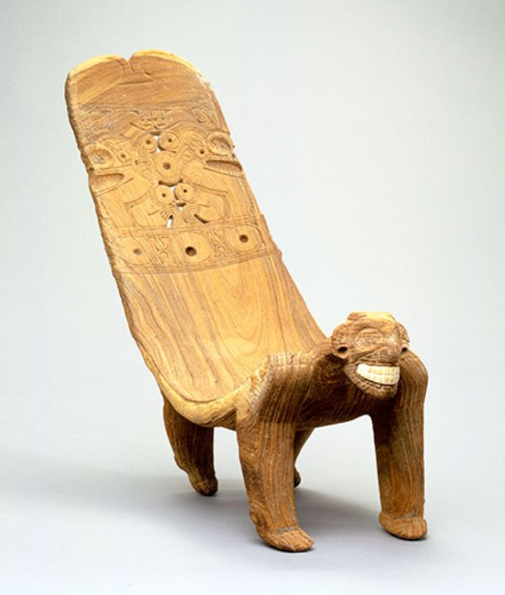
Pre-Columbian: The Caribbean
Taino inhabited the Greater Antilles

Slide 13
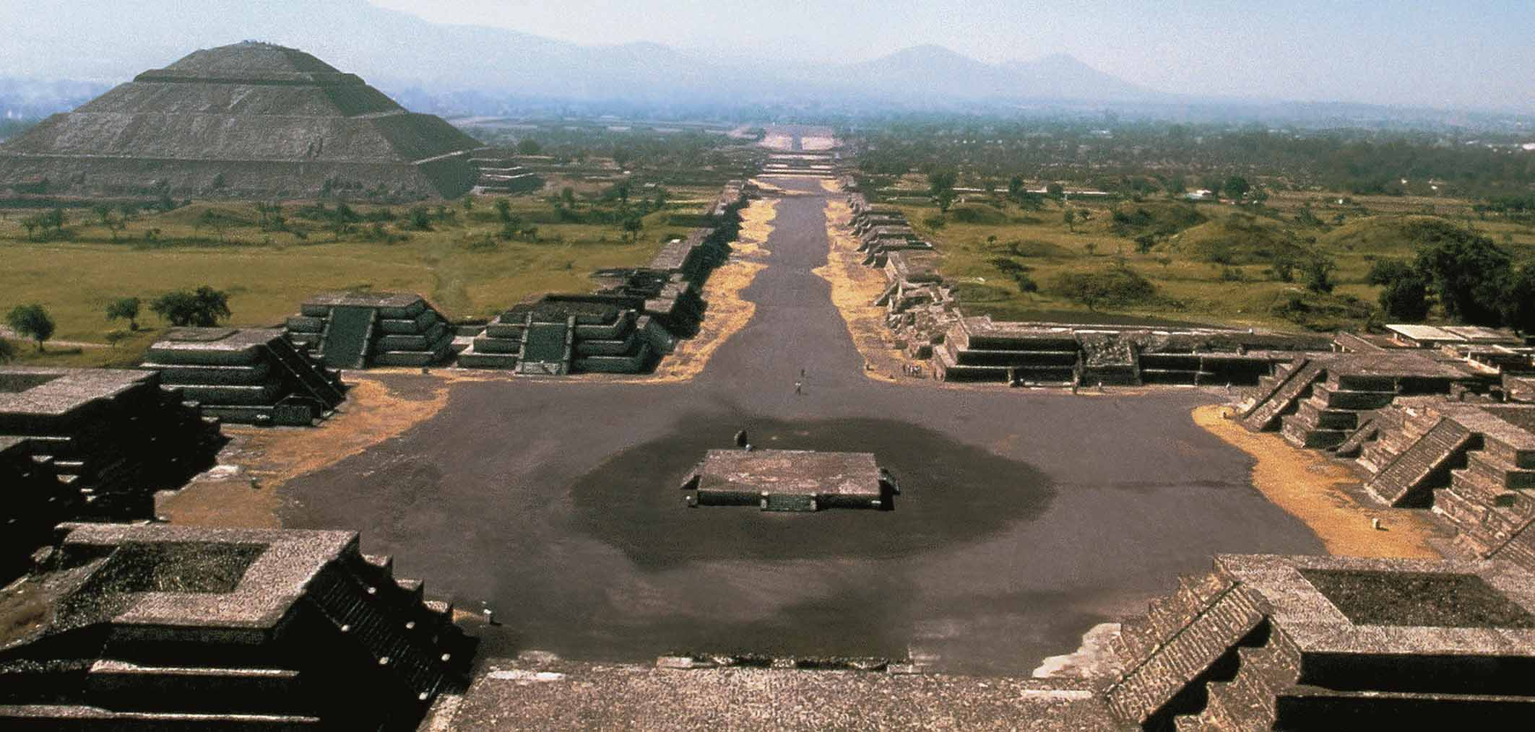
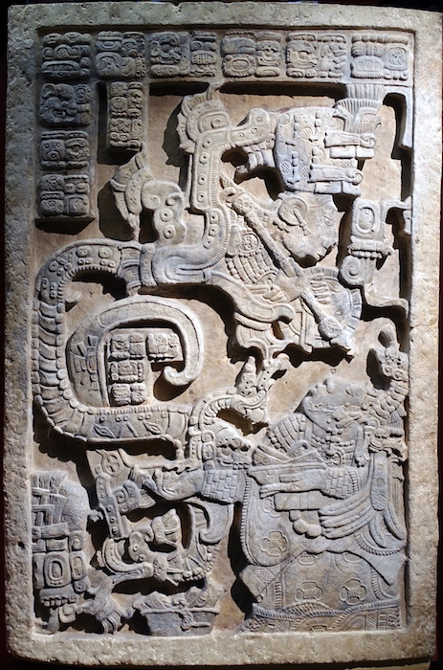
Pre-Columbian: Mesoamerica
Aztec and Maya had a written language and pyramids.

Slide 14
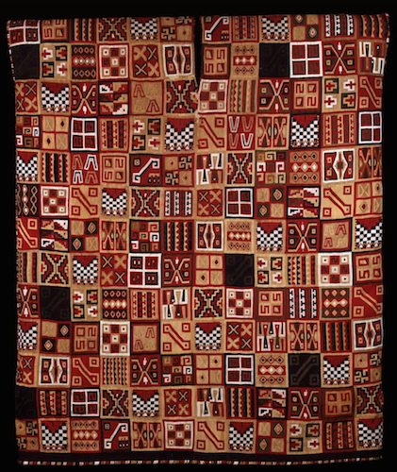
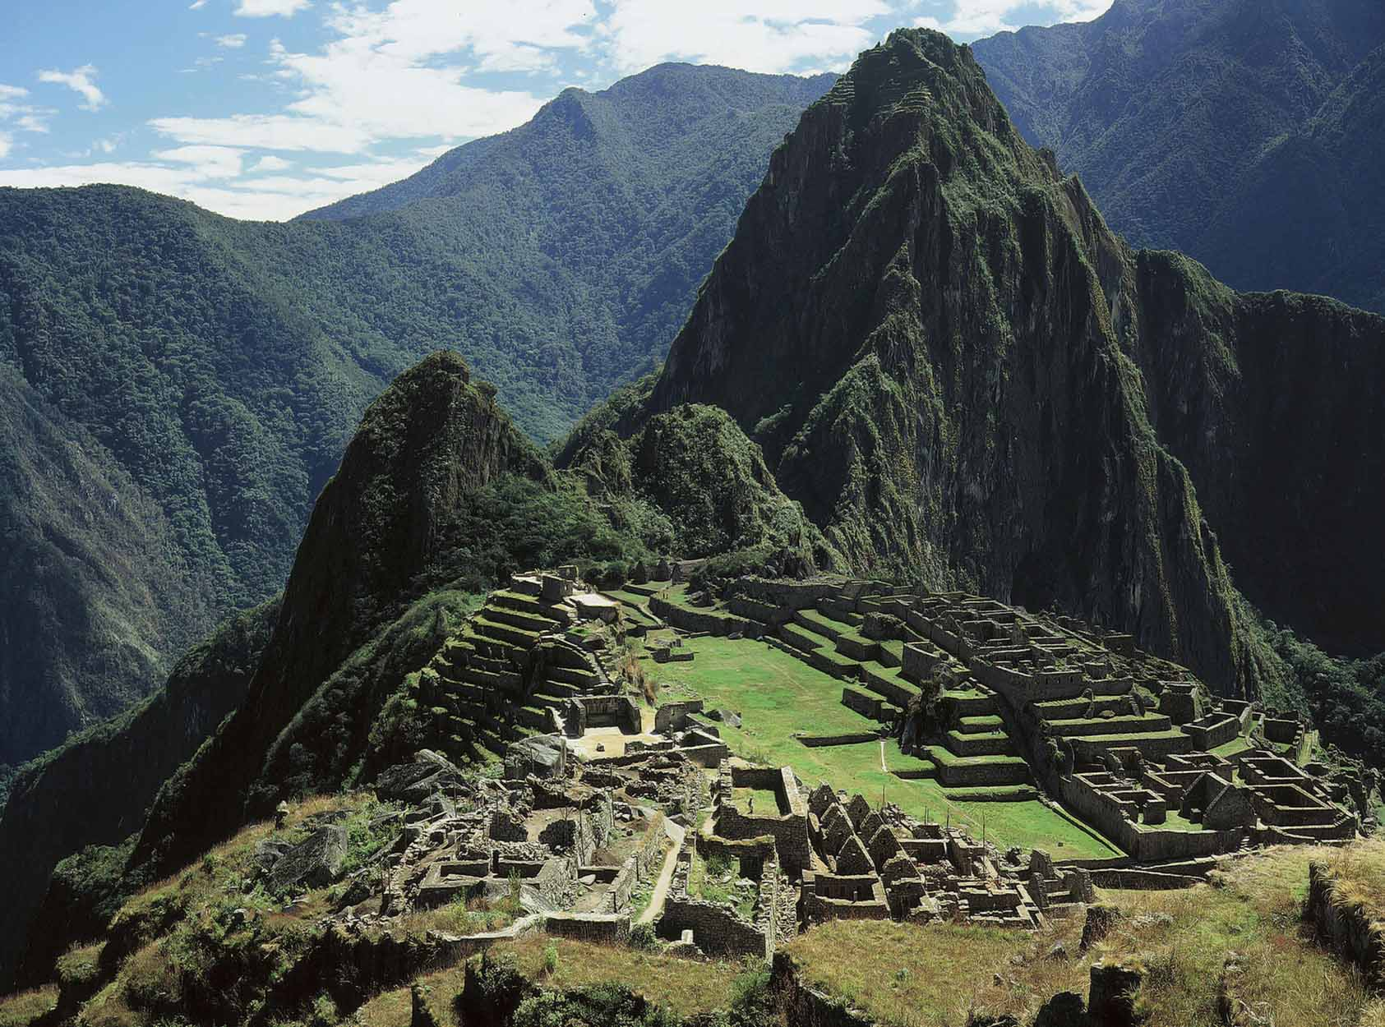
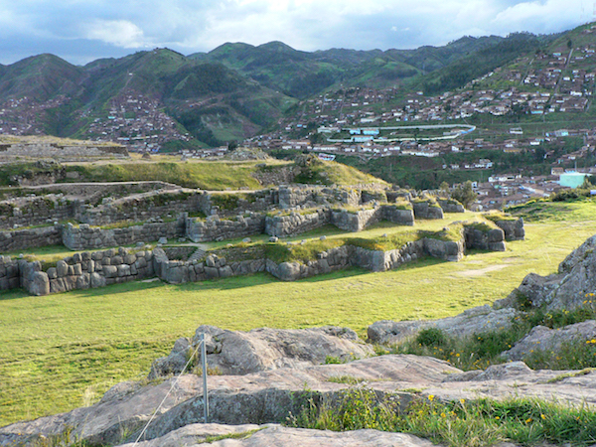
Pre-Columbian: Andes
Inka Empire stretched across the Andes.

Slide 15
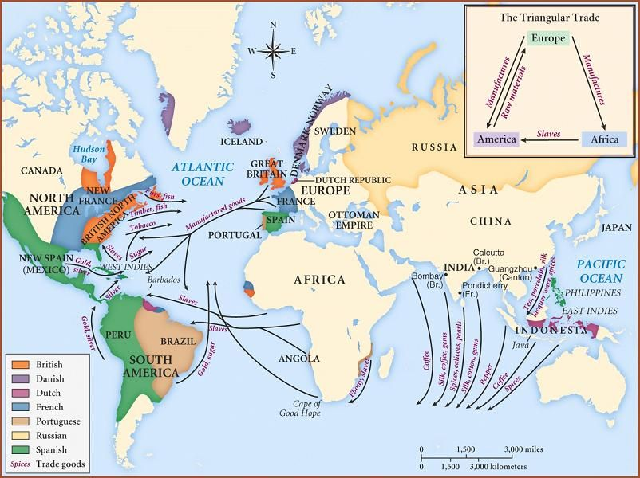
Colonial era is an era of global exchange

Slide 16
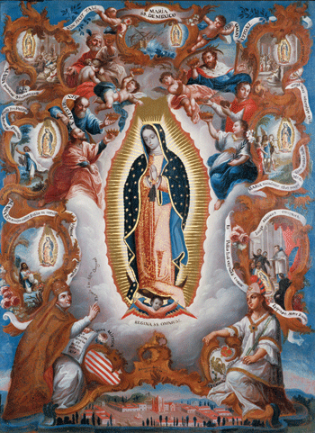
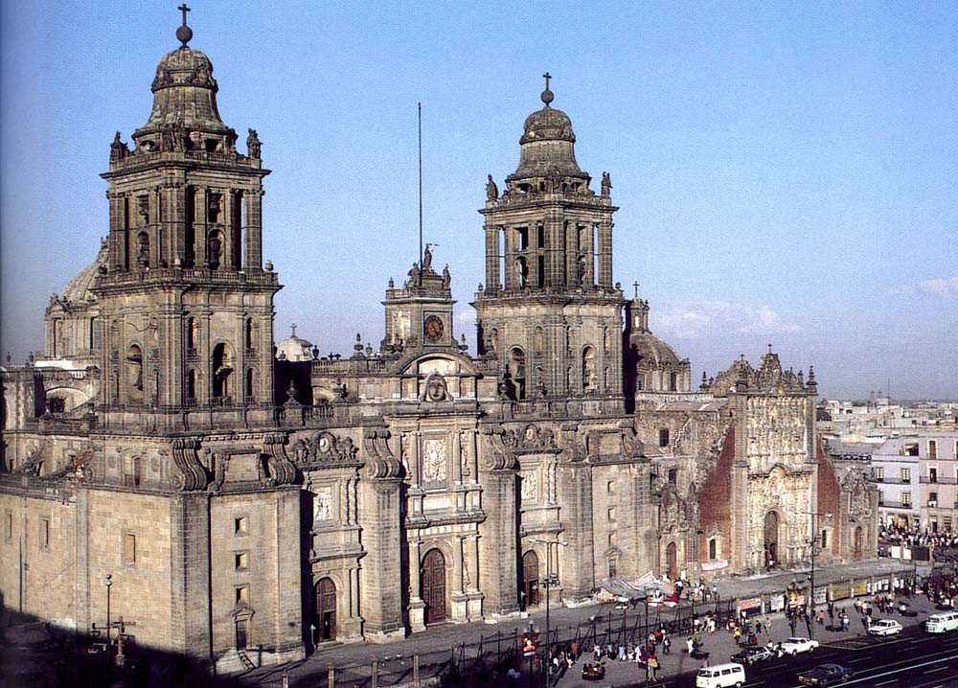
Colonial: Viceroyalty of New Spain
Virgin of Guadalupe
Cathedral of Mexico City

Slide 17
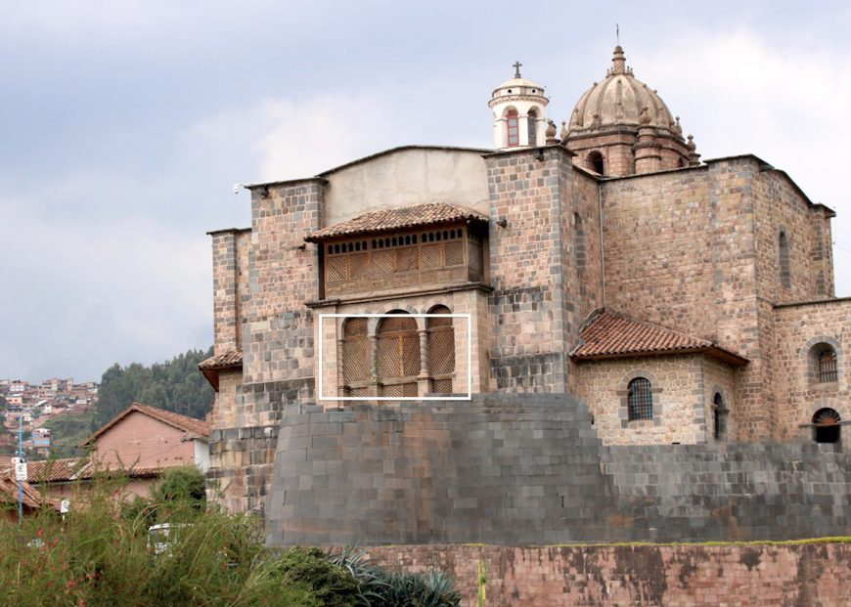
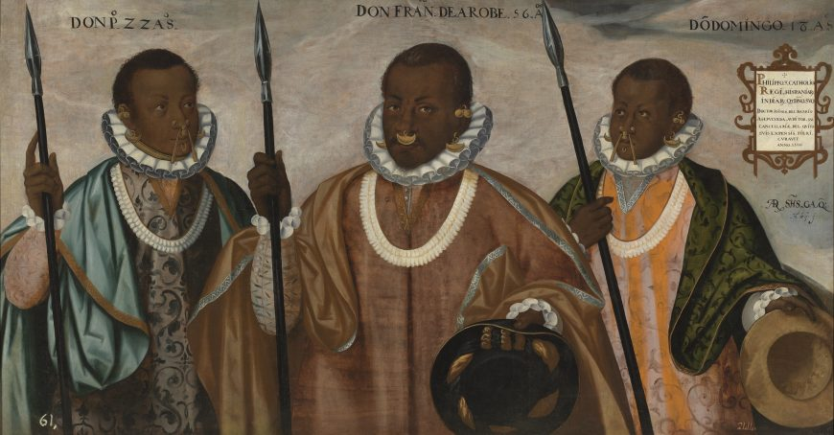
Colonial: Viceroyalty of Peru
Church of Santo Domingo, Peru Three Mulatto Gentlemen of Esmeraldas, Ecuador

Slide 18
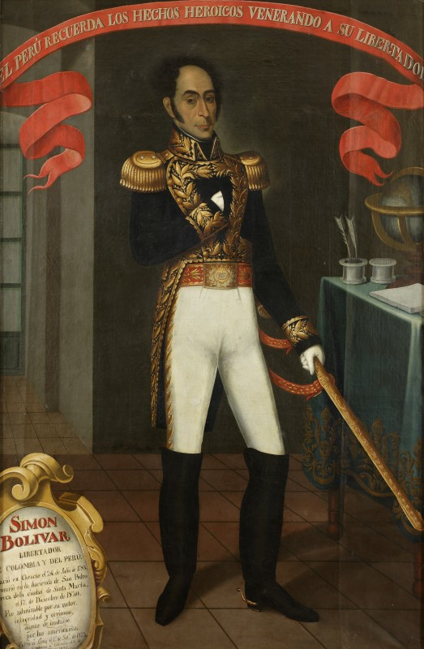
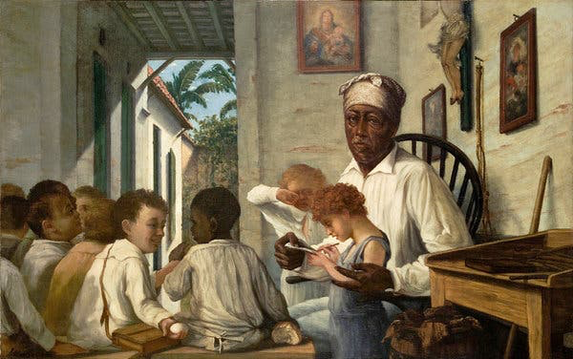
Post-Independence
Simon Bolivar, Gran Colombia Oller, School of Rafael Cordero, 1892, Puerto Rico

Slide 19
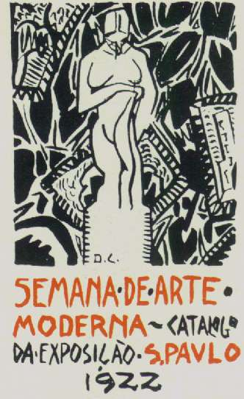
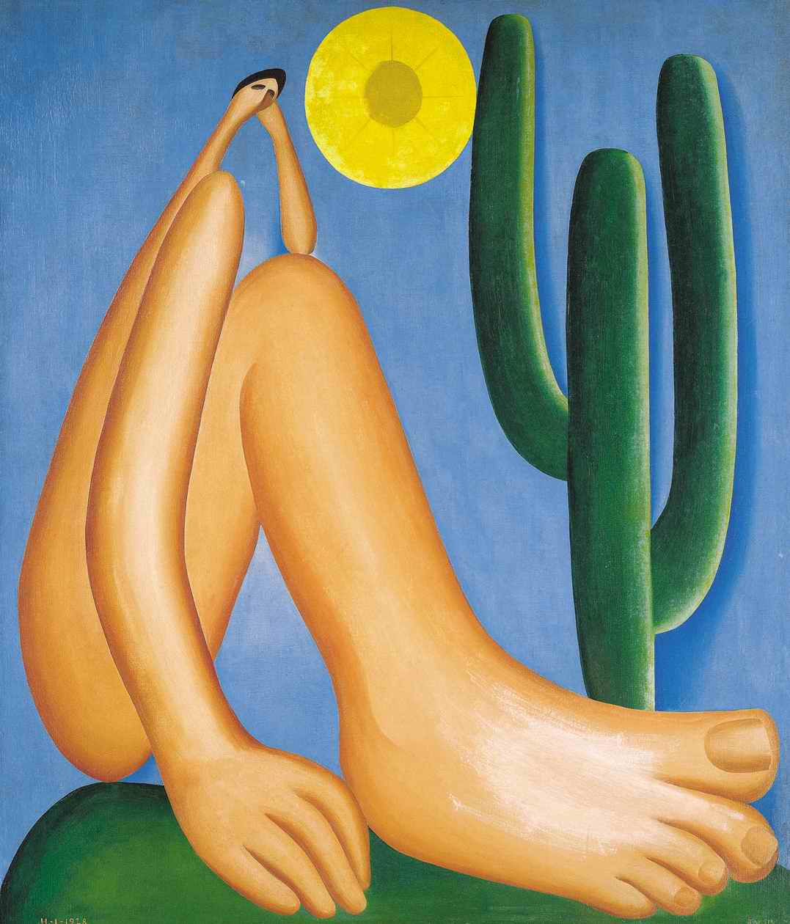
Modern: Brazil
Tarsila do Amaral, Abaporú, 1928

Slide 20
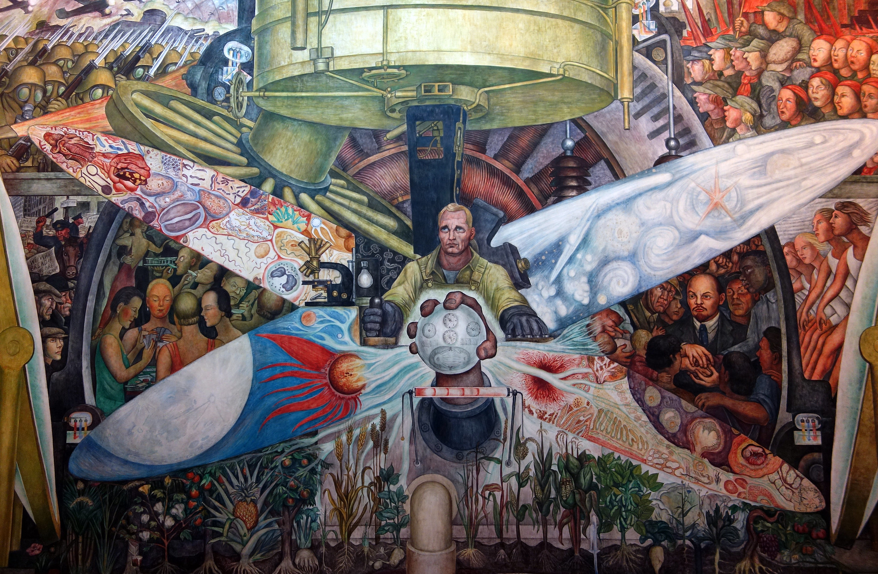
Modern Art: Muralism
Rivera, Man, Controller of the Universe, 1934, fresco

Slide 21
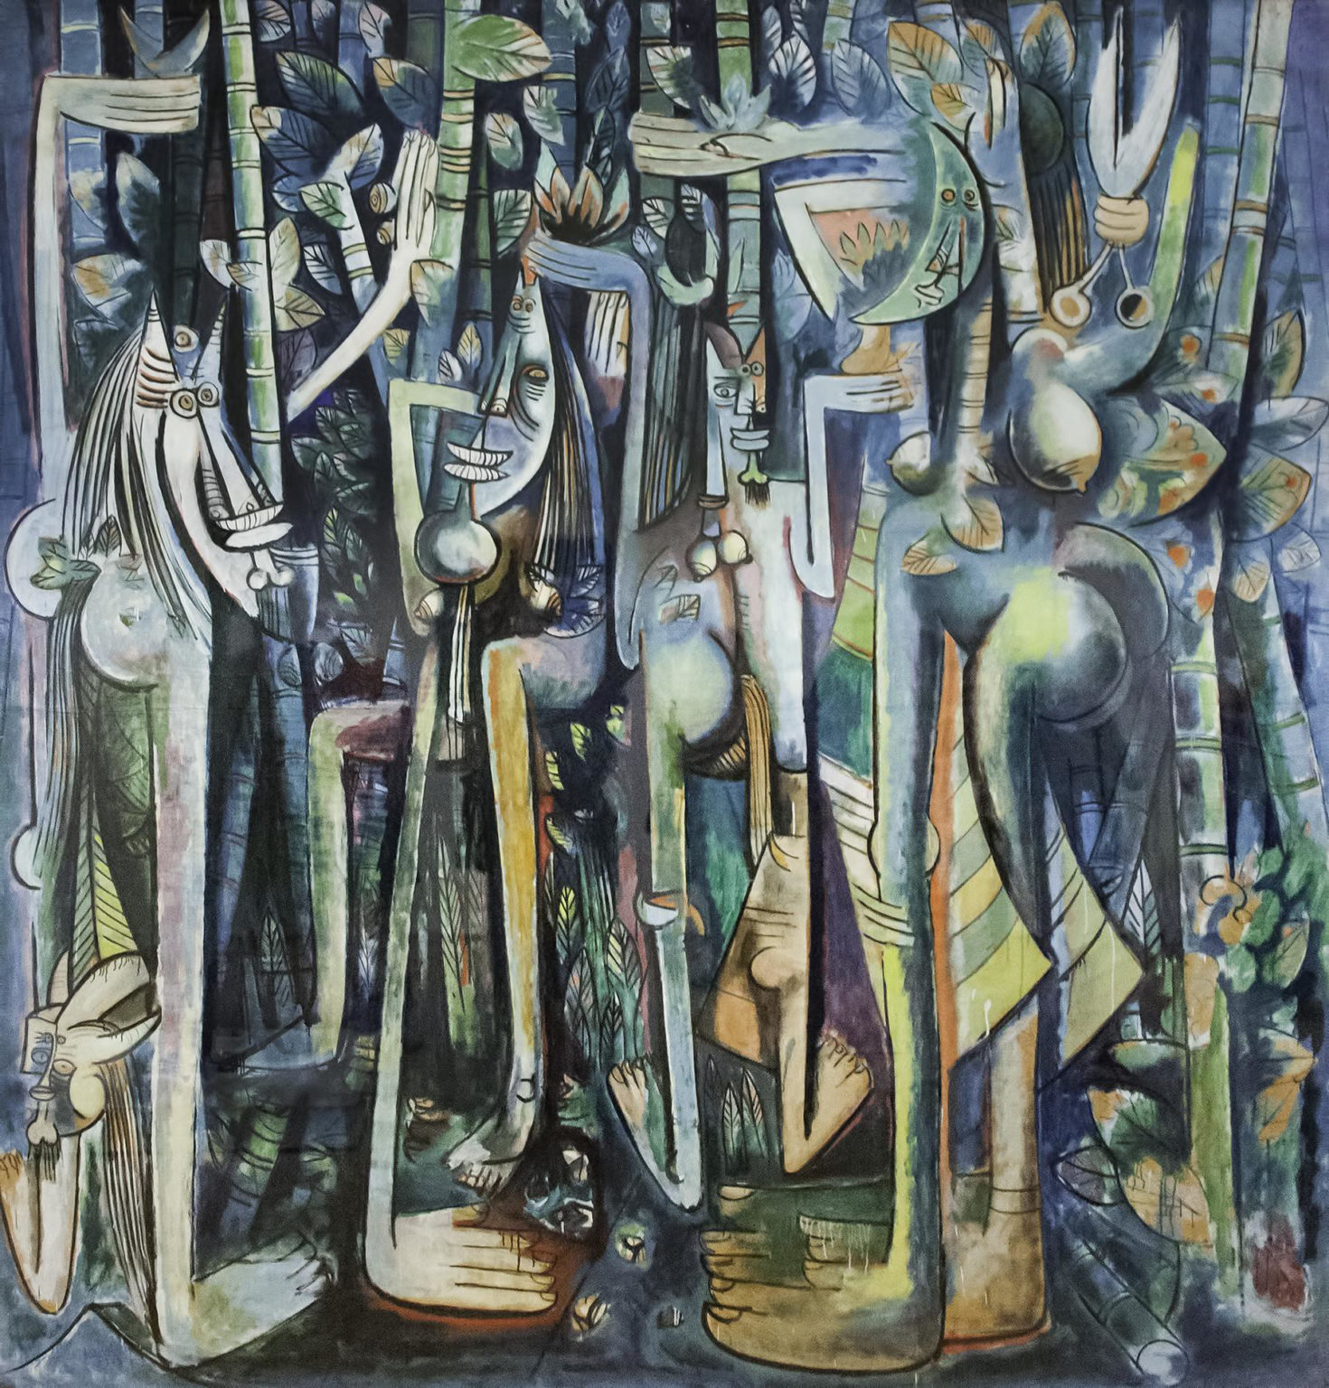
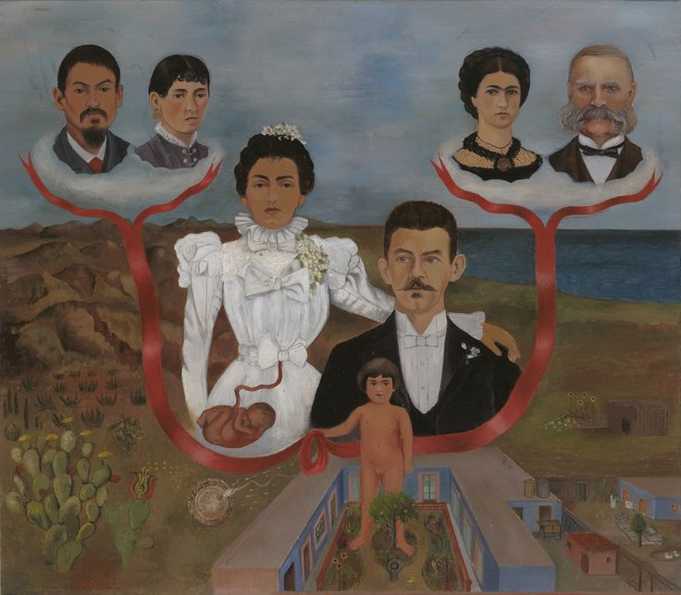
Modern Art: Surrealism
Kahlo, My Grandparent, My Parents, and I, 1936
Wifredo Lam, The Jungle, 1942–43

Slide 22
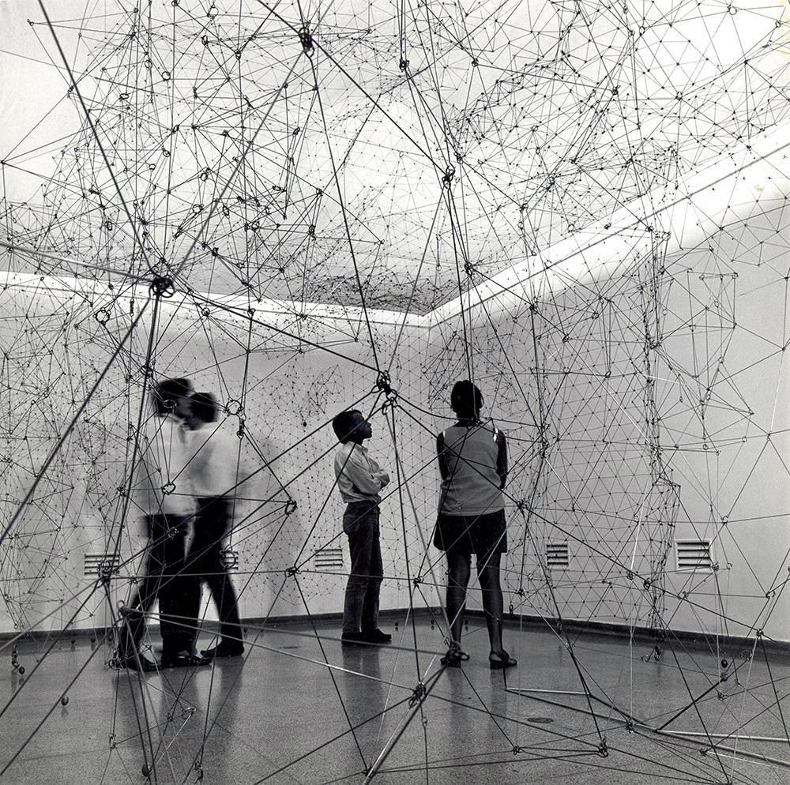
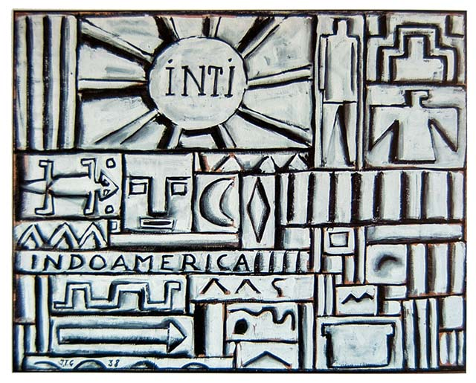
Modern: Geometric Abstraction
Joaquin Torres-Garcia, Uruguay
Gego, Venezuela

Slide 23
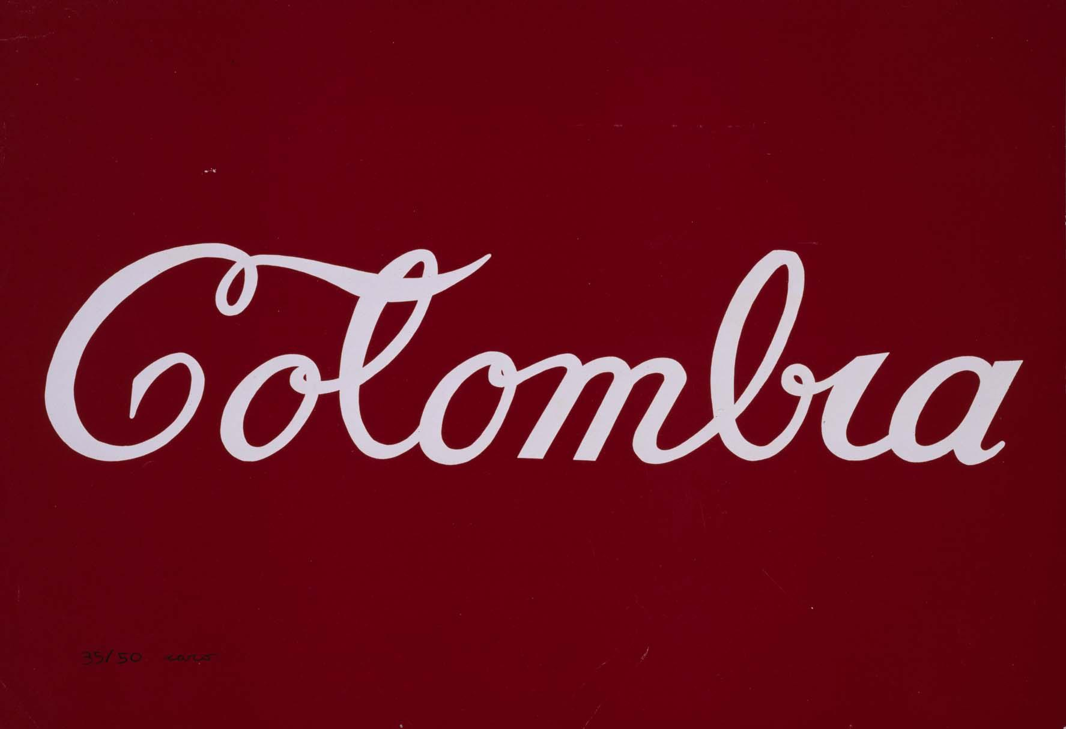
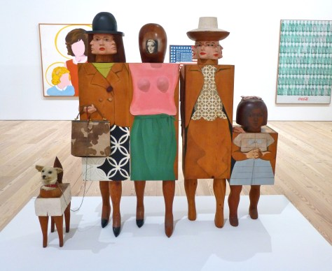
Contemporary: Pop
Antonio Caro, Colombia
Marisol, Venezuela

Slide 24
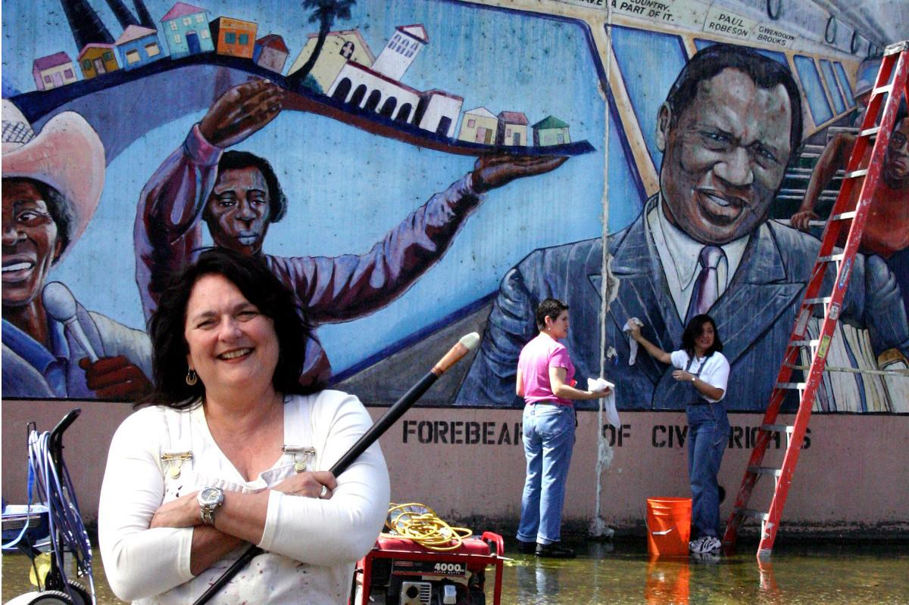
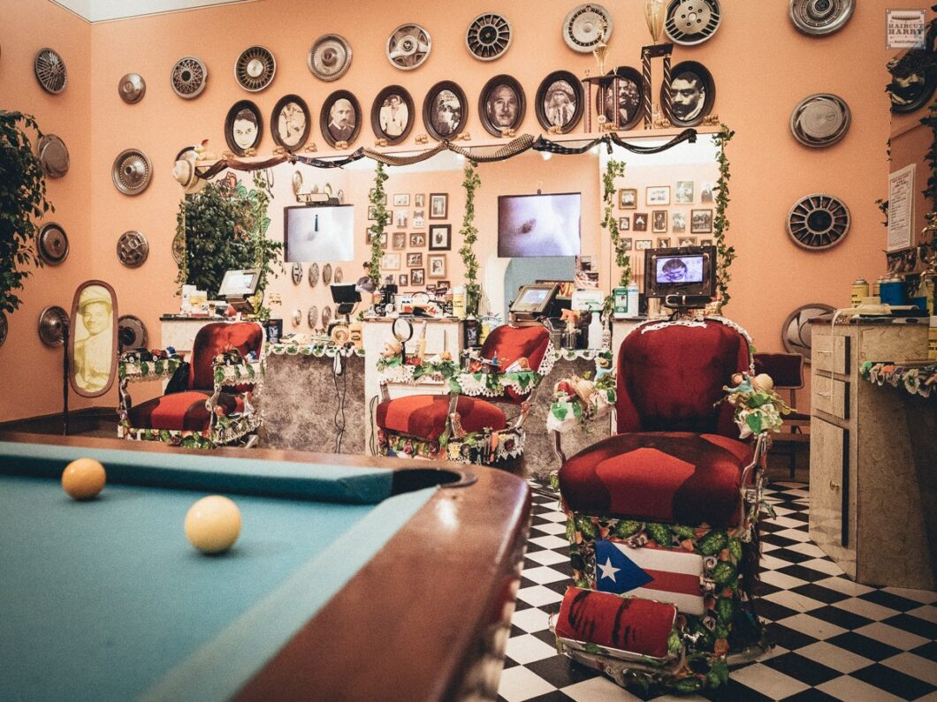
Contemporary: Latinx
Judy Baca, California
Pepón Osorio, New York

