Slide 1
Greek tragedies
It’s all Greek to me!

Slide 2
dionysus
Greek god of wine
Not simply the god of wine, however; he also is the god of what wine does to those who drink it
  Dionysus was the god of liminal abandon: inhibitions were suppressed and people “crossed boundaries”
  Polar opposite of Apollo, who represents law and order
  Dionysus festivals are similar to Mardi Gras parties today

Slide 3
Description of greek theatre
Took place in large hillside amphitheaters
  held 20, 000 people!!
Players included a chorus and their leader
Lines were chanted
Chorus performed in an “orchestra”, not on a raised platform

Slide 4
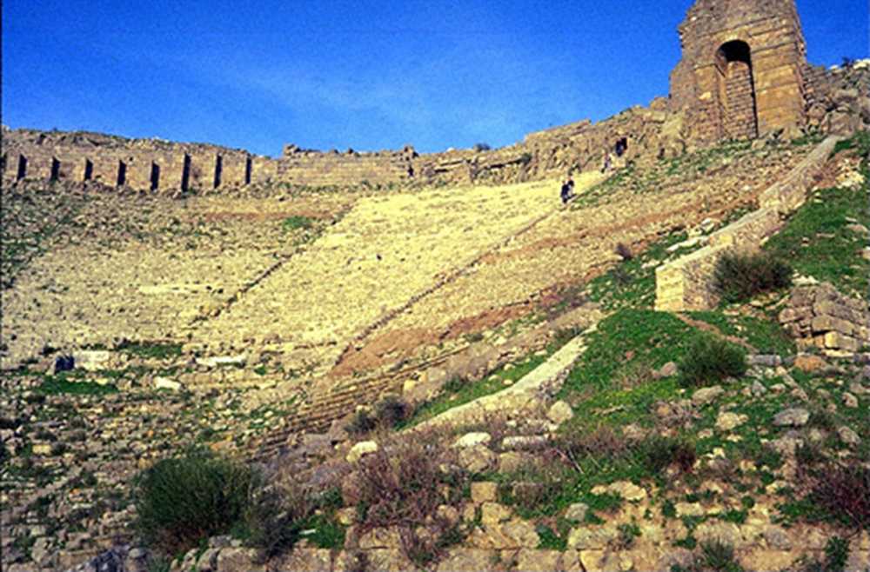
Greek theatre

Slide 5
Greek tragedy
Nearly all surviving tragedies are based on myth
Character’s struggle against hostile forces ended in defeat and ultimately in death
A series of dramatic episodes separated by choral odes (mini-songs).

Slide 6
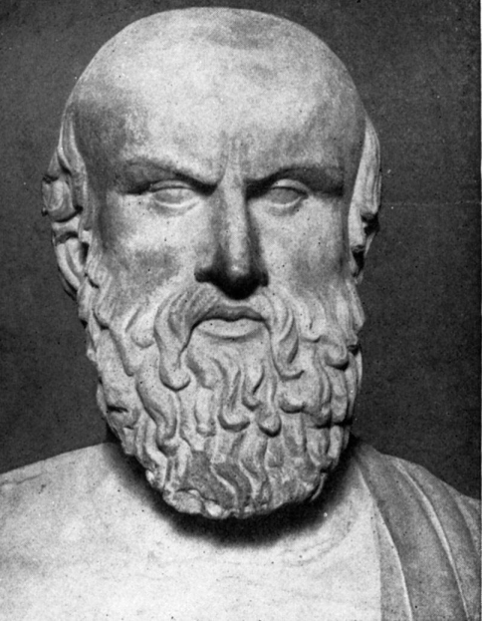
Three famous playwrights
Aeschylus
  Most famous for Oresteia
  Introduced concept of second actor
  Expanded possibilities for plot

Slide 7
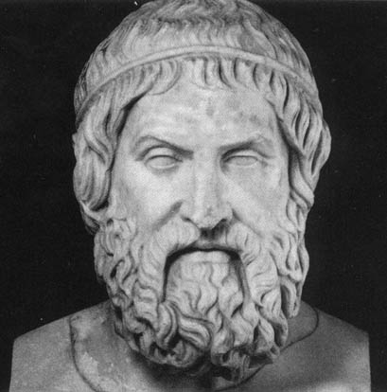
sophocles
Innovation of the third actor
Most famous for Oedipus Rex

Slide 8
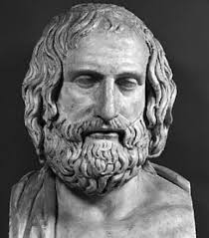
euripides
Created the ultimate form of drama
Far more naturalistic or human
approach in his works
Showed interest in psychology
through portraits of women
Medea is most famous work
  Describes how a mother kills her
  children to gain revenge against
  their father

Slide 9
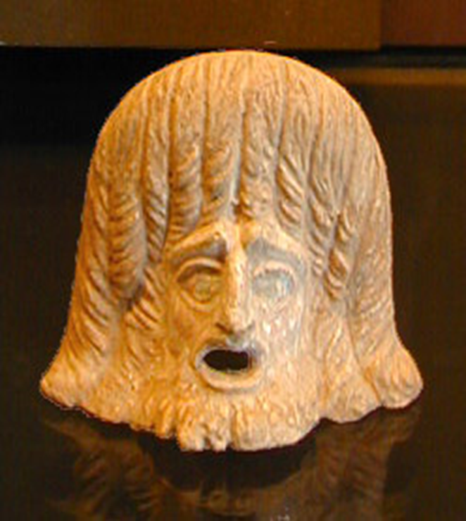
Costumes in greek tragedies
Actor wore:
  Mask
  Robes
  Platform boots

Slide 10
The audience
Any male could attend
    Women most likely able to attend
    Aeschylus’ Furies
State funded attendance
    Cost was the average daily wage of a laborer
    Theoric Fund
      Never suspended, even when Athens in dire straights
      Supplied public tickets
    “Must-see TV”

Slide 11
The morals
    “learning through suffering”
    Moderation is to be sought in all things, even good things
    The mighty fall so far that we admire them for being so high
    A spiritual cleansing of the audience
    Performances emotional

