Slide 1
Think and Write
What is language? What are the different functions of language? What are some ways in which language shapes your worldview?

Slide 2
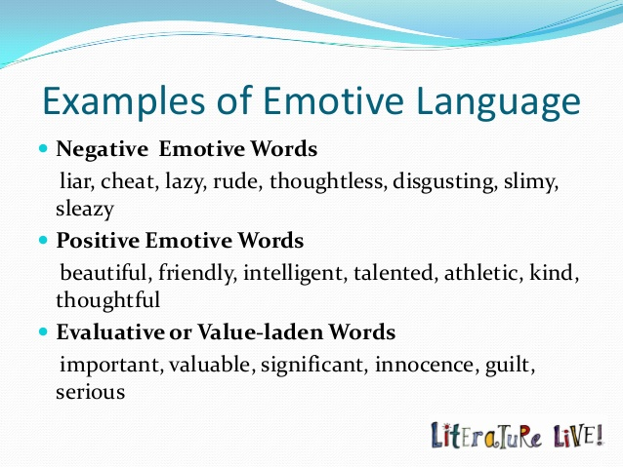
Emotive Language

Slide 3

Emotive Language

Slide 4
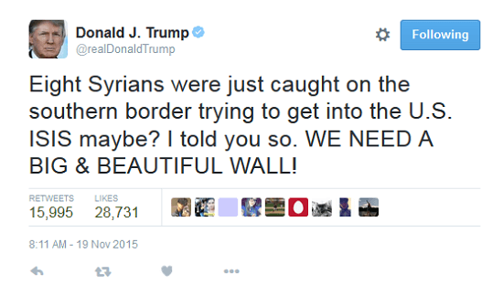
Emotive Language

Slide 5
Rhetorical devices
Like emotive language, rhetorical devices use psychological persuasion, rather than reason, to persuade others to accept a particular position.
Common rhetorical devices include euphemisms, dysphemisms, sarcasm, and hyperbole.

Slide 6
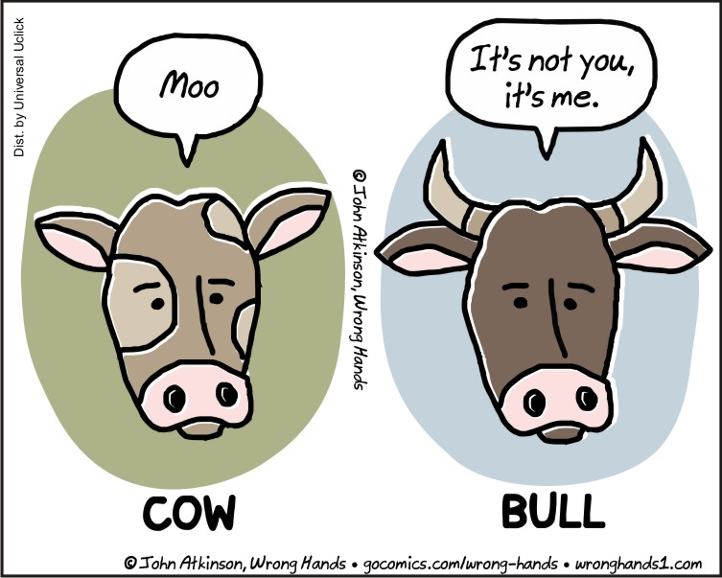
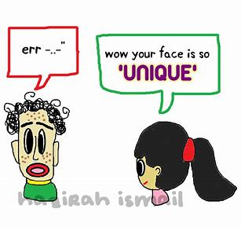
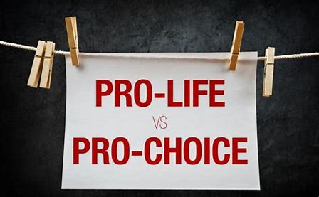
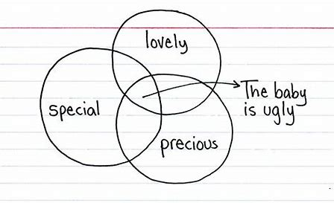
Euphemism
A euphemism is the replacement of a negative term with a neutral or positive one to cover up or sugarcoat the truth.
Think about the ongoing debate about women’s reproductive rights.
What does the term “pro-life” stand for?
What does the term “pro-choice” stand for?
Why do we use euphemisms?
A few other examples of euphemisms:

Slide 7
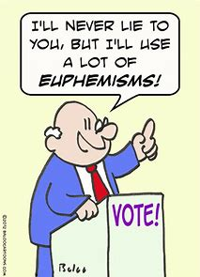

Why do politicians use euphemisms?
Enhanced Interrogation
Enhanced interrogation is a euphemism for the torture of prisoners. It’s often a double euphemism, in which prisoners are called detainees.
“Enhanced interrogation” was coined by the Nazis, but in more recent years, the term has described the US government’s use of water-boarding, sleep deprivation and other systematic torture during the George W. Bush administration, from 2001 to 2009. The term detainees also came into use at that time, referring to the roughly 780 people who were held at the US military prison at Guantánamo Bay, Cuba.
From dictionary.com

Slide 8
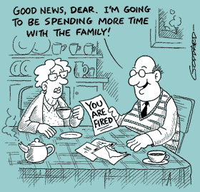
Euphemisms
Come up with a few other examples of euphemisms.
Is there a time when using euphemisms is appropriate?
3. How can the use of euphemisms lead to miscommunication and false expectations?

Slide 9


Dysphemisms
Dysphemisms, in contrast to euphemisms, are used to produce a negative effect.
In the abortion debate, the term anti-choice creates a negative feeling toward people who are opposed to abortion rights.
Snail mail instead of?
Nutcase for someone with a mental illness.
The house is falling apart!

Slide 10

Can you spot the euphemism and dysphemism in the pair below?
This essay is…
inspired by a source
Plagiarized
Can you rephrase the message using neutral language?

Slide 11
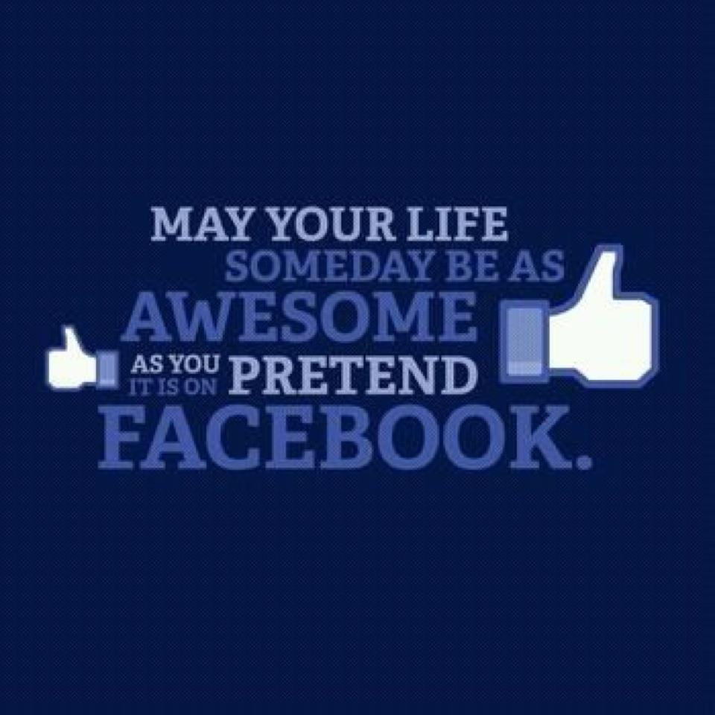
Sarcasm
Sarcasm, another rhetorical device, involves the use of ridicule, insults, taunting, and/or caustic irony. It derives its power from the fact that most people hate being made fun of. Like other rhetorical devices, sarcasm is used to deflect critical analysis and to create a feeling of disapproval toward the object of the sarcasm.
Sarcasm is often dismissed as humor by those who use it. However, it is anything but funny to its intended target. As good critical thinkers, we need to be able to see though this rhetorical device and not be belittled by it.

Slide 12
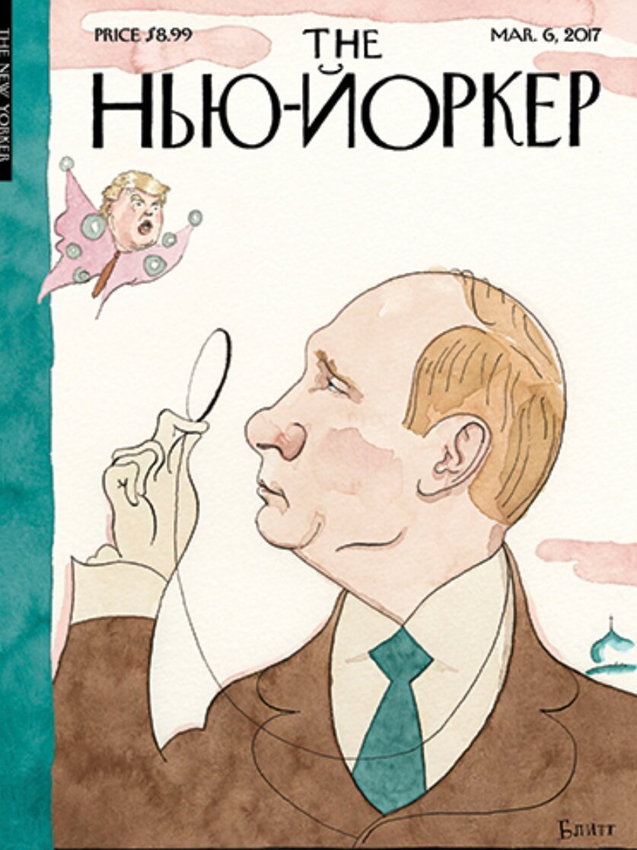
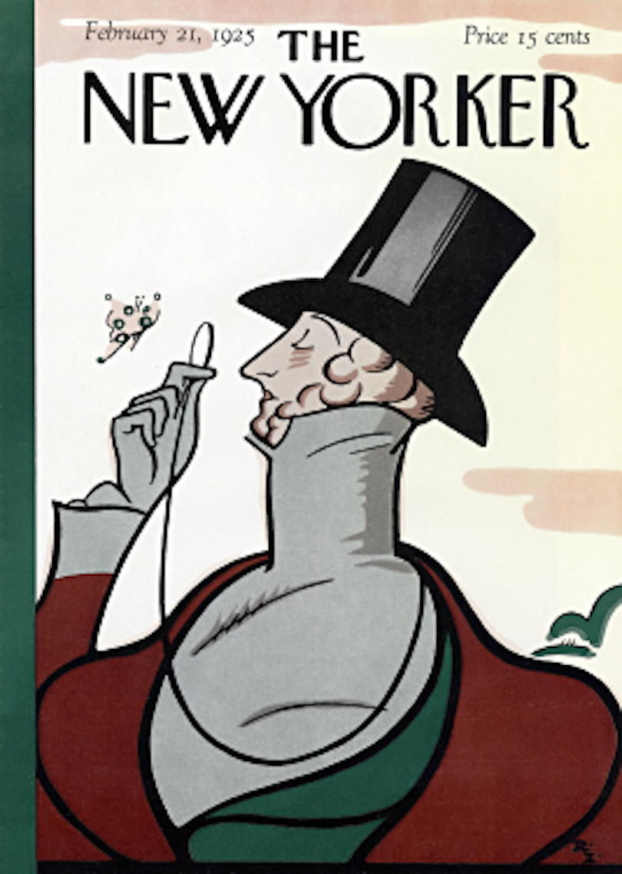
Hyperbole
Hyperbole is a type of rhetoric that uses exaggeration or overstatement to distort the facts.
“I thought I would die when the professor called on me in class today,” moans a college student.
Some journalists use hyperbole for the purpose of sensationalism, exaggerating a story to the point of absurdity.
Why do journalists use hyperbole, and how can we avoid being taken in by it?

Slide 13
A Lie
What is a lie? How is a lie different from a rhetorical device such as a euphemism?
When former President Bill Clinton was asked if he had had sex with Monica Lewinsky, Clinton replied that he had not. His response was based on the fact that the definition provided by the lawyers did not specifically list “mouth” as one of the body parts involved in sex. Clinton later admitted that his answer had been intended to “mislead” and “give a false impression” regarding his inappropriate sexual relationship with Lewinsky.
Is it ever morally acceptable to lie to spare someone's feelings or to promote what we regard as the “greater good”? How about a lie to save a life? Most ethicists agree that the great majority of lies are not justified. Lies can damage trust. In addition, making a political or life decision based on someone else's lies can have ruinous results. Wars may be waged based on misinformation. A murderer may go free if the investigating police officer or jury believes his or her lies.
Most of us are easily taken in by the lies of others. A study found that people lie about a third of the time in their interactions with others; only about 18 percent of lies are ever discovered. The average person is able to tell the difference between a liar and a truth-teller only about 55 percent of the time (not much better than chance). Even when lies are exposed, the public will sometimes get caught up in doublethink—knowing that what they once believed is a lie but continuing to act as though the lie were true.
The good news is that we can train ourselves to be better at detecting other people's lies. Skilled lie-catchers, such as police, FBI investigators, and some psychiatrists, are able to distinguish between liars and truth-tellers with 80 percent to 95 percent accuracy.

Slide 14
Think about it
How does the media manipulate you through the use of emotive language and sensationalism?
How can you recognize and avoid being taken in by manipulative language in advertisements?

